Slide 1
Astra Tech Implant System EV Restorative hands-on

Slide 2
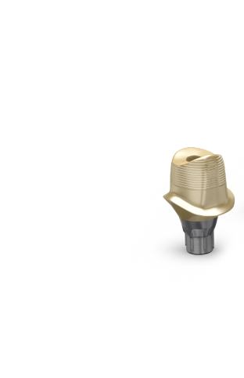
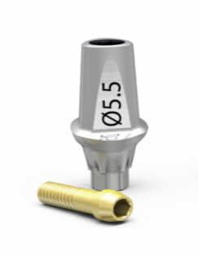
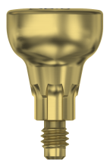
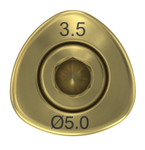
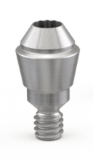
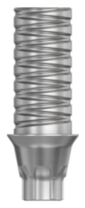
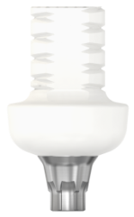
Demo & hands-on - restorative
HealDesign EV
Implant Pick-Up EV
Implant Transfer EV
ATLANTIS Abutment for OsseoSpeed EV/TiDesign EV
Uni Abutment EV
Temporary and Lab components

Slide 3
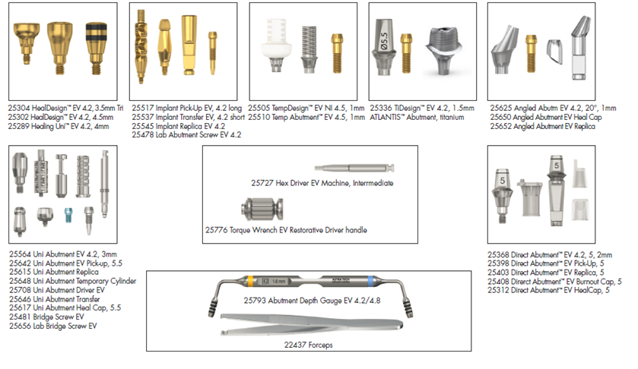
Prosthetic kit layout

Slide 4
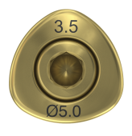
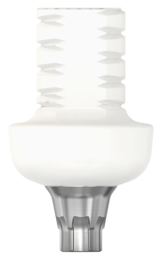
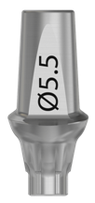
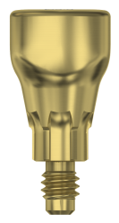
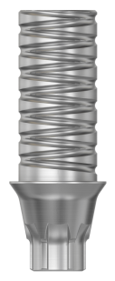
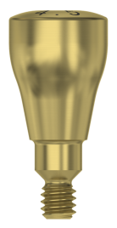
Cement-retained, OsseoSpeed EV 4.2 - where to place the components
Notes:
HealDesign EV 4.2 Ø5-3.5 Tri
TempDesign EV 4.2
Implant Transfer EV 4.2 S
TiDesign EV 4.2 Ø5.5-1.5 Tri
Direct Ab. EV 4.2 Ø5 - 2 mm
Direct Ab. EV HealCap 5
Direct Ab. EV Pick-Up 5
Direct Ab. EV Burnout Cap 5
HealDesign EV 4.2 Ø5 - 4.5mm
Implant Pick-Up EV 4.2 Long
Temp Abutment EV 4.2
ATLANTIS abutment for OsseoSpeed EV 4.2 Titan

Slide 5
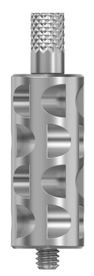
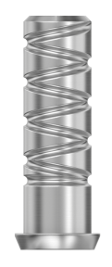
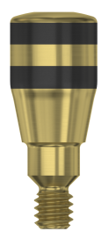
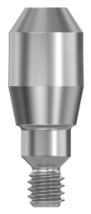
Screw-retained, OsseoSpeed EV 4.2 - where to place the components
Notes:
Healing Uni EV 4.2 - 4 mm
Uni Abutment EV Heal Cap Ø 5.5
Uni Abutment EV 4.2 - 3 mm
Uni Abutment EV Pick-Up Ø 5.5
Uni Abutm. EV Temp. Cylinder
Lab Bridge Screw EV
Angled Abutm.EV 4.2 20° - 1mm
Angled Abutm.EV Heal Cap

Slide 6
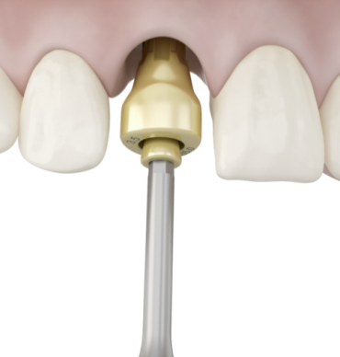
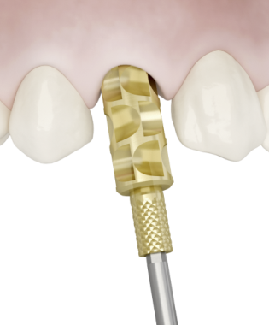
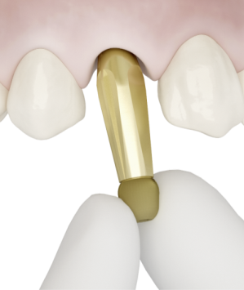
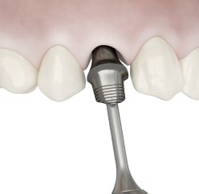
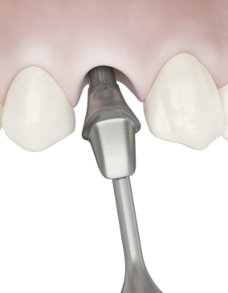
Hands-on
– cement-retained solutions
HealDesign EV, round
HealDesign EV, triangular
Implant Pick-Up EV
Implant Transfer EV
ATLANTIS Abutment
TiDesign EV
The round HealDesign EV is index free.
Pick up and install the HealDesign EV using the Hex Driver EV.
Manually tighten the healing abutment using light finger force(5–10 Ncm).
The triangular HealDesign EV has six possible placement options. Pick up and seat the healing abutment in the preferred index position before using the Hex Driver EV. Manually tighten the healing abutment using light finger force (5–10 Ncm)
Note: When removing a two-piece HealDesign EV, keep the sleeve and screw assembled
Use the Hex Driver EV or manually pick up and connect the Implant Pick-Up EV/Implant Transfer EV.
Secure the implant pick-up/implant transfer with manual tightening torque (5–10 Ncm) using the Hex Driver.
Note: The Implant Pick-Up EV and Implant Transfer EV has a self-guiding feature that requires only one hand for seating and is designed to engage only in the correct position
ATLANTIS Abutments for OsseoSpeed EV will seat in one-position-only.
TiDesign EV has six possible placement options.
Manually seat the abutment in position before securing the abutment screw using the Hex Driver.

Slide 7
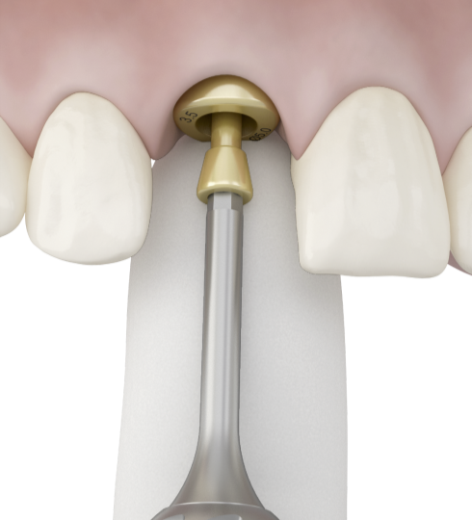
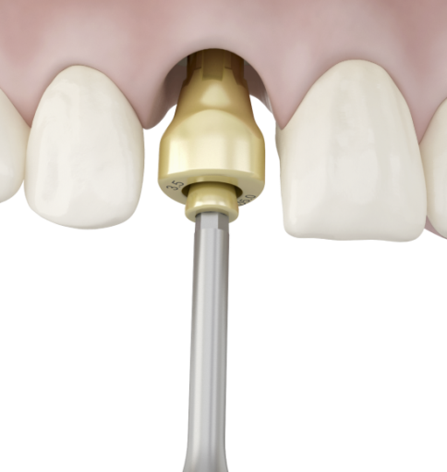
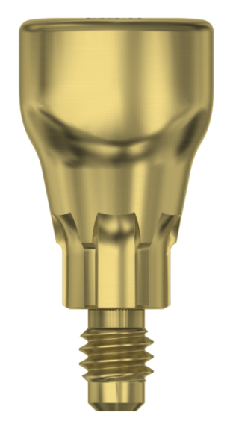
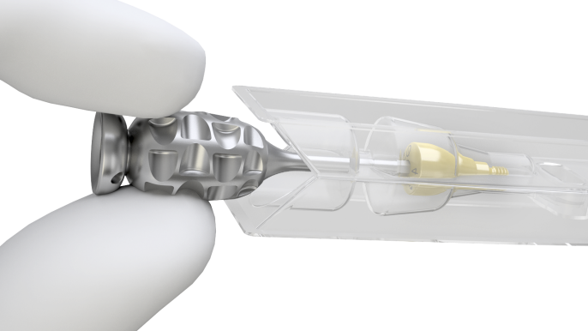
HealDesign EV Tri - installation and removal
Installation
Removal
Notes:
Pick up and install the HealDesign EV using the Hex Driver EV.
Manually tighten the healing abutment using light finger force(5–10 Ncm).
Remove the HealDesign EV keeping the sleeve and pin ensemble together

Slide 8
Prosthetic Kit layout

Slide 9
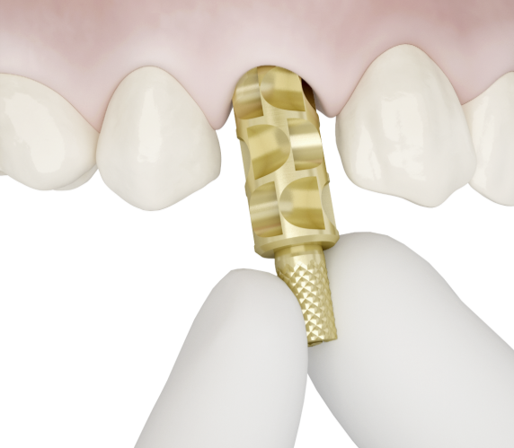
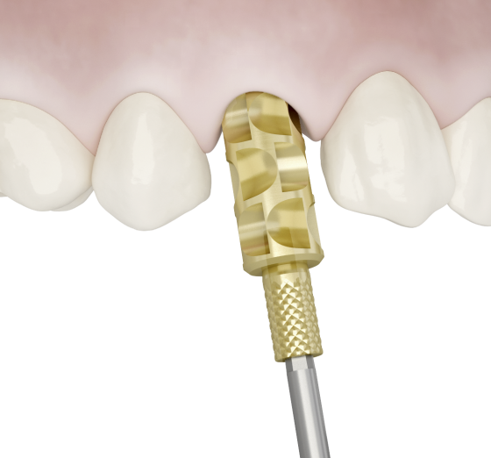
Implant Pick-Up EV - installation and removal
Manual and Driver
Hex Driver only
Notes:
Use the Hex Driver EV or manually pick up and connect the Implant Pick-Up EV.
Secure the implant with manual tightening torque (5–10 Ncm) using the Hex Driver.
Note: turn the pin only, do not attempt to position the sleeve as this seats automatically when the pin is turned.

Slide 10
Implant Pick-Up EV - installation
Self-guiding impression component; engages into the implant only when correctly seated
One-hand installation procedure

Slide 11
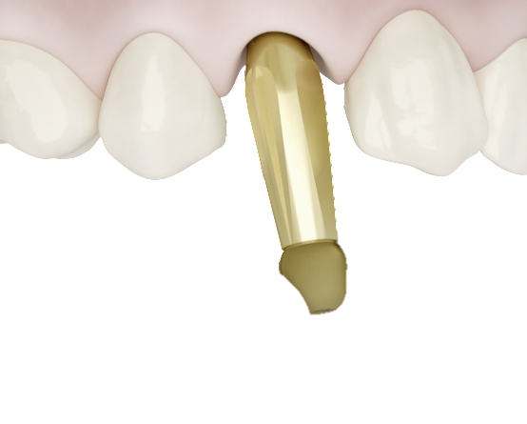
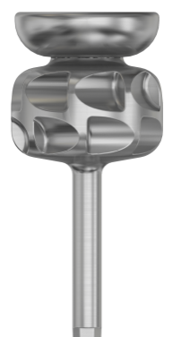
Implant Transfer EV - installation and removal
Manual and Driver
Hex Driver only
Notes:
Use the Hex Driver EV or manually pick up and connect the Implant Transfer EV.
Secure the implant transfer with manual tightening torque (5–10 Ncm) using the Hex Driver.
Note: turn the pin only, do not attempt to position the sleeve as this seats automatically when the pin is turned.

Slide 12
Prosthetic Kit layout

Slide 13
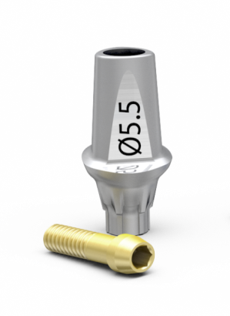
ATLANTIS Abutment and TiDesign EV for OsseoSpeed EV - Installation and removal
One-position-only
Six positions
Notes:
Manually seat the abutment in position before securing the abutment screw using the Hex Driver
ATLANTIS Abutments for OsseoSpeed EV will seat in one-position-only.
TiDesign EV has six possible placement options.

Slide 14
ATLANTIS Abutment for OsseoSpeed EV
ATLANTIS Abutment will seat in one-position-only
Notes:
ATLANTIS Abutment will seat in the one-position-only, unique for ASTRA TECH Implant System EV

Slide 15
Prosthetic Kit layout

Slide 16
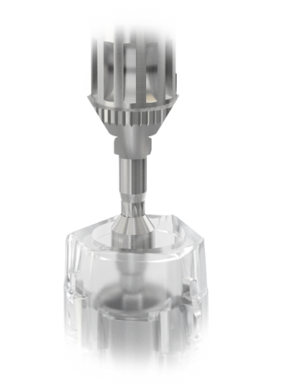
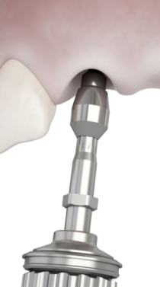
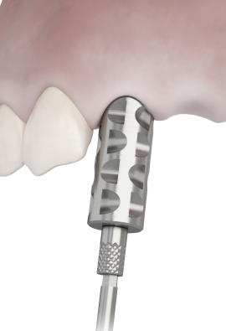
Hands-on
– screw-retained solutions
Healing Uni EV
Uni Abutment EV
Uni Abutment EV Pick-Up
Uni Abutment EV Transfer
Angled Abutment EV
Pick up and install the Healing Uni EV using the Hex Driver EV.
Manually seat the healing abutment using light finger force (5–10 Ncm).
Pick up the Uni Abutment EV with the driver by gently pressing downwards into the bridge screw hole. Tighten the abutment and release the Uni Driver EV using a small wiggling motion while lifting the driver gently.
Manually seat a Uni Abutment EV Heal Cap onto
the abutment.
Connect and secure the pick-up/transfer using manual tightening torque (5–10 Ncm).
Install the Angled Abutment EV with the Abutment Screw EV, to recommended torque value, using the Hex Driver EV
It is recommended to position the abutment
in the desired direction and thereafter secure the abutment screw.
Manually seat a Angled Abutment EV Heal Cap onto the abutment.

Slide 17
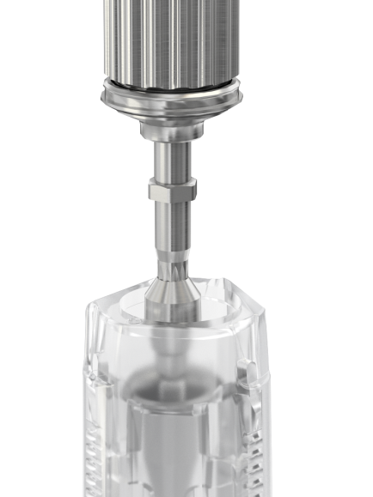
Uni Abutment EV and Uni Driver EV

Slide 18
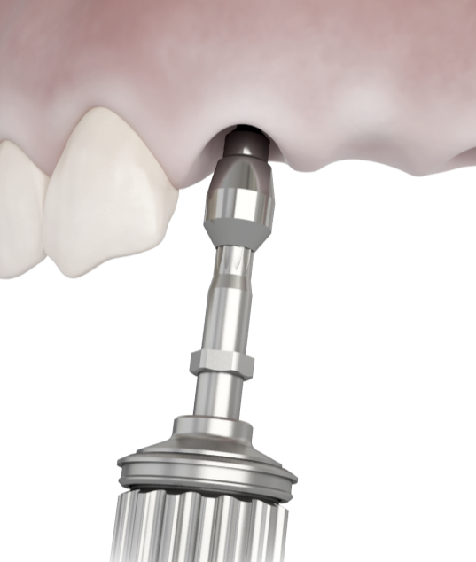
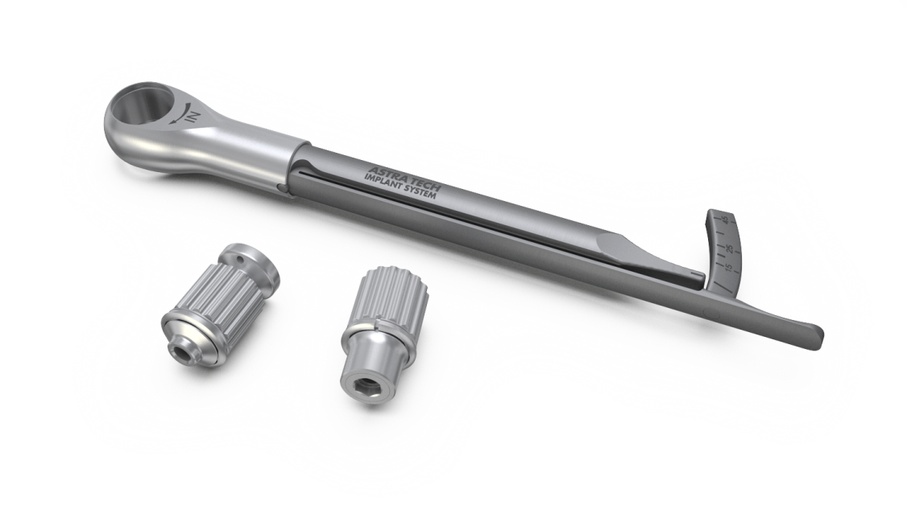
Uni Abutment EV and Uni Driver EV
- installation
Restorative Driver Handle
Install
Click!
Install
Notes:
Pick up the Uni Abutment EV with the driver by gently pressing downwards into the bridge screw hole.
Tighten the abutment and release the Uni Driver EV using a small wiggling motion while lifting the driver gently.
Manually seat a Uni Abutment EV Heal Cap onto the abutment.

Slide 19
Prosthetic Kit layout

Slide 20
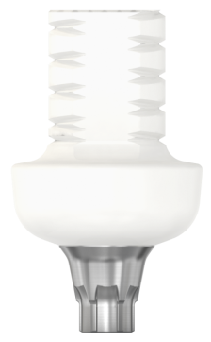
Lab and temporization components
Temp Design EV
Implant Replica EV
Lab Abutment Screw EV
Notes:
Touch, feel and try the components

Slide 21
Prosthetic Kit layout

Slide 22
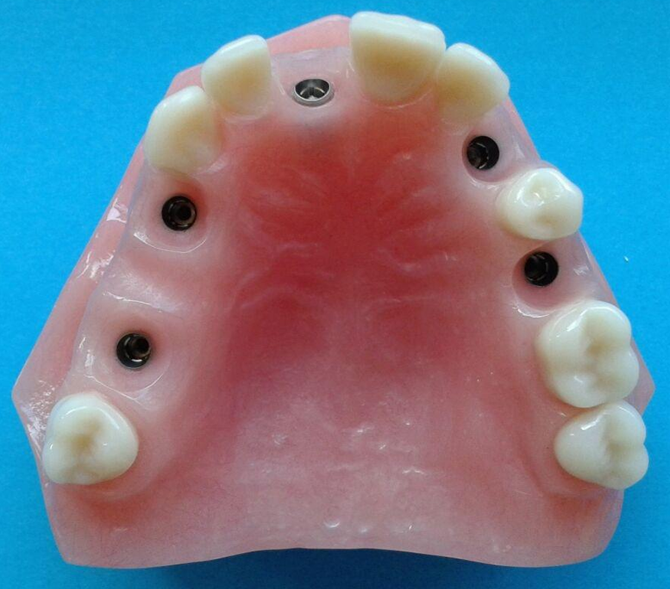
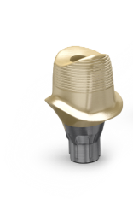
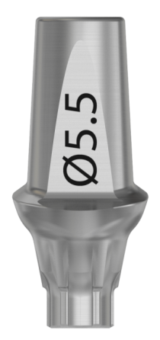
Model for OsseoSpeed EV 4.2 S
Touch and feel - different index solutions
Notes:
Install the components on the model, find out the correct positions

Slide 23
Notes:
Install the components on the model, find out the correct positions

Slide 24
Notes:
Install the components on the model, find out the correct positions

Slide 25
Thank You

