Slide 1
Astra Tech Implant System EV Surgical hands-on

Slide 2
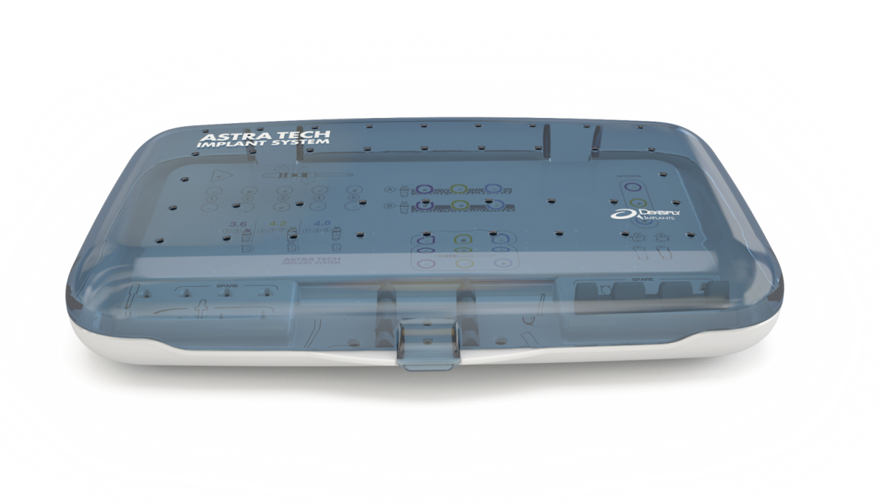
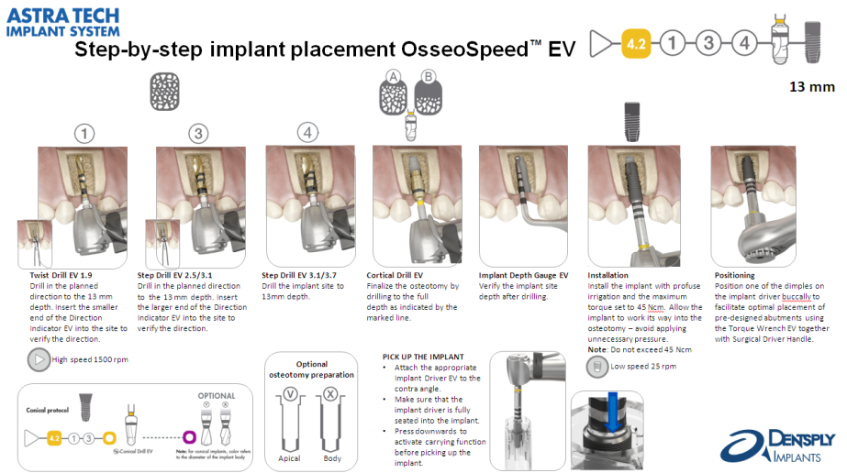
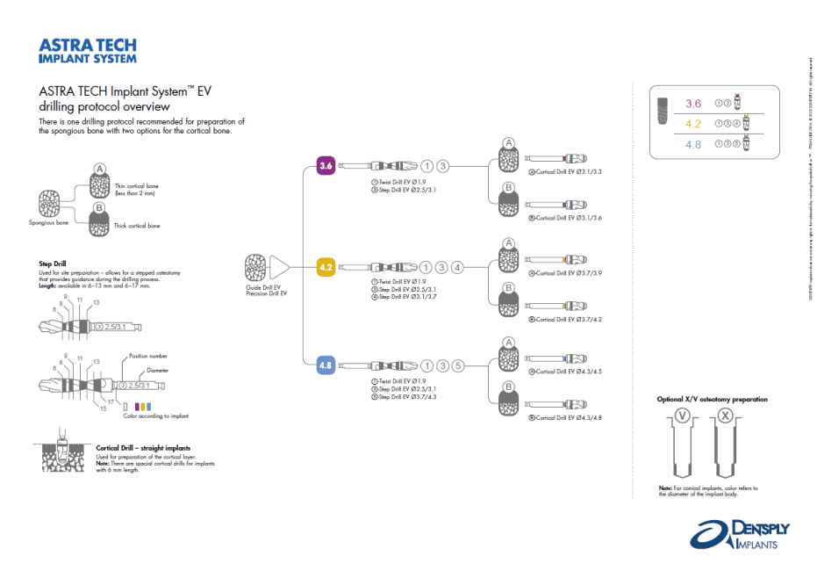
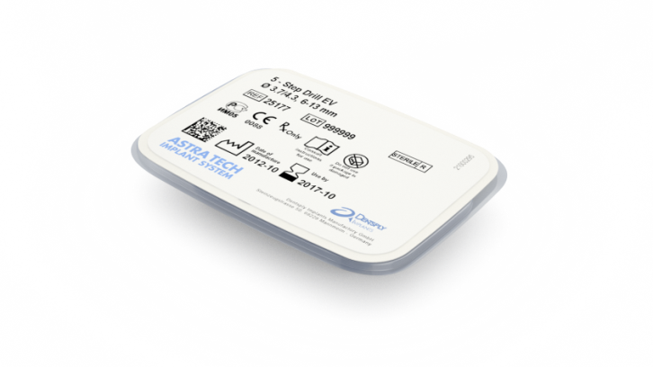
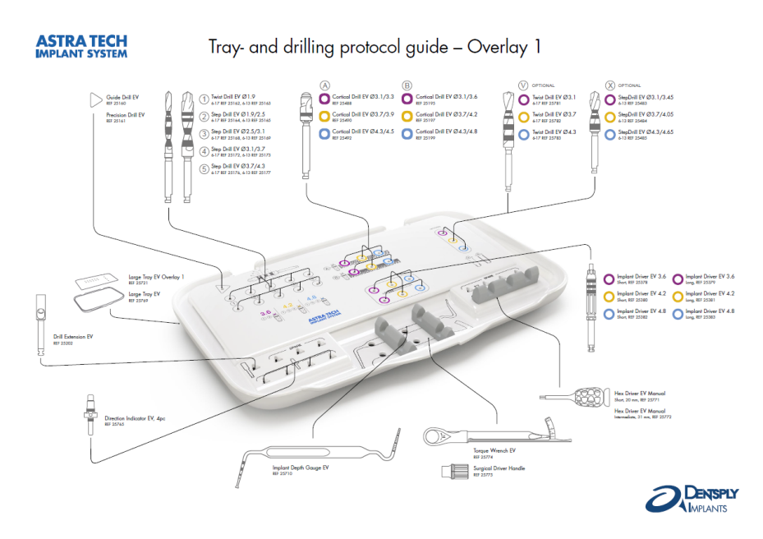
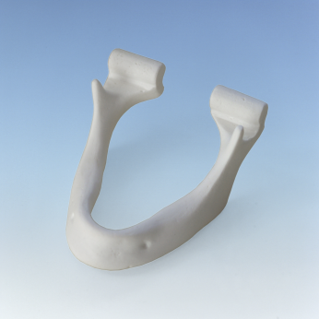
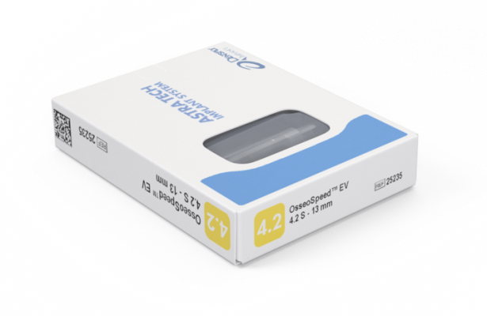
Training equipment
13 mm
Notes:
Present the training equipment
Guidelines, Step-by-step implant placement overview , Tray and drilling overview
Drill jaw – mandible
Surgical Tray
Drill package
Implant package
Torque Wrench

Slide 3
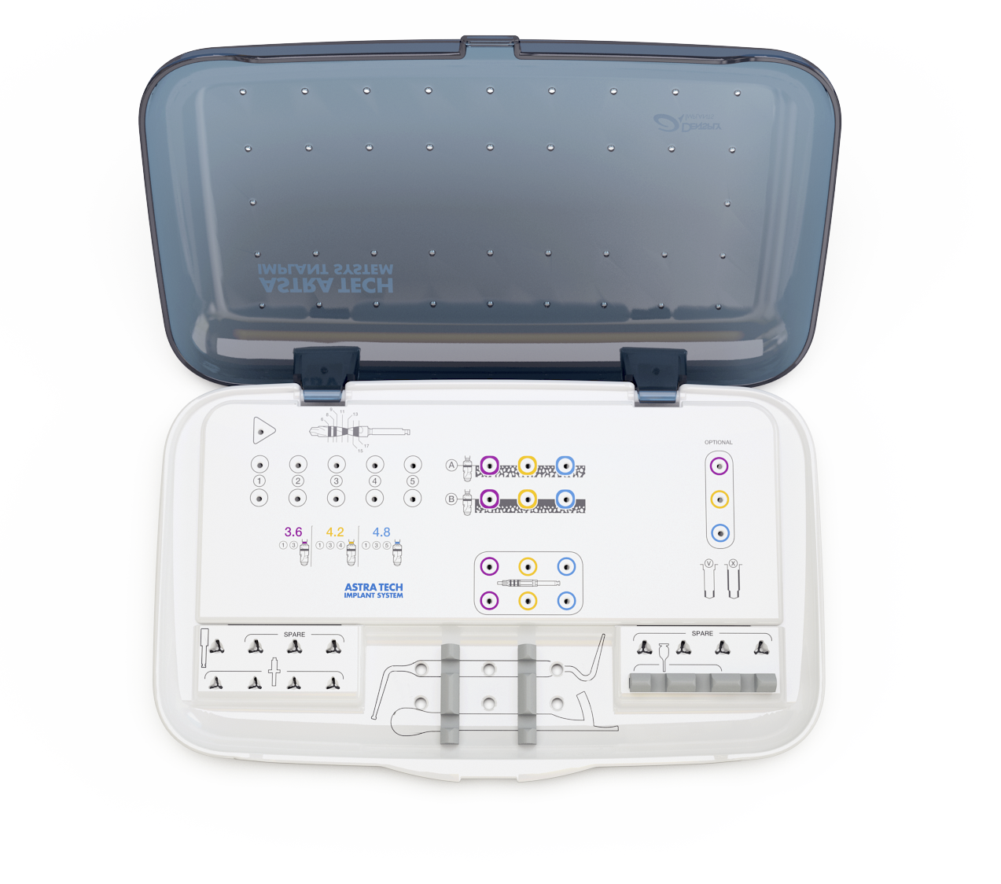
Space for Guide Drill
Drill with markings
Optional drilling
Drilling protocol
Implant Driver EV
Drill Extension EV Spare Implant Depth Gauge EV Hex Screwdriver EV Spare Direction Indicator EV Torque Wrench EV
Notes:
Go through the tray
Drilling protocol for the most common straight implant sizes, 3.6S, 4.2S and 4.8S
Drills 1 to 6 for the spongious bone preparation, color white.
Drills A and B for the cortical bone preparation. Color: corresponds to implant size.
Optional drills extra apical or body preparation, V or X. Color: corresponds to implant size.
Implant Drivers EV, short and long
Space for additional instruments
Space for Guide Drill
Drill symbol showing depth markings on twist- and step drills (symbol not actual size)

Slide 4
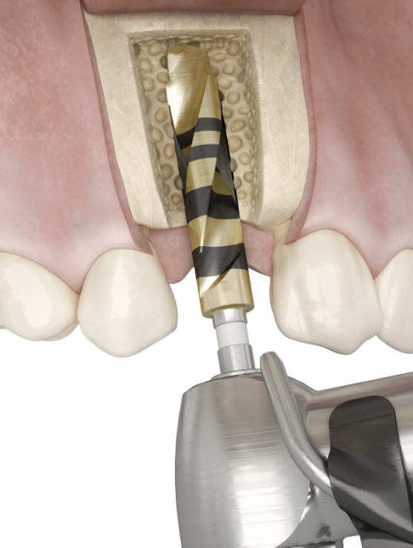
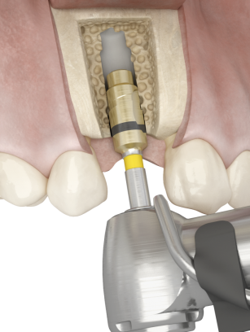
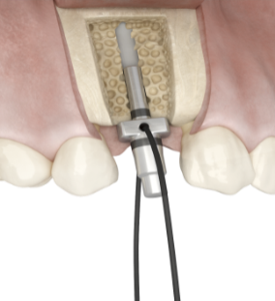
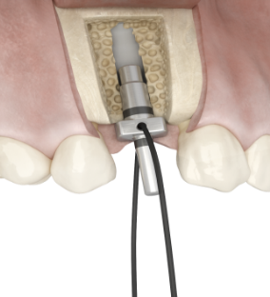
Drilling
Notes:
Twist Drill EV 1.9 1
If preferred, Guide Drill EV or Precision Drill EV can be used to create a pilot hole prior to the Twist Drill 1 .
Drill in the planned direction to the appropriate depth.
The drilling will provide valuable information about the cortical and spongious bone.
Insert the smaller end of the Direction Indicator EV into the site to visualize/verify the direction.
Note: The depth should allow the implant to be level with or slightly submerged in relation to the adjacent marginal bone.
Step Drill EV 2.5/3.1 3
Drill in the planned direction to the appropriate depth.
Insert the larger end of the Direction Indicator EV into the site to visualize/verify the direction.
Step Drill EV 3.1/3.7 4
Drill the implant site to the appropriate depth.
Cortical Drill EV
Finalize the osteotomy by drilling to the full depth as indicated by the marked line. Use the cortical drill based on the cortical bone thickness:
Cortical Drill A for a thin cortical bone
Cortical Drill B for a thick cortical bone

Slide 5
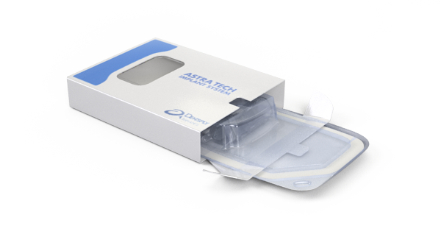
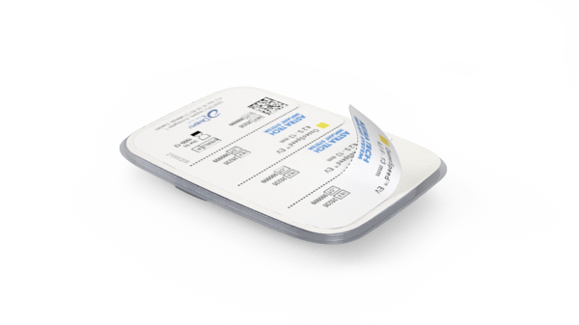
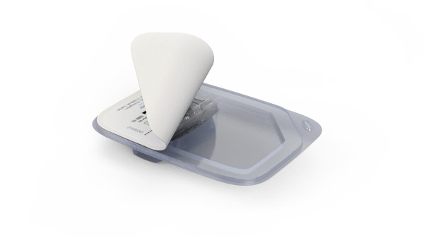
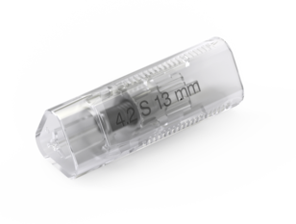
Implant packaging

Slide 6
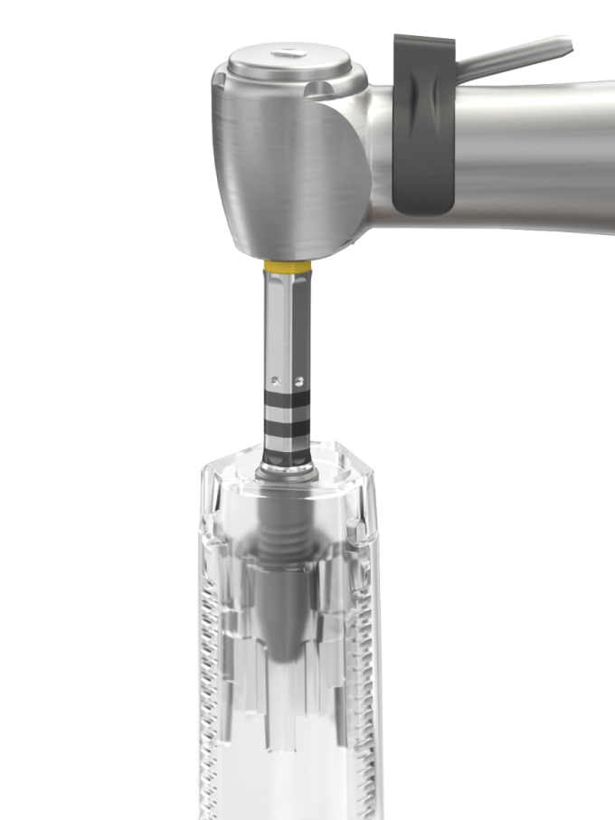
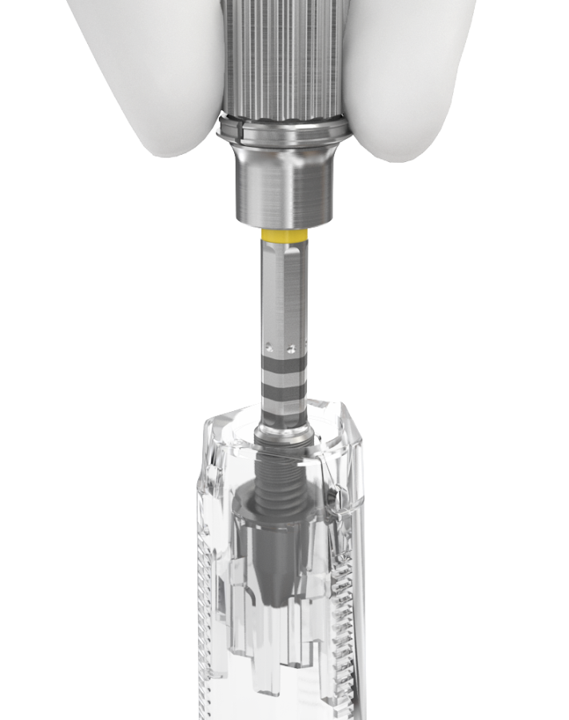
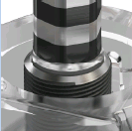
Implant pick-up
Notes:
Remove the cap from the container using a twisting motion.
Pick up the implant
Attach the yellow 4.2 Implant Driver EV to the contra angle.
Make sure that the implant driver is fully seated into the implant
Press downwards to activate carrying function before picking up the implant.
Manual implant pick up
• Attach the yellow 4.2 Implant Driver EV to the Surgical Driver Handle.
• Make sure that the implant driver is fully seated into the implant
• Press downwards to activate the carrying function before picking up a the implant
Manual installation
Install the implant.

Slide 7
Pick up the implant with Implant Driver EV
Notes:
Pick up the implant
Attach the yellow 4.2 Implant Driver EV to the contra angle.
Make sure that the implant driver is fully seated into the implant
Press downwards to activate carrying function before picking up the implant.

Slide 8
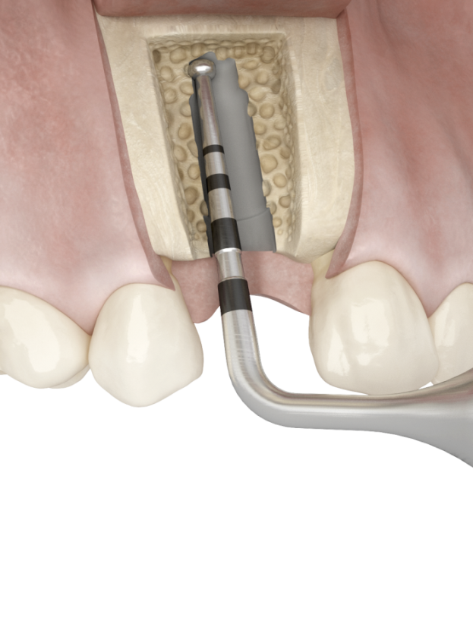
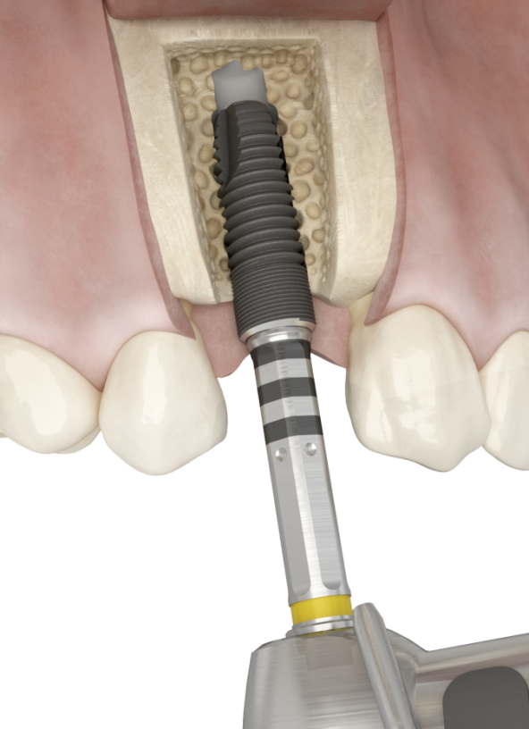
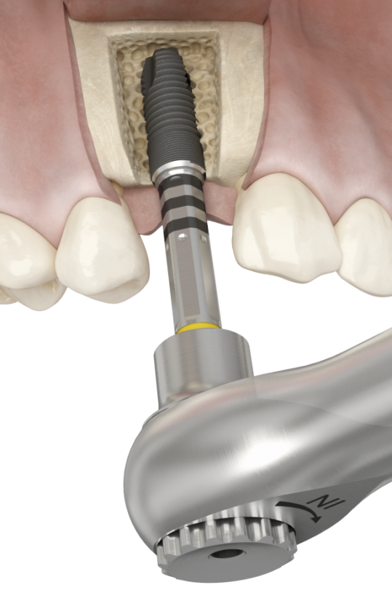
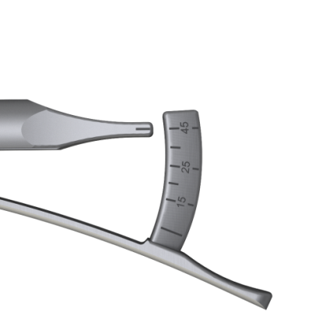
Implant installation
Notes:
Implant Installation
Verify the implant site depth after drilling using the Implant Depth Gauge EV.
Note: The depth should allow the implant to be level with or slightly submerged in relation to the adjacent marginal bone.
Implant installation
• Install the implant with the contra angle at low speed (25 rpm) (no irrigation at hands-on) and the maximum torque set to 45 Ncm.
• Allow the implant to work its way into the osteotomy. Avoid applying unnecessary pressure.
Note: Do not exceed 45 Ncm when installing the implant. If not completely seated before reaching 45 Ncm, reverse/ remove the implant and widen the osteotomy appropriately
Positioning
• Position one of the dimples on the implant driver buccally to facilitate optimal placement of pre-designed abutments using the Torque Wrench EV together with Surgical Driver Handle.

Slide 9
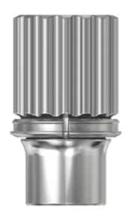
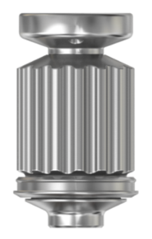
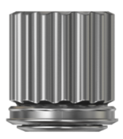
Torque Wrench EV
Torque Wrench EV
Surgical Driver Handle
Restorative Driver Handles
Notes:
A torque wrench together with Surgical Driver Handle are used for implant installation and adjustment of implant positioning. Do not use the restorative driver handle for implant placement or removal.
The Torque Wrench can also be used for tightening of abutment screws and/or bridge screws together with a Restorative Driver Handle.

Slide 10
Torque Wrench EV and Surgical Driver Handle
Notes:
The film clip is showing how to assemble the Torque Wrench EV with the Surgical Driver Handle and how to use it. Note; Do not exceed 45 Ncm.

Slide 11
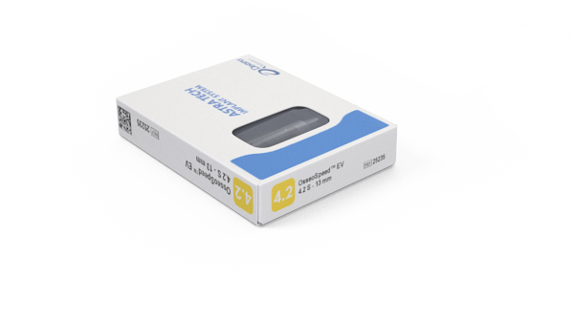
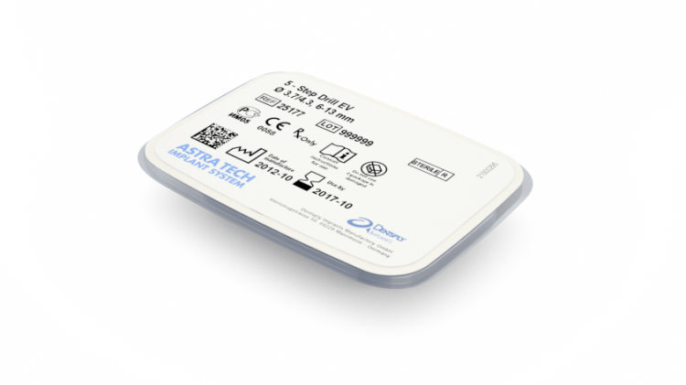
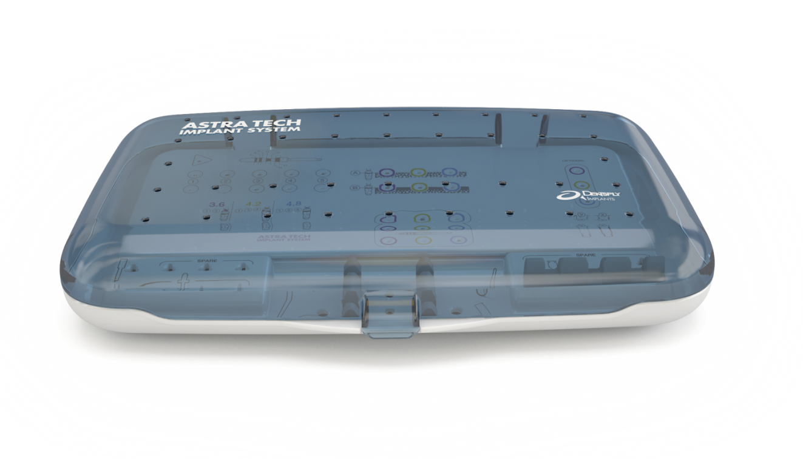
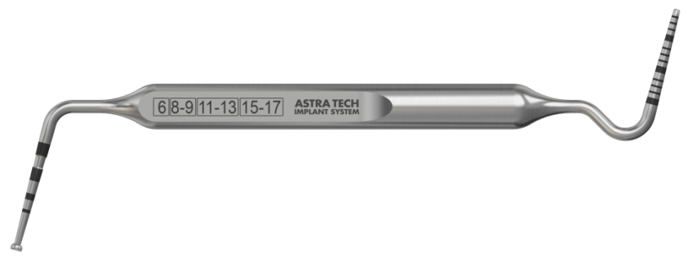
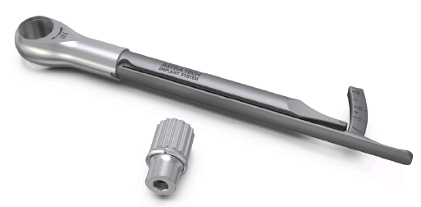
Prepare the tray for surgery
Notes:
You have the instruments and drills for placing a 4.2 S, 13 mm implant. When using the jawbone as a “patient” you will need to use drill 1, 3 and 4 and the B drill for the cortical preparation.
There will also be drills for placing a 4.2 C, 13 mm implant (please remember the body of 4.2 C implant is 3.6).

Slide 12
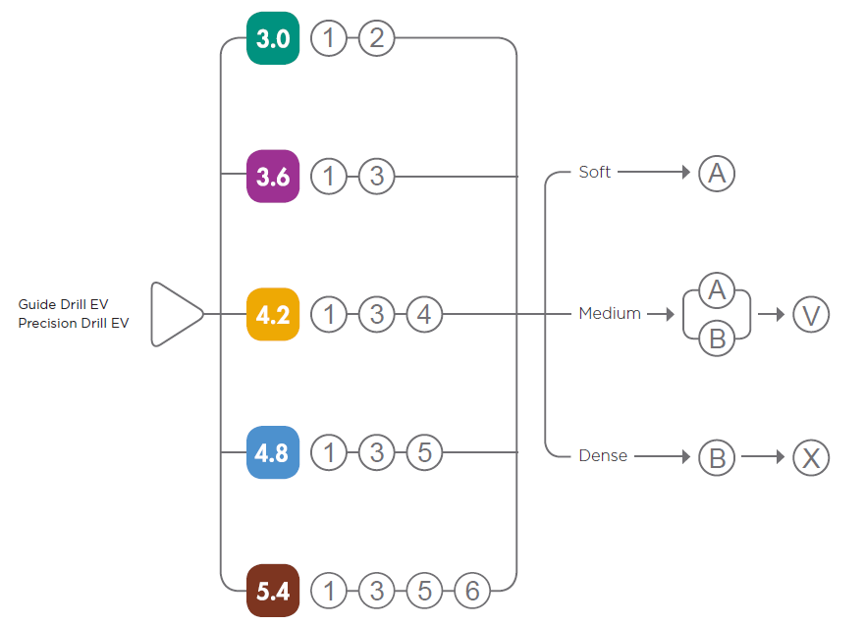
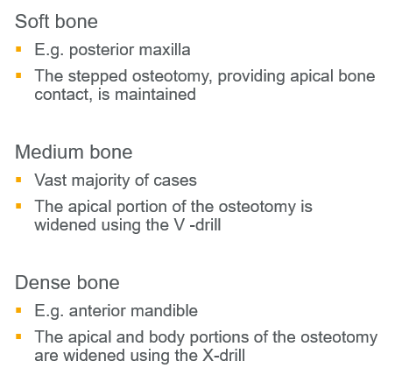
Drilling protocol – OsseoSpeed® EV straight
Notes:
Flexible drilling protocol that allows for preferred primary stability
The drilling procedure is made easy by using color-coding and a simple numbering system

Slide 13
Notes:
Follow the 4.2S drilling protocol for placing an OsseoSpeed EV - 4.2S - 13 mm implant

Slide 14
Thank You

