Slide 1

For better, safer, faster dental care
Implants

Slide 2
Atlantis
Beyond CAD/CAM
Patient-specific abutments for all major implant systems

Slide 3
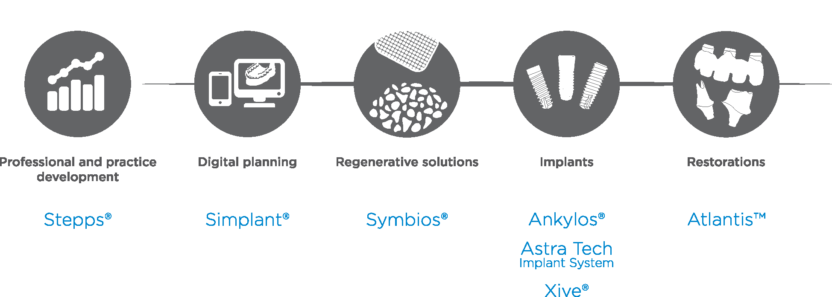
Comprehensive solutions for all phases of implant therapy

Slide 4
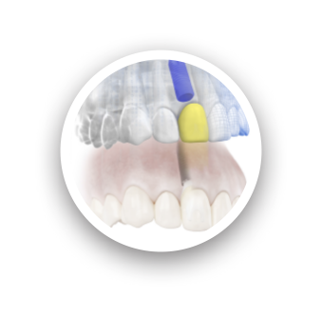
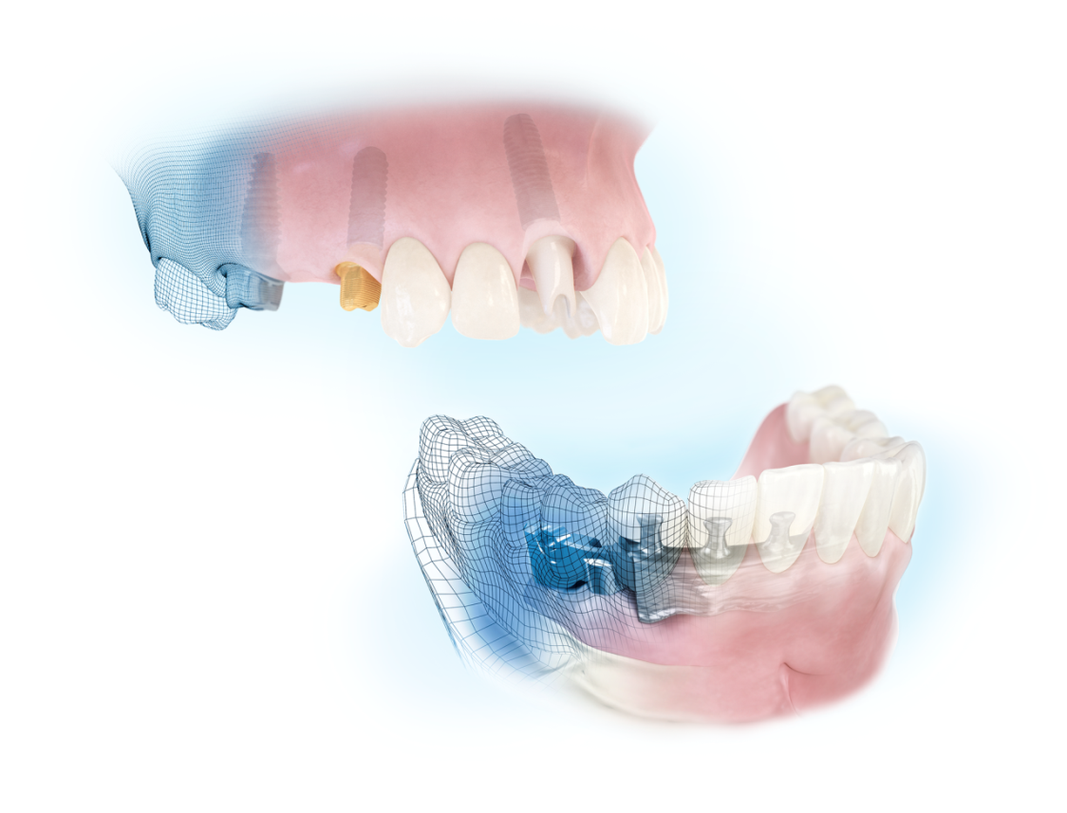
Digital solutions from Dentsply Sirona Implants
Simplant
Computer guided implant treatment
Atlantis
For all major implant systems
Patient-specific prosthetic solutions
- beyond CAD/CAM

Slide 5
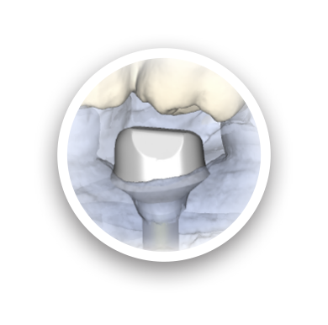
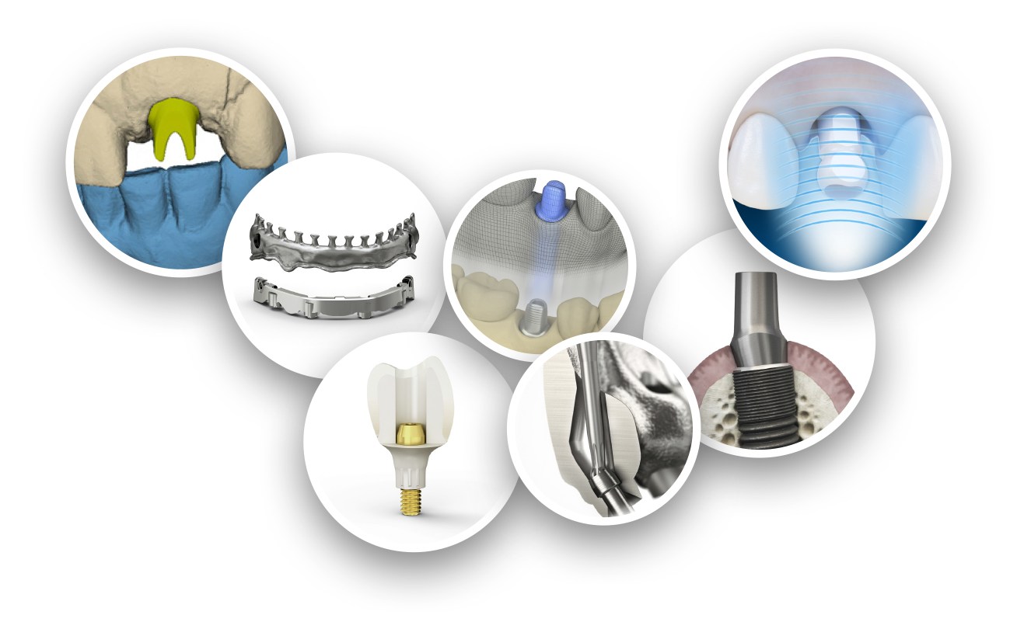
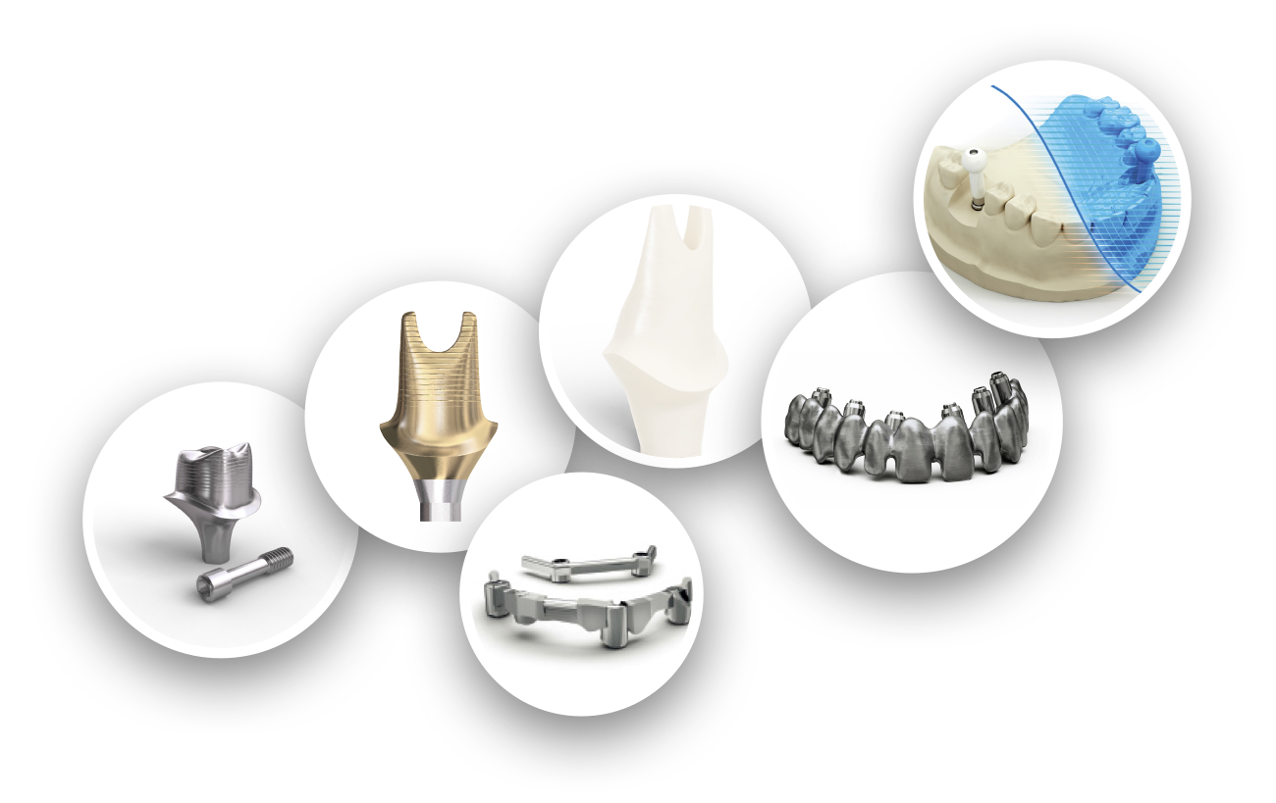

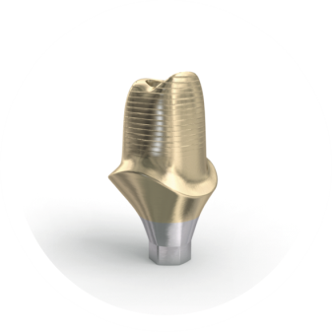
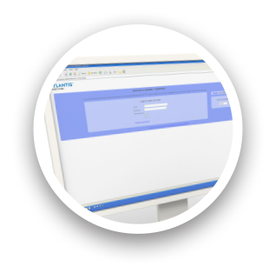
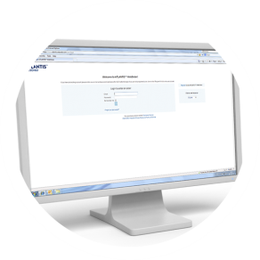
Ongoing innovation
2014
Intraoral scanning
for Atlantis Abutment
2009
Lab-based scanning
for Atlantis abutments
2011
2in1 suprastructure
2006
Abutments in zirconia
2012
Atlantis Core file
2004
Abutments in gold-shaded titanium
1999
First patient-specific abutment delivered –
in titanium
2010
Atlantis Editor for abutments
2008
Bridge and hybrid for
Screw-retained restorations
2015
Atlantis
Conus concept
2005
First bar
delivered –
In titanium
2007
Atlantis WebOrder
online ordering system
2011
Atlantis
Crown Abutment
2014
Angulated screw access
for Atlantis Bridge and Hybrid

Slide 6
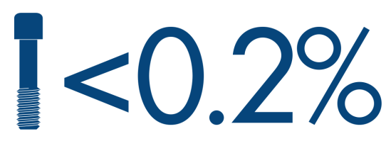

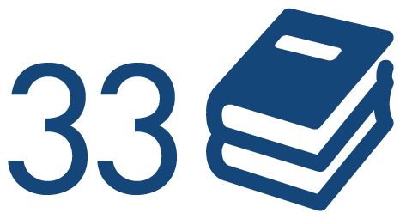
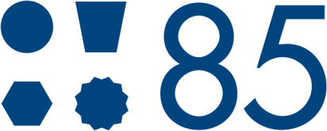
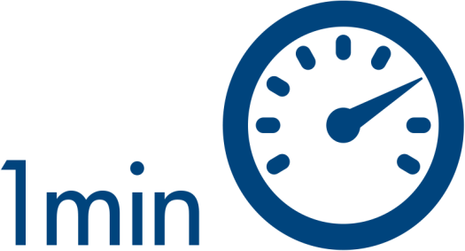
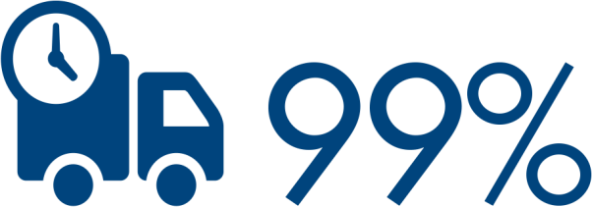
Confidence you can count on
1999
Notes:
1999: Atlantis Abutment is introduced and the first abutments are delivered
1 minute: Time it can take to enter and process an order for an abutment in Atlantis WebOrder
99% on-time, early or same-day shipping history
85 compatible implant connections
<0.2% Complaint rate based on an analysis of registered screw-related complaints in relation to the total number of abutments sold since 2008.
>1.5 million Atlantis abutments produced and sold globally
33 published clinical studies and case reports documenting success using Atlantis abutments on different implant platforms

Slide 7
Restorative freedom
Atlantis abutments
For cement-, (single tooth) screw-
and attachment-retained restorations.
Atlantis suprastructures
A full range of implant suprastructures
for fixed and removable prostheses.

Slide 8
Surgical flexibility
Compatible with 85 implant connections
Dentsply Sirona Implants
  Ankylos
  Astra Tech Implant System
  Xive
BioHorizons
Biomet 3i
Camlog
Keystone Dental
Nobel Biocare
Straumann
Zimmer Dental
All trademarks, company names and implant designs are the property of their respective owners.
Notes:
Atlantis is an open solution available for all major implant systems.

Slide 9
Material flexibility
Available in biocompatible materials including titanium, gold-shaded titanium and zirconia.
All trademarks, company names and implant designs are the property of their respective owners.
Notes:
Atlantis abutments support cement-, (single-tooth) screw- and attachmet-retained restorations,

Slide 10
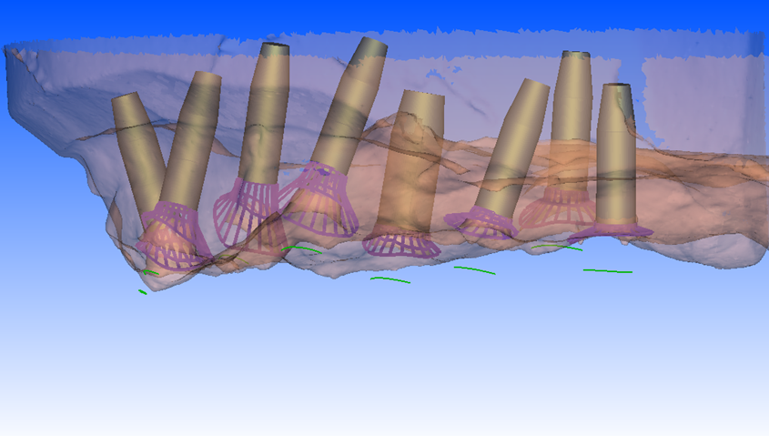
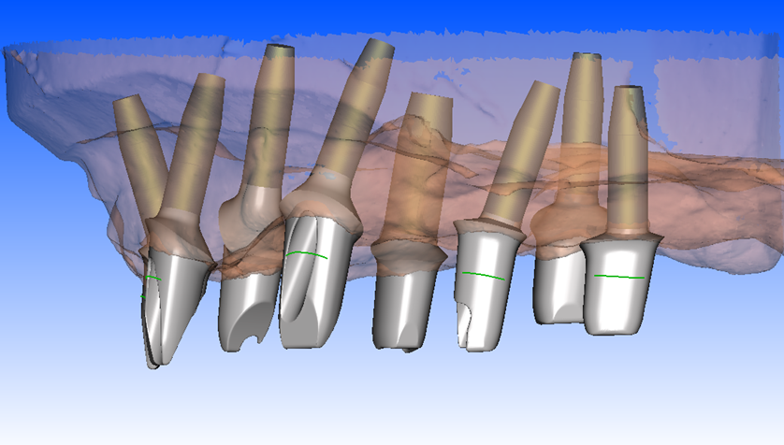
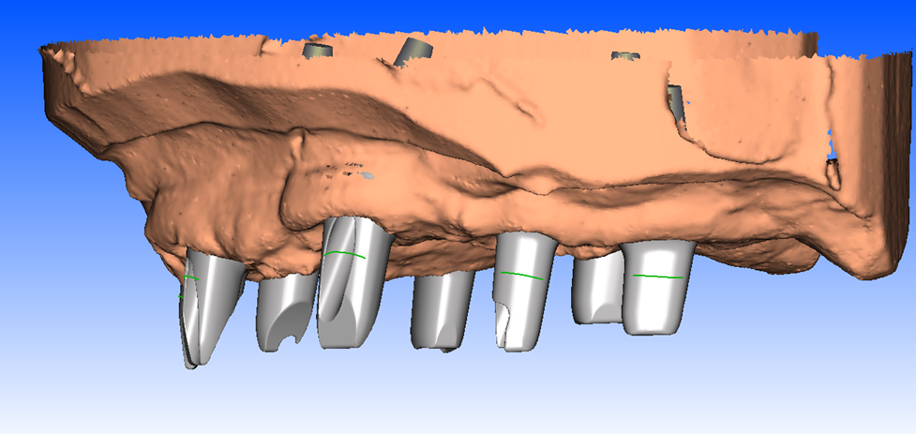
Address challenging implant placement

Slide 11

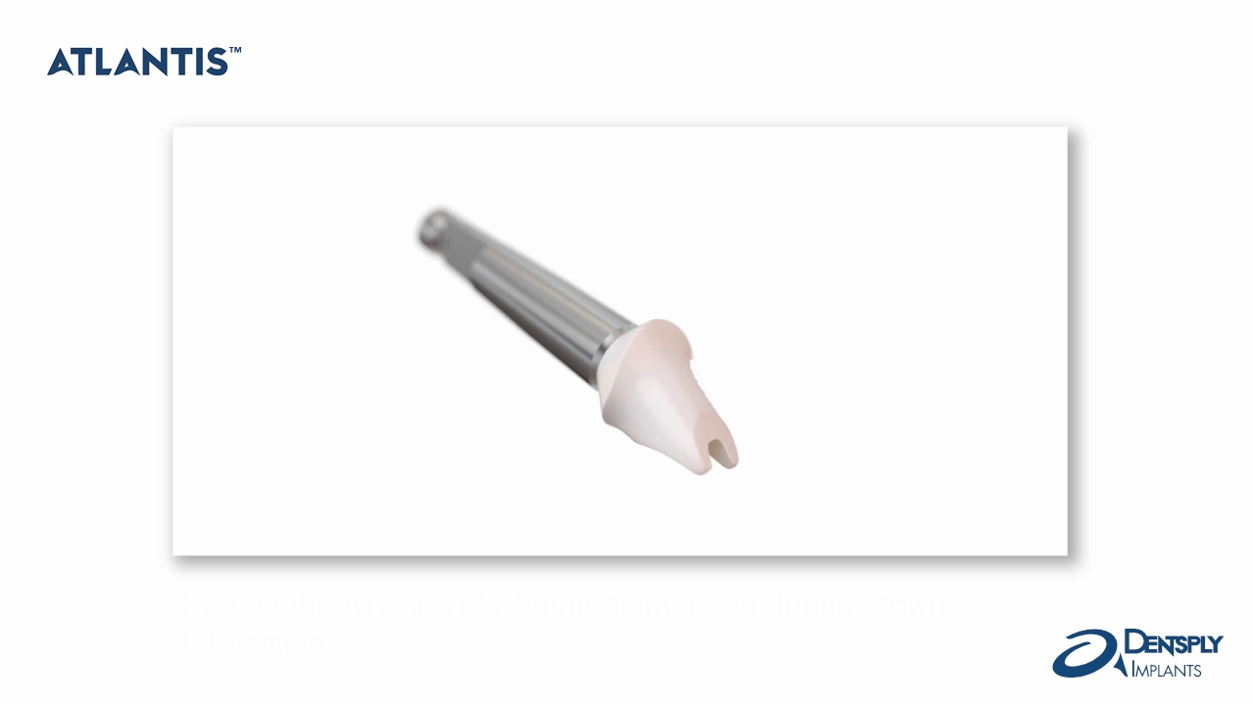
Handling procedures

Slide 12
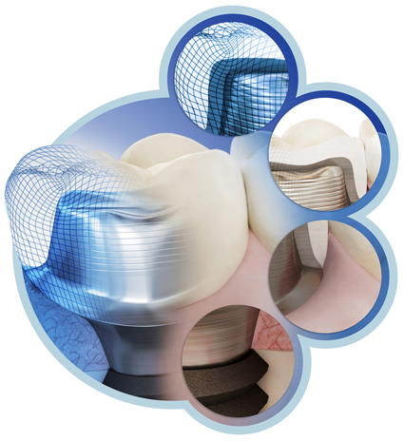
Atlantis BioDesign Matrix
Atlantis VAD (Virtual Abutment Design)
Designed from the final tooth shape
Natural Shape
Shape and emergence profile are based on
the individual patient anatomy
Soft Tissue Adapt
Optimal support for soft tissue sculpturing
and adaptation to the finished crown
Custom Connect
Strong and stable fit – customized connection for all major implant systems
Notes:
A synergy of four unique elements that together allow for design and production of consistent, high-quality, patient-specific abutments for all major implant systems.

Slide 13
Atlantis BioDesign Matrix
Atlantis VAD (Virtual Abutment Design)
Designed from the final tooth shape
Natural Shape
Shape and emergence profile are based on
the individual patient anatomy
Soft Tissue Adapt
Optimal support for soft tissue sculpturing
and adaptation to the finished crown
Custom Connect
Strong and stable fit – customized connection for all major implant systems
Notes:
A synergy of four unique elements that together allow for design and production of consistent, high-quality, patient-specific abutments for all major implant systems.

Slide 14
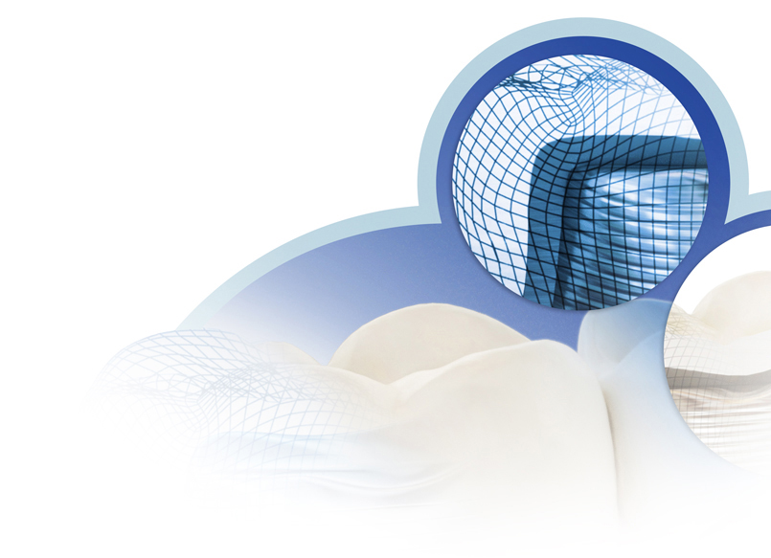
Atlantis VAD goes beyond CAD
CAD
Designed by technicians – aided by computer
Atlantis VAD (Virtual Abutment Design)
Designed by computer – aided by technicians

Slide 15
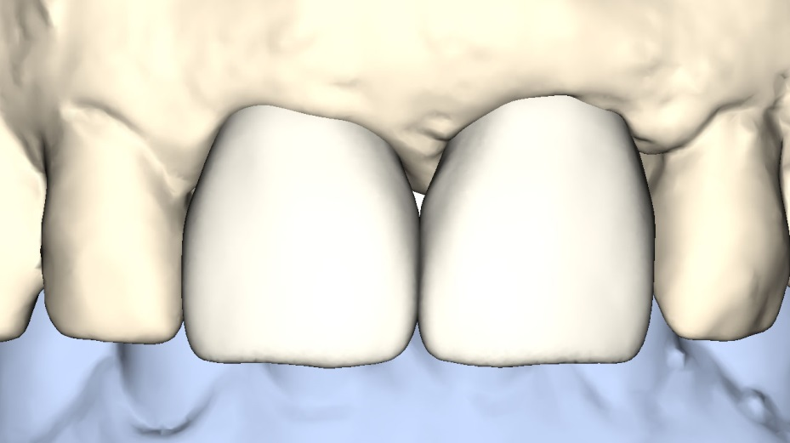
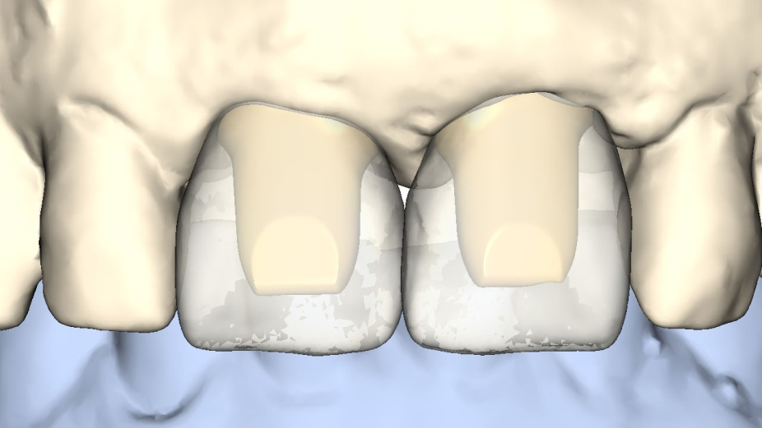
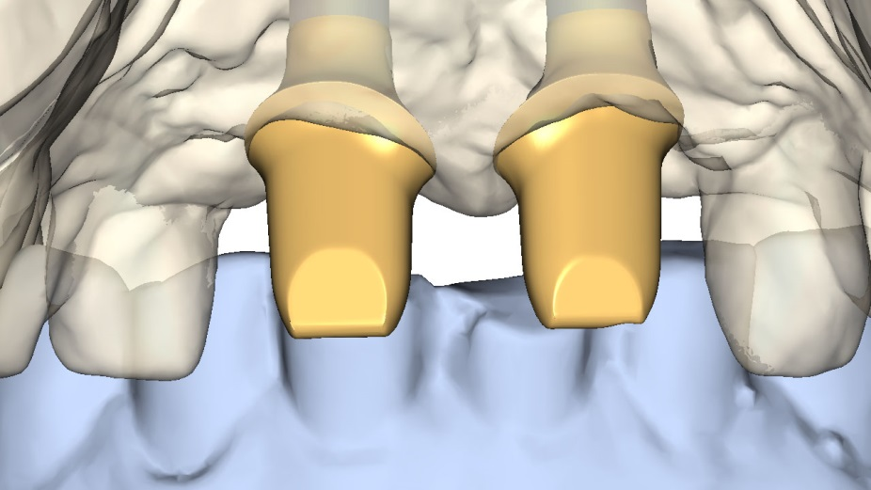
Atlantis VAD considers all design parameters
Proposed tooth shape
Abutment design based
on tooth shape
Final Atlantis
abutment design

Slide 16
Design options that go beyond CAD/CAM
Indexing
Anti-rotation
Abutment-to-implant fit
Tooth-related base shape
Emergence width options
Material strength control
Shoulder control
Margin follows soft tissue
Core height and retention
Parallelism
Papilla support
Retentive surface
Path of insertion
Controlled core thickness
Cusp angles
Taper angle
Cusp and fossa position
Notes:
Atlantis VAD considers the numerous features and design parameters for premium prosthetic solutions

Slide 17
Atlantis BioDesign Matrix
Atlantis VAD (Virtual Abutment Design)
Designed from the final tooth shape
Natural Shape
Shape and emergence profile are based on
the individual patient anatomy
Soft Tissue Adapt
Optimal support for soft tissue sculpturing
and adaptation to the finished crown
Custom Connect
Strong and stable fit – customized connection for all major implant systems
Notes:
A synergy of four unique elements that together allow for design and production of consistent, high-quality, patient-specific abutments for all major implant systems.

Slide 18
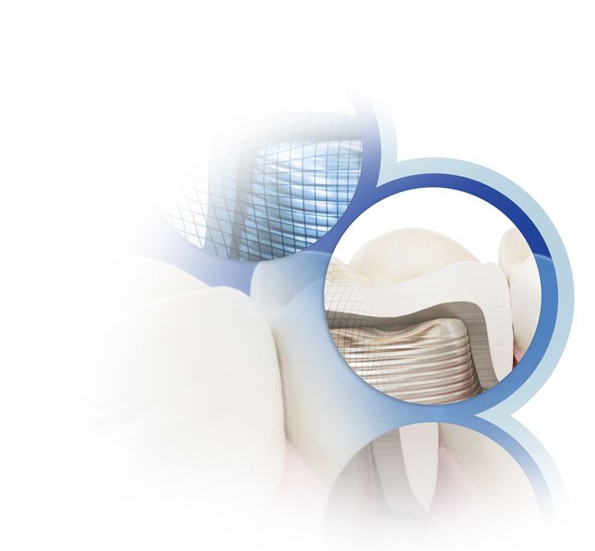
Natural Shape
A choice of anatomical emergence profiles for excellent function and esthetics
Margins designed and placed
at an ideal level for easy and safe removal of excess cement

Slide 19
Atlantis BioDesign Matrix
Atlantis VAD (Virtual Abutment Design)
Designed from the final tooth shape
Natural Shape
Shape and emergence profile are based on
the individual patient anatomy
Soft Tissue Adapt
Optimal support for soft tissue sculpturing
and adaptation to the finished crown
Custom Connect
Strong and stable fit – customized connection for all major implant systems
Notes:
A synergy of four unique elements that together allow for design and production of consistent, high-quality, patient-specific abutments for all major implant systems.

Slide 20
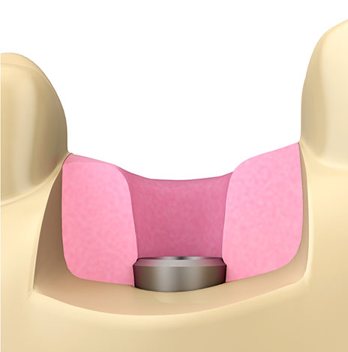
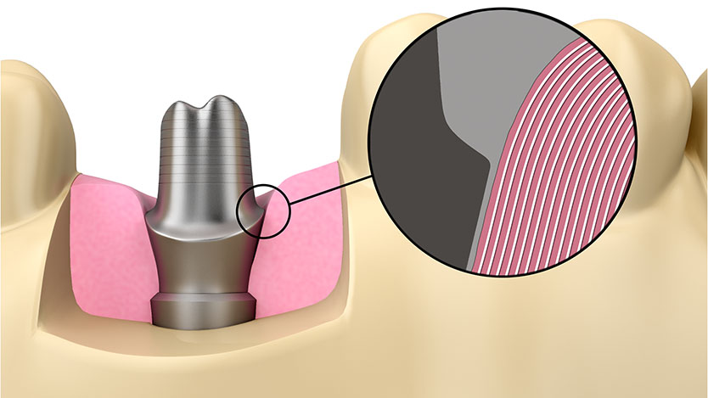
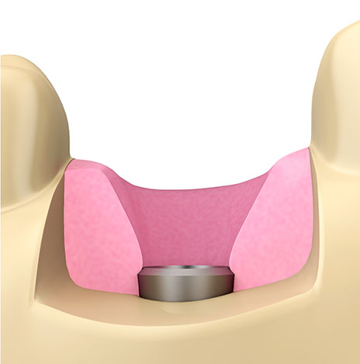
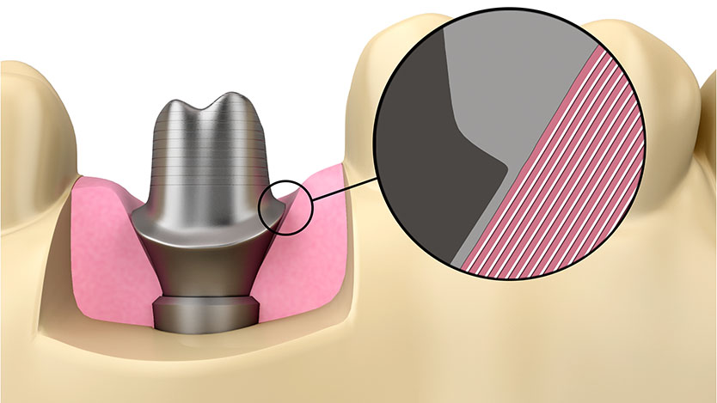
Soft tissue Adapt
Healing space
No tissue displacement
Emergence width options
Narrow
Wide

Slide 21
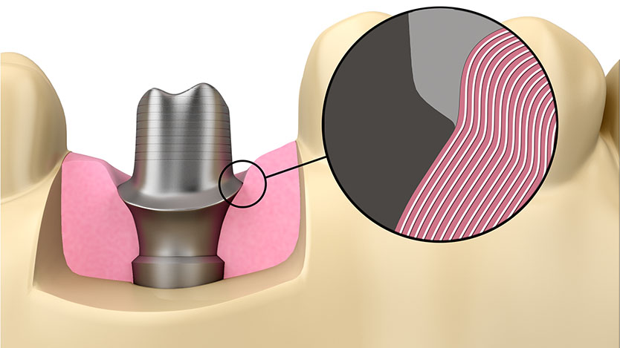
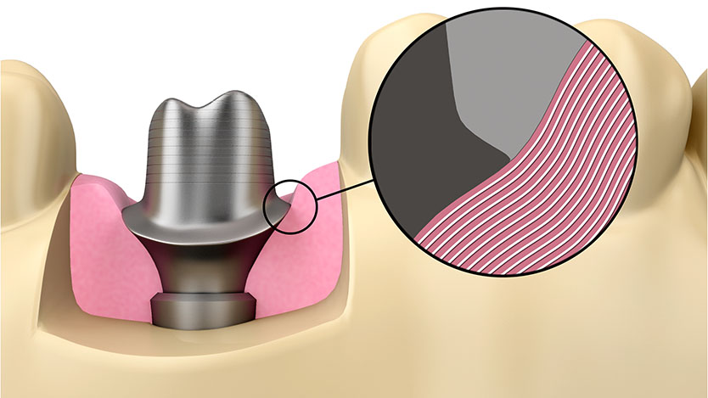
Soft tissue Adapt
Healing space
Support tissue
Emergence width options
Narrow
Wide

Slide 22
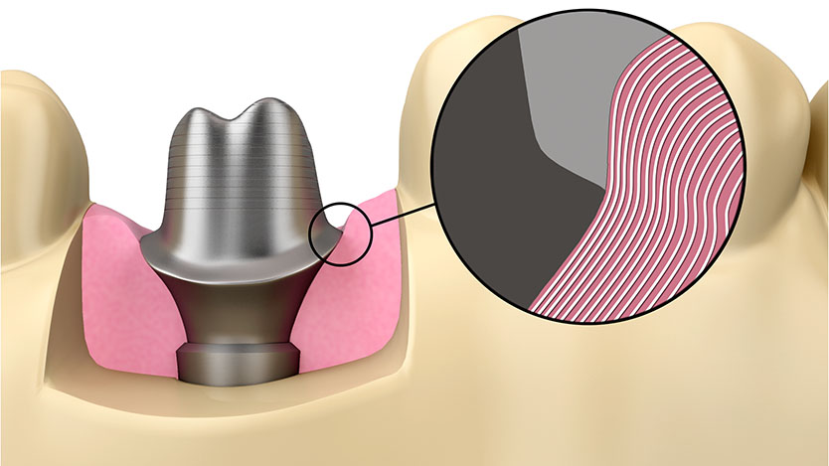
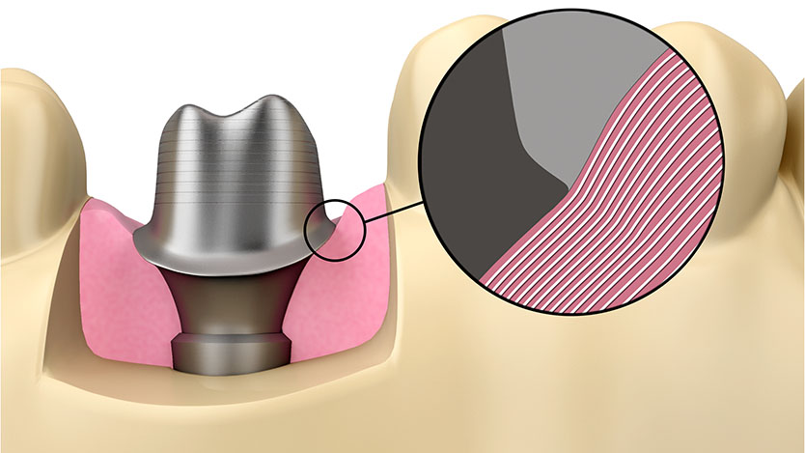
Soft tissue Adapt
Healing space
Contour tissue
Emergence width options
Narrow
Wide

Slide 23
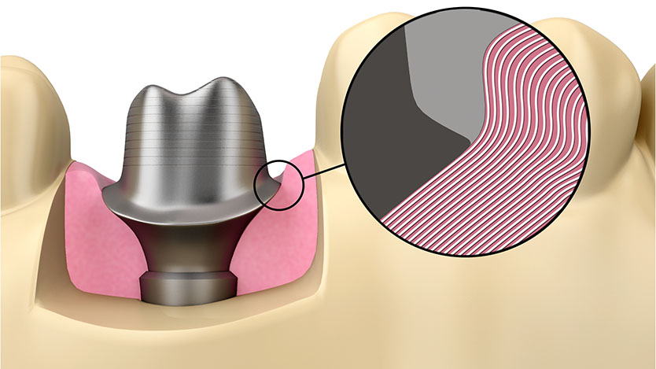
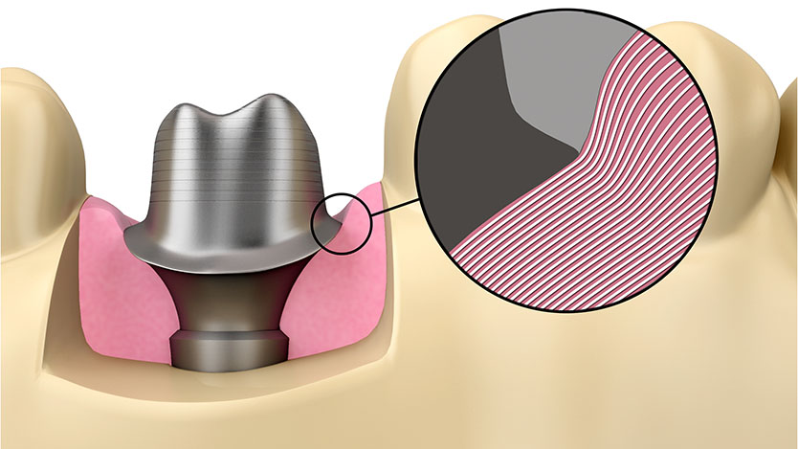
Soft tissue Adapt
Healing space
Full anatomical
Emergence width options
Narrow
Wide

Slide 24
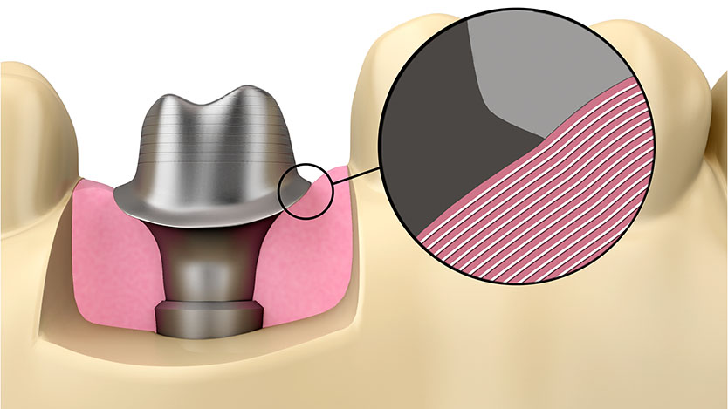
Soft tissue Adapt
Healing space
Anatomical support
Emergence width options
Narrow
Not applicable on
wide healing situations
Wide

Slide 25
Atlantis BioDesign Matrix
Atlantis VAD (Virtual Abutment Design)
Designed from the final tooth shape
Natural Shape
Shape and emergence profile are based on
the individual patient anatomy
Soft Tissue Adapt
Optimal support for soft tissue sculpturing
and adaptation to the finished crown
Custom Connect
Strong and stable fit – customized connection for all major implant systems
Notes:
A synergy of four unique elements that together allow for design and production of consistent, high-quality, patient-specific abutments for all major implant systems.

Slide 26
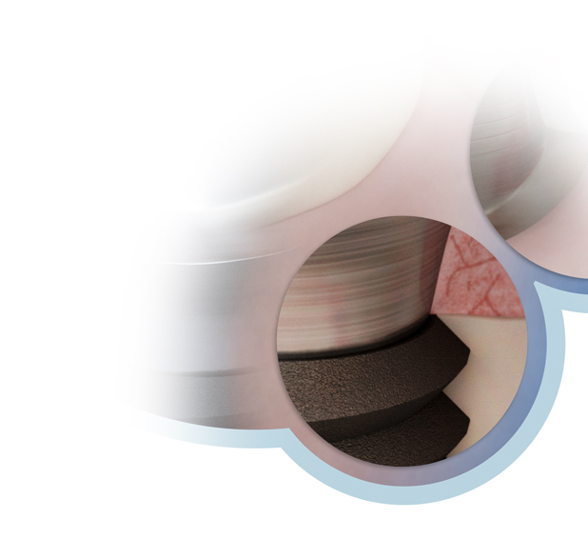
Custom Connect
Indexing
Anti-rotation
Abutment-to-implant fit
Abutment screw
Notes:
Provides a strong and stable fit.

Slide 27
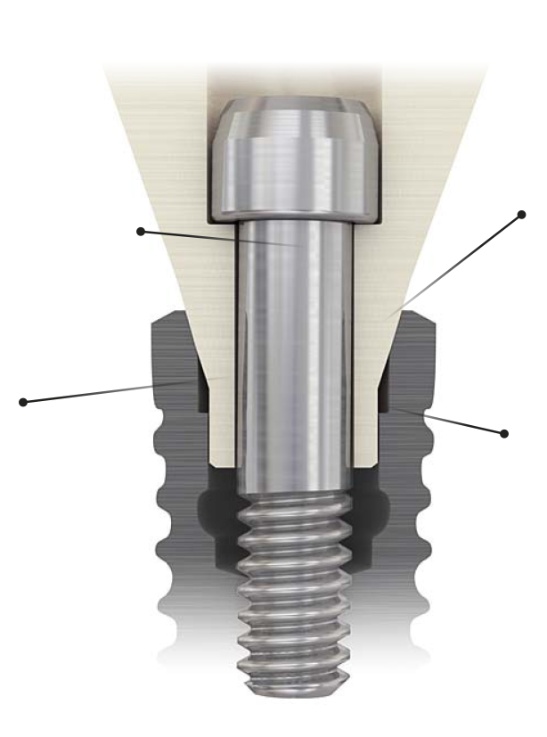
Custom Connect
Abutment screw
Functions with clinicians’
existing drivers; and provides retrievable mechanical
attachment.
Abutment-to-implant fit
Designed and milled for precise connection and load transfer between abutment and implant.
Indexing
Ensures the abutment is correctly oriented to the implant.
Anti-rotational feature
Keeps the abutment from moving during torquing.
All trademarks, company names and implant designs are the property of their respective owners.

Slide 28
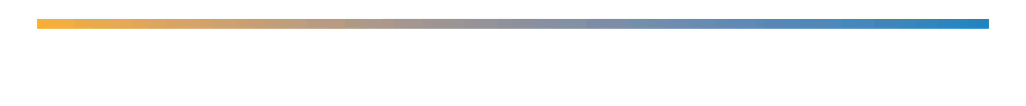
Cement-retained restorations
1

Slide 29
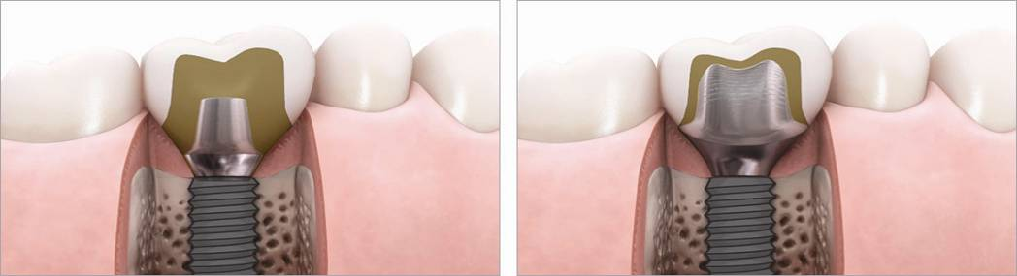
Cement-retained restorations
A choice of anatomical emergence profile for excellent function and esthetics
Margins designed and placed at an ideal level for easy and safe removal of excess cement
Atlantis patient-specific abutments
Pre-fabricated abutments

Slide 30
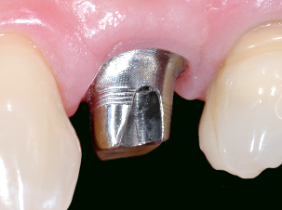
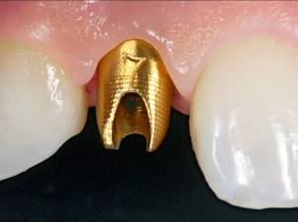
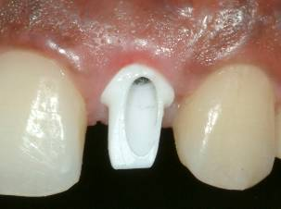
Cement-retained restorations
– Available in a different material options and suitable for all positions in the mouth
Atlantis Abutment in titanium
Atlantis Abutment in gold-shaded titanium with a thin coating of biocompatible titanium nitride (TiN)
Atlantis Abutment in zirconia
are milled from solid blanks of
yttria-stabilized tetragonal zirconia polycrystals (Y-TZP)
Courtesy of Dr. Julian Osorio, Dr. Keith Phillips and Dr. Harold van der Burg

Slide 31
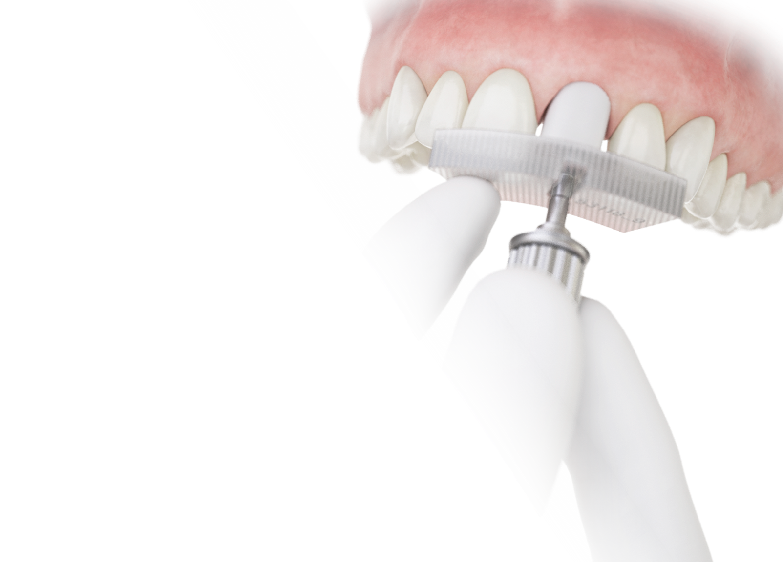
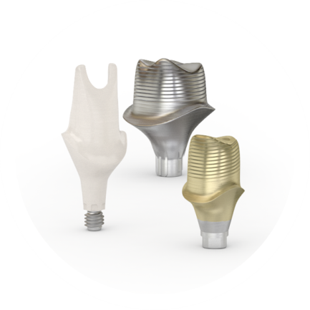
Cement-retained restorations
– Atlantis Insertion Guide
A precisely-crafted, 3D-printed device that holds an Atlantis Abutment securely at the correct angle and orientation during installation for single- and multiple-unit, cement-retained solutions.
Notes:
A single tooth that enables precise and reliable abutment placement
Atlantis Abutment scan data is used to create the insertion guide for an optimal design and fit
Designed to accurately match the abutment margin, avoiding soft tissue to interfere during installation
Designed with oriented access channel for easy location of the screw access hole and insertion of the abutment screw

Slide 32
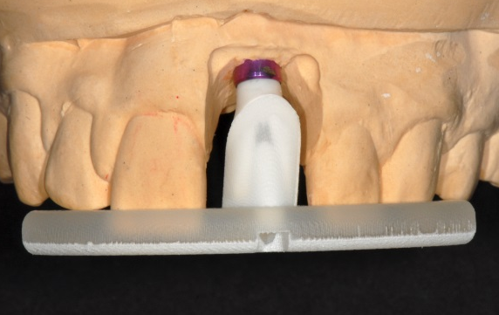
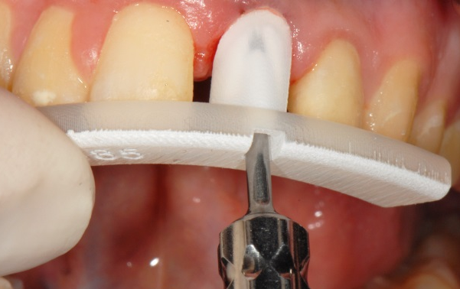
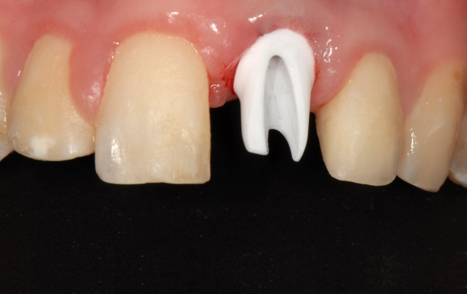
Atlantis Insertion Guide: Case Study
– Reliable treatment solution for esthetically demanding cases
An Atlantis Insertion Guide is created from the Atlantis Abutment design.
The produced abutment and guide are delivered to the dental laboratory. When the restoration is finalized, it is sent it to the clinician.
After placing the abutment in the guide, the guide is seated using the neighboring teeth as an index. While holding the guide in place, the abutment screw is inserted and tightened with light finger force.
After removing the guide, the abutment is secured to the implant using the appropriate torque. The screw access hole is blocked and the abutment is ready for cementation of the final restoration.
Courtesy of Dr. Arnold Rosen, MBA, DDS
Notes:
An Atlantis Abutment is designed using the Atlantis VAD software. The design can be reviewed and/or edited in the Atlantis Editor by the dental technician before being manufactured by Dentsply Sirona Implants.

Slide 33
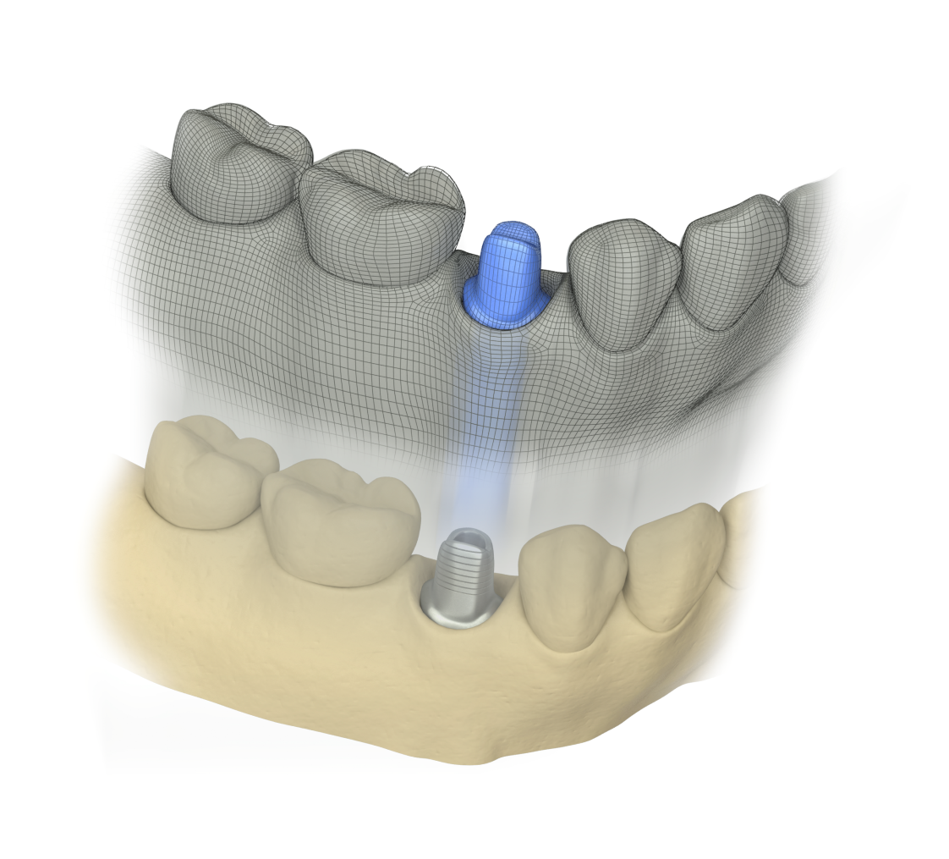
Atlantis Core File
A digital representation of the outer surface of an Atlantis Abutment that enables the design of the coping and final restoration before even receiving the physical abutment ordered.
Available for:
  3M ESPE Lava 7
  Dental Wings
  3Shape
Notes:
Technology that helps you to communicate

Slide 34
Screw-retained restorations
1

Slide 35
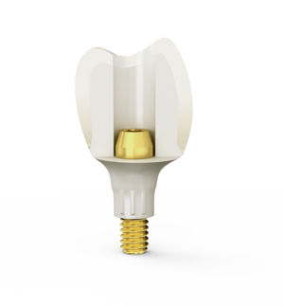
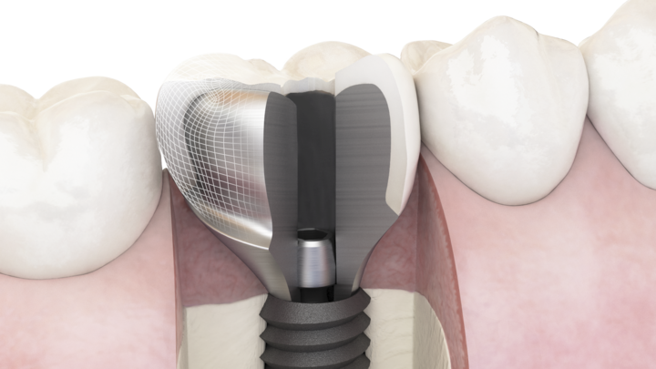

Atlantis Crown Abutment
– For single-tooth, screw-retained restorations
  Does not require further modification or the use of cement which reduce patient chairtime
  Porcelain or composite applied directly
  to the abutment
  Easily retrievable, if needed, saving
  time and costs related to preparing a separate, new crown
  Available in biocompatible materials including five shades of zirconia and titanium
  Suitable for all positions in the mouth
Notes:
An efficient, effective and esthetic alternative to traditional cast abutments.

Slide 36
Attachment-retained restorations
1

Slide 37
Attachment-retained restorations
– Atlantis Conus concept
A removable prosthesis with the comfort of a fixed restoration
Notes:
For edentulous patients
A uniquely designed, conical shaped abutment that incorporates a friction fit, implant-borne prosthesis while being removable like an overdenture.
Allows optimal access for oral hygiene while providing the patient with a cost-effective treatment option.
For all major implant systems

Slide 38
Attachment-retained restorations
– Atlantis Conus concept
Atlantis Conus Abutment – overdenture
Designed to fit SynCone caps
Atlantis Conus Abutment - custom
Notes:
Provides fully edentulous patients with a cost-effective, implant-supported prosthesis
The stability of a friction-retained, non-resilient prostheses, but the comfort of a fixed restoration

Slide 39

Atlantis Conus Abutment - overdenture
Available in titanium
Designed to fit SynCone 5° caps
Cannot be combined with any other type of Atlantis abutment within the same arch
  Ex. Atlantis Conus Abutment and Atlantis Crown Abutment in the same restoration.

Slide 40


SynCone caps
The friction-retained SynCone caps are part of the SynCone concept, a proven solution that has been used since 2001
The SynCone caps are prefabricated and available with and without retention for the denture
Orderable through Atlantis WebOrder
Polymerization sleeve
Retentive
Non-retentive

Slide 41
Direct technique
1. Laboratory orders Atlantis Conus Abutment in Atlantis WebOrder and the abutment design is reviewed and approved before production.
2. Install abutment and suture soft tissue around the base. After normal healing, the treatment can continue.
3. Attach the caps and sleeves, mounted chairside or on the model, utilizing friction-fit retention.
Prepare the prosthesis and extended functional margins can be shortened as far as possible.
4. Introduce polymer compound around the cap. The polymerization sleeve, protect the tissue.
Finish the prosthesis and shorten the functional margins.
5. Insert the prosthesis after polymer has cured and polished.
For more detailed information, refer to the Ankylos Prosthetic Manual
Notes:
Direct technique (intraoral) chairside - pick up of copings to an existing denture.
For long-term temporary solutions, without framework
Max. six months

Slide 42

Indirect technique
1. Laboratory orders Atlantis Conus Abutment in Atlantis WebOrder and the abutment design is reviewed and approved before production.
2. Install abutment and suture soft tissue around the base. After normal healing, the treatment can continue.
3. Attach the caps utilizing friction-fit retention and prepare for bonding.
4. Try-in of framework, produced at the laboratory.
Pink opaquer is applied to the framework to complete the prosthesis.
5. Intraoral fixation of the caps cemented to the framework.
6. The final result, cap and framework integrated in the removable prosthesis..
Notes:
Indirect technique, with or without a framework. Fabricated by the laboratory in an existing or new denture.
Permanent solutions, with framework .
First two steps are the same as the Direct Technique.
Note: The patient should be instructed how to remove and reinsert the denture/bridge and which hygiene measures are to be observed.

Slide 43


Atlantis Conus Abutment - overdenture
– Designed to fit SynCone caps
Atlantis Conus Abutment - overdenture is designed for optimal retention for the SynCone 5˚caps.
SynCone 5˚caps fits with friction fit to the Atlantis Conus Abutment – overdenture.
Courtesy of Dr. Arnold Rosen

Slide 44

Atlantis Conus Abutment - custom
Available in titanium and gold-shaded titanium
Parallel abutments for removable, non-resilient bridges/ overdentures with more individual design options
Does not have a pre-set shape and does not fit with SynCone caps
Ideal for cases where additional variety of design options are required
Notes:
The position of the abutments will be in relation to the space needed for the final restoration and a diagnostic tooth set-up is always required.
As default the margins will be placed as close to the soft tissue level as possible. This contributes in making the insertion and removal of the bridge easier for the patient.
The default taper angle for the Atlantis Conus Abutments - custom is set to 1° (range between 0.5° – 3.0°)

Slide 45
Atlantis Conus Abutment – custom
Models and tooth set-up were scanned;
the Atlantis abutments were designed and produced by Dentsply Sirona Implants
Atlantis Conus Abutment – custom positioned in the laboratory model.
Galvano copings were produced and placed onto the abutments.
Courtesy of Jose de San Jose Gonzalez, MDT, Dr. Wolfgang Hertfelder, DDS, Dr. Rene Wörtche, Germany

Slide 46
Atlantis Conus Abutment – custom
A metal framework was made to fit onto the galvano copings.
The Atlantis Conus Abutments were installed and torqued. The screw access holes were sealed with composite.
Galvano copings placed onto the abutments.
Courtesy of Jose de San Jose Gonzalez, MDT, Dr. Wolfgang Hertfelder, DDS, Dr. Rene Wörtche, Germany

Slide 47
Atlantis Conus Abutment – custom
The galvano copings were cemented into the framework (tertiary structure) in the patient mouth to ensure a passive fit.
An impression was taken with the copings and framework (tertiary structure). A new laboratory model was made for the design of the final restoration.
The prosthesis was finalized at the dental laboratory.
Courtesy of Jose de San Jose Gonzalez, MDT, Dr. Wolfgang Hertfelder, DDS, Dr. Rene Wörtche, Germany

Slide 48
Streamlined ordering process
1

Slide 49




Atlantis is good business
– Increased practice and laboratory efficiency
Fully-integrated process
1
Implant level impression taken by clinician.
Sent to dental laboratory with request for Atlantis.
3
Abutments designed by Dentsply Sirona Implants using Atlantis VAD.
2
Dental technician enter order in Atlantis WebOrder. Model or scan files transferred to Dentsply Sirona Implants.
4
Abutments returned to dental
laboratory. Dental technician makes the final restoration
and send back to the dental practice.

Slide 50
1. Initiating the order
An implant-level impression is taken by the clinician and sent to the dental laboratory with a request for
Atlantis abutments.

Slide 51
2. Entering the order
The order is entered by
the dental technician using Atlantis WebOrder.
Case models and materials
can be shipped to Dentsply Sirona Implants or scanned at the dental laboratory.

Slide 52
3. Designing
All Atlantis abutments are designed by Dentsply Sirona Implants using the Atlantis VAD software. Designs can be reviewed and/or edited in Atlantis Editor prior to production.

Slide 53
4. Shipping the case
Once produced, the Atlantis abutments are returned to the ordering dental laboratory which then produces the final prosthetic solution and sends the completed case back to the clinician.

Slide 54




Let’s get connected
Dentsply Sirona Implants provides technology that make it easier for the team to connect, streamlining the workflow for all of your implant restorations.

Slide 55
Let’s get connected
—Immediate Smile featuring Atlantis Abutment
Fully digital solution for immediate temporization
Contains a Simplant Guide for the surgery, and Atlantis Abutment and Atlantis Core File for making the temporary crown
Guide, abutment and temporary crown delivered before surgery

Slide 56

Let’s get connected
—Intraoral scanning for Atlantis abutments
The streamlined process of using
intraoral scanning for cement-retained restorations
(compatible with iTero) ensures efficient coordination
between the dental practice and dental laboratory.
All trademarks, company names and implant designs are the property of their respective owners.

Slide 57


Let’s get connected
—Lab-based scanning for Atlantis abutments
Laboratories can quickly and easily transfer digital scan information to Dentsply Sirona Implants
  Provides reduced turnaround time and cost of transportation
  Your models stay with the dental laboratory
  Environmentally friendly
Notes:
Available with 3M ESPE Lava, 3Shape and Dental Wings.

Slide 58
Let’s get connected
—Lab-based scanning for Atlantis abutments
Atlantis Scan Upload allows dental laboratories with open STL scanners to upload scans for Atlantis abutments
Notes:
Stand alone software tool.

Slide 59


Let’s get connected
—Atlantis CaseSafe
Ensures efficient processing of your order and safe transport of your case materials.

Slide 60


Let’s get connected
—Atlantis WebOrder
Online ordering system that enables quick and easy order entry
  24/7 accessibility
  No need to install or upgrade software
  Case data remains easily accessible
  Consistent workflow
  No investment costs

Slide 61
Let’s get connected
– Atlantis VAD software
Considers the edentulous space and surrounding teeth for higher precision and more natural esthetics
Considers numerous features and design
Premium prosthetic solutions

Slide 62

Let’s get connected
—Atlantis Editor
Allows dental technician to review and edit the abutment design prior to production
Accessible in Atlantis WebOrder

Slide 63

Let’s get connected
—Atlantis Core File
Digital file that allows the dental laboratory to design a temporary or final crown, before the final abutment is delivered
High precision digital file of an Atlantis Abutment
Used for designing a coping even before receiving of the final abutment
Available for 3M ESPE Lava 7
Dental Wings 3Shape

Slide 64

Let’s get connected
—Duplicate abutment and Later order
Duplicate abutment
An identical duplicate
that can be ordered and delivered with the original abutment.
Later order
Orders for an original abutment can be placed at a later date with or without changes to the existing abutment design.
Notes:
For simplicity and peace of mind.

Slide 65

  Incorporating Atlantis into the dental practice and dental laboratory will result in time savings and high quality results.

Slide 66
For the clinician
A choice of anatomical emergence profiles for excellent function and esthetics
Simple restorative procedure –
just take an impression and send it to your dental laboratory with a request for Atlantis abutments
Comprehensive warranty program*
*Subject to the terms and conditions of the Atlantis abutments warranty.

Slide 67

For the laboratory
Consistent, premium quality and delivery performance regardless of order volume
Time designing and modifying abutments eliminated, freeing up skilled technicians’ time for other tasks
No investment in or maintenance of additional equipment and software

Slide 68

We have you covered
For added assurance that you are receiving genuine Atlantis original abutments, warranty cards are provided with an order identification number for every case delivered.

Slide 69



We have you covered
If an implant supplier does not honor their warranty, due to the use of Atlantis abutments, Dentsply Sirona Implants will cover both the abutment and the implant*
With its lifetime warranty of titanium abutments, Atlantis abutments comprehensive warranty is unique in
the industry
Titanium
Gold-shaded titanium
Zirconia
Lifetime
Lifetime
5 year
*Subject to the terms and conditions of the Atlantis abutments warranty.
Notes:
For added assurance that you are receiving genuine Atlantis original abutments, warranty cards are provided with an order identification number for every case delivered.

Slide 70
Thank You

