Slide 1
Azento™ Single tooth replacement Supporting slides
Astra Tech Implant System®

Slide 2
Content
Azento introduction
Configurations
Workflow
Step by step
My Simplant
Astra Tech Implant System and Xive
Start-up kit
Atlantis healing abutment
Atlantis temporary restoration
Images

Slide 3
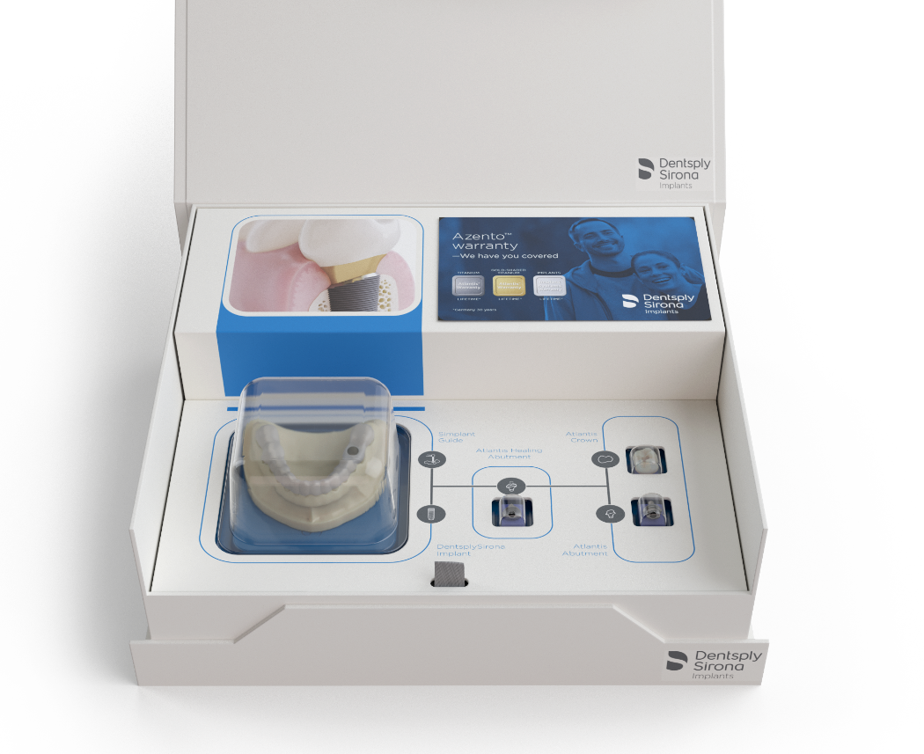
A streamlined custom implant solution
Azento provides dentists the stock and custom products they need to perform a single tooth implant placement surgery
Surgical and restorative planning service
Implant
Xive® or
Astra Tech Implant System®
Surgical guide
Atlantis® healing abutment
Drills and instruments needed for the case
Atlantis® temporary restoration*
*=optional

Slide 4
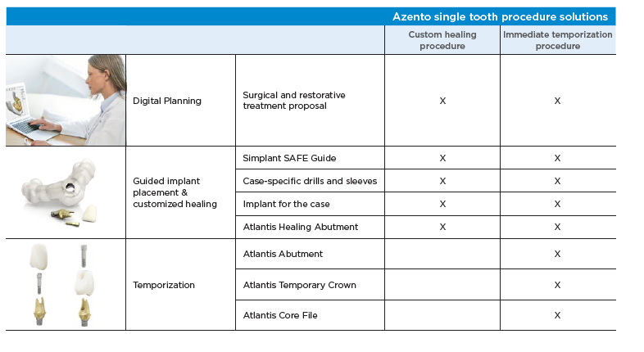
Azento Single tooth replacement Configurations

Slide 5
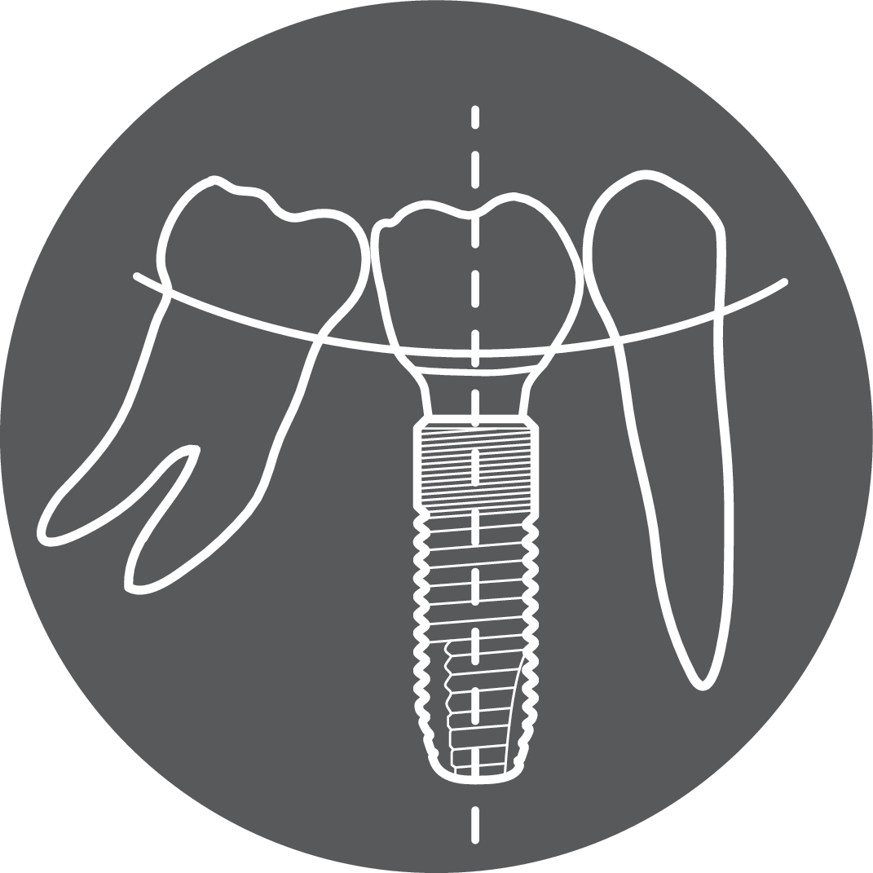
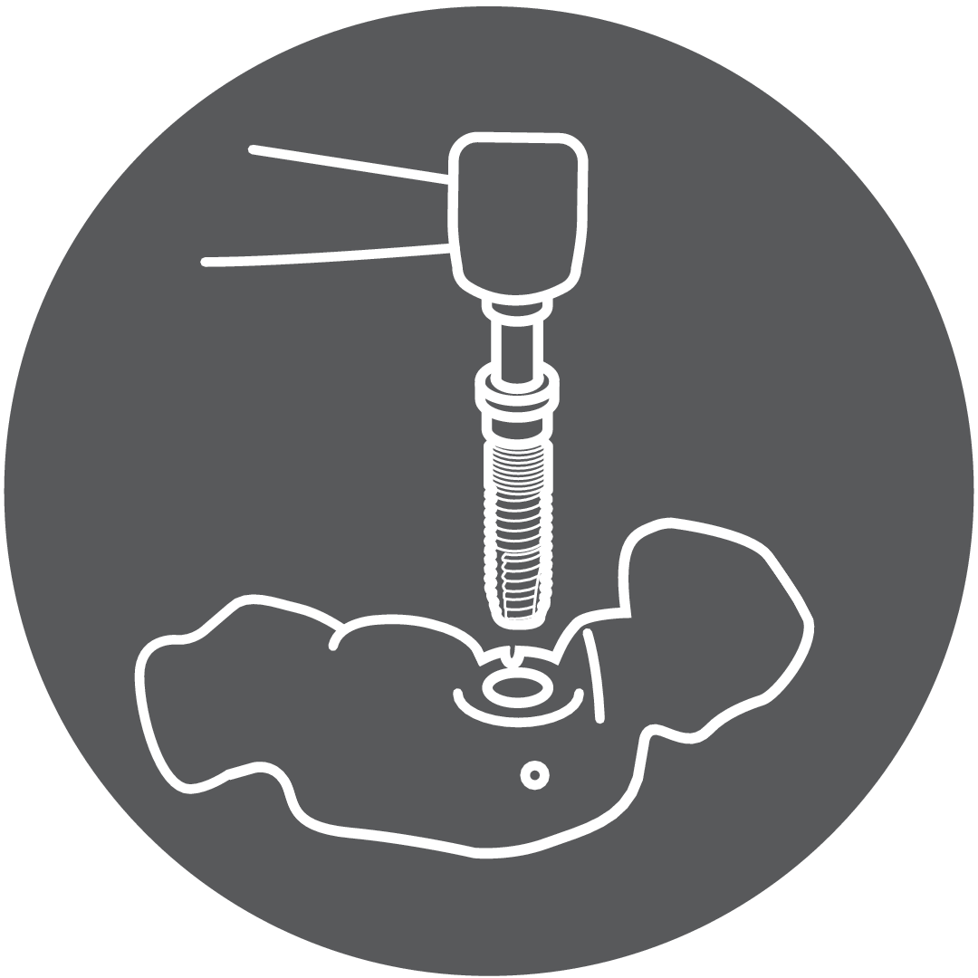
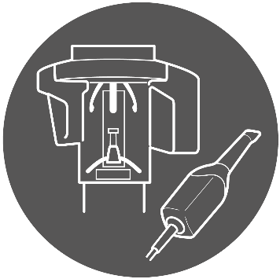
The conventional workflow
Data capture
Surgical planning
Surgical ordering and manufacturing
Guided surgery
Custom healing design and manufacturing
Place provisional
The Azento workflow
Scan and upload
Confirm surgical and restorative planning
Treat

Slide 6
The Azento workflow
Scan and upload
Confirm surgical and restorative planning
Treat

Slide 7
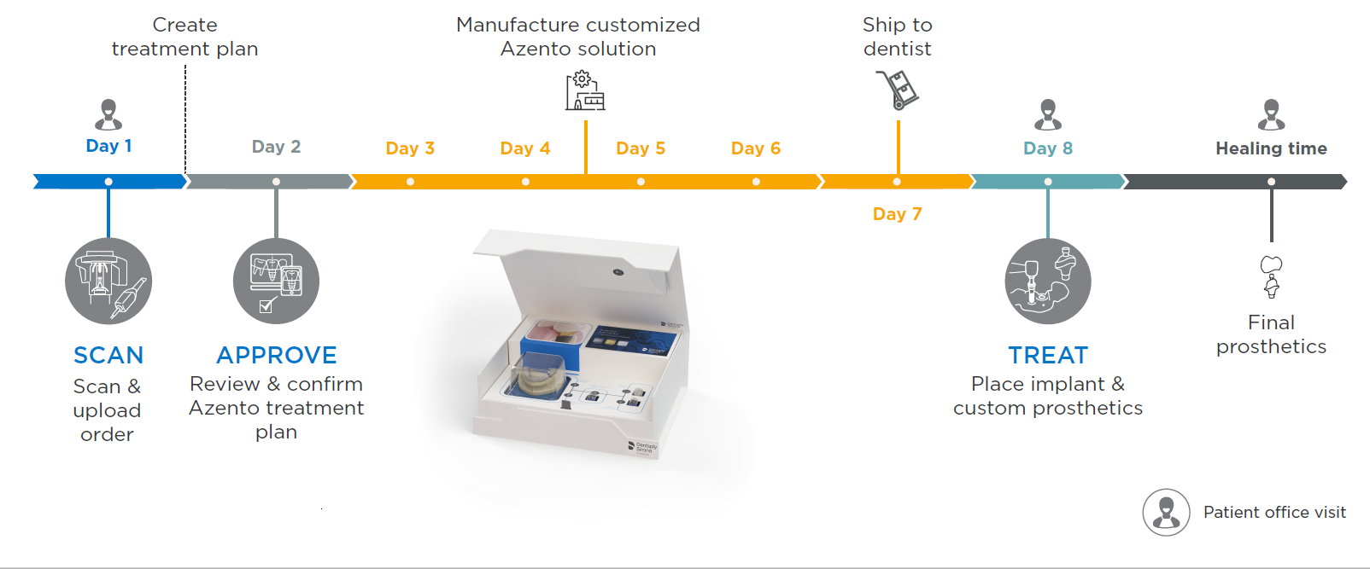
Process timeline

Slide 8
Streamlines digital implant planning, purchasing and delivery,
from imaging to restoration
Start-to-finish custom solution
Easy ordering and case management
Significantly reduce workflow steps
Save time and money

Slide 9
Increased clinical predictability
Designed to help dentists provide the optimal implant, position, healing environment, and restoration for every case
Prosthetically-driven custom treatment plan based on CBCT and intraoral scan
Custom healing abutments contour the emergence profile enabling an esthetic final result
Reduced risk for complications

Slide 10
Reduced risk for complications through:
Precise implant selection and positioning
Fully guided surgical solution
Sharp drills every time
Customized healing abutment

Slide 11
The patient experience
Reduce patient visits and chair time, potentially improving case acceptance rate
Atlantis healing abutment, Atlantis abutment and temporary restorations assist in contouring the emergence profile
From consultation to surgery, in as few as 8 business days (subject to dentist’s approval of treatment plan)
Single-visit surgical and provisional solution

Slide 12
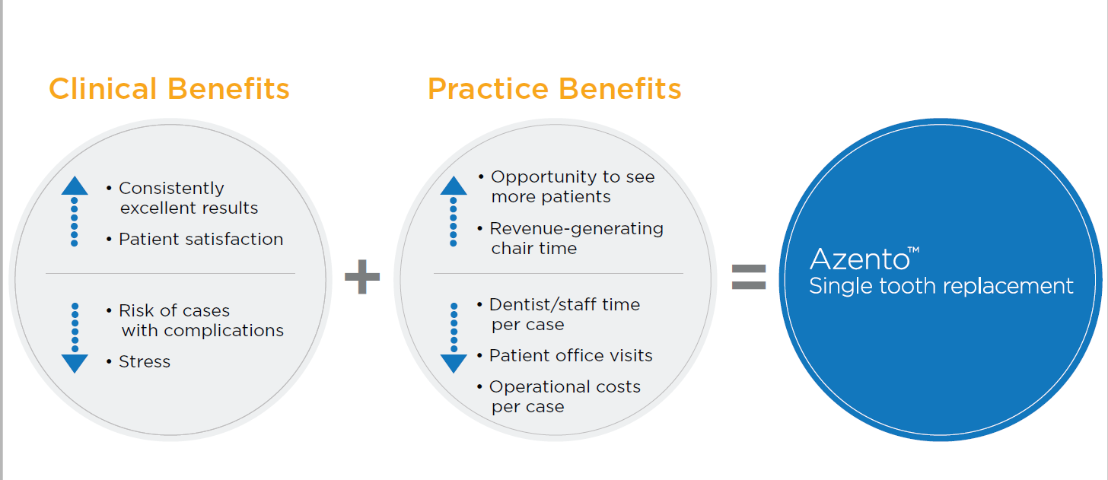
The value of Azento

Slide 13
Time savings
Workflow from D.G. Butterman DDS

Slide 14
Time savings

Slide 15
Azento
Step by step

Slide 16
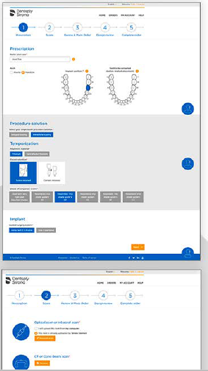
Azento ordering portal
The case management portal is intuitive and efficient with quick and simple submission of scans
Reduces the need for costly inventory
Dentists approve or modify the recommended treatment plan, position and size of implant, and restorative solution
Process can be customized to accomodate practice preferences for final restoration using outside lab or chairside milling

Slide 17
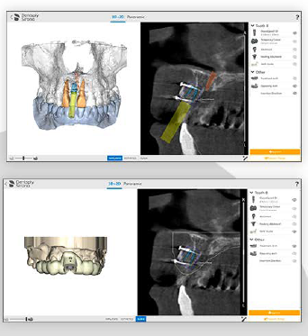
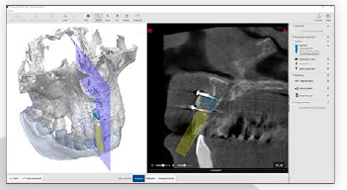
My Simplant planning service
Azento:
merges the CBCT and intraoral scan data
provides the surgical and restorative planning service
return the plan within 24 hours for the dentist’s review and approval

Slide 18
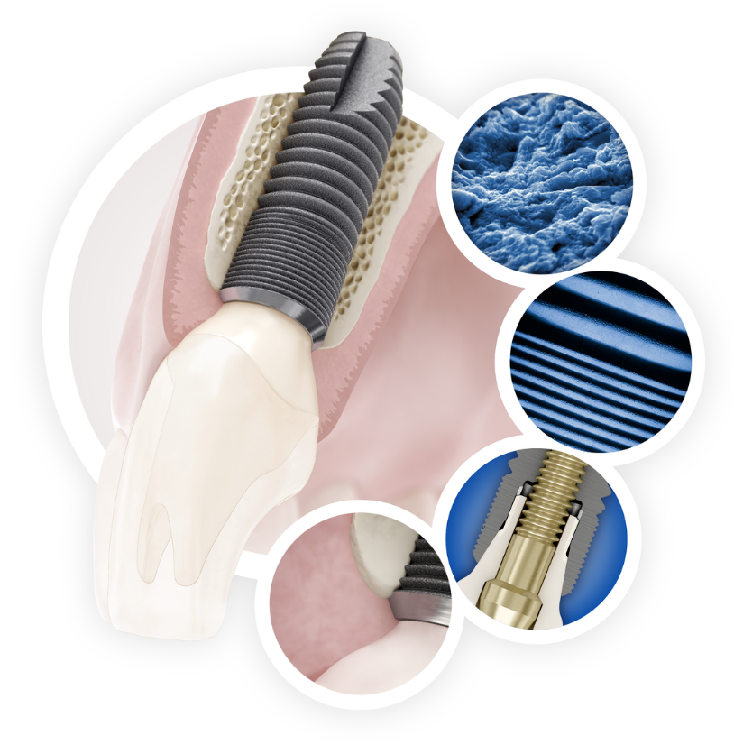
Astra Tech Implant System BioManagement Complex®
OsseoSpeed®
MicroThread®
Conical Seal Design™
Connective contour™
Notes:
The foundation for Astra Tech Implant System EV is the unique Astra Tech Implant System BioManagement Complex, well-documented for its long-term marginal bone maintenance and esthetic results.

Slide 19
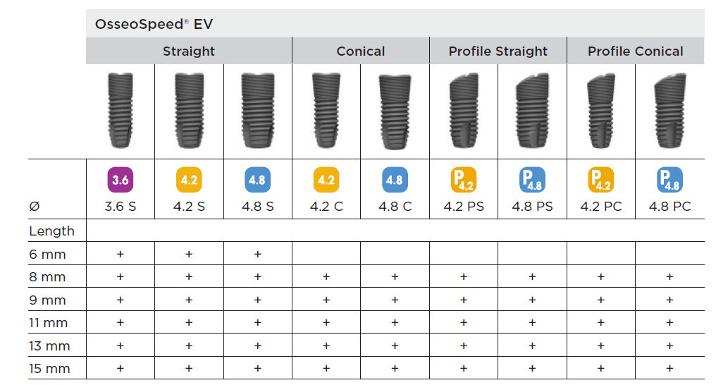
Astra Tech Implant System EV Implants supported by Azento:

Slide 20
Astra Tech Implant System EV Start up kit
Guided Surgery instruments
Five implant drivers
An implant driver extender
Torque Wrench EV, surgical handle driver and hex screwdriver
Cover screws
Small Tray EV, Surgical
Small Tray EV, Storage
Restorative instruments
Torque Wrench OsseoSpeed EV and a restorative Driver handle
Hex Driver OsseoSpeed EV Machine, Intermediate
Hex Driver OsseoSpeed EV Manual 31 mm
Atlantis screws for each OsseoSpeed EV implant diameter
Atlantis IO FLO supporting all implants (scanbody for final restoration)

Slide 21
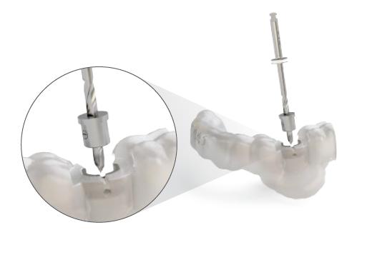
Guided surgery with the Simplant SAFE Guide
Sleeve-on-Drill concept
Simplant SAFE Guide with optional lateral opening
Markings on the implant driver to ensure the correct indexing of the implant

Slide 22
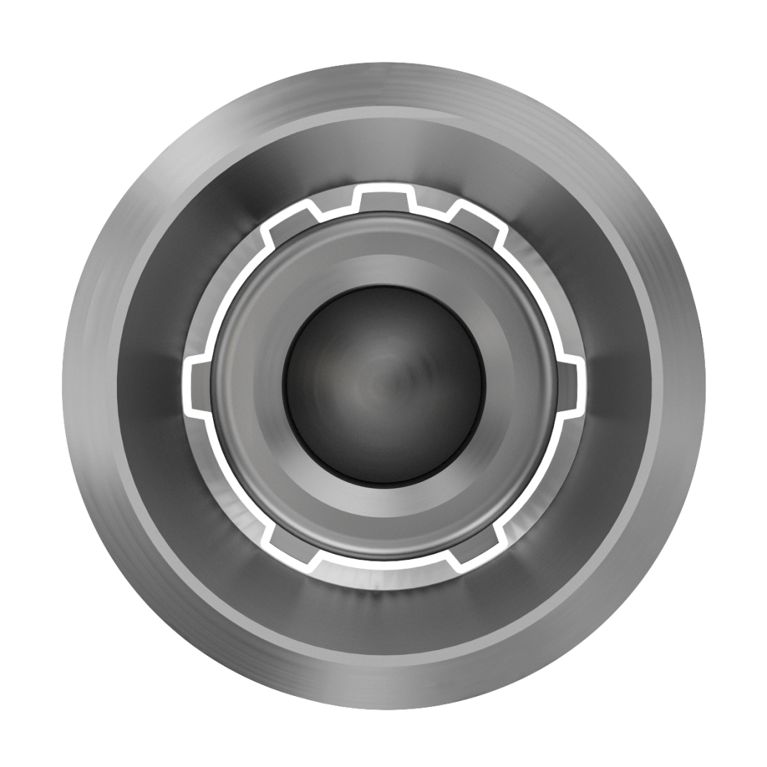
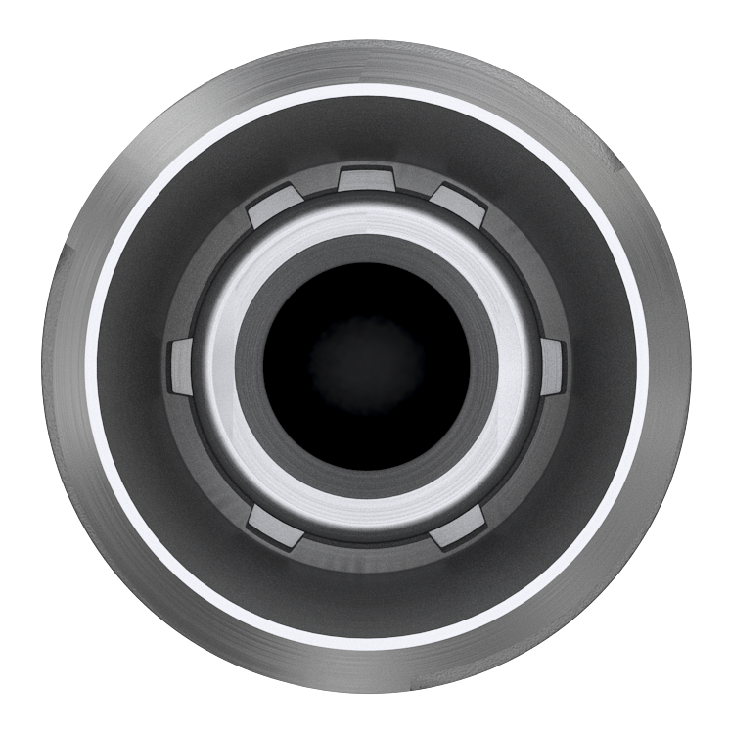
Restoration
One-position-only
Atlantis patient-specific abutments will seat in one position only.
Notes:
The OsseoSpeed EV implant has a unique interface for one-position-only placement of Atlantis patient-specific abutments. The interface also allows for the flexibility of six-position indexing of pre-fabricated abutments, while index-free abutments can be seated in any rotational position.
Abutment placement option
One-position-only
Atlantis patient-specific abutments will seat in one position only.
Six positions
Indexed abutments will seat in six available positions.
Index free
Index free abutments will be seated in any rotational position.

Slide 23
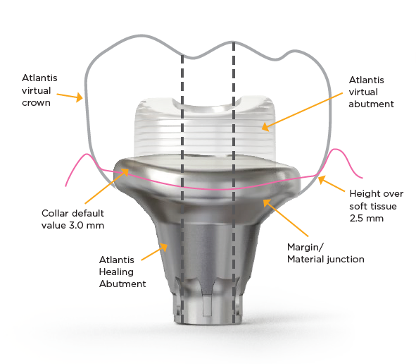
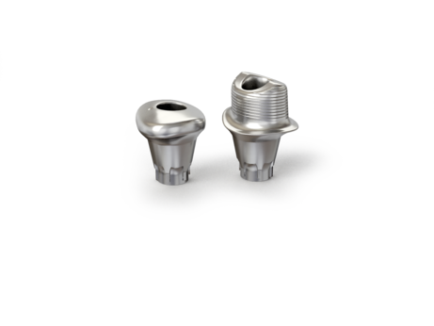
Atlantis® Healing Abutment

Slide 24
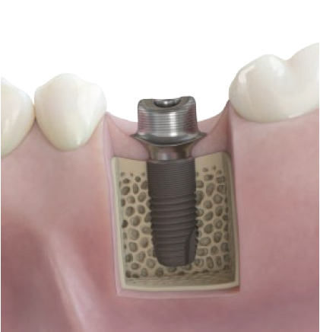
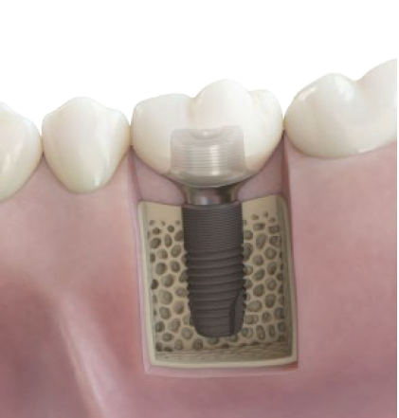
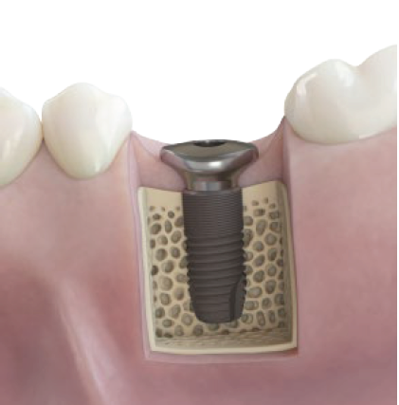
Atlantis® Healing Abutment
Atlantis® CustomBase solution – Astra Tech Implant System
Atlantis Healing Abutment
Atlantis Abutment
Final restoration based on same design

Slide 25
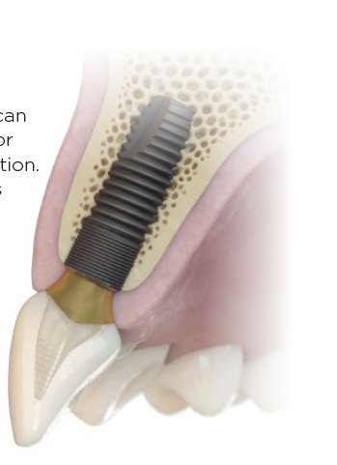
Atlantis® abutment and temporary crown (optional)
Immediate temporization solution for esthetic zone cases where a temporary crown is needed
Screw-retained
Cement-retained

Slide 26
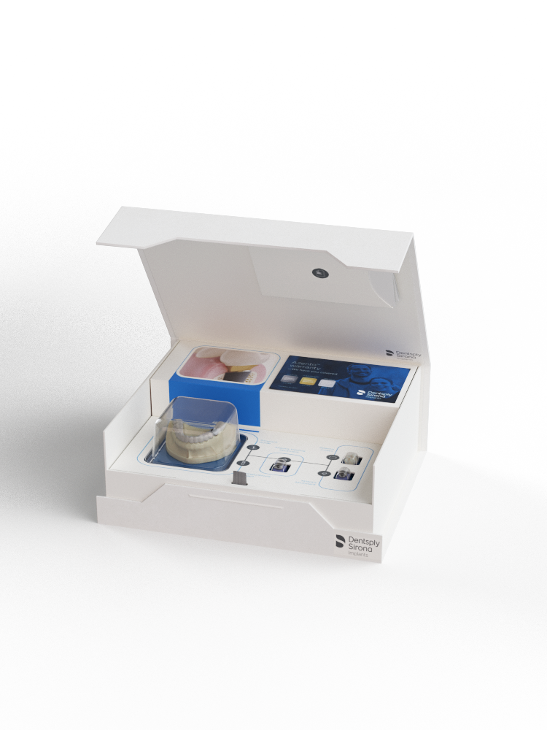
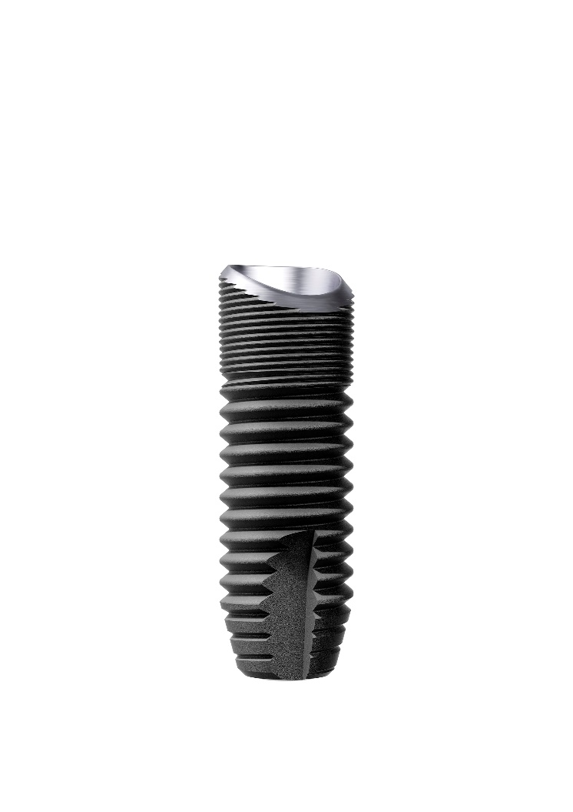
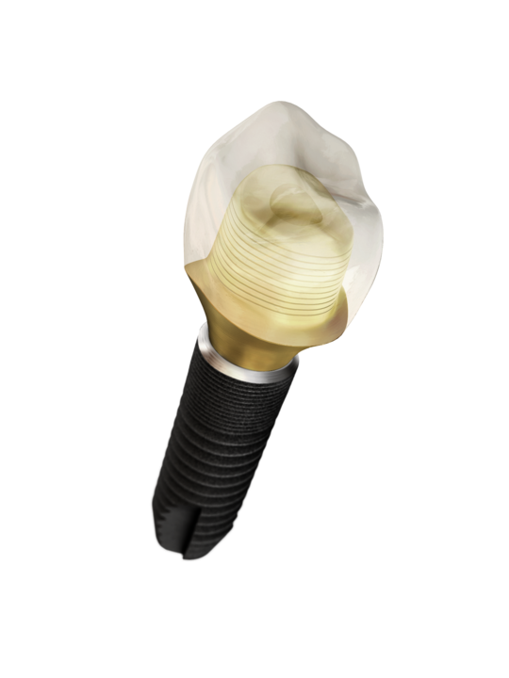
Images

