Slide 1
Primescan

Slide 2
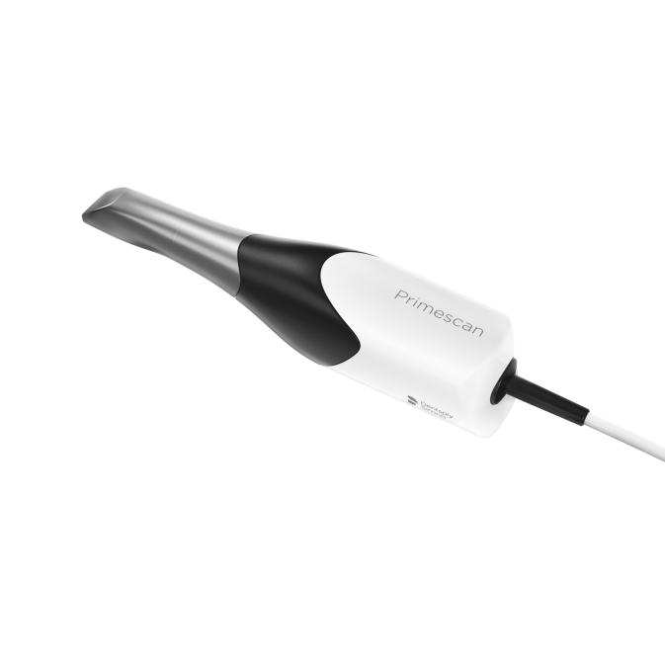
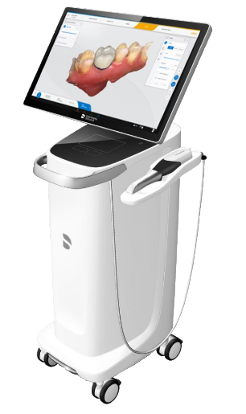
Primescan

Slide 3
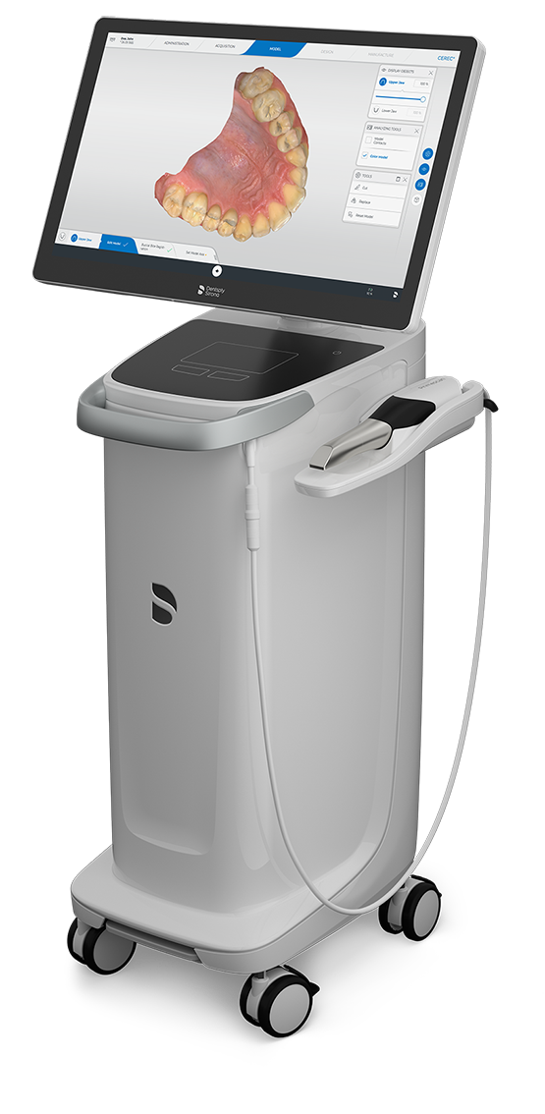

Slide 6
Primescan camera

Slide 9
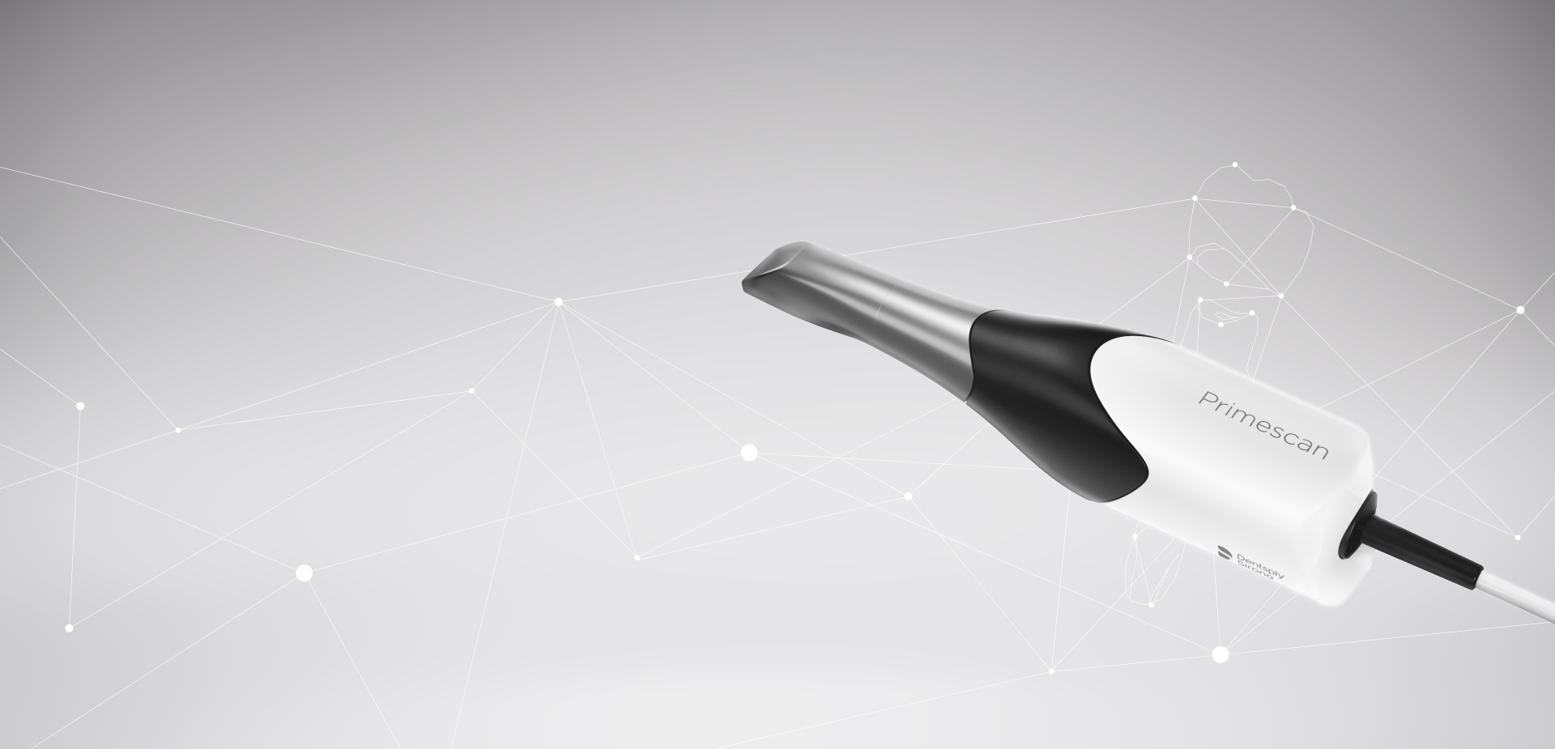

Slide 10
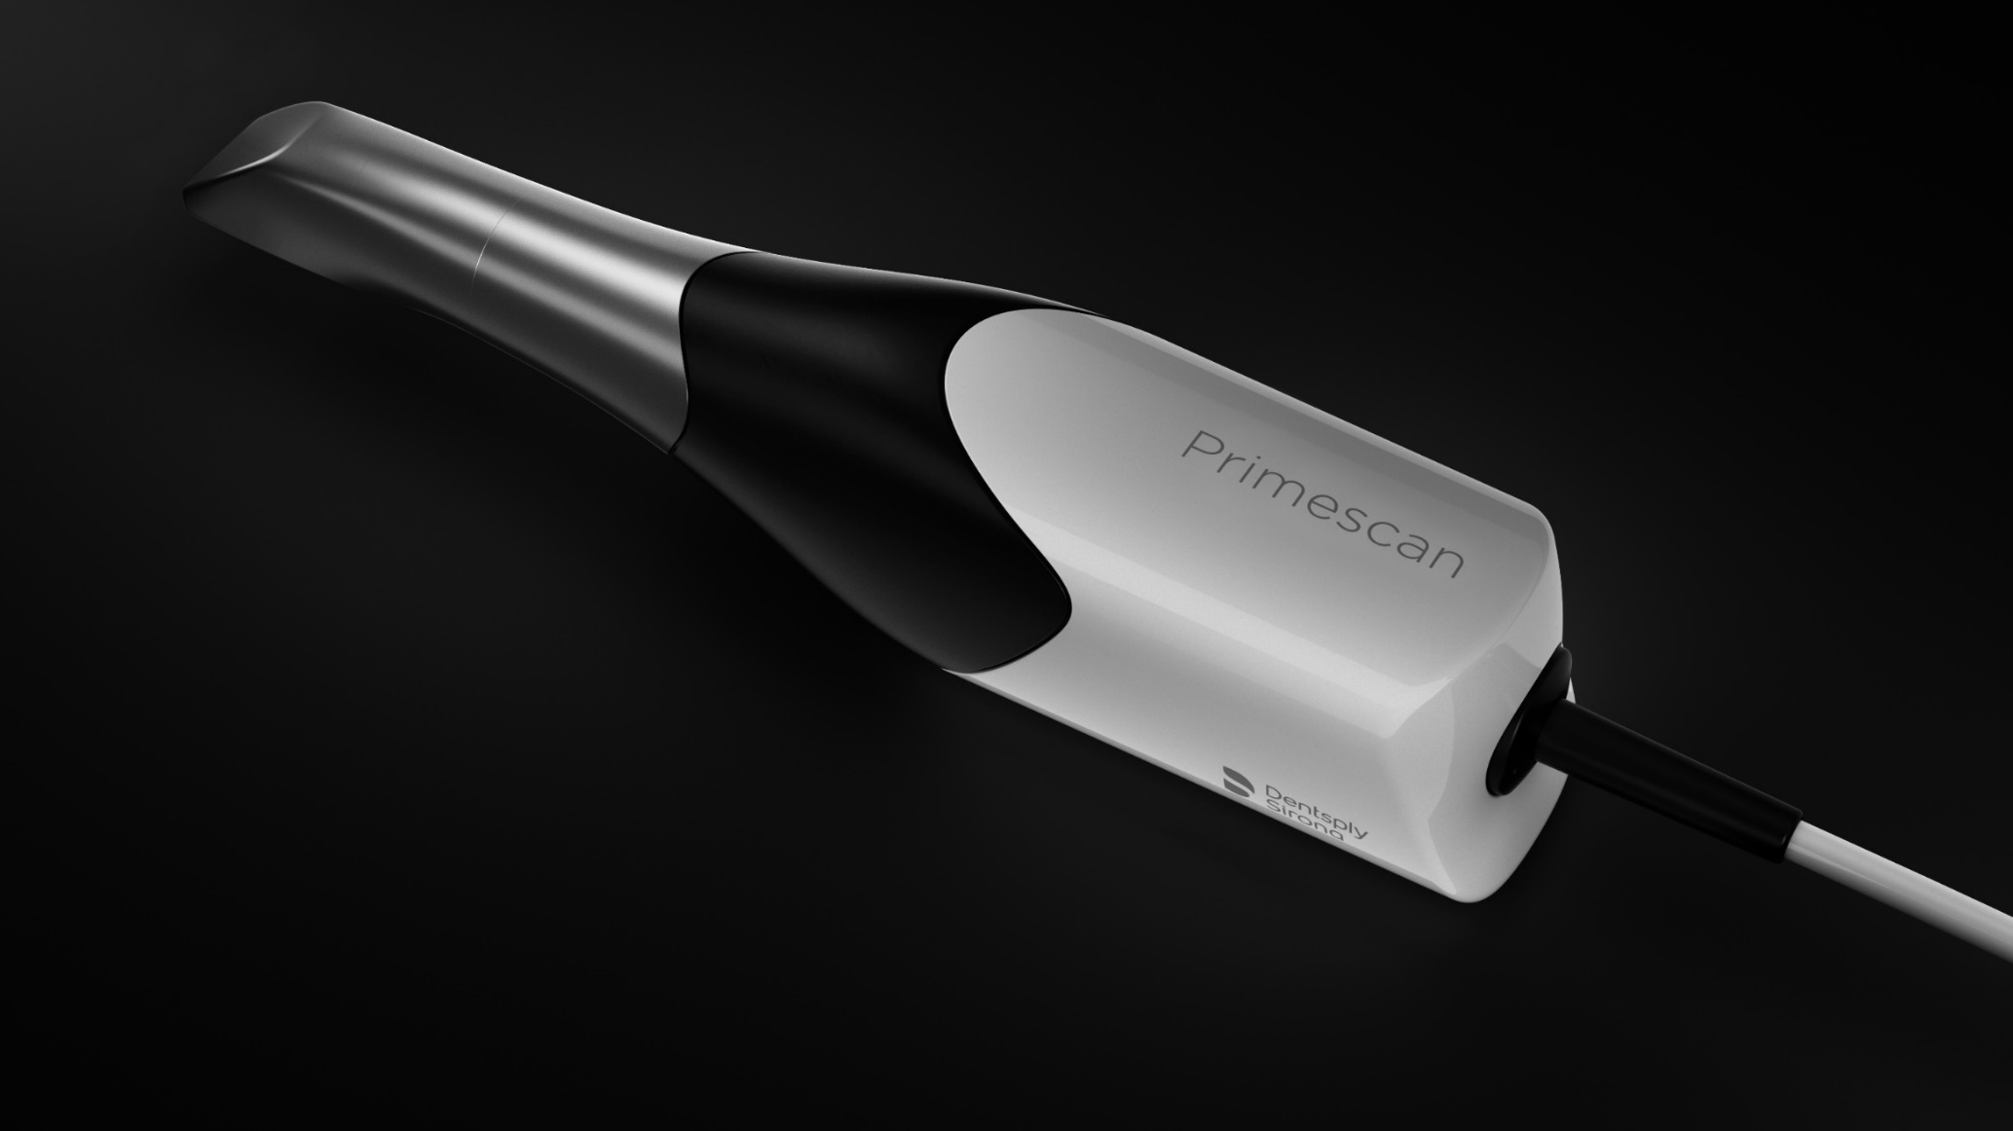

Slide 12
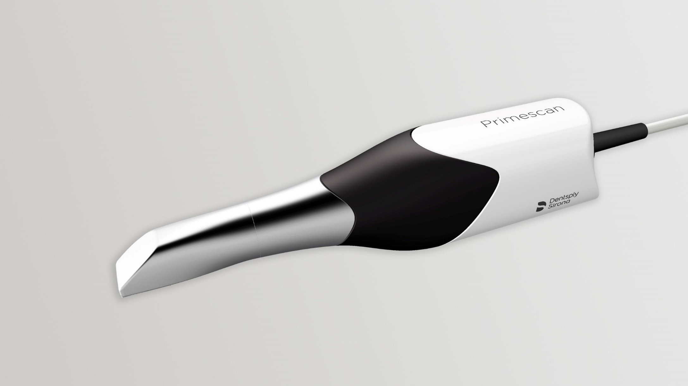

Slide 13
Primescan is the enabler for efficient digital workflows

Slide 14
Software screenshots

Slide 15
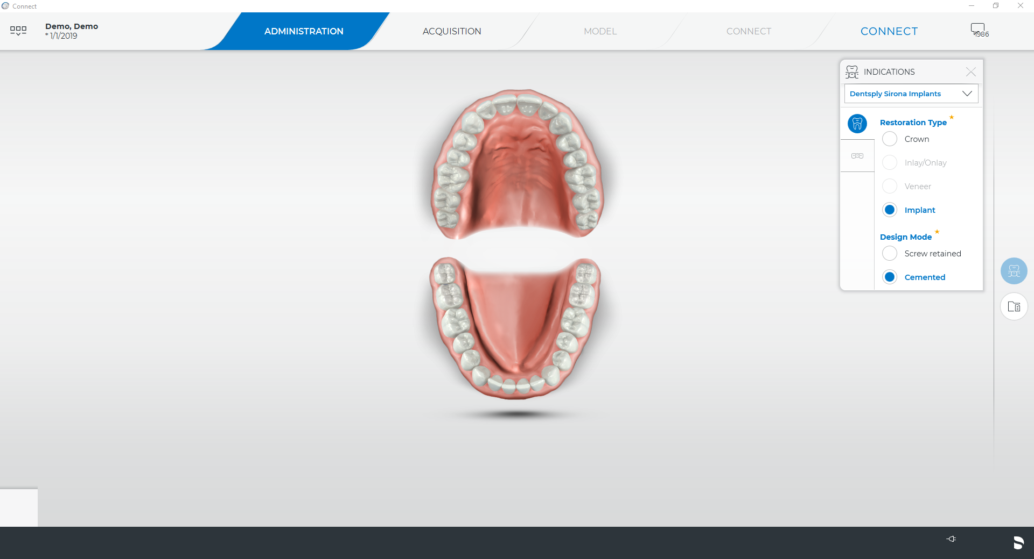

Slide 16
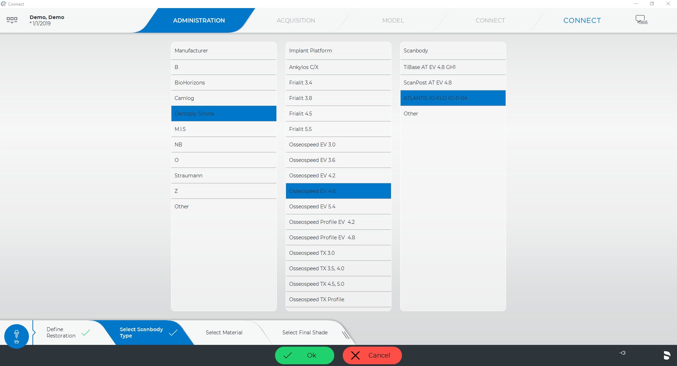

Slide 17
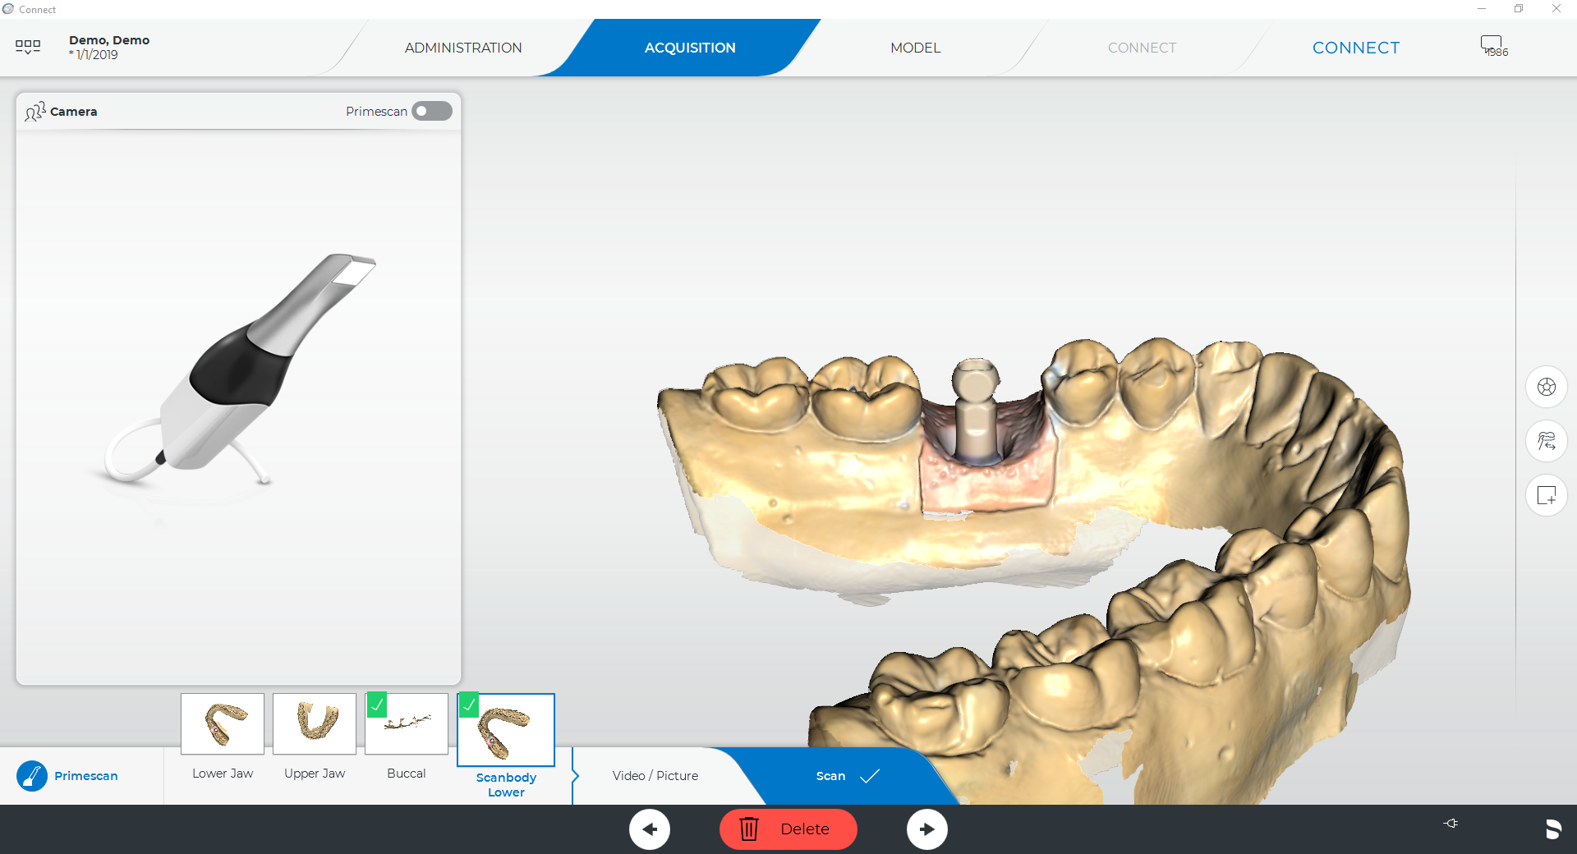

Slide 18
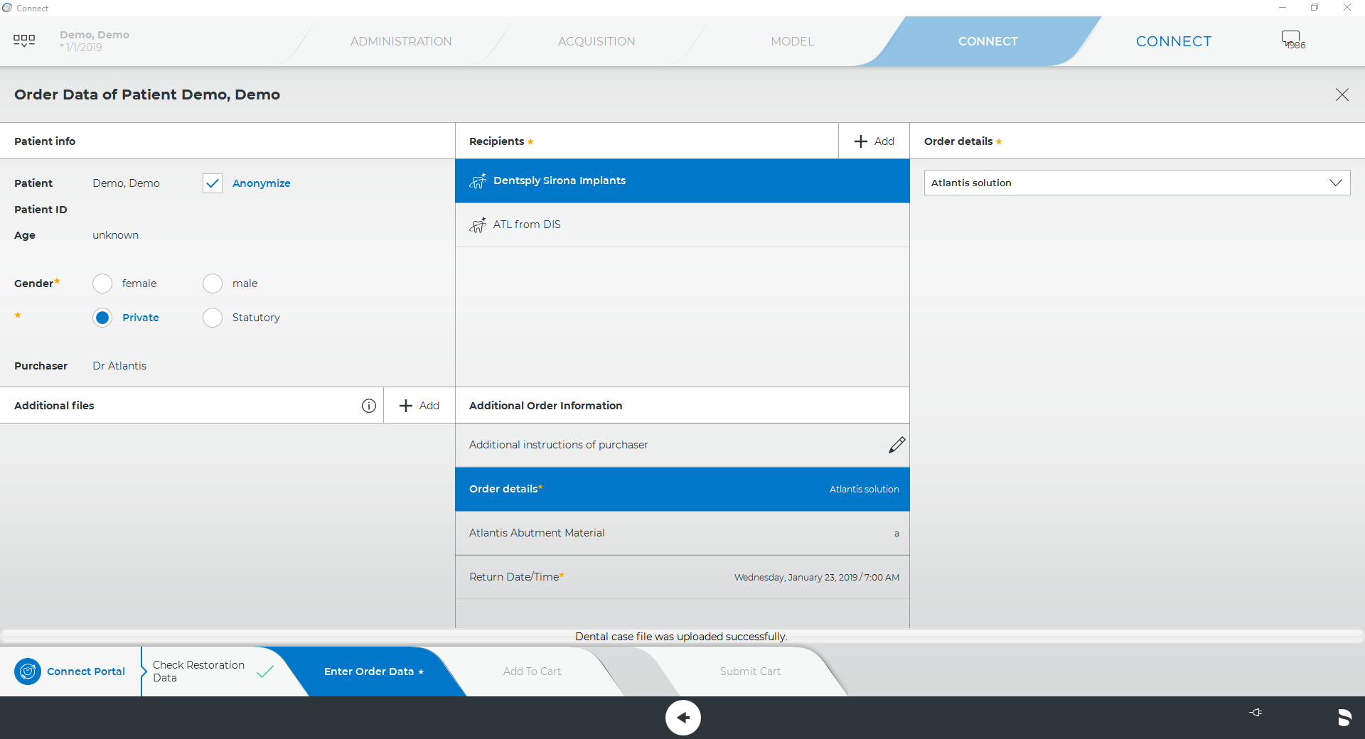
Notes:
Connect Case Center (new name for Sirona Connect Portal)

Slide 19
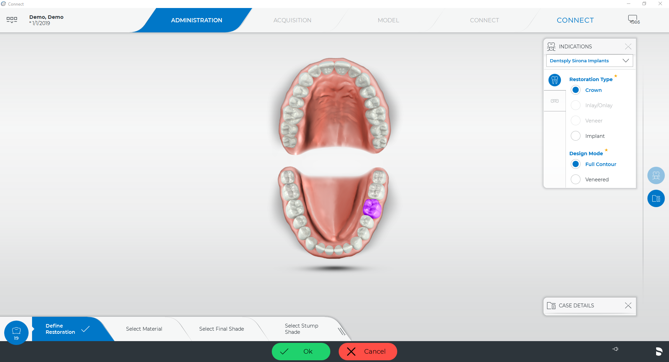

Slide 20
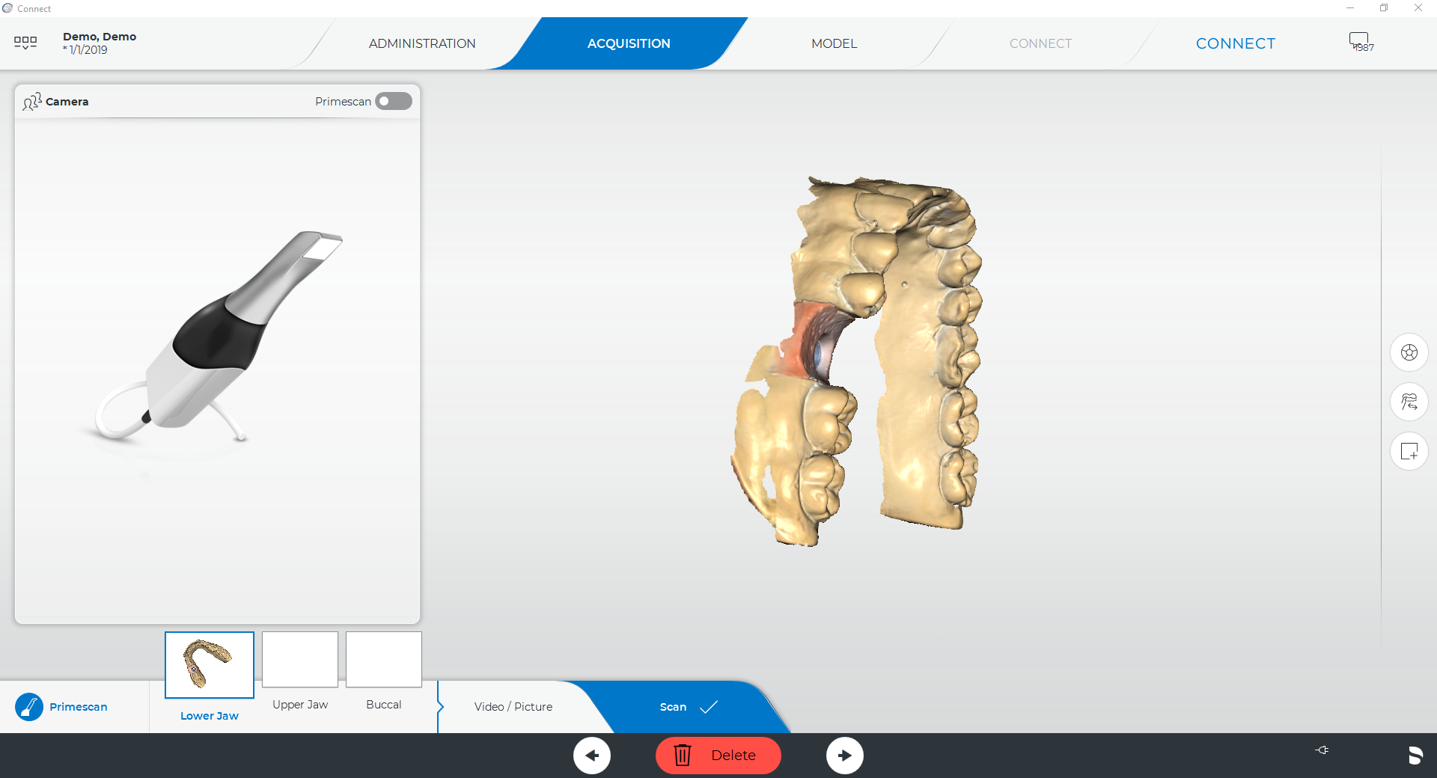

Slide 21
Notes:
Connect Case Center (new name for Sirona Connect Portal)

Slide 22
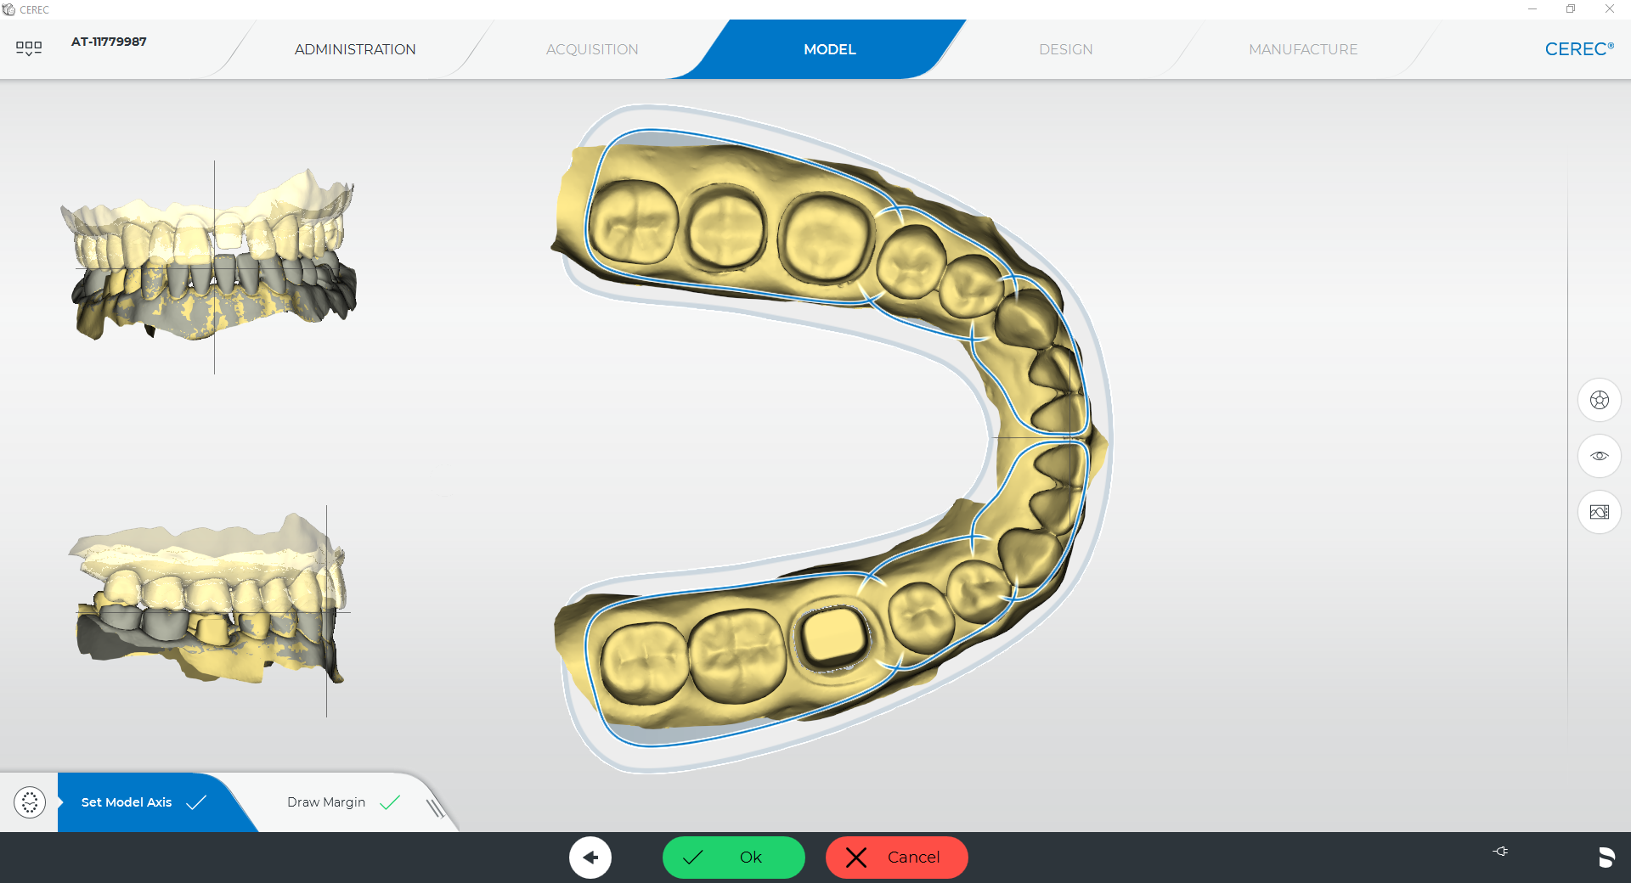
Atlantis® Core File

Slide 23
Chairside

Slide 24
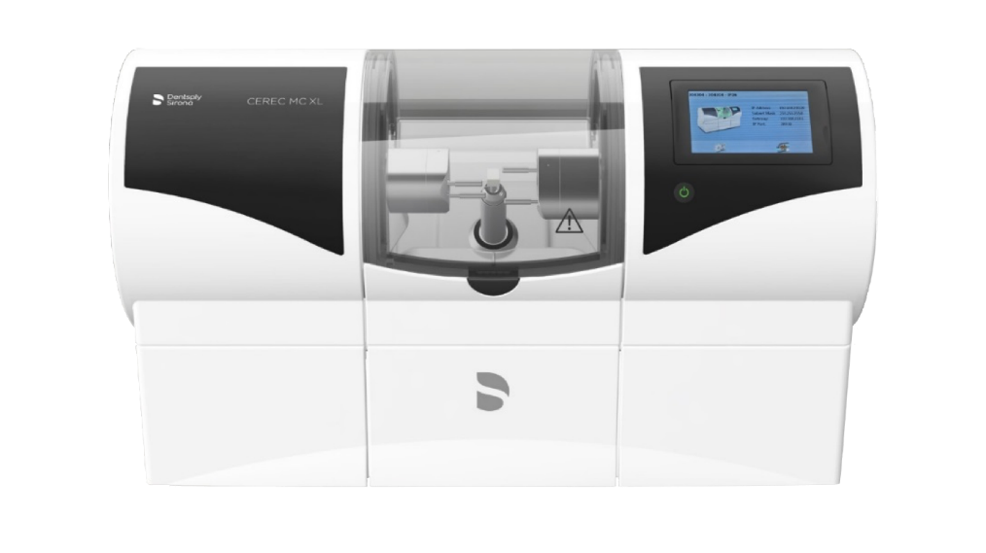
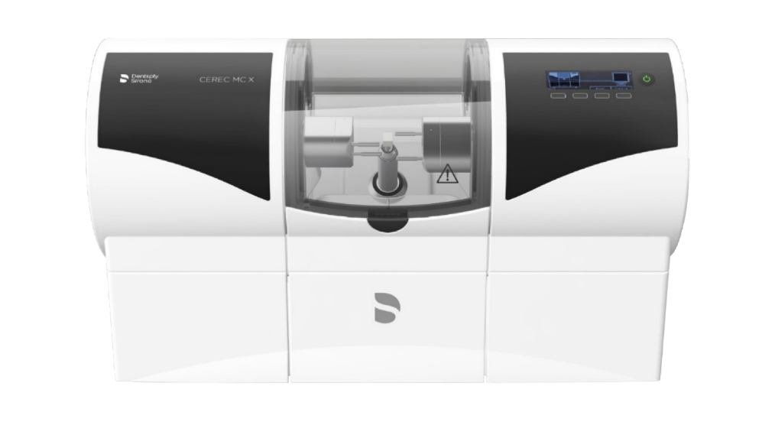
The Chairside family. New MC Family Design

