Slide 1
SmartFix® concept
Product presentation
Astra Tech Implant System® EV

Slide 2
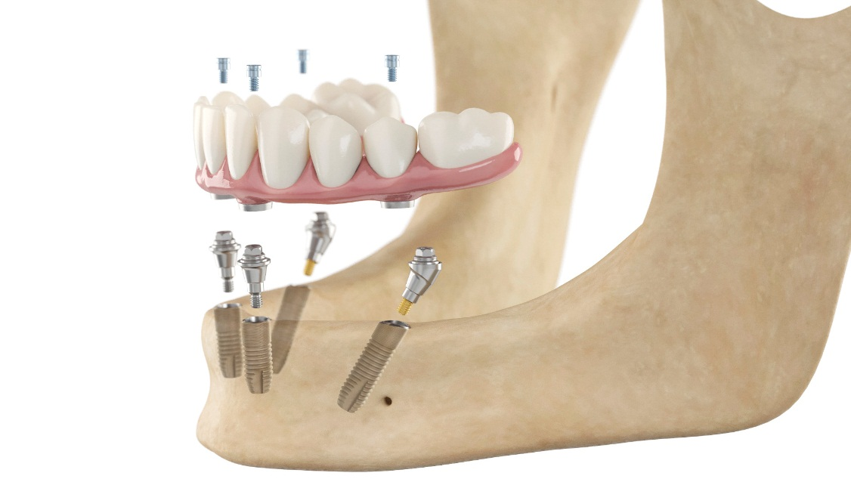
SmartFix® treatment concept
– Edentulous maxilla and /or mandible
One-stage surgery
Splinted implants
Immediate loading
Four or more implants
Fixed temporary restoration
Posterior implants tilted in distal direction
Angled abutments to compensate for the distal inclination
Notes:
Immediate results
SmartFix treatment concept allows for a simplified treatment on four or more implants that in most cases can provide the patient with a full-functioning temporization on the day of surgery.

Slide 3

Why SmartFix® concept?
Easier/faster procedures:
  Minimally invasive - avoiding sensitive anatomical structures minimizing the need for grafting or sinus lift
  Patients may prefer avoiding additional surgical procedures,
  time and cost involved
Primary stability / immediate load:
  Increasing patient demand for immediate function
  With splinted implants immediate loading is possible
  in the majority of cases
Notes:
The SmartFix concept enables clinicians to optimize available bone and to avoid anatomical structures by placing the distal implants at an angle whereby complex grafting procedures may be avoided thus reducing overall treatment time as well as the cost and number of visits.
Offering a cost-effective immediate solution can attract new patient groups and also increase patient acceptance.

Slide 4

Why SmartFix® concept?
Financial arguments
Lower cost – more affordable for patients
Potentially fewer visits – time saving
Attracting new patient groups - practice building
Notes:
By offering SmartFix concept you can increase the productivity and profitability of your practice with a standardized procedure and a streamlined workflow

Slide 5
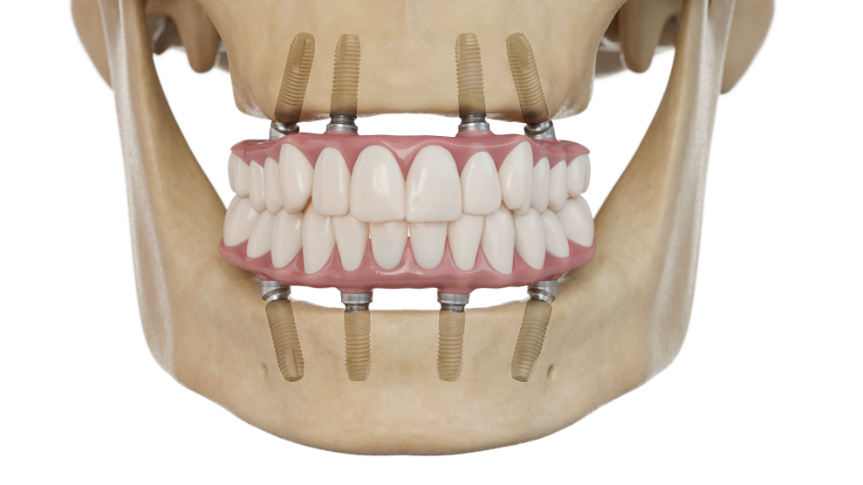
SmartFix® concept – Astra Tech Implant System® EV
Clinical application
  The concept includes a screw-retained, fixed bridge or a bar-supported removable, full arch restoration with a maximum of 12 teeth
  For maxilla and/or mandible
  For immediate, early or delayed loading protocols
  One- or two-stage surgery
  Minimum of four implants, two anterior and two posterior with a distal inclination allowing for a reduction in cantilever length

Slide 6
SmartFix® concept – Astra Tech Implant System® EV
Pre-operative considerations
Both parts of the Multibase EV abutment need to be tightened to 25 Ncm to secure a stable screw joint and pre-load. Thus implants need to be stable enough to withstand this tightening torque if you consider immediate temporization
For tilted posterior implants, plan for the emergence of the screw access hole to be located within the occlusal surfaces of the posterior teeth
Notes:
Both parts of the Multibase EV abutment need to be tightened to 25 Ncm to secure a stable screw joint and pre-load. Thus implants need to be stable enough to withstand this tightening torque if you consider immediate temporization.
If in doubt, healing abutments or even a two stage surgical approach can be an alternative

Slide 7
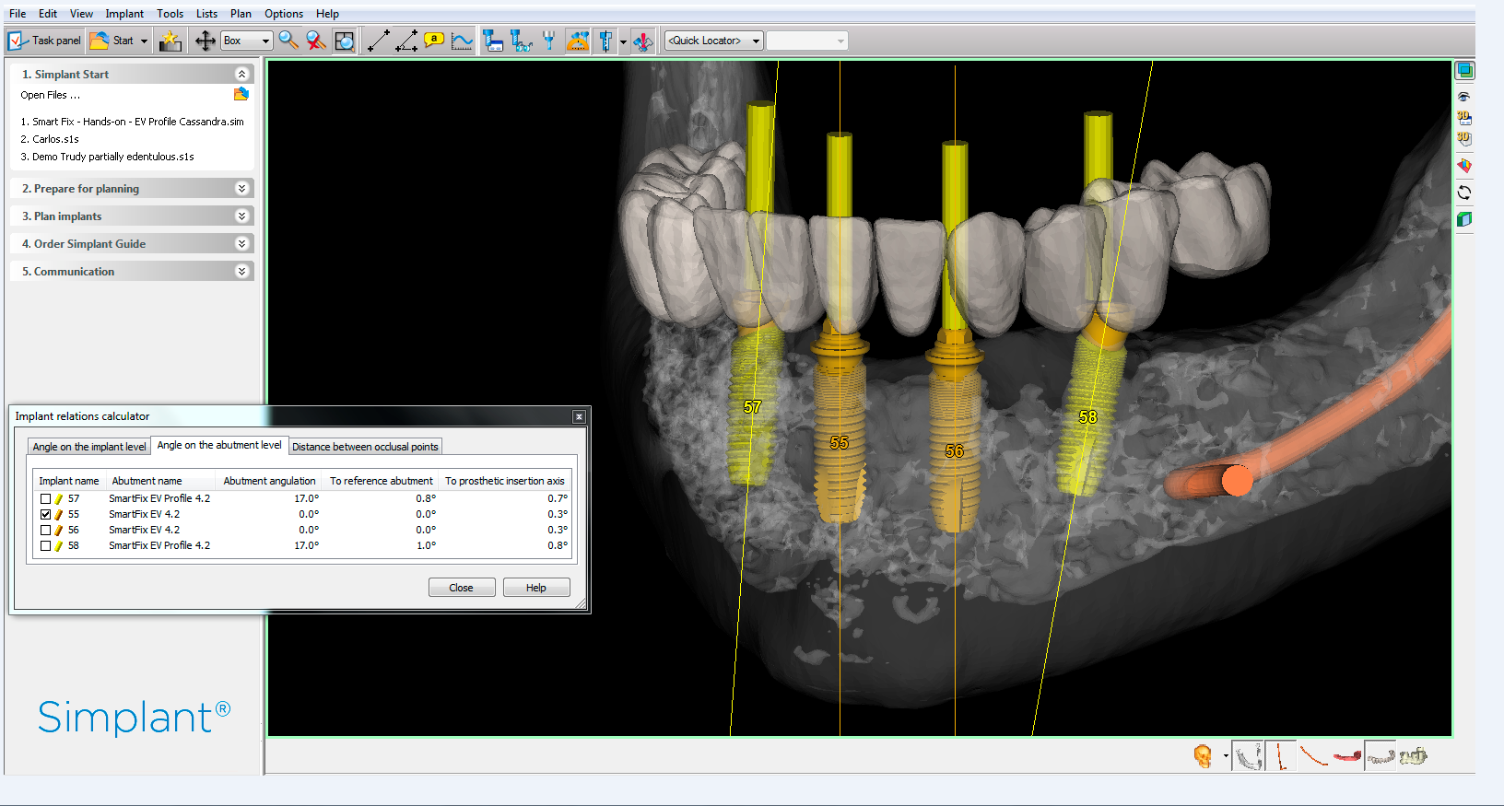
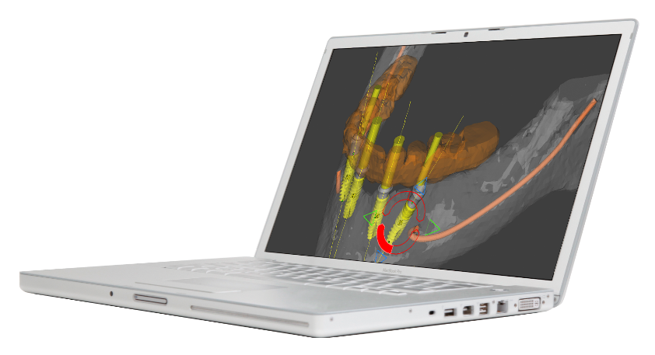
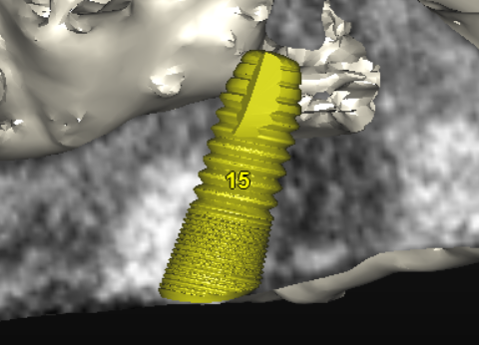
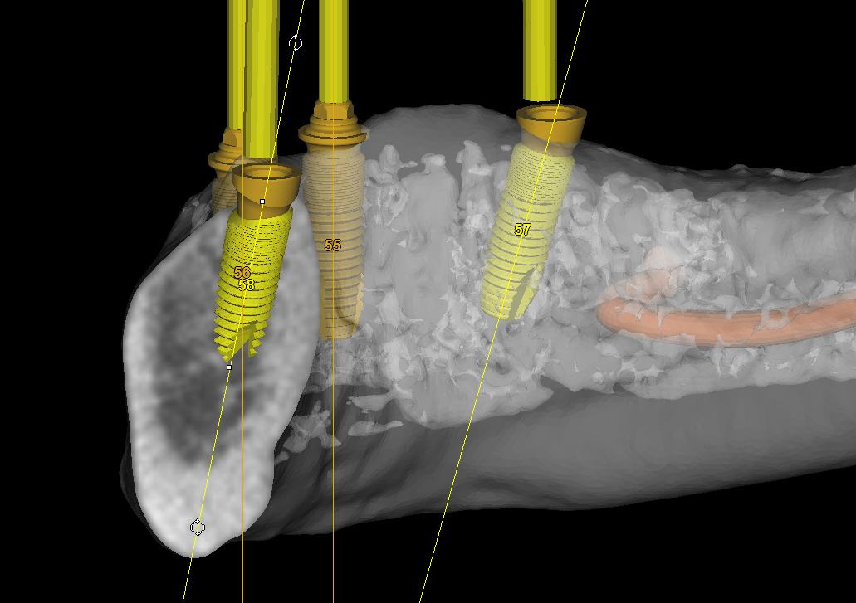
Why choose SmartFix® concept
- Simplant® computer guided implant treatment
Simplant software and surgical guides can be used for the SmartFix concept to ensure accurate planning for optimized implant position and placement
The available implant diameters for Multibase EV abutments and guided surgery are 3.6 / 4.2 / 4.8, and the maximum implant length for use with a Simplant SAFE Guide is 15 mm
Multibase EV abutments (straight, 17° and 30°) can be selected in the Simplant Library
Notes:
Simplant computer guided implant treatment delivers precise implant planning and predictable restorative results.

Slide 8
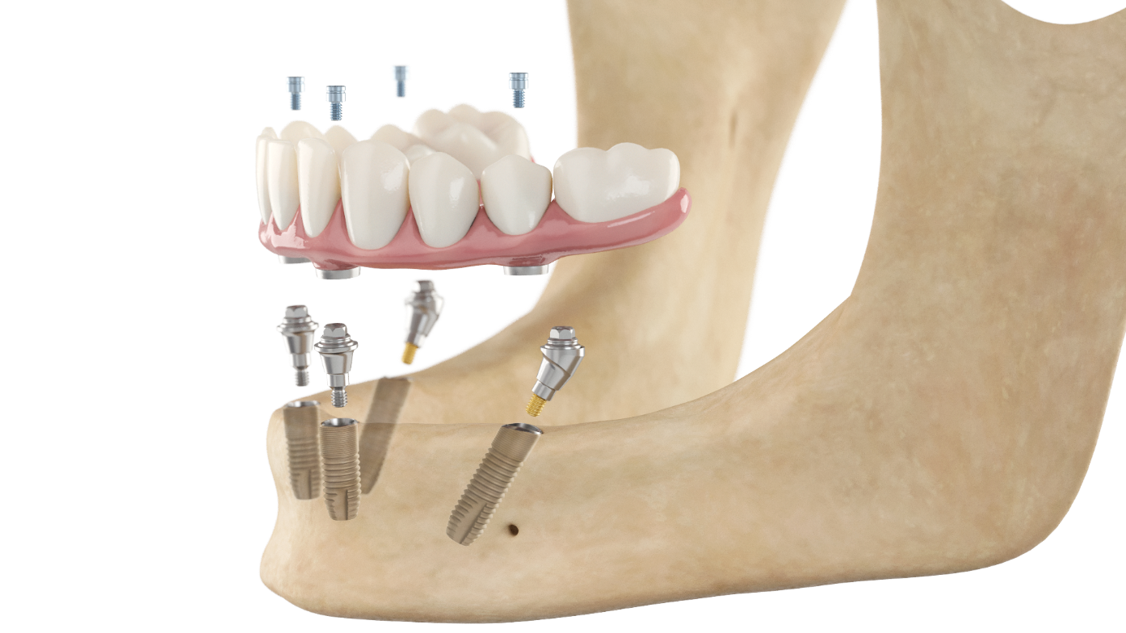
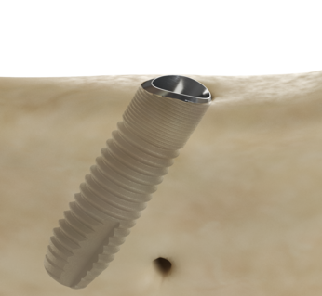
Why choose SmartFix® concept
- Astra Tech Implant System® EV
Maximize marginal bone preservation using OsseoSpeed Profile EV
Placement of the uniquely designed OsseoSpeed Profile EV at an angle can help to eliminate/reduce the need for bone removal at installation
When placing the uniquely designed OsseoSpeed Profile EV implant distally at an angle, the implant can often be aligned flush with the marginal bone, thereby avoiding the occurrence of a partially-submerged implant margin
As a consequence the need for bone reamers is reduced
Note: Only index-free Multibase EV abutments fit OsseoSpeed Profile EV.
Notes:
Tilting the unique OsseoSpeed Profile EV implant means less bone removal at installation through less submerged placement

Slide 9
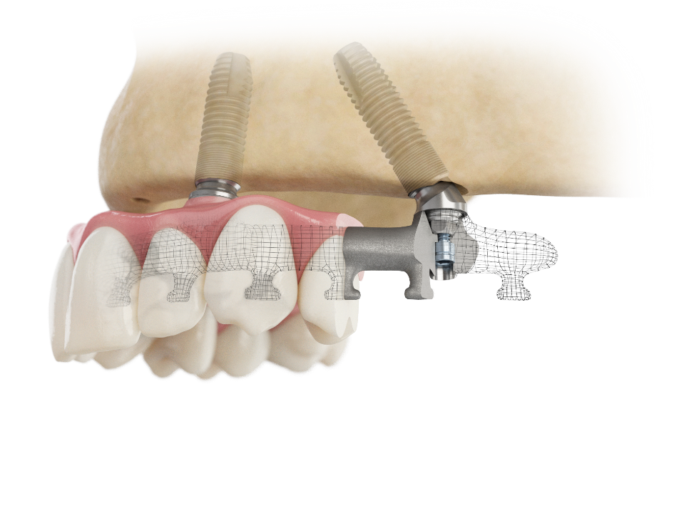
Why choose SmartFix® concept
- Atlantis® patient-specific suprastructures
Screw-retained solutions
Atlantis Bridge and Atlantis Hybrid frameworks for ceramic, composite layering or denture resin
  Optional feature of angulated screw access up to 30 degrees off the implant/abutment axis, for optimal esthetics and function
Notes:
Angling the bridge screw access channel is a unique option of Atlantis suprastructures, promoting ideal esthetics and function as well as simplifying handling during installation and/or removal of the prosthesis
ASA(angulated screw access ) enables for divergence up to 30°
ASA even for the bridge screw

Slide 10
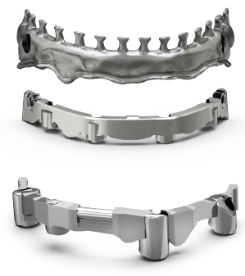
Why choose SmartFix® concept
- Atlantis® patient-specific suprastructures
Friction- and attachment-retained solutions
Atlantis 2in1 in titanium is a primary suprastructure, fixed to implants, and a secondary suprastructure that attaches to the primary using friction and additional retention elements
Atlantis Bar in titanium and cobalt-chrome for removable dentures, using a combination of various attachment options

Slide 11
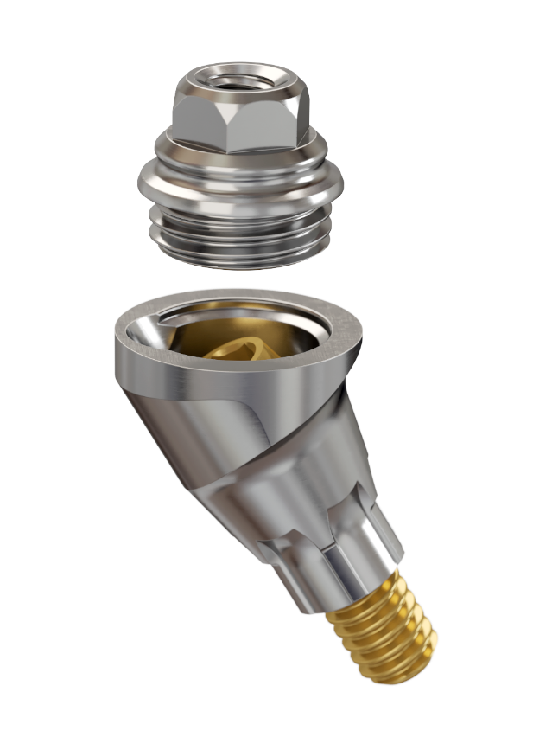
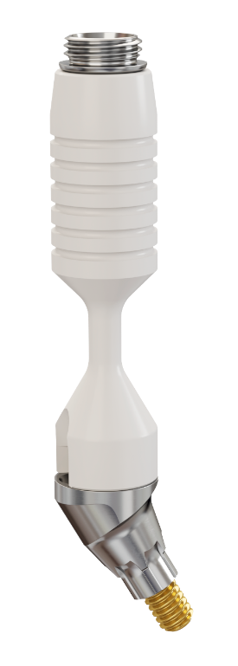
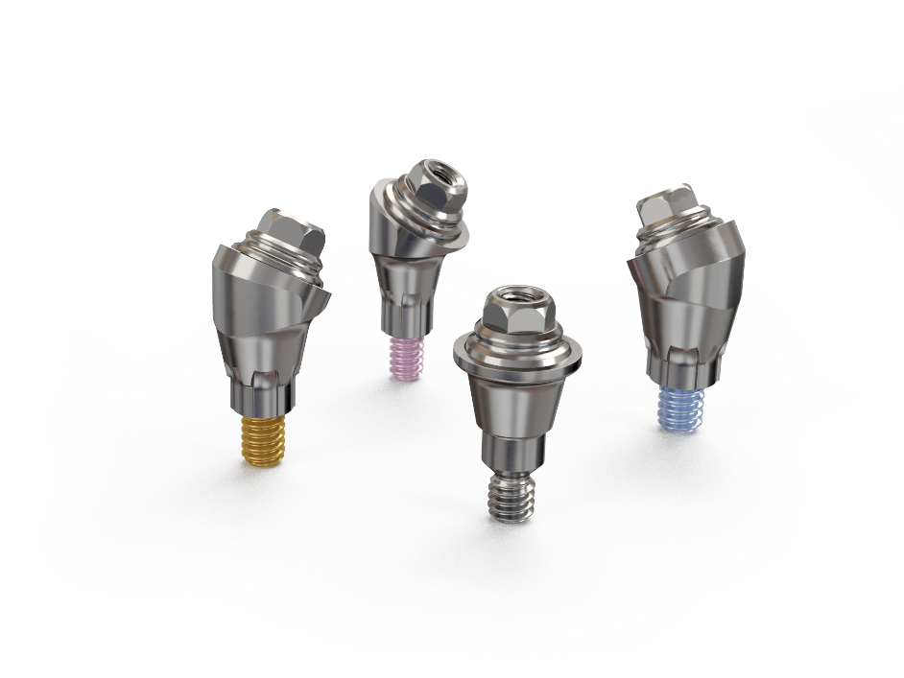
Why choose SmartFix® concept
- Astra Tech Implant System® EV – Restorative versatility
Reduced component height - more inter-arch space for prosthetic design.
Cone taper 21˚ - allows for flexible bridge insertion of non-parallel abutments.
The narrow abutment design reduces the need for bone reaming, thereby simplifying the abutment connection.
One uniform interface for all abutments, simplifying inventory.
The abutment is designed with two pieces, which provides for full wall strength and full thread support for bridge screw.
Straight, 17˚ and 30˚, indexed and index-free, in different gingival heights are ideal for handling challenging clinical situations.
Fitting 3.6, 4.2 and 4.8 OsseoSpeed EV and OsseoSpeed Profile EV implant diameters.
The short and flexible holder allows for easy seating of Multibase EV abutments even when space is limited

Slide 12
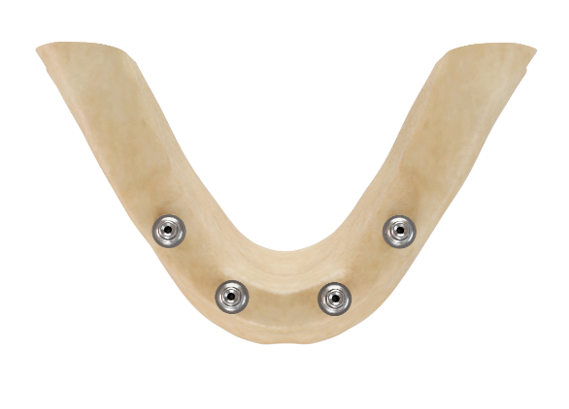
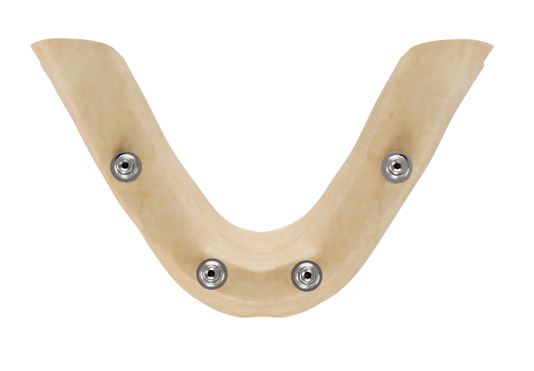
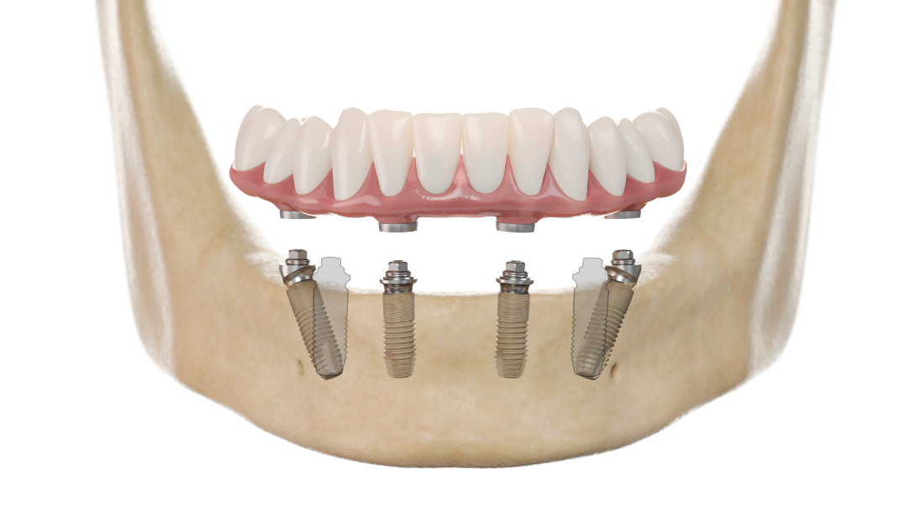


Anterior/Posterior implant distribution
The tilted posterior implants reduce cantilevers and improve prosthetic support by increasing
the anterior/posterior spread and allows for a 12-unit restoration.
Notes:
By placing two posterior implants at an angle, longer implants can be used adjacent to areas of otherwise anatomically compromised bone volume such as close to the mental foramen or the maxillary antrum, increasing bone-to-implant contact and reducing the need for vertical bone augmentation.
The tilted posterior implants reduce cantilevers and improve prosthetic support by increasing the anterior/posterior spread.

Slide 13
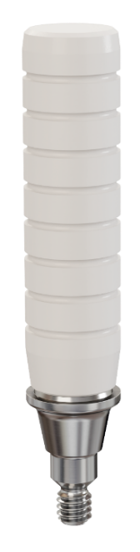

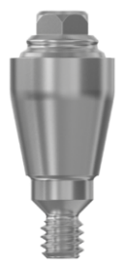
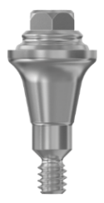
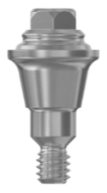
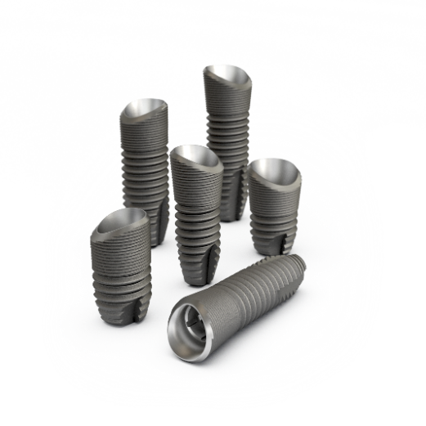
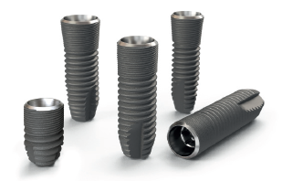
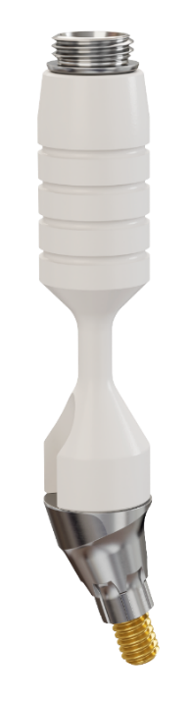




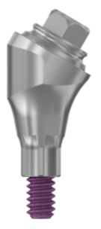
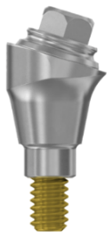
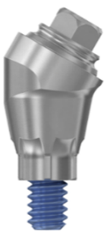
Multibase EV abutments
Implants
Abutments
Multibase EV straight abutment
3 gingival heights (1.5 / 2.5 / 3.5 mm)
Abutment/prosthetic interface: ø4.8 mm
Index-free
1-piece (+ holder)
Multibase EV angled abutments
17˚ and 30˚
2 gingival heights (1.5 / 2.5 mm)
Abutment/prosthetic interface: ø4.8 mm
Index and index-free
3-piece (+ holder)
Note: For OsseoSpeed Profile EV only index-free abutments are available.

Slide 14
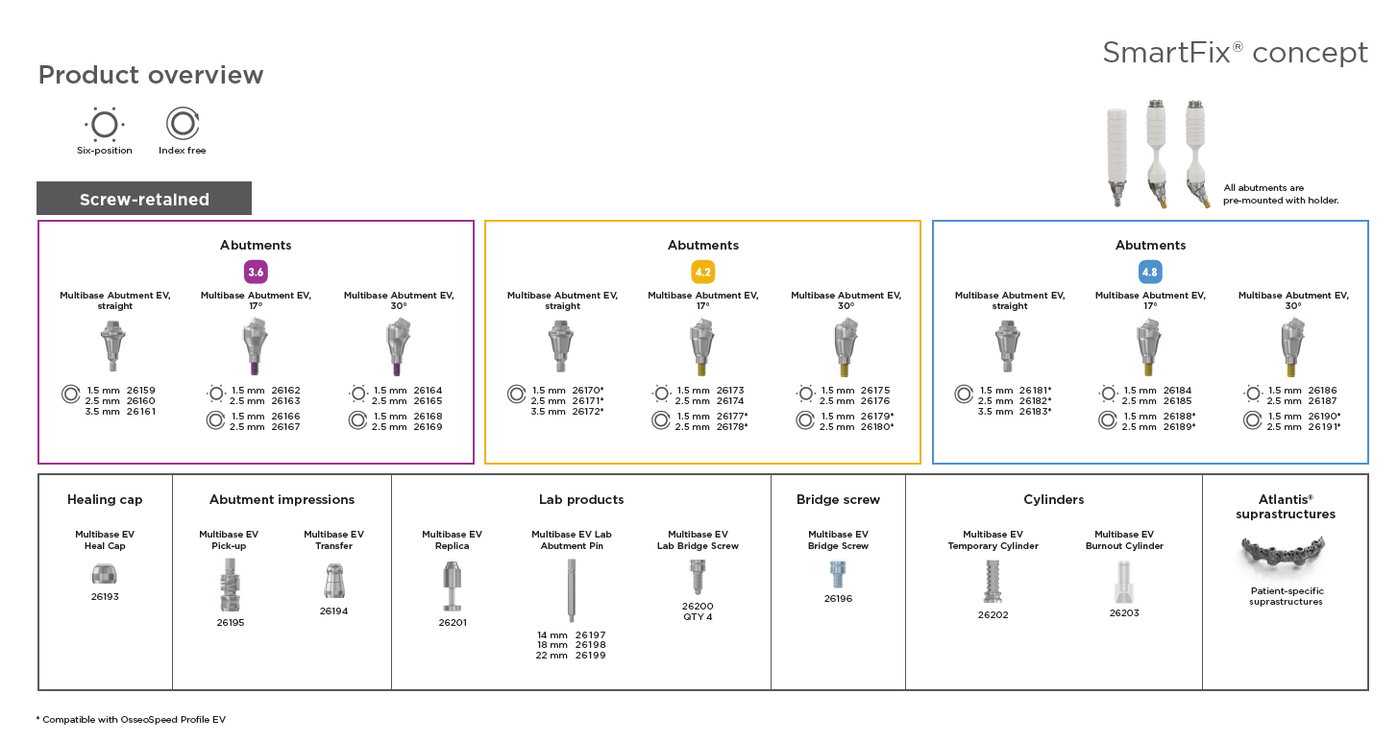

Slide 15
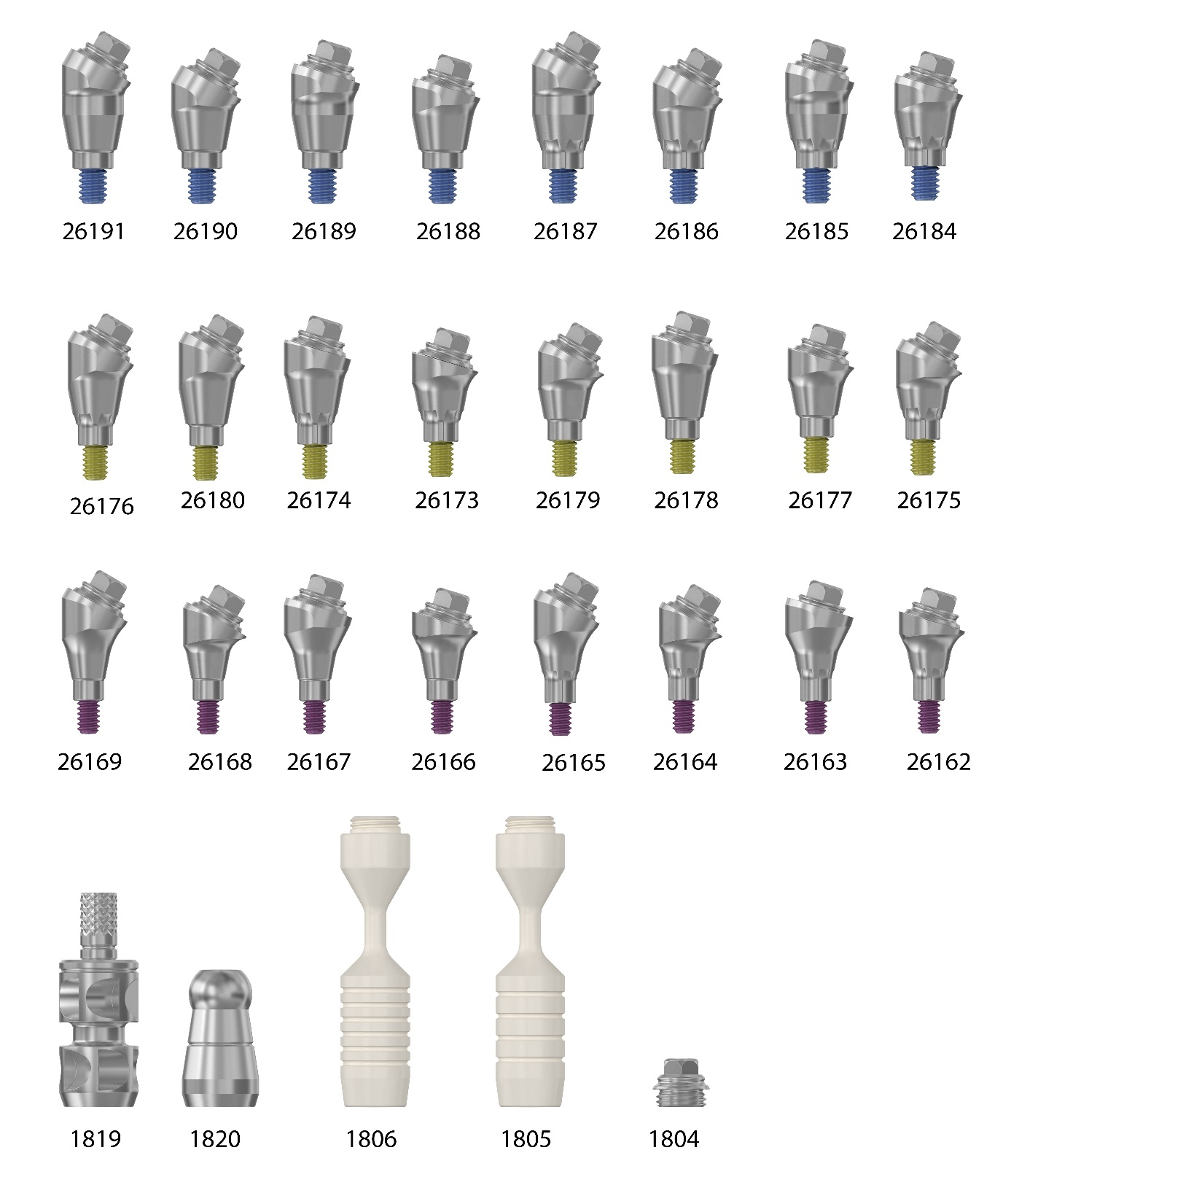

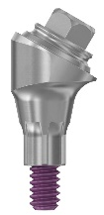



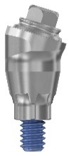

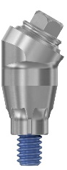
Multibase Abutment EV 17˚and 30˚
17˚
30˚
1.5 mm
2.5 mm
1.5 mm
2.5 mm
Indexed abutments can be seated in six available positions. Not compatible with OsseoSpeed Profile EV
17˚
30˚
Index-free abutments can be seated in any rotational position
1.5 mm
2.5 mm
1.5 mm
2.5 mm
17˚
30˚
1.5 mm
2.5 mm
1.5 mm
2.5 mm
Note: For OsseoSpeed Profile EV only index-free abutments are available.
Notes:
The versatile Multibase EV assortment allows for a wide range of options for the three connection sizes, 3.6, 4.2 and 4.8 respectively.
Multibase Abutment EV for OsseoSpeed EV
Version: 17° and 30°
Height: 1.5, 2.5
Indexing options:
Indexed abutments will seat in six available positions
Index-free abutments will be seated in any rotational position
Multibase Abutment EV for OsseoSpeed Profile EV
Version: 17° and 30°
Height: 1.5, 2.5,
Indexing option:
Index-free abutments will be seated in any rotational position

Slide 16


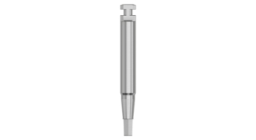
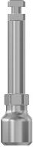
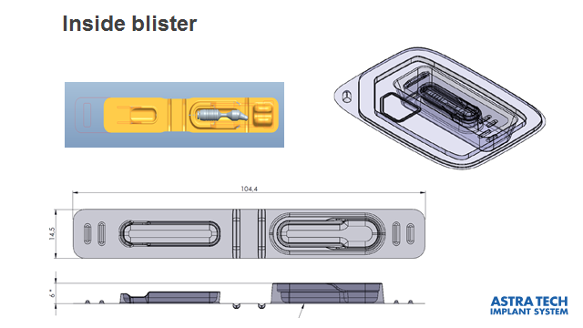
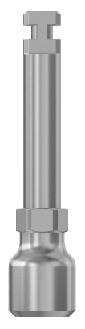
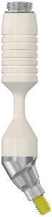
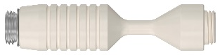
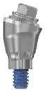
Multibase Abutment EV 17˚ and 30˚
Delivered with a pre-mounted holder
Hex Driver EV
Machine
Multibase Driver EV
19 mm
20 mm
19 mm
Delivered sterile
17˚
30˚
Spare part:
”Abutment Head with holder”
Notes:
Titanium with a PEEK plastic holder, sterile
The holders keep the abutment screw in place, therefore 2 different versions.
4 rings/markings on the handle for the 17˚ version and 6 rings/markings for the 30˚.
Abutment screw, body, head and holder are co-packed and delivered in a sterile packaging.
The abutment body is tightened with Hex Driver EV and the head with the Multibase Driver EV.
The abutment head with holder is also available as a spare part(6 rings).
For details consult the SmartFix concept manual and product catalog.

Slide 17

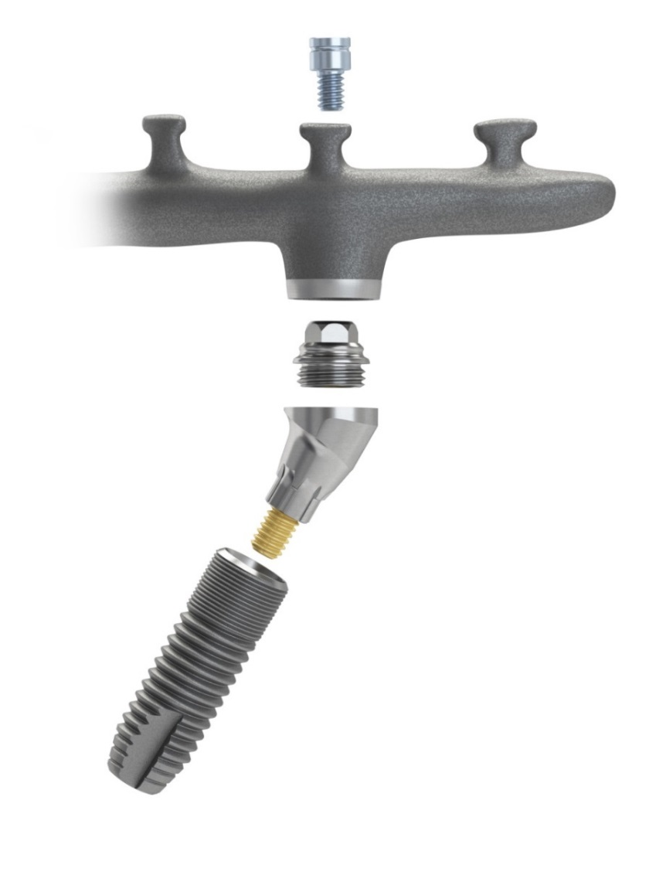
Multibase Abutment EV 17˚ and 30˚ specific parts
Abutment head
Bridge screw
Holder
Abutment head
Framework
Abutment head
Abutment body
Abutment body
Abutment screw
Abutment screw
Abutment body
Abutment screw

Slide 18
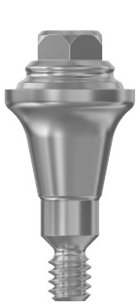

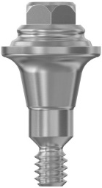

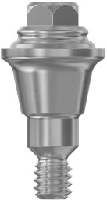

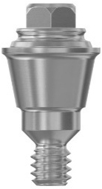
Multibase Abutment EV (straight)
2.15 mm
1.5 mm
2.5 mm
3.5 mm
Index-free abutments can be seated in any rotational position
1.5 mm
2.5 mm
3.5 mm
1.5 mm
2.5 mm
3.5 mm
Notes:
The versatile Multibase EV assortment allows for a wide range of options for the three connection sizes, 3.6, 4.2 and 4.8 respectively.
Multibase Abutment EV for OsseoSpeed EV and OsseoSpeed Profile EV
Version: straight
Height: 1.5, 2.5, 3.5
Indexing options:
Index-free abutments will be seated in any rotational position

Slide 19
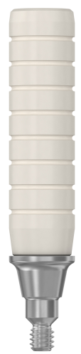

Multibase Abutment EV (straight)
Delivered with a pre-mounted holder
Multibase Driver EV
19 mm
18 mm
Delivered sterile
Notes:
Titanium with a PEEK plastic holder, sterile
The holder facilitates the abutment connection.
For straight Multibase EV abutments the holder has 8 rings/markings on the handle.
The abutment with its pre-assembled holder is delivered in a sterile packaging.
The abutment is tightened using the Multibase Driver EV

Slide 20
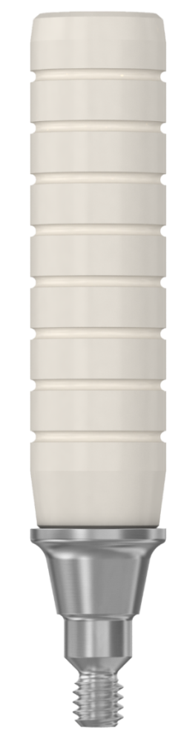
Multibase Abutment EV (straight) Specific parts
Bridge screw
Framework
Holder
Abutment
Abutment

Slide 21
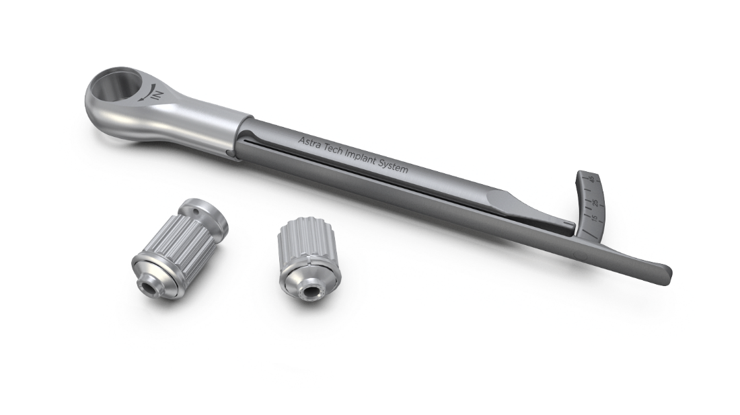
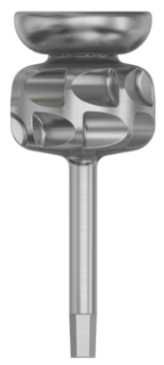
General prosthetic instruments needed
Notes:
Apart from the Multibase Driver EV you also need some prosthetic instruments:
Hex Driver EV, manual
Hex Driver EV, machine
Prosthetic Driver Handle EV
Torque Wrench EV (or similar torque wrench that can deliver 25Ncm and 15 Ncm tightening torque respectively).

Slide 22
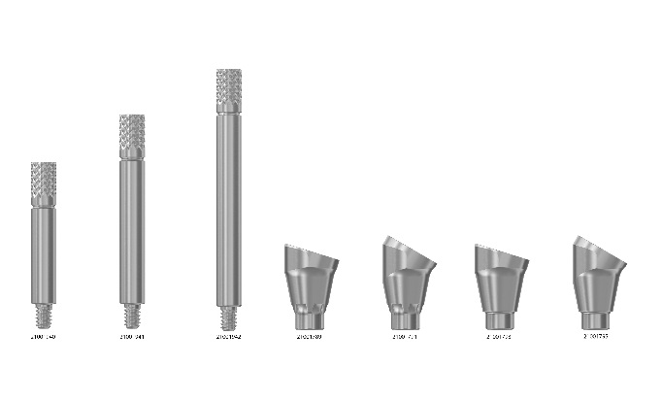

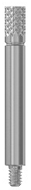
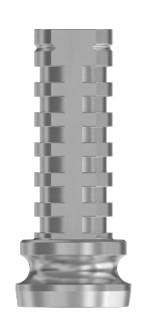






Overview - Multibase EV products
Prosthetic and laboratory products
Atlantis Angulated Screw Access(ASA) Screwdriver and bridge screw
Heal Cap
Pick-up
for open tray option
Transfer for closed tray option
Bridge
Screw
Lab Bridge Screw
Temporary Cylinder
Burnout Cylinder
Replica
Lab abutment Pin
Multibase Driver EV
Polymerization Sleeve
Notes:
These products fit all Multibase EV abutments
Slimmed assortment - Prosthetics:
One diameter
One height
Burnout cylinder for casting procedures
Individual product markings-identifications on components, to differentiate them from other Astra Tech Implant System EV components.
A new Multibase Driver EV, for abutment head (for abutment screw the Hex Driver EV is used)
To protect the wound from resin you can use the polymerization sleeves. You can also use a rubber dam.
For the angulated screw access channel you also need a special ASA(angulated screw access) screwdriver used for the Atlantis suprastructures.

Slide 23



Prosthetic components - Multibase EV
 |  | Markings | Material
Multibase EV Heal Cap Ø 5.4 mm – 4 mm |  |  | Titanium Sterile
Multibase EV Bridge Screw M1.4 |  |  | Titanium
4 mm
Ø max: 5.4 mm
1.65 mm
Notes:
Multibase EV Heal Cap and Multibase EV Bridge Screw have a marking to distinguish them from other similar components.
Heal Cap with a laser ring on the top.
Bridge Screw with a small groove

Slide 24

Minimal height for the prosthetic components
4.5 mm
Notes:
Minimal height needed for the prosthetic components from the abutment level is approximately 4.5 mm. Obviously, there must be space for the veneering material.

Slide 25




Prosthetic components - Multibase EV
 |  | Markings | Material
Multibase EV Pick-up |  |  | Stainless steel Two-piece
Multibase EV Transfer |  |  | Stainless steel Two-piece
15 mm
10 mm
Ø 5.5 mm
9.4 mm
Ø 5.4 mm
Notes:
Multibase EV Pick-up and Multibase EV Transfer, have a marking to distinguish from other similar components.
They both have a small groove for identification.
Both the pick-up and the transfer consists of two parts.

Slide 26




Lab products - Multibase EV
 |  | Marking | Material
Multibase EV Temporary Cylinder |  |  | Titanium
Multibase EV Burnout Cylinder |  |  | PMMA Burn-out plastic
12 mm
Ø 5 mm
10 mm
Ø 4.8 mm
Notes:
Multibase EV Temporary Cylinder* and Multibase EV Burnout Cylinder each have a marking to distinguish from other similar components. They have a small groove.
* With two flat surfaces for anti-rotation.

Slide 27







Lab products - Multibase EV
 |  | Marking | Material
Multibase EV Lab Abutment Pin |  |  | Stainless steel
Multibase EV Replica |  |  | Stainless steel
Multibase EV Lab Bridge Screw, M1.4 Qty 4 |  |  | Titanium
14
18
22
1.65 mm
4.7 mm
Notes:
Multibase EV Lab Abutment Pin, Multibase EV Replica and Multibase EV Lab Bridge Screw, each have a marking to distinguish from other similar components. They have a small groove.
Note: The Multibase EV Lab bridge screw comes in a package of 4 screws.

Slide 28


Bone Reamers EV
Notes:
The bone reamers, together with the bone reamer guides, are used for removing excess crestal bone that hinders correct seating of an abutment.
The bone reamer guides are color coded and used to guide the bone reamers into correct position and to provide a depth stop.
The bone reamers and bone reamer guides are available from 3.0 to 5.4 in the assortment and cover the use for most abutment diameters and designs.
Note: The guides are placed in the tray with the threaded portion facing up.

Slide 29








Bone Reamer EV
Bone Reamer Guide EV
Overlay Bone Reamer EV
Bone Reamer EV
Notes:
All guides have the same cylinder diameter
Thus it is technically possible to use all bone reamers for any implant size
A Small Tray overlay is available for bone reamers and guides and can be used with the Small Tray EV
The most commonly used combinations of reamers and guides are indicated on the tray
The Small Tray EV Overlay Bone Reamers, provides guidance in the selection of reamers per implant size.
Straight line – first alternative
Dotted line– second alternative
Spare positions are also available for e.g. round burs etc. according to the user’s preference
Note: The guides are placed in the tray with the threaded portion facing up

Slide 30

Bone Reamer EV
The depth markings on the bone reamer are measured from the implant up to the indication line
The guide is provided with a drilling depth stop
5 mm
4 mm
3 mm
2 mm
Notes:
Bone Reamer EV is placed over the Bone Reamer Guide EV.
Laser-etched depth indication lines. The depth markings on the bone reamer are measured from the implant up to the indication line.

Slide 31


Step-by-step Bone Reamer EV(optional)
Manually connect the appropriate Bone Reamer Guide EV to the implant using a hex driver
Use the appropriate Bone Reamer EV together with the Restorative Driver Handle.
Place the bone reamer over the guide and remove bone by rotating the reamer under irrigation. Or use the reamer in a contra angle at low speed under irrigation (max. 100 rpm)
Remove the guide using a hex driver
Notes:
Manually connect the appropriate Bone Reamer Guide EV to the implant using a hex driver
Then place the bone reamer over the guide and remove bone by rotating the reamer under irrigation
You can also use the reamer in a contra angle at low speed, max 100 rpm, under irrigation
Remove the guide using a hex driver

Slide 32


SmartFix® Guide
Angle markings on both sides
30
Notes:
The SmartFix Guide is used in edentulous jaws for visual orientation during drilling procedures when a mesio-distally tilted implant installation is desired.
The guide can also be used as an orientation during drilling from a bucco-lingual aspect.
The SmartFix Guide consists of three separate parts, a slightly conical pin with a ball connection, a fastening screw and a guide part with extensions.
The markings are for 0˚, 15˚, 17˚ and 30˚, on both sides.
Before handling the SmartFix guide intra-orally engage the screw 2-3 turns, to ensure that the pin and guide are kept together.
The pin has a conical shape to allow for it being used apart from the Astra Tech Implant System EV, Ankylos and Xive.
The length of the pin of the SmartFix Guide is 10 mm.
For Astra Tech Implant System EV use the drill number 1 (which is 1.9 mm)
For Ankylos & Xive, use a 2.0 mm drill

Slide 33


Step-by-step SmartFix® Guide EV(optional)
After raising a flap, prepare an osteotomy for the SmartFix Guide
Drill in the midline using 1-Twist Drill EV 1.9 to a depth of 11 mm.
Assemble the guide and secure by manually tightening the screw
The guide can be pre-shaped outside the oral cavity
Notes:
SmartFix Guide (Optional)
After raising a flap, prepare an osteotomy for the SmartFix Guide
Drill in the midline using 1-Twist Drill EV 1.9 to a depth of 11 mm
Assemble the guide and secure by manually tightening the screw
The guide can be pre-shaped outside the oral cavity
Note: SmartFix Guide should be disassembled in three parts for cleaning. Let the parts dry before sterilization.

Slide 34



Step-by-step procedure - Implant installation
Choose a starting point and an angle which results in an osteotomy that does not interfere with the maxillary sinus
Drill to appropriate depth and check for correct angulation, by using the SmartFix guide
Prepare the implant site. All drilling should be performed at a maximum speed of 1500 rpm with profuse irrigation
Follow the drilling protocol for OsseoSpeed EV 4.2 S implant
Install the implant so that the top of the implant is at bone level on the mesial side. This could result in a subcrestal position at the distal
Notes:
SmartFix Guide and implant installation
Choose a starting point and an angle which results in an osteotomy that does not interfere with the maxillary sinus.
Prepare the implant site. Drill to appropriate depth and check for correct angulation, by using the installation guide.
Follow the drilling protocol for OsseoSpeed EV 4.2 S implant.
Install the implant so that the top of the implant is at bone level on the mesial side. This could result in a subcrestal position at the distal.
Note: Regarding minimum torque requirement for immediate temporization, see section Pre-operative considerations.
Both parts of the Multibase EV abutment need to be tightened to 25 Ncm to secure a stable screw joint and pre-load. Thus implants need to be stable enough to withstand this tightening torque if you consider immediate temporization. If in doubt, healing abutments or even a two stage surgical approach can be an alternative.
Note: See surgical manual for detailed surgical drilling protocol and options. All drilling should be performed at a maximum speed of 1500 rpm with profuse irrigation.

Slide 35

Step-by-step procedure - Abutment connection
Multibase Abutment EV 30˚
Abutment body
Abutment body/head
Abutment head
Notes:
Abutment body
Select the appropriate abutment angle and height.
Connect the abutment body to the implant and rotate the abutment to the desired position (1a).
The flexible holder can be bent to facilitate placement.
Perform initial tightening of the abutment screw with a manual hex driver (1b).
Unscrew the holder from the abutment body (1c).
Abutment body/head
Use the restorative driver handle together with the hex driver and the Torque Wrench EV to tighten the abutment screw to the recommended torque (25 Ncm) (2a).
Flip the holder over 180 degrees to the side that holds the abutment head (2b).
Screw the abutment head into the abutment body with the holder (2c).
Abutment head
Snap off the handle (3a).
Perform initial tightening with the manual Multibase Driver EV to initially tighten the abutment head (3b).
Use the restorative driver handle together with the Multibase Driver EV and the torque wrench to tighten the abutment head to the recommended torque (25 Ncm) (3c).

Slide 36

Step-by-step procedure - Abutment connection
Multibase Abutment EV straight
Abutment connection
Abutment connection
Notes:
Abutment connection
Pick up the selected abutment in the pre-mounted plastic holder (1a).
Manually seat and secure the abutment using the holder (1b).
Snap off the holder (1c).
Abutment connection
Perform initial tightening with the restorative driver handle together with the Multibase driver (2a).
Use the restorative driver handle together with the Multibase driver and torque wrench and tighten to the recommended torque (25 Ncm) (2b).

Slide 37

Step-by-step procedure – Immediate temporization
The following procedure is a technique where a denture is used as the base for a temporary restoration.
Multibase EV Temporary Cylinder
Adjust the denture
Attach temporary cylinders
Notes:
Multibase EV Temporary Cylinder
After all abutments are seated, close the flap and suture.
Manually seat and secure the temporary cylinders to the abutments with the Multibase EV Bridge Screws using the hex driver (1a).
Apply the polymerization sleeves to protect the wound from resin (1b). A rubber dam can also be used.
Adjust the denture
Perforate the denture to allow it to seat onto the mucosa without interfering with the cylinders. (2)
Attach temporary cylinders
Use autopolymerizing resin to attach the temporary cylinders to the denture (3a).
After resin has set, unscrew the bridge screws and remove the denture (3b).

Slide 38

Step-by-step procedure – Immediate temporization
The following procedure is a technique where a denture is used as the base for a temporary restoration.
Connect Multibase EV Heal Cap
Modify denture
Temporary bridge installation
Notes:
Connect Multibase EV Heal Cap
Manually seat and secure the heal caps to the abutments using light finger force (5–10 Ncm) with the hex driver. (4)
Modify denture
Cut off the excessive parts of the temporary cylinders (5a).
Grind away the palatal plate of the denture and reduce the buccal base plate (5b).
Fill in any voids with resin and adjust the soft tissue side of the denture to allow access for good oral hygiene.
Temporary bridge installation
Remove the heal caps from the abutments.
Connect the temporary bridge with the Multibase EV Bridge Screws and check the fit. (6)
Use the restorative driver handle together with the hex driver and the torque wrench to tighten to the recommended torque (15 Ncm).
Check function and contacts for balanced occlusion and articulation.

Slide 39

Step-by-step procedure - Prosthetic and laboratory
Below is a step-by-step procedure using an open tray procedure.
Multibase EV Pick-up
Applying impression material
Impression
Notes:
Multibase EV Pick-up
Remove the temporary bridge.
Connect the pick-ups using the Hex Driver EV. (1)
Secure the pick-ups using manual tightening torque (5–10 Ncm).
Applying impression material
Cover an open tray with wax (2a).
Apply an elastomeric impression material around the pick-ups separately (2b).
Impression
Place the tray, filled with the impression material, and take the impression. (3)
Once the impression material has set, unscrew the pins and remove the impression.
Check the impression for correct and stable retention of the pick-ups.
Reinstall the temporary bridge.

Slide 40

Step-by-step procedure - Prosthetic and laboratory
Multibase EV Pick-up/ Multibase EV Replica
Master model / Tooth set-up
Order – Atlantis suprastructures
Notes:
Multibase EV Pick-up/ Multibase EV Replica
Connect the replicas carefully to the pick-ups and tighten. (1)
Secure the pick-ups using manual tightening torque (5–10 Ncm).
Note: Multibase EV Replica is for single use.
Master model / Tooth set-up
Prepare the impression for duplication with a removable soft tissue mask by applying silicone around the replica sites.
Pour high quality stone and fabricate the master model (2a).
Prepare a tooth set-up in wax (2b).
Consult the separate Atlantis suprastructure Design Guide for detailed handling procedures in the laboratory.
Order – Atlantis suprastructures
Enter the order via the Atlantis WebOrder. Consult the Atlantis suprastructures – User guide for the ordering process. (3)
After review and final approval of the design in Atlantis Viewer, the suprastructure is fabricated.

Slide 41



Step-by-step Prosthetic and laboratory procedures
Final restoration Atlantis suprastructures
Final restoration Atlantis suprastructures
Installation of the final restoration
Notes:
Final restoration – Atlantis suprastructures
The Atlantis suprastructure is shipped to the dental laboratory.
Note: The Multibase EV Lab Bridge Screw is recommended to be used during the laboratory procedure with Atlantis suprastructures for the Astra Tech Implant System EV.
Final restoration – Atlantis suprastructures
Fabricate the final prosthesis.
Installation of the final restoration
Remove the temporary bridge.
Connect the final restoration with the Multibase EV Bridge Screws and check the fit.
Use the restorative driver handle together with the hex driver and the torque wrench to tighten to the recommended torque (15 Ncm).
Cover the screw head before the screw channel is filled with a suitable material e.g. composite resin.
Check function and contacts for balanced occlusion and articulation.
Note: The lab bridge screw should be replaced with a clinical bridge screw for placement of the final restoration in the clinical situation.

Slide 42

Step-by-step procedure – Verification jig
Creating a foundation
Final restoration installation
Stress–free jig
Notes:
Creating a foundation
Multibase Pick-ups are secured to the replicas in the master cast.
Dental floss is webbed around the pick-ups. The web provides a foundation for auto-polymerizing resin or flowable composite to secure the relationship of the pick-ups.
Apply a loose mixture of powder and liquid to the created web in small increments.
Final restoration installation
Once the resin has set, the verification jig has to be made stress-free before trying it in the mouth.
To relax the tensions built up in the verification jig during setting of the resin, the jig needs to be sectioned (2a).
The sections are reconnected with resin. This will prevent distortions when the jig is removed from the model (2b).
Stress–free jig
The verification jig is now ready for try-in in the mouth. (3)

Slide 43

Step-by-step procedure – Verification jig
Insertion/inspection
Sectioning/resin application
New impression
Notes:
Insertion/inspection
When placing the verification jig in the mouth, start with a single bridge screw in one of the distal abutments. (1)
If a misfit is detected, the verification jig has to be sectioned to correct the poor fit and to allow for the components to be fully seated.
The objective is to achieve a passive fit so that the jig is seated completely on all abutments.
Sectioning/resin application
Section the verification jig (2a).
Reconnect the sectioned jig by applying auto-polymerizing resin intra-orally (2b).
New impression
Pick up the jig in a new impression and pour a new master cast. (3)
The new model is used to fabricate the final prosthesis and to ensure its accuracy.

Slide 44

The ease of using the SmartFix® concept
Reduces treatment time for the patient
Involves all team members in the treatment plan to ensure a quality outcome
Uses a prosthetically driven protocol to improve the esthetic result
Allows the patient to leave the clinic with implant-retained teeth on the day of surgery
Provides a simplified restorative concept to reduce chair time
Increases patient acceptance by minimizing costs
Notes:
It’s just Smart
Your patients rely on you to restore their ability to eat, speak and smile with confidence.
With the SmartFix concept you can improve the quality of life of your edentulous patients with a secure and reliable immediate full-arch restoration.

