Slide 1
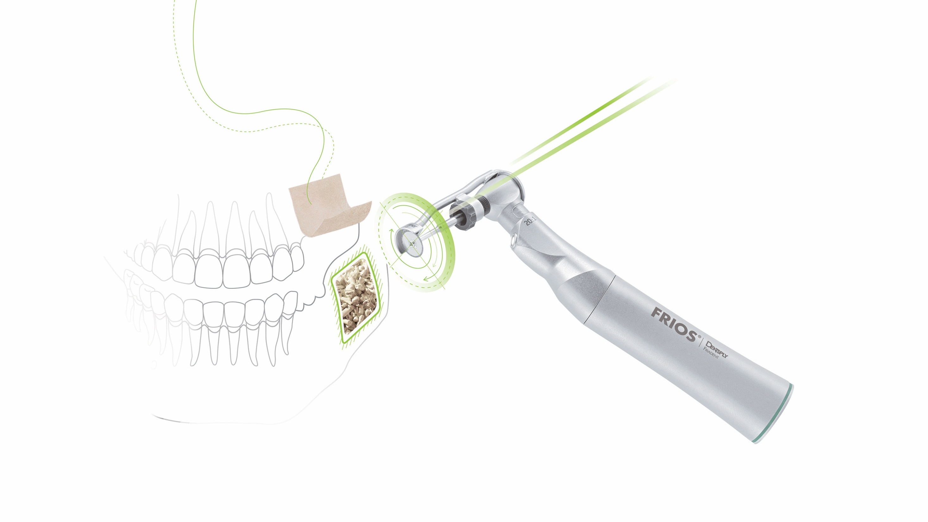
Symbios
Regenerative Solutions

Slide 2
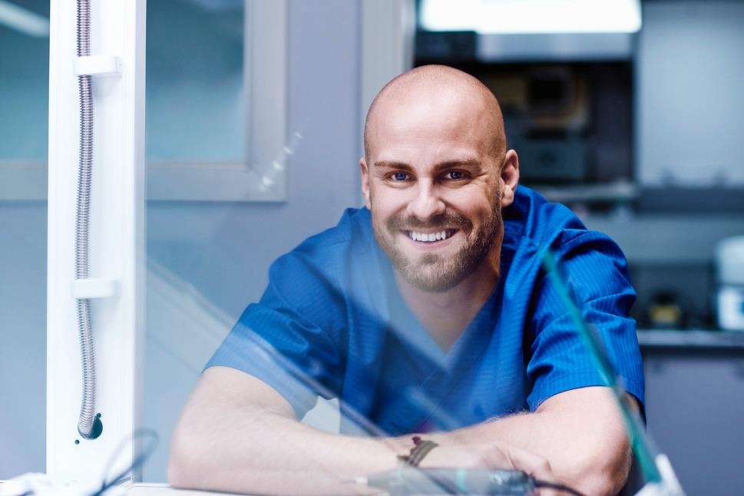
Symbios® – Solutions for all your regenerative needs
A range of reliable bone graft materials, resorbable and non-resorbable membranes and instruments
Promotes bone formation, volume and stability for predictable, long-term outcomes that patients and dental professionals can rely on
Notes:
Designed for the widest range of dental surgery and implant needs

Slide 3

Symbios® Portfolio
Bone graft materials
  Allograft
  Xenograft
  Synthetic
Membranes
  Allograft
  Xenograft
  Synthetic
Instruments
  Frios MicroSaw
  Frios BoneCollector
  BoneTrap

Slide 4
Bone graft materials

Slide 5
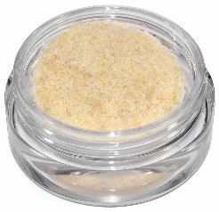
Symbios® Allograft Particulate
Allograft bone is the most widely used class of bone graft material
Symbios allograft particulate is easy to handle and integrates with natural bone for predictable performance
Benefits include:
  100% bone particulate
  Predictable outcome
  Five year shelf life
  Convenient and ambient temperature storage
  Variety of choices
Human bone - 2500 X magnification

Slide 6
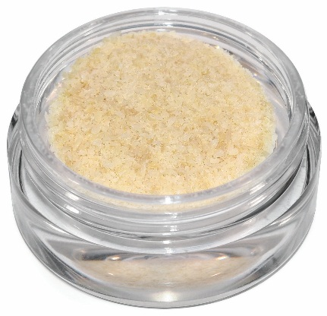
Symbios® Mineralized Cortical Powder
Provides stability and structural support
Slower revascularization
100% cortical human bone
Particle size of 212-850 µm
Available in 0.25 cc, 0.5 cc, 1 cc, 2.5 cc
Integrates in 6-8 months
Indication for use includes socket grafting, ridge augmentation, sinus lift and periodontal defects

Slide 7
Symbios® Demineralized Cortical Powder
Inorganic mineral removed, leaving behind the organic “collagen” matrix
Marshall Urist in 1965 discovered that the removal of bone mineral exposes more biologically active bone morphogenetic proteins (BMP)
These proteins and growth factors modulate the differentiation of cells to form bone and cartilage
Particle size of 212-850 µm
Available in 0.25 cc, 0.5 cc, 1 cc, 2.5 cc
Integrates in 6-8 months
Indication for use includes extraction socket grafting and periodontal defects
Notes:
100% cortical human bone with minerals removed
slightly shorter integration time due to demineralized nature of the product

Slide 8
Symbios® Mineralized Cancellous Powder
Mineralized allograft does not undergo additional processing to remove inorganic mineral in natural bone
  Rapid revascularization
  Faster remodeling
Particle size of 212-850 µm
Available in 0.5 cc, 1 cc, 2.5 cc
Integrates in 4-5 months
Indication for use includes socket grafting, ridge augmentation, sinus lift and perio defects
Notes:
100% cancellous human bone

Slide 9
Symbios® Cortical & Cancellous Granules
A combination of 80% (cortical bone) and 20% (cancellous bone)
Mimics the natural bone anatomy, providing both space maintenance and surface area for bone formation
  Provides stability and mechanical strength
  Easy to handle and hydrate
Available in mineralized or demineralized form
Mineralized
Demineralized
Two particle size of 200-1,000 µm and 100-2,000 µm
Available in 0.5 cc and 1 cc
Integrates in in ~6 months
Two particle size of 200-1,000 µm and 500-3,000 µm
Available in 0.5 cc and 1 cc
Integrates in in 3-4 months
Notes:
Indicated for various surgical application such as extraction socket, ridge augmentation and preservation, sinus lift, apicoectomy, as well as in combination with prosthetic devices
Combination product provides optimum performance

Slide 10
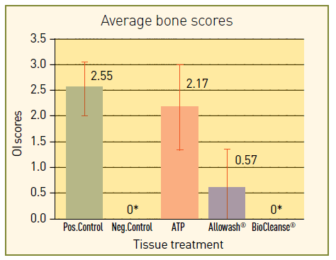
Symbios® DBX Putty
- Demineralized Bone Matrix
Offers the highest bone content, optimal osteoinductivity and exceptional handling characteristics when compared to other DBM products
Example of histological section used to grade osteoinductivity in the athymic mouse Bar = 100 micron.
Osteoinduction scores for tissue processed through various techniques. Statistically different to ATP and control.2

Slide 11
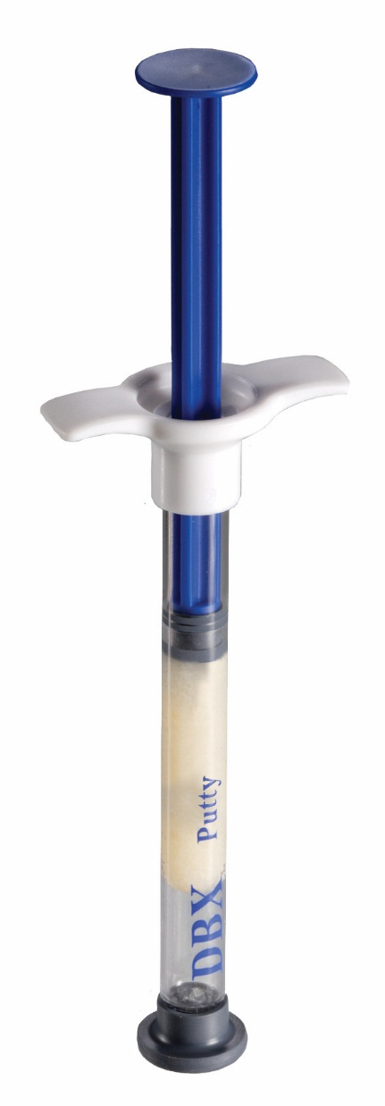
Symbios® DBX Putty
High quality and biocompatible
  Highest demineralized bone content available – 93% by volume
Proven bone formation through optimal osteoinductivity
  DBX® is osteoconductive, and since it is not gamma irradiated it is shown to have optimal osteoinduction in appropriately designed model¹
Easy to use
  High molecular weight means material maintains its physical integrity and resists movement under irrigation
Available in 0.5 cc, 1 cc, 2.5 cc
Integrates in 3-4 months
Ready to use, no preparation required
Excellent handling characteristics
Convenient ambient temperature storage

Slide 12
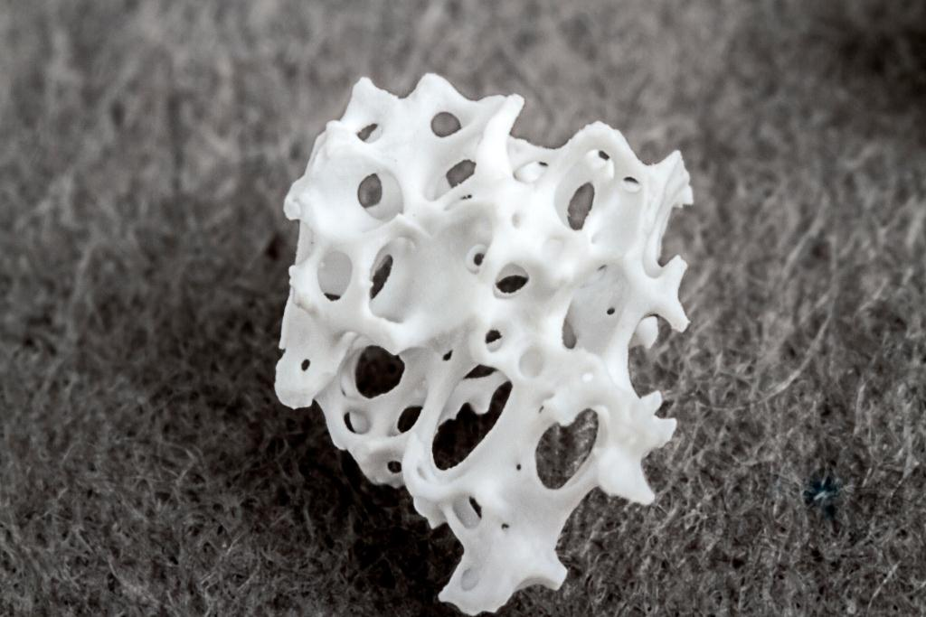
Symbios® Xenograft Granules
Porcine Bone Graft Material
Derived from porcine cancellous bone
Highly porous carbonate apatite particles
Natural pore structure for cell conduction
High intra- and inter-particle space for osteoconduction and new bone deposition
The anorganic bone matrix has an interconnecting macro- and microscopic pore structure
    Supports vascularization, bone ingrowth and nutrition
Rough surface texture
    Facilitates cell adhesion and bone ingrowth

Slide 13
Symbios® Xenograft Granules
Indications
Augmentation or reconstructive treatment of the alveolar ridge.
Filling of infrabony periodontal defects.
Filling of defects after root resection, apicoectomy, and cystectomy.
Filling of extraction sockets to enhance preservation of the alveolar ridge.
Elevation of the maxillary sinus floor.
Filling of periodontal defects in conjunction with products intended for Guided Tissue Regeneration (GTR) and Guided Bone Regeneration (GBR).
Filling of peri-implant defects in conjunction with products intended for Guided Bone Regeneration (GBR).

Slide 14
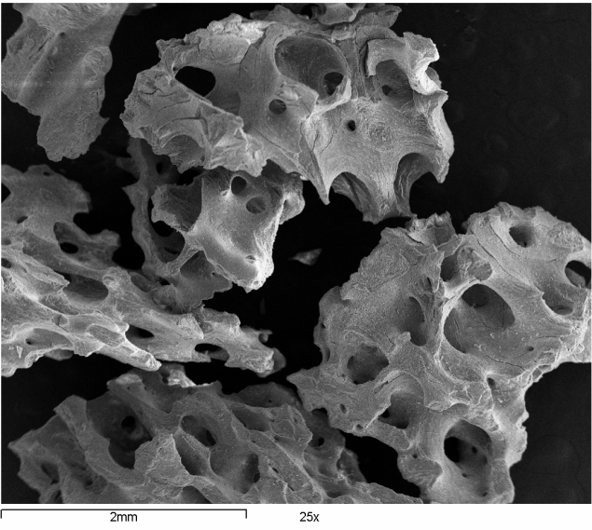
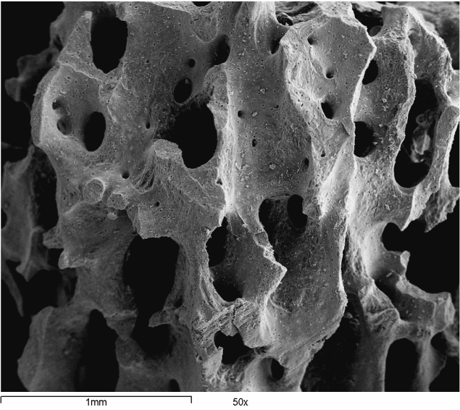
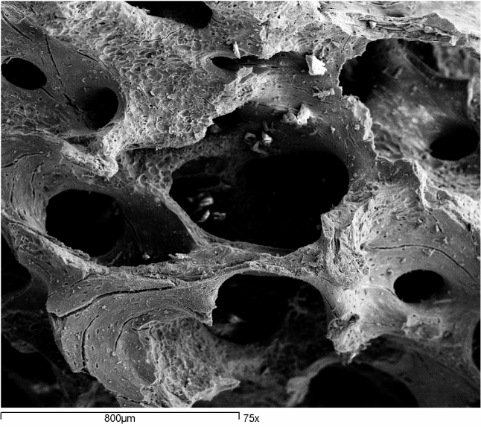
Symbios® Xenograft Granules
88%
void space
for bone
Ingrowth
(0.25-1.0 mm particle size)
SEM pictures illustrate interconnecting pores and the rough surface

Slide 15
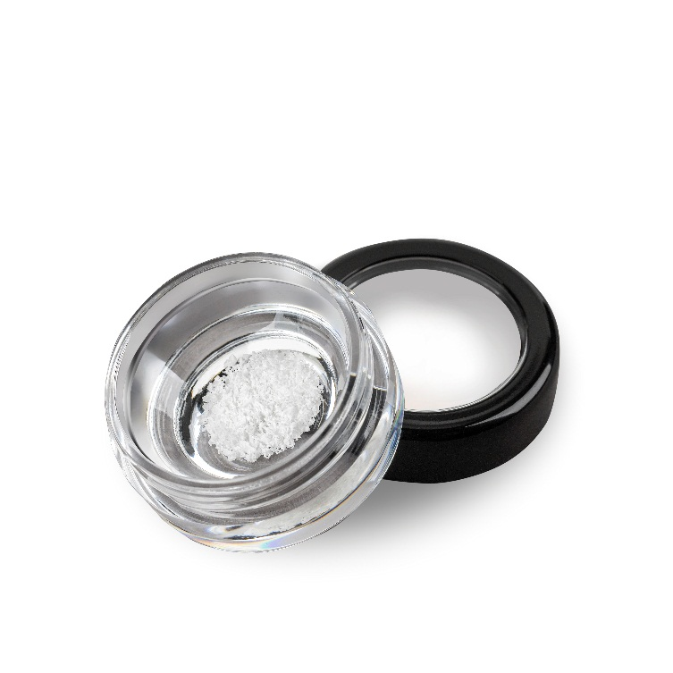
Symbios® Xenograft Granules
Highly porous with 88% to 95% empty space
    More space for new bone deposition
Carbonate apatite
    Aids remodeling of the healing bone
Granules hold together upon hydration
    Ease of handling and placement in the defect site
Available in two particle sizes:
250-1,000 µm - 0.5 cc, 1 cc, 2.0 cc and 4.0 cc
1,000-2,000 µm - 1 cc and 2.0 cc
Integrates in 3-4 months
Ready to use, no preparation required
Excellent handling characteristics
Convenient ambient temperature storage

Slide 16
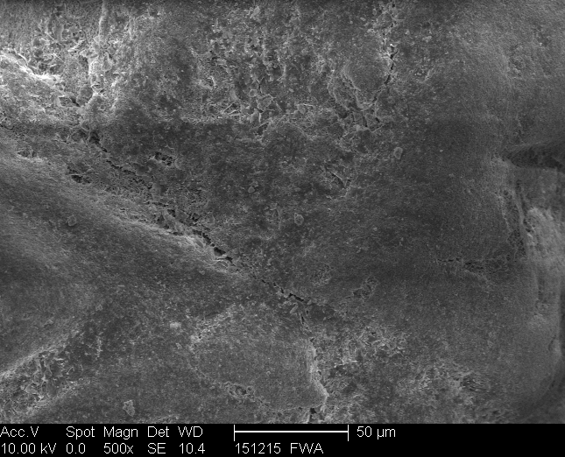
Symbios® OsteoGraf N
- Dense bovine bone graft material
A sintered bovine-derived hydroxylapatite which is conductive to cell-mediated resorption and provides a scaffold for new bone growth, which holds dimension until host bone takes over
Effective bone replacement graft material alone or when mixed with autogenous bone and/or DFDBA
OsteoGraf N-300 – 500 x magnification

Slide 17
Symbios® OsteoGraf N
  Cell-mediated resorption
  Hydrophilic – cohesive consistency when hydrated
  Remodels to vital bone at same rate as host bone
  Predictable increase in bone dimension
  Easy to handle and hydrate
  Available in two forms:
    OseoGraf N-300: dense bovine bone with particle size 250-420 µm
    OseoGraf N-700: dense bovine bone with particle size 420-1,000 µm
  Available in 1.0 g and 3.0 g
Resorbs in 9-12 months

Slide 18
Symbios® OsteoGraf LD
- Low-density hydroxylapatite bone graft material
A synthetic bone graft product that has a 56% porosity and high surface area
Highly radiopaque
Provides excellent handling properties
Effective alternative for patients who prefer a synthetic material
OsteoGraf LD-300– 500 x magnification

Slide 19
Symbios® OsteoGraf LD
  Low-density, 100% pure synthetic hydroxylapatite
  Solution-mediated resorption
  Hydrophilic – cohesive consistency when hydrated
  Maintains alveolar bone for ridge preservation
  Readily available source of calcium for bone regeneration
  Available in particle size 250-420 µm
  Available in 0.5 g, 1.0 g and 3.0 g
Resorbs in 15+ months

Slide 20
Symbios® OsteoGraf D
- Dense hydroxylapatite bone graft material
  Dense, 100% pure synthetic hydroxylapatite
Can be successfully used in dental applications where maintenance of bulk and contour of the restoration and ridge is needed
Provides supporting matrix for bone and/or connective tissue deposition
OsteoGraf D-700– 100 x magnification

Slide 21
Symbios® OsteoGraf D
  Non-porous, non-resorbable, permanent graft material
  Atrophic ridges can be augmented in both height and dimension using this product
  Maintains augmented dimension for esthetic and prosthetic support
  Reduces resorption rate of underlying bone
  Available in two forms:
    OsteoGraf D-300 - particle size 250-420 µm
    OsteoGraf D-700 – particle size 420-1,000 µm
  Available in 0.5 g, 1.0 g and 3.0 g

Slide 22
Membranes

Slide 23
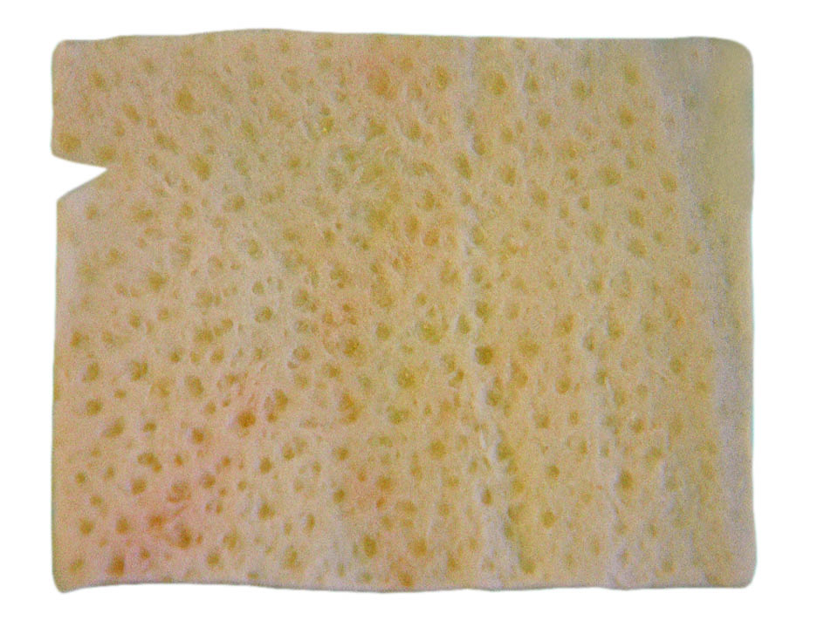
Symbios® PerioDerm® Acellular Dermis
  An acellular dermal allograft designed for predictability in replacing damaged or inadequate tissue in the repair, reinforcement or supplemental support of soft tissue defects
Minimally processed to remove epidermal and dermal cells while preserving the extra-cellular matrix
Undergoes a three-phase process that gently cleans, decellularizes and disinfects without cross-linking or compromising the integrity of the dermal matrix
Has been shown to support the migration of host cells from wound margins and surrounding tissue

Slide 24
Symbios® PerioDerm®
  Excellent handling characteristics, similar to autologous human skin grafts
  Rehydrates quickly, reducing surgery time and cost
  Freeze-dried grafts require no refrigeration and provide more storage options
  Over 90% thickness consistency for uniform vascularization and aesthetic results
  No cross-linking for ready incorporation and less risk of surgery site inflammation and rejection
  Available in thick and thin versions and a variety of sizes
  Integrates in 3-4 months

Slide 25
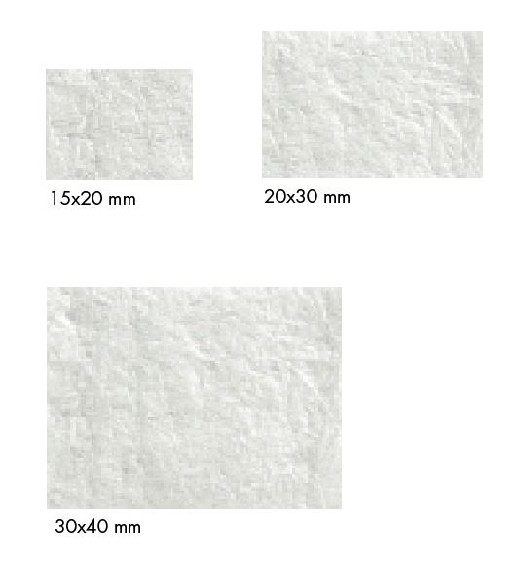
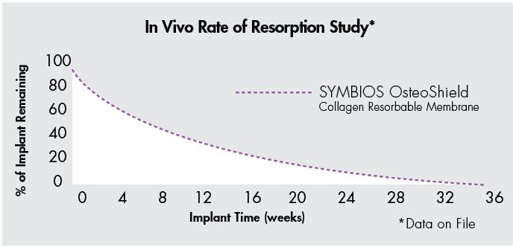
Symbios® OsteoShield® Collagen Resorbable Membrane
  This resorbable tissue matrix made from Type1 bovine collagen delivers predictability in performance in dental surgery procedures, in the area of dental implant, bone defect or ridge reconstruction

Slide 26
Symbios® OsteoShield® Collagen Resorbable Membrane
  Manufactured from highly purified Type-1 bovine Achilles tendon for safety
  Multi-layer construction assists in healing of bone and surrounding tissue while inner layers help prevent cellular and bacterial down growth
  Unique fiber orientation provides for unusually high tensile strength and for stable performance with sutures and resorbable tacks
  Optimized flexibility for excellent wet handling, while still allowing maintenance of space
  Either side may be placed on the site
  Available in three sizes: 15x20 mm, 20x30 mm, and 30x40 mm
  Resorbs in 26-38, weeks when primary closure is achieved

Slide 27
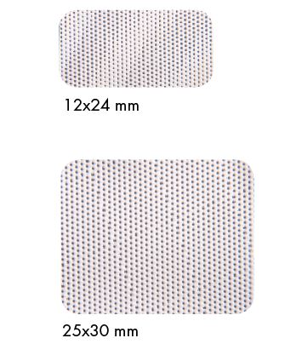
Symbios® OsteoShield® d-PTFE Non-resorbable Membrane
  This non-resorbable yet easily removable d-PTFE membrane is designed for use in extraction site grafting, large bony defects and where primary closure is not possible or desired

Slide 28
Symbios® OsteoShield® d-PTFE Non-resorbable Membrane
  Medical grade d-PTFE is biocompatible and non-reactive
  Micro-machined surface texture facilitates cell adhesion, enhances membrane stability, reduces flap retraction and increases pull-out strength
  Primary closure is not required. This membrane is virtually impervious to bacteria, resulting in minimal risk of bacterial invasion
  By avoiding releasing incisions and primary closure, the membrane maintains soft tissue architecture, preserves keratinized mucosa and requires minimal flap reflection or dissection
  The exposed membrane may be easily removed non-surgically with a gentle tug
  Available in two sizes: 12x24 mm and 25x30 mm

Slide 29
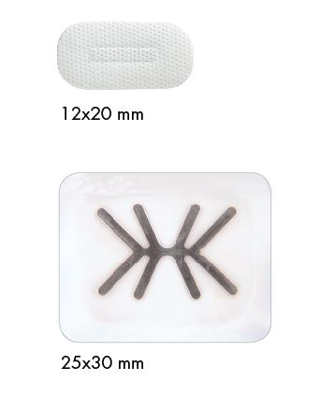
Symbios® OsteoShield® d-PTFE Titanium-reinforced
Non-resorbable Membrane
  This titanium-reinforced membrane is designed for use with large defects, two- or three-walled defects, or where space-making is required.

Slide 30
Symbios® OsteoShield® d-PTFE Titanium-reinforced
Non-resorbable Membrane
  Has all the benefits of Symbios OsteoShield d-PTFE Non-resorbable Membrane, plus:
    Self-supporting titanium-reinforcement, which helps create additional space, especially in defects with deficient bony architecture
    Titanium-reinforcement prevents folding or wrinkling
    Grade 1 titanium, which is flexible, for easy membrane shaping
  Available in two sizes: 12x20 mm and 25x30 mm

Slide 31
Instruments

Slide 32
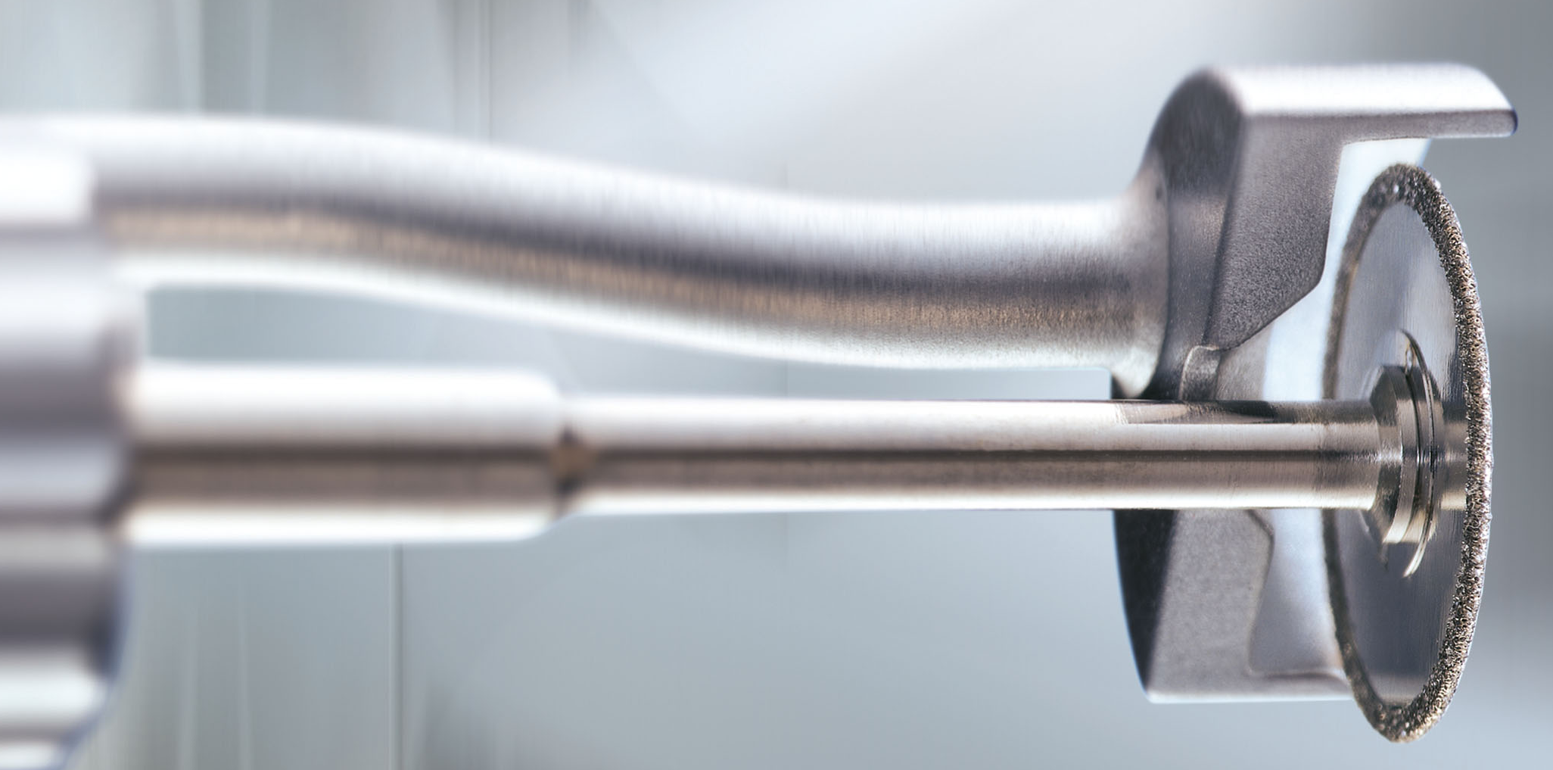
Frios® MicroSaw
Smooth and bone preserving preparation of bone blocks and access windows
0.29 mm MicroSaw disk for extremely accurate osteotomy line
Maximum cutting depth of 3.2 mm
Hinged soft tissue protector
In clinical use since 1986
Frios MicroSaw acc. to Prof. Dr. F. Khoury

Slide 33
Frios® MicroSaw
Highest precision - 0.29 mm MicroSaw disc produces an extremely accurate osteotomy line
Fast - Rapid work with the Frios straight and contra-angle handpieces – even for the most difficult anatomical situations.
Atraumatic - The hinged soft tissue protector is easy to attach and to remove again. Direct blade cooling prevents overheating during the procedure.
Easy application - With the Frios angled handpiece the exact preparation can be made in the retromolar region, even with restricted mouth opening.

Slide 34
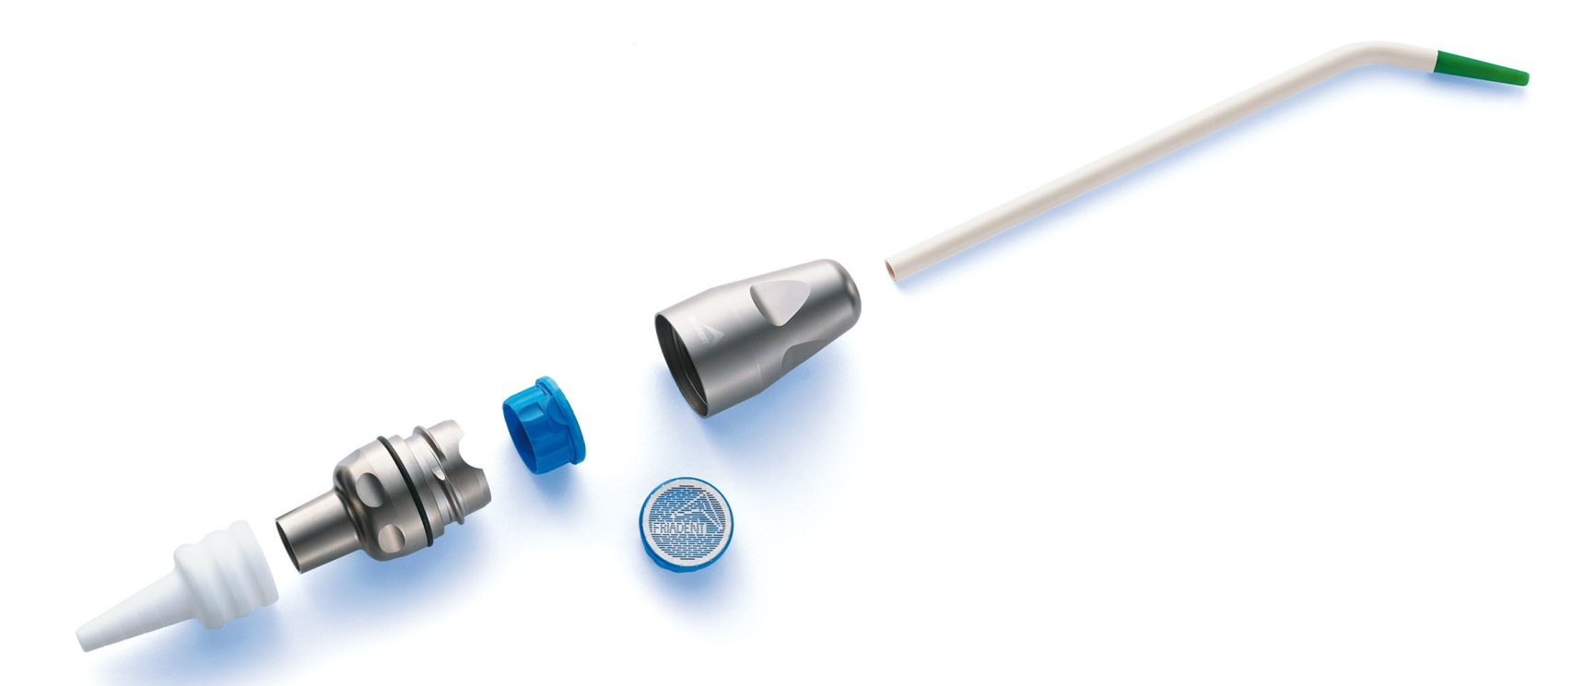
Frios® BoneCollector
A re-usable option for the harvesting of vital bone chips during bone surgery or preparation of the implant site – for multiple use
Only one procedure - implant placement and harvesting of valuable, vital bone chips
Gentle on your patients - reduce the need for a second donor site operation
Use of a second aspirator during the procedure prevents contamination
Sterilizable (Note: suction tube and titanium filter are single-use only items)

Slide 35
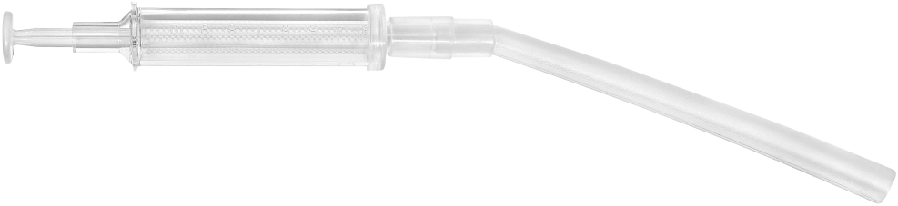
BoneTrap
Harvesting vital bone chips in parallel with the preparation of the implant site – for single use.
Simplified procedure -instrument allows for convenient collection and use of autologous bone.
Time saving - delivered sterile and is disposable.
Cost effective - reduces the need for costly artificial material.

Slide 36
Thank You

