Slide 1
Xive System overview

Slide 2
Progress and experience
2009 Patient-specific suprastructure implant suprastructures
2012 SmartFix concept
2005 Introduction of Cercon zirconia abutments
2013 More platform-switch options on Xive
2002 Xive TG
1990 Color-coded Friadent prosthetic range
2010 Atlantis patient-specific CAD/CAM abutments
2011 TitaniumBase – two-piece CAD/CAM abutments
2003 Friadent plus implant surface
2009 Computer-guided surgery
2003 Xive S 3.0 mm implant
2014 WeldOne concept
2001 Launch of the Xive implant system
1999 Frialoc implants
Note: Not all products available in all countries.
Notes:
The development and launch of Xive in 2001 was based on a foundation of 25 years of experience in implant dentistry, including pioneering work and groundbreaking developments in the fields of immediate implant loading and implant surface structuring. Prosthetically, Xive is fully compatible with FRIALIT, offering a well structured line of color-coded abutments that has already set the standard since the 1990s.
Xive is designed to adapt to each individual case and the preferences of the clinican both surgically and prosthetically. The system comes with a versatile range of implant diameters and lengths as well as a TG (transgingival) and S (subgingival) solution with identical endosseous designs for surgical flexibility. The systems’ patented combination of a bone-specific preparation protocol and condensing thread design allows for tangible primary stability, even in soft bone. For full restorative freedom on implant- and abutment-level, a range of pre-fabricated and patient-specific abutments are available supporting a single crown, fixed partial denture or a removable prosthesis. The unique TempBase concept facilitates the procedure for immediate temporary restorations.

Slide 3
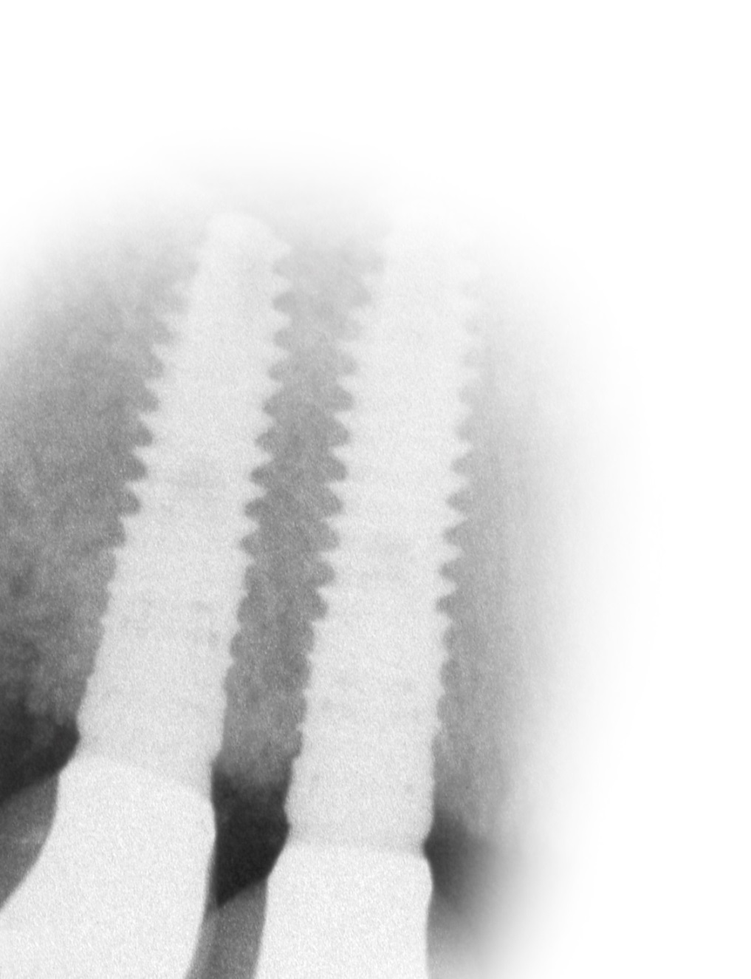
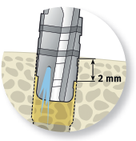
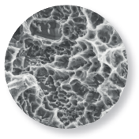
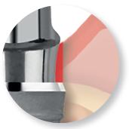
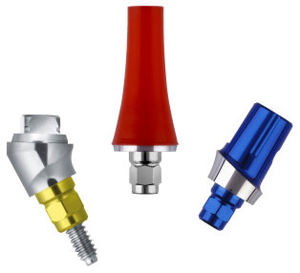
Versatility and ease
ActiveBoneControl
Friadent plus surface
Bone care with platform-switch
Easy and versatile prosthetics
Courtesy of Dr. M. Degidi, Bologna, Italy
Notes:
ActiveBoneControl A high primary stability in all types of bone can be achieved by the patented combination of a bone-specific preparation protocol and a bone-condensing thread design.
FRIADENT plus surface The grit-blasted and high temperature-etched FRIADENT plus microstructure excels by rapid bone formation on the implant surface. This results in early osseointegration and high bone-to-implant contact.
Bone care with platform-switch An integrated platform-switch option supports an improved preservation of crestal bone levels with concurrent favorable soft tissue conditions.
Easy and versatile prosthetics A range of pre-fabricated and patient-specific abutments provides versatility in prosthetics, both on implant- and abutment-level, including immediate restorations for any possible indication. An internal butt-joint connection with self-guiding properties and color-coded or laser marked components support error-free workflow.

Slide 4
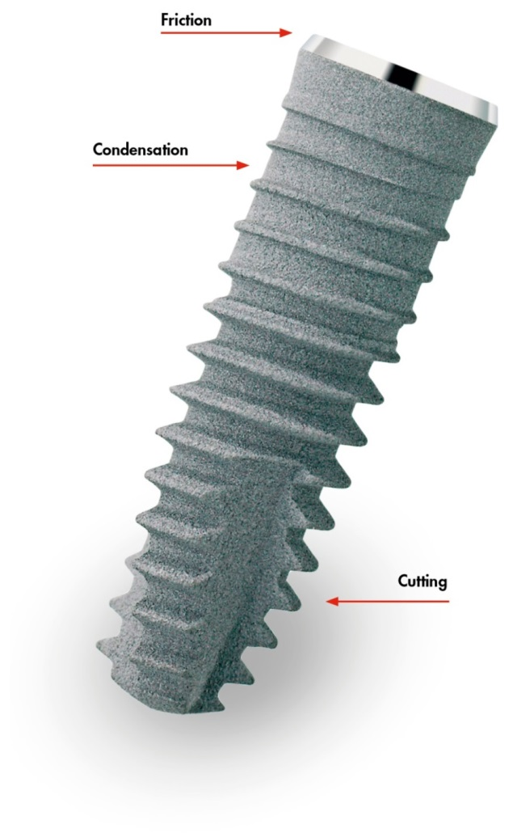
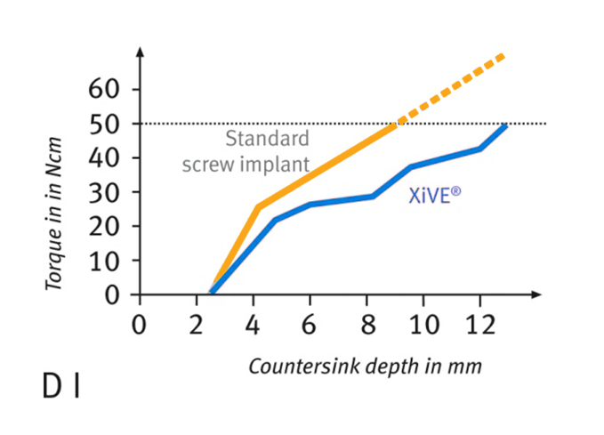
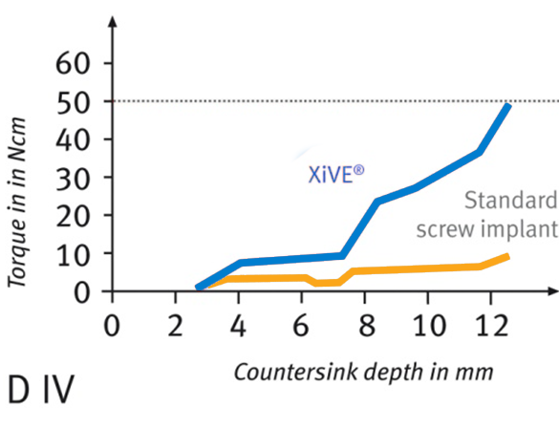
ActiveBoneControl
High primary stability
Bone-specific preparation protocol
Bone-condensing thread design
Notes:
Images
1 | Torque stabilization in bone quality D I; the platform formation guarantees an atraumatic placement
2 | Torque stabilization in bone quality D IV by internal condensation
Primary stability is an important factor in the success of implant placement. Xive allows for excellent and tangible primary stability in every type of bone to be achieved with ease. With the patented combination of a bone-specific preparation protocol and a condensing thread design, Xive provides predictable treatment outcomes for all implant-prosthetic indications in all types of bone.
Bone-specific preparation protocol
Preparation of the implant site is the first step towards optimal stability. With Xive, you can modify the surgical protocol during preparation depending on the bone quality. The depth of the final crestal drilling and, in bone class D I, additional tapping will allow you to control the degree of bone condensation and with it the torques achieved during placement.
Bone-condensing thread design
In interaction with the bone-specific preparation protocol, the extended crestal section of the Xive implant condenses the peri-implant bone atraumatically during insertion. This internal condensation principle achieves tangible primary stability even in very soft bone and compromised bone sites. The self-cutting apical thread supersedes the need for pre-tapping in bone class II to IV and supports optimal primary stability of the implant.

Slide 5
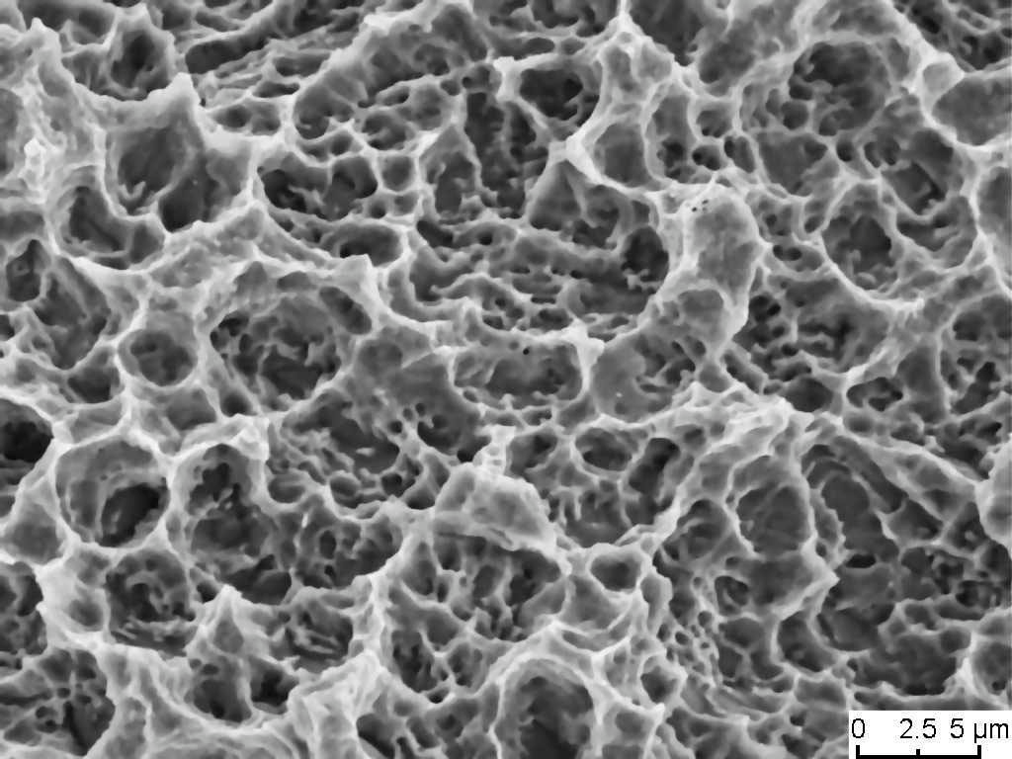
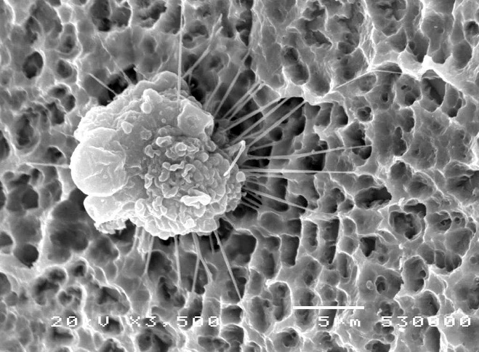
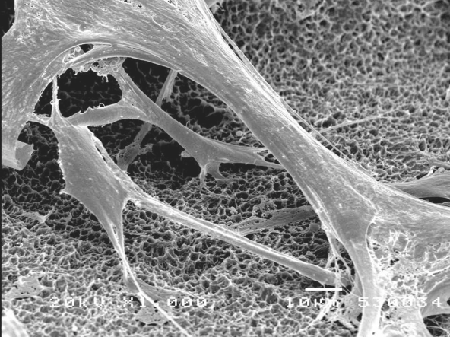
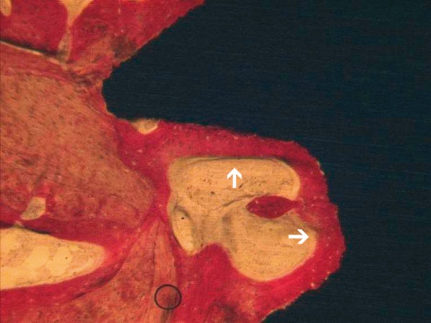
Friadent plus surface
Friadent plus and ActiveBoneControl – the perfect match
Outstanding wetting properties for activation of the primary cell apposition
Unique three-dimensional microdesign
Intensive formation of new bone
Notes:
Images (left – right)
1 | 1_SEM (3000 x) of FRIADENT plus surface structure. Bimodular morphology with micropores (0.5-1 μm) in macrostructure.
2 | Initial contact and anchorage of an osteoblast by thread-like extensions (filopodia) on the FRIADENT plus surface.
3 | Cells on FRIADENT plus typically form widespread multifocal contacts, connecting each other, spanning surface pores and cavities over long distance. Cell chains consist of 3 to 6 cells, each approx. 30 μm long (Figs. 1–3 courtesy of R. Sammons et al., Birmingham, UK). 4 | Cut-out of one thread of a Xive plus implant (20 x magnification). Arrows indicate homogenous bone line (red) between threads (courtesy of A. Piattelli, Chieti, Italy).
FRIADENT plus and ActiveBoneControl – the perfect match
In combination with ActiveBoneControl, the increased bone formation in the initial healing phase of Xive implants provides ideal conditions for high primary stability and the option for immediate restoration, even in difficult clincial situations, for a predictable treatment outcome.
Key benefits of FRIADENT plus surface
Outstanding wetting properties for activation of the primary cell apposition
Unique, three-dimensional microdesign that promotes the apposition of bone-forming cells and subsequently optimum osseointegration
Intensive formation of new bone with increased bone maturation in the early stages for high stability at the interface

Slide 6
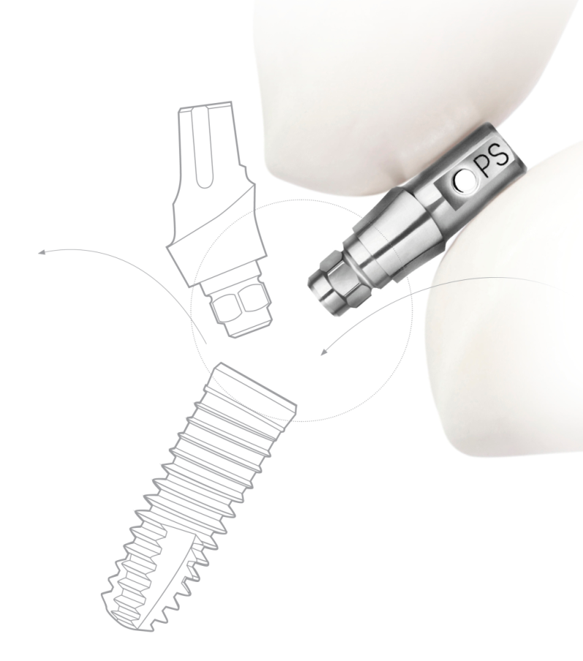
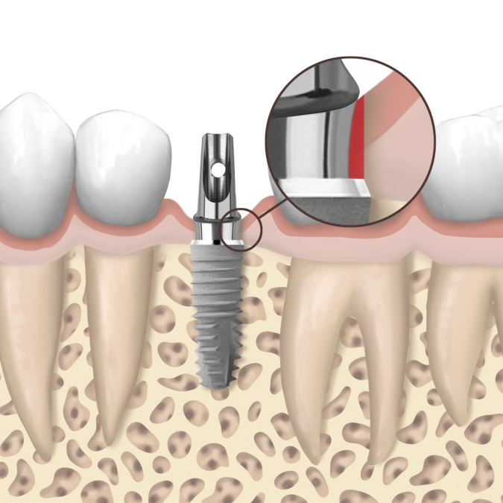
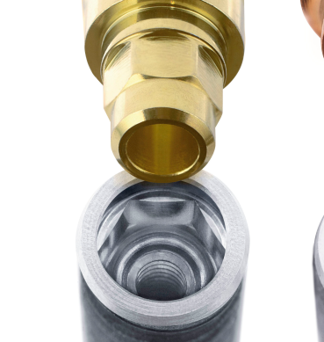
Bone care with platform-switch
Designed for effective
tissue control
Deep internal hex connection with high precision
Gaining soft tissue through platform-switching
Note: Not all products are available. Additional platform-switching components coming soon.
Notes:
The implant macrodesign and the implant abutment-interface in the emergence area play a critical role for long-term tissue maintenance and a successful outcome of implant restorations with optimal esthetic results.
Deep internal hex connection with high precision
An important feature of the subgingival Xive implant is the deep internal hex implant-abutment connection. The precise hexagon facilitates placement of the abutments in six defined positions. With parallel walls above and below the hex, the internal connection extends over a total length of approximately 3.5 mm. This provides high stability and minimizes micromovement between the implant and the abutment.
Gaining soft tissue through platform-switching
The specific design of the beveled, structure-polished implant collar and an integrated option for platform-switching is a key feature of the Xive design. In combination with the use of reduced-diameter abutments, this results in a positive effect on the peri-implant tissues. To achieve a successful restoration following the platform-switching concept, it is essential not only to use the reduced-diameter final abutment, but to start also with a reduced-diameter cover screw and continue with the corresponding prosthetic components. The Xive prosthetic portfolio provides all of these components

Slide 7
Easy and versatile prosthetics
Restorative freedom
Comprehensive range of prosthetic solutions
Individualized contouring of the emergence profile
Premium and cost-effective full arch restorations
Color-coded components
Notes:
A range of pre-fabricated and patient-specific abutments provides versatility in prosthetics, both on implant- and abutment-level, including immediate restorations for any possible indication. An internal butt-joint connection with self-guiding properties and color-coded or laser-marked components support error-free workflow.
The Xive individual concept consists of four coordinated treatment steps in which customizable pre-fabricated and fully individually shaped components of the Xive system can be used. The final restoration can be fabricated using the CAD/CAM option of a patient-specific Atlantis Abutment.
A patient-specific suprastructure on the Xive TG implant provides the advantages of a high precision, patient-specific restoration and the cost-effectiveness of a transgingival implant. Surgery performed in just one stage saves time and money and is comfortable for the patient. Due to the transgingival design of the implant, additional abutments are no longer necessary.
Color-coded for easy handling and communication between oral surgeon, laboratory technician and dentist.

Slide 8
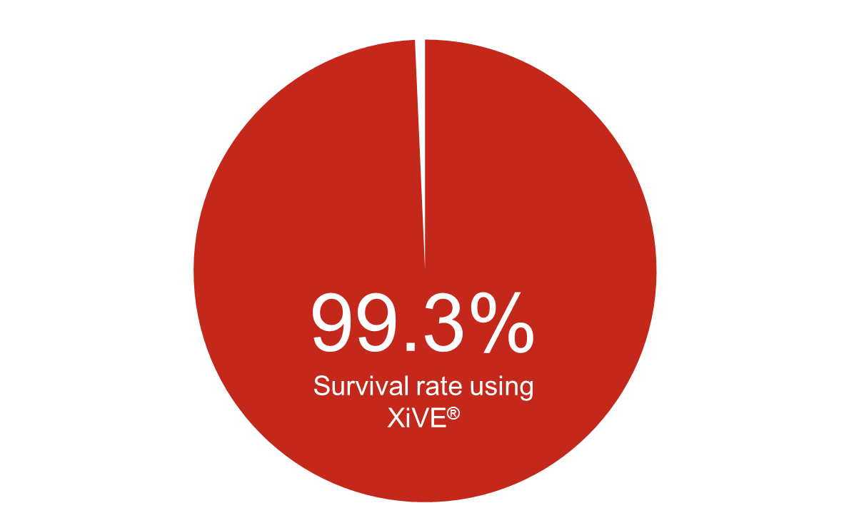
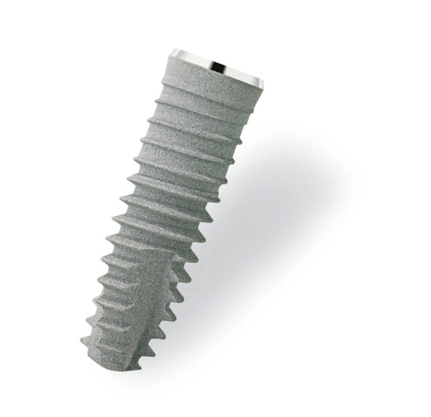
Behind the results since 2001
Progress and innovative solutions
Surgical versatility and unlimited prosthetic freedom
High primary stability in all types of bone even for immediate loading
Degidi M, Daprile G and Piattelli A: Primary stability determination
by means of insertion torque and RFA in a sample of 4,135 implants. Clin Implant Dent Relat Res; 2012
Notes:
A study by Degidi et al. including more than 4,000 Xive implants in 2011 confirms high survival rates, even in immediate implant placement.
A clinical investigation of 4,135 Xive implants by Degidi, Daprile and Piattelli using insertion torque measurement and resonance frequency analysis (RFA) showed that with Xive a comparably high primary stability could be achieved both with immediate and delayed implant placement. In addition, when comparing immediate implant placement to delayed implant placement, no higher rates of implant loss have been observed. The number of documented implant losses at an early stage has been extremely low, resulting in a survival rate of 99.3% after six months. Hence, the authors concluded that Xive is very reliable in both healed bone and immediately after tooth extraction, provided that patients were accurately selected and instructions for use were followed.
(Degidi M, Daprile G, Piattelli A: Primary stability determination by means of insertion torque and RFA in a sample of 4,135 implants. Clin Implant Dent Relat Res 2012;14(4):501-7)

Slide 9
Xive
Implant design philosophy
Implant design philosophy

Slide 10
Xive implant design
+ 0.175 mm
per side
Implant shoulder
Slightly extended implant shoulder for a sealed cervical contact between bone and implant
Implant threading
Unique thread design for atraumatic placement and high primary stability irrespective of bone quality
Preparation protocol
Adapted to all bone qualities without overloading the cortical bone

Slide 11
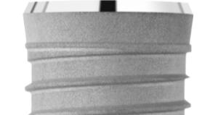
Xive implant-abutment interface
Abutment connection is 0.35 mm smaller than the implant diameter
Secure fit of prosthetic components
Promotes healthy conditions in soft-tissue zone
Notes:
Implant – abutment interface
Abutment connection is 0.35 mm smaller than the implant diameter
Secure fit of prosthetic components (no bone interference)
Promotes healthy conditions in soft-tissue zone

Slide 12
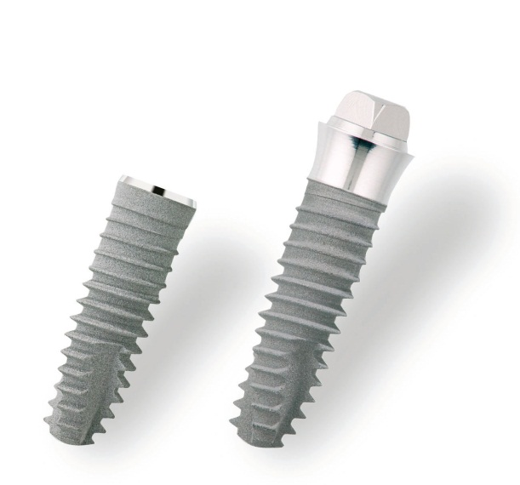
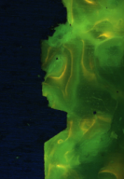
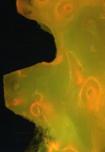
Xive thread design
Notes:
Xive thread design enables atraumatic placement and high primary stability.
Patented combination of bone specific preparation protocol and bone condensing thread design.

Slide 13
Xive thread design
Friction
Condensation
Cutting
Notes:
One implant design for all bone types
Optimal primary stability
“Internal condensation“ due to innovative thread design
Atraumatic implant placement in D I and D II due to bone adaptive preparation protocol
Patented combination of condensing thread design and bone-specific preparation protocol

Slide 14
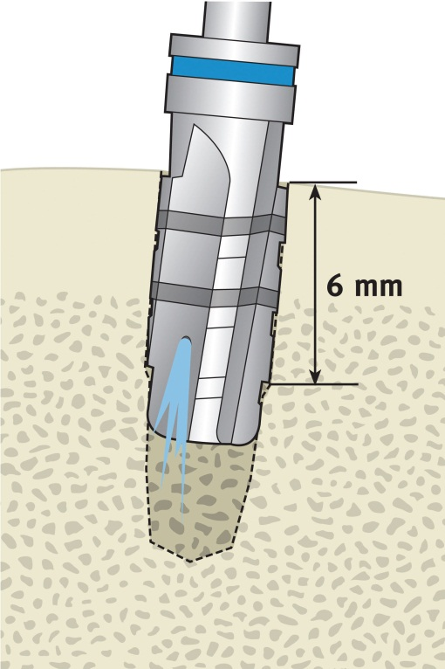
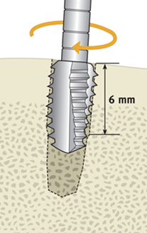
Xive thread design
Step-by-step preparation for cortical bone D I
Interim drilling
Crestal drilling
Threading
Insertion
Notes:
In case of dense bone, additional condensation is not necessary.
By using the crestal drill in full depth (6mm), the condensation portion will be recessed and as a result the condensation effect of the Xive implant will be eliminated. In case of very dense bone, an additonal threading can be performed.
Bone class D I: Dense cortical bone.

Slide 15
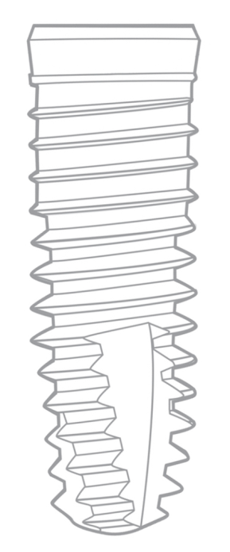
Xive thread design
Torque stabilization in cortical bone D I
Notes:
Torque stabilization of Xive (red) in bone quality D I (dense cortical bone); the platform formation reflects an atraumatic placement.
Standard cylindrical shaped implants,as the diagram above indicates, are having a linear torque increase reflecting a constant strain on the bone until the implant is finally seated. Due to the specific interaction of thread design and preparation technique, the Xive implant is creating a stepped torque increase reflected by the platform formation. During the platform formation phase, the Xive implant is screwed in without having a torque increase. As a result, there is a strain and a relaxing phase to the bone until the Xive implant is in final position.

Slide 16
Xive thread design
Reduced step-by-step preparation for spongy bone D IV
Interim drilling
Crestal drilling
Insertion
Notes:
In case of soft bone, an additional condensation is necessary to reach sufficient primary stability.
By using the crestal drill in a reduced depth (2mm), a condensation portion (yellow) of at least 4mm is activated, and as a result the condensation effect of the Xive implant is performed.
Bone class D IV: No cortical bone, fine spongy bone.

Slide 17
Xive thread design
Torque stabilization in cortical bone D IV
Notes:
Torque stabilization of Xive (red).
Standard cylindrical shaped implants, as the diagram above indicates, are having a less torque increase in soft bone until the implant is finally seated. Due to the specific interaction of thread design and preparation technique, the Xive implant increases the insertion torque incrementally reflecting a high primary stability in soft bone. During the platform formation phase the Xive implant is screwed in without having a torque increase. As a result, there are strain-relaxing phases to the bone until the Xive implant is in final position.

Slide 18
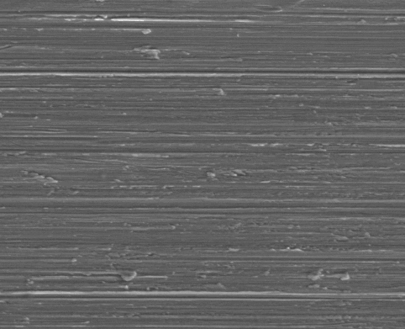
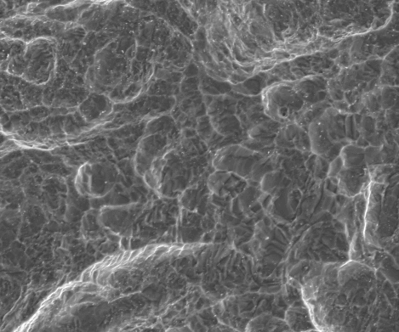
Friadent PLUS surface: Trimodal and 3D
Epithelial area
(0.4 mm / R_{a}=0.5 µm)
For no bacteria adhesion
Subepithelial area
(0.9 mm / R_{a}=0.9 µm)
For improved osseointegration of corticalis
Endosseous area
(R_{a}=2.23 µm)
For improved osseointegration of the spongiosa
Notes:
All Xive implants are manufactured with the innovative Friadent plus implant surface. The excellent properties of this microstructure result in early osseointegration and high bone-to-implant contact as documented in numerous in-vitro and in-vivo studies. The Friadent plus surface (grit-blasted and high-temperature acid-etched) is textured in three increasing roughness properties according to the bone structure.
1 | Machined polished
2 | Only high-temperature acid-etched
3 | Grit-blasted and high-temperature acid-etched

Slide 19
Xive
Implant assortment

Slide 20
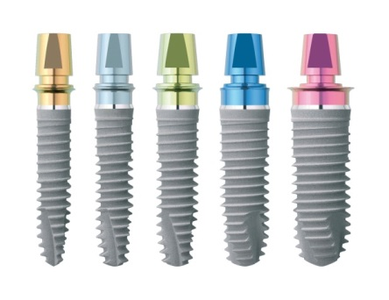
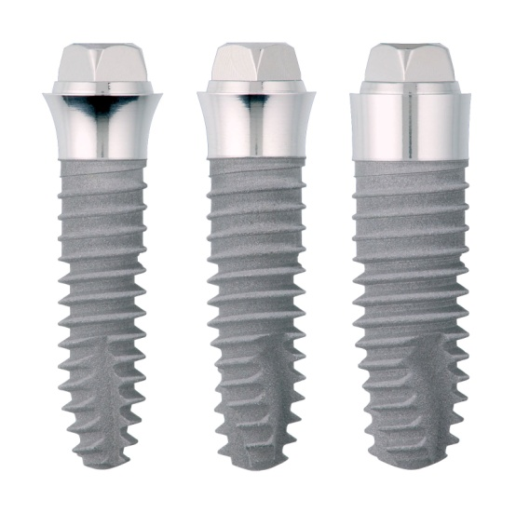
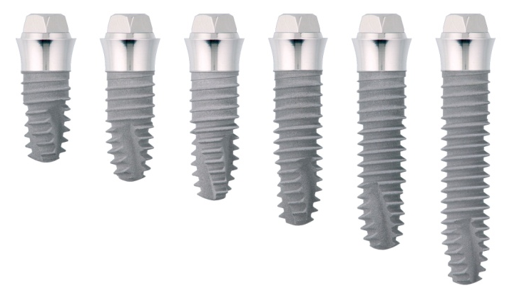
Implant sizes
Xive S
Xive TG
Notes:
Depending on the clinical need, you can select the subgingival Xive S implant or the transgingival alternative Xive TG. The identical endosseous implant design even allows you to make your choice during the actual surgical procedure. Xive has the right implant for every type of jaw anatomy.
Xive S (subgingvial) Xive TG (transgingival)
Selection of five diameters and six lengths in the fully color-coded range of subgingival Xive S implants.
Depending on the actual case, a selection between the Xive S or transgingival alternative Xive TG is possible. The unified endosseous implant design even allows you to make selection during surgery.
Xive TG also offers numerous variations that allow you to make optimum use of the available bone volume.

Slide 21
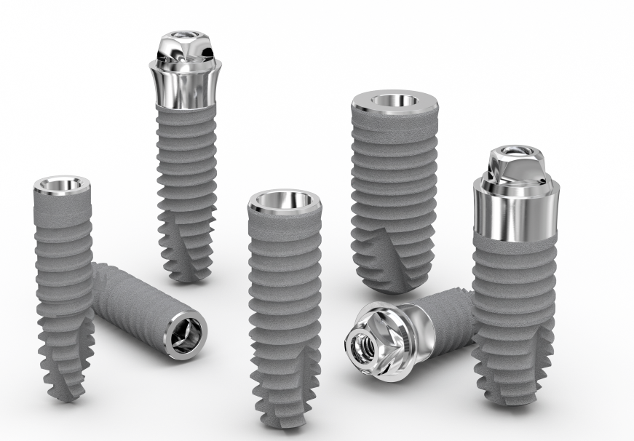
Surgical flexibility
Outstanding primary stability even in soft bone
Bone specific preparation protocol
Covers all sites including 3.0 mm
Subgingival and transgingival options
Notes:
Adapts to bone quality – outstanding primary stability even in soft bone
Bone specific preparation protocol
Covers all sites incl. 3.0 mm in diameter and 18 mm in length
Offers subgingival and transgingival options with identical site preparation

Slide 22
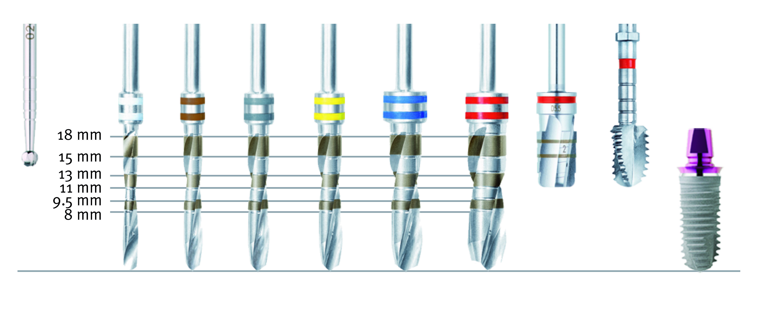
Surgical Steps
Machine-driven instruments with internal irrigation
Final preparation by machine or by hand
* From 2 mm in D IV to 6 mm in D I
** Only in very dense D I bone
Round Drill
Twist Drill
D 2.0
Twist Drill
D 3.0
Twist Drill
D 3.4
Twist Drill
D 3.8
Twist Drill
D 4.5
Twist Drill
D 5.5
Twist Drill*
crestal D 5.5
Tap**
D 5.5
Xive S
D 5.5

Slide 23
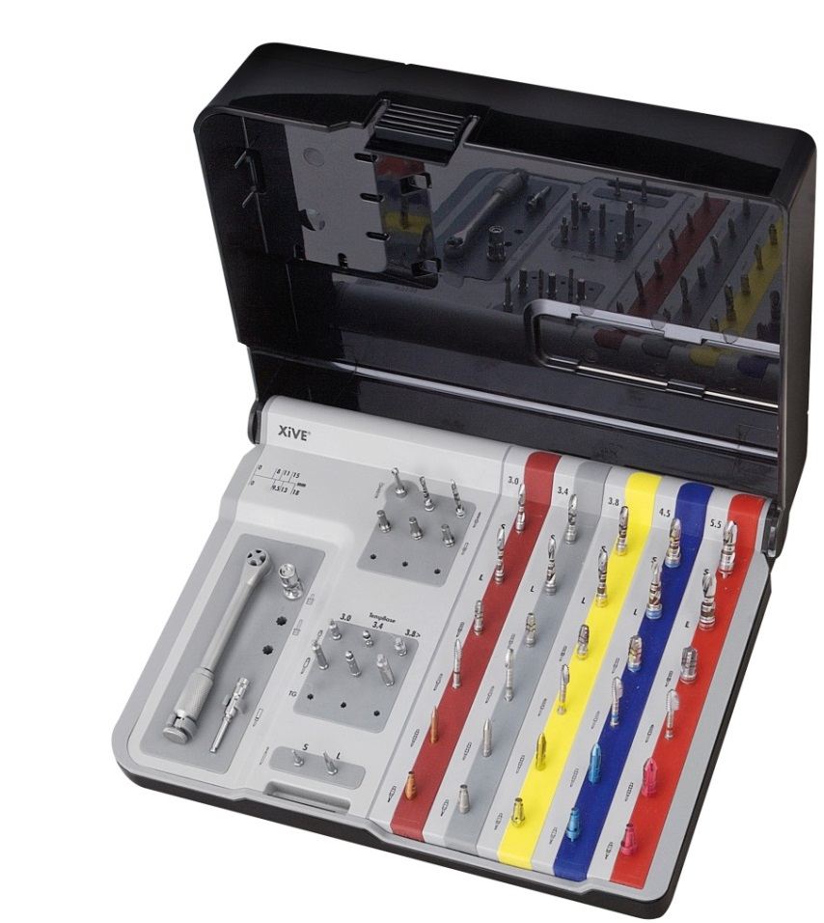
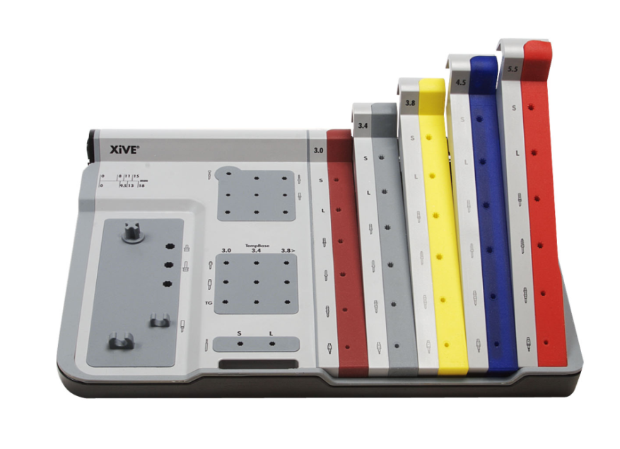
Surgical kits
Modular light plastic trays
Easily accessible
All instruments are securely held in silicone holders
Three different versions
D3.0 Kit
D3.0 – 3.8 Kit
D3.0 – 5.5 Kit
Notes:
The modular design of the Xive surgical kits include all instruments required for the standard surgical teatment protocol.
Different types of kits are available for both conventional drill protocols and guided surgery.

Slide 24
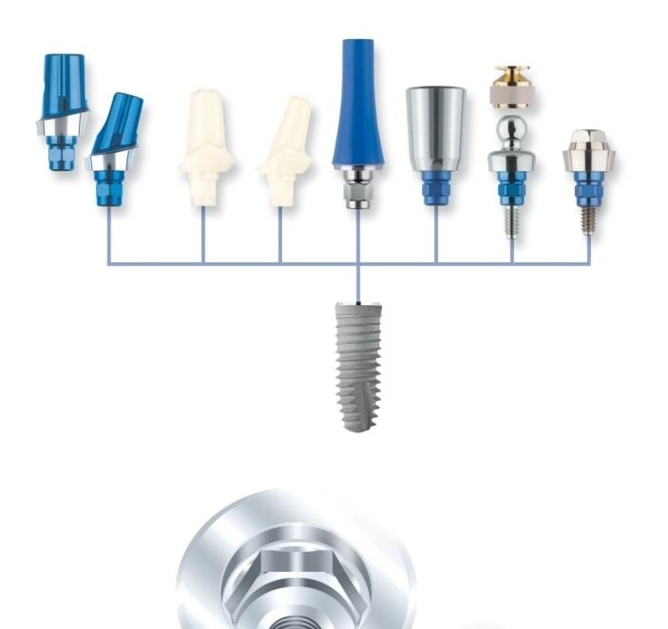
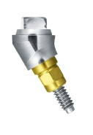
Prosthetic versatility
Comprehensive range of prosthetic solutions
Individualized contouring of the emergence profile
Premium and cost-effective full arch restorations
Color-coded components
Notes:
A range of pre-fabricated and patient-specific abutments provides versatility in prosthetics, both on implant- and abutment-level, including immediate restorations for any possible indication. An internal butt-joint connection with self-guiding properties and color-coded or laser-marked components support error-free workflow.
The Xive individual concept consists of four coordinated treatment steps in which customizable pre-fabricated and fully individually shaped components of the Xive system can be used. The final restoration can be fabricated using the CAD/CAM option of a patient-specific Atlantis Abutment.
A patient-specific suprastructure on the Xive TG implant provides the advantages of a high precision, patient-specific restoration and the cost-effectiveness of a transgingival implant. Surgery performed in just one stage saves time and money and is comfortable for the patient. Due to the transgingival design of the implant, additional abutments are no longer necessary.
Color-coded for easy handling and communication between oral surgeon, laboratory technician and dentist.

Slide 25
Xive
Solutions
Narrow gaps
Prosthetic options on angled implants
Patient-specific suprastructures on transgingival Xive TG
Immediate loading and temporary restorations
Patient-specific esthetics
Narrow gaps

Slide 26
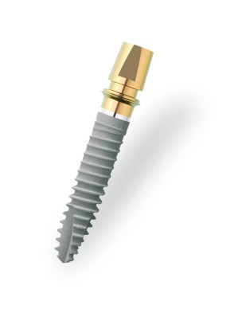
Xive D 3.0 mm: For even the narrowest gaps
For clinical situations with limited space
Ideal for congenitally missing natural teeth in the anterior region
Large selection of prosthetic components
Notes:
Indication Single-tooth restoration in the anterior region, 7 + 10 and 23 – 26.
Splinted single-tooth restoration region 23 - 26
Two-stage procedure or non-functional immediate loading
Delayed immediate or late implant placement

Slide 27
Placement of a Xive D 3.0 mm implant
Notes:
Animation of the Xive 3.0 implant – for clinical situations with limited space.

Slide 28
SmartFix concept
Prosthetic solution on
angled implants
Stable prosthetic fit
Avoids critical anatomical areas
Very small abutment head
Secure handling with premounted seating instrument
Notes:
The SmartFix concept is an implant-prosthetic procedure for the immediate restoration of edentulous patients with screw-retained bridges or bar dentures in the maxilla and mandible on a minimum of four implants.
(Animation)

Slide 29
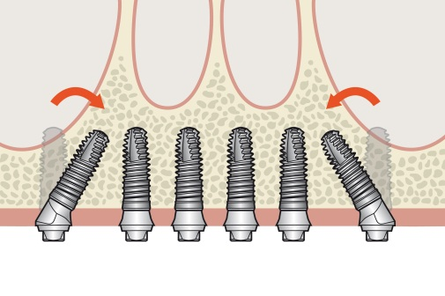
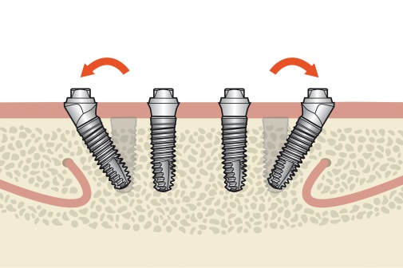
Angled MP abutments
SmartFix concept
Implant-prosthetic procedure for immediate restoration with screw-retained bridges or bar dentures
Edentulous patients
In the maxilla and mandible
Avoids critical anatomical areas
Avoids sinus floor elevation in the maxilla or nerve transposition
Notes:
Advantages
1 | Avoiding the need for bone grafting Augmentation and critical anatomical areas can be largely circumvented by using implants placed in an angled position, thus avoiding sinus floor elevation in the maxilla or nerve transposition in the mandible.
2 | Stable prosthetic fit The area supporting the prosthesis is extended distally by anchoring the angled implants in existing bone volume. The local bone is thus utilized optimally and improves the support of the prostheses by reducing cantilevers.
3 | Freedom of design The very small abutment head provides optimum freedom of design for the suprastructure in terms of height and diameter.
4 | Secure handling with simplified delivery of the Xive MP abutments with the short and flexible seating instrument, especially when space is restricted.
5 | Indexed positioning with integrated hex providing accurate positioning of angled MP abutments. Please note: a marker on the implant driver must point in the direction of the implant apex to make sure that the Xive MP abutment compensates the axial divergence correctly.
6 | Platform-Switching shifts the transition between the implant and the abutment in a central direction for implants with the diameters 4.5 and 5.5. This enables easy access of the abutments to the implant and avoids irritation of the peri-implant bone. Collision with the distal bone crest is largely avoided by the narrow angled abutments.
7 | Compatibility with precision-fit CAD/CAM Atlantis suprastructure suprastructures in titanium and cobalt chrome through the optimal connection of the angled MP abutments to the Atlantis suprastructure suprastructures.

Slide 30
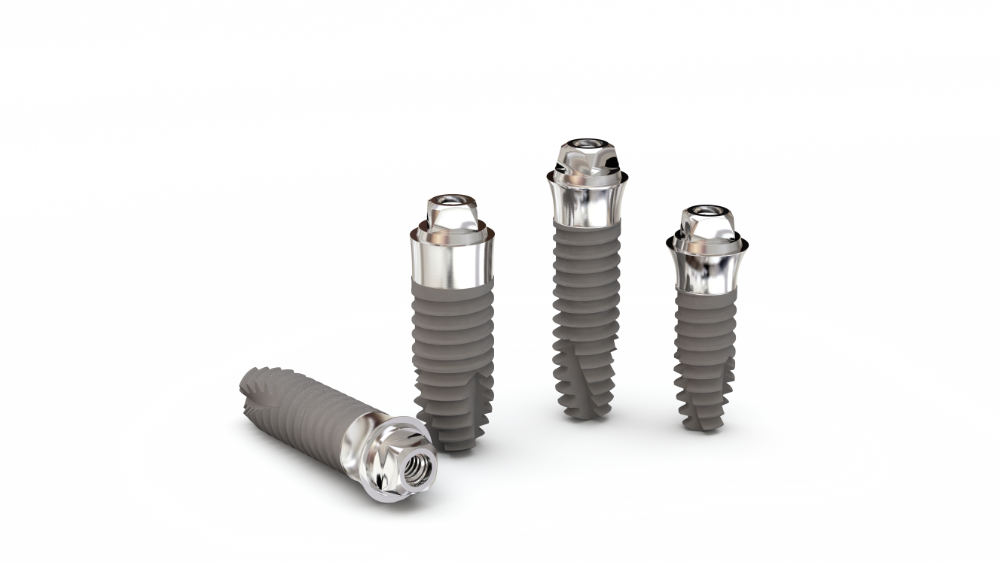
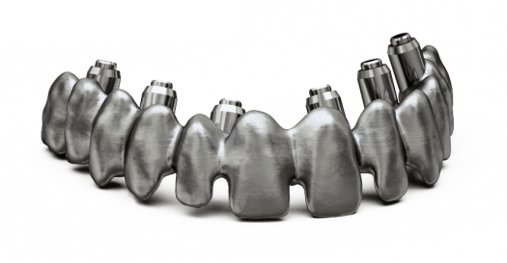
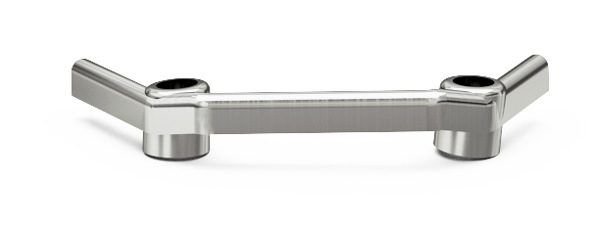
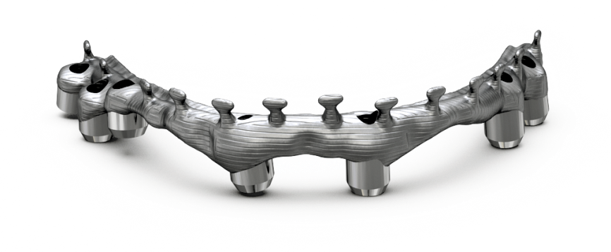
Atlantis suprastructure on Xive TG
High precision
and versatility
High precision of a patient-specific restoration with the cost-effectiveness of a transgingival implant.
Notes:
A patient-specific suprastructure on the Xive TG implant provides the advantages of a high precision, patient-specific restoration and the cost-effectiveness of a transgingival implant. Surgery performed in just one stage saves time and money and is more comfortable for the patient. Due to the transgingival design of the implant, additional abutments are no longer necessary.

Slide 31
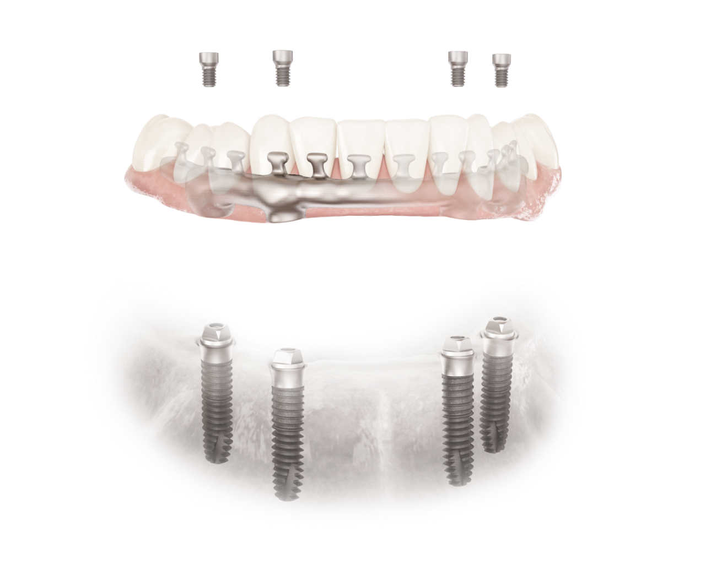
Atlantis suprastructure on Xive TG
One-stage surgery
Time-saving
Cost-effective
Precise and passive fit
Notes:
With the Xive TG implant, you achieve high primary stability in all types of bone. As a result of the innovative implant thread design and surgical preparation, you can rely on Xive TG, even in cases with unfavorable bone structure.
The prosthetic restoration for Xive TG allows you to choose between a patient-specific implant suprastructure for a fixed or a removable dental implant prosthesis.
With an Atlantis suprastructure patient-specific suprastructure on Xive TG implants, you utilize all the benefits of a high precision CAD/CAM restoration on transgingival implants:
Single session surgical protocol with a high level of patient comfort
Time and cost saving by eliminating uncovery surgery
Option of temporary immediate restoration using the adapted existing prosthesis on the day of surgery
Additional abutments for prosthetic restoration no longer required thanks to the transgingival implant design
Impression making and integration of the patient-specific suprasturcture on the gingiva level
Passive, first-time fit for the restoration without need of modifying suprastructure and additional patient appointments
Atlantis suprastructure implant suprastructures are milled only after review and final approval of the design
Predictable thorough manufacturing of the milled construction by Dentspy Sirona Implants

Slide 32
Atlantis suprastructure on Xive TG
Atlantis suprastructure bar on Xive TG
Atlantis suprastructure Bridge on Xive TG
Notes:
Alternative 1 | Atlantis suprastructure Bar on Xive TG
With the Atlantis suprastructure bar on Xive TG, following transgingival healing of the implants, the patient’s final restoration is achieved with a high quality and absolutely tension-free, patient-specific bar denture on an individually milled Atlantis suprastructure structure.
Alternative 2 | Atlantis suprastructure Bridge on Xive TG
Restoration of partially and completely edentulous patients with a high quality, individually milled, fixed Atlantis suprastructure Bridge is also tension-free and allows larger spans without segmentation.

Slide 33
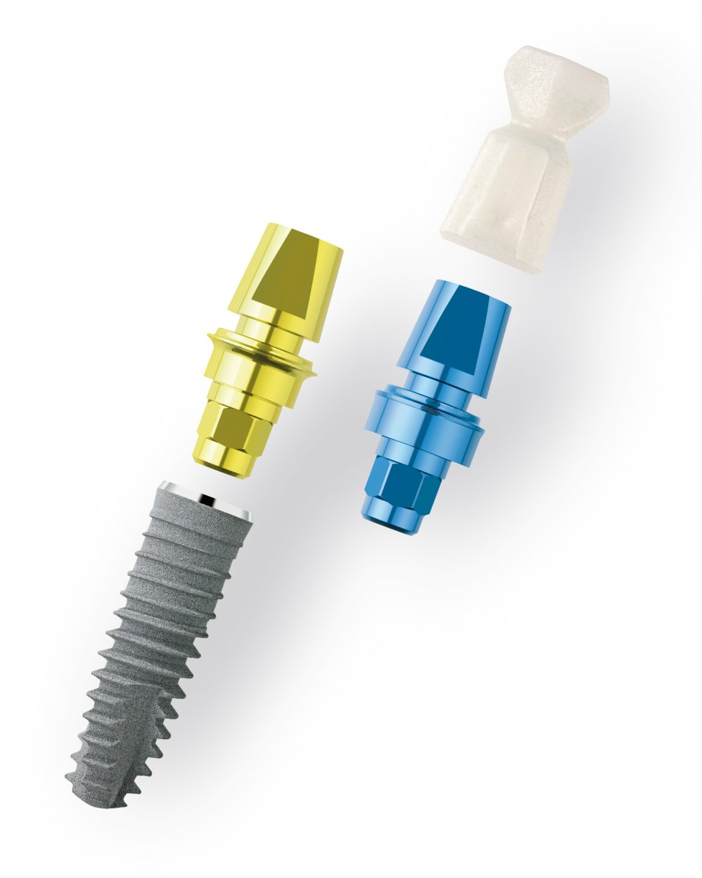
TempBase concept
Temporary restoration
Multi-functional
Time-saving
Cost-effective
Implant placement and index registration
A temporary denture in 5 minutes
Notes:
The unique TempBase concept for Xive allows immediate restoration with a high-quality temporary denture.
Multifunctional, 3-in-1
Placement head
Index registration
Temporary abutment
Time-saving
The multifunctional TempBase is premounted as a placement head on all Xive S implants
Option for index registration directly after implant placement
Cost-effective
No additional costs for a temporay abutment
Temporary crown can be fabricated chairside with the help of the TempBase Cap
Designed to be used as a provisional abutment to which a temporary restoration can be attached without changing components (i.e., without additional risk)
Clinical images 1 | Initial situation: Insertion of the Xive implant with color-coded TempBase 2 | Clipped TempBase Cap: The pre-fabricated TempBase Cap as the base for the temporary denture 3 | Result -- temporary crown: Non-functional immediate loading with a temporary crown

Slide 34
TempBase concept
Implant insertion via TempBase with immediate temporary restoration
Notes:
Animation

Slide 35
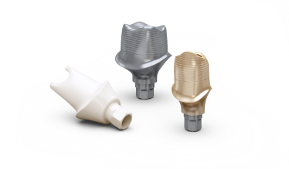
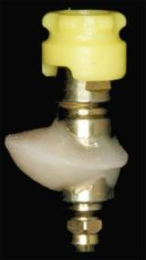
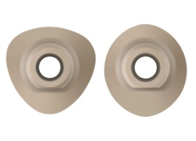
Patient-specific esthetic concept
Surgery
Prosthetics
1. Individualized, adaptable surgical protocol
2. Individualized gingiva formers/ provisonals
3. Individualized impression-taking
4. Individualized final abutments
All bone types: Patented bone specific preparation protocol (bone condensing thread design, crestal drill)
All site sizes: Includes 3.0 diameter and 18mm in length
All healing modes: Sub- and transgingival option with same site preparation
All loading options: - Functional immediate loading - Non-functional immediate loading - Late loading
Friadent EsthetiCap
triangular & oval
Inidvidualized transfer- coping
Atlantis patient-specific abutments
Notes:
The esthetic individual concept provides the solution to create a predictable esthetic outcome in demanding and patient-specific cases.
A patient-specific treatment approach from surgery through the provisionalization, impression-taking and final restoration with Atlantis abutments allows for high esthetic outcomes.

