Slide 1
Speaker slide deck
See notes for each of the slides in the NOTES VIEW.
This material is divided into sections. Use only what is appropriate for the location of your presentation.
If needed you should TRANSLATE from English to your local language.
We want you to ADD YOUR OWN CASES where appropriate.
Where official directions are offered, you must follow the manufacturer instructions (ON LABEL USAGE ONLY).
All materials are property of Dentsply Sirona or their original copyright holders.
Please DO NOT PUBLISH or transfer any slides, images or videos to any other person, institution or company.
Notes:
This presentation material is the property of Dentsply Sirona Implants.
The entire contents are copyright protected either by Dentsply Sirona or the original authors. This material is furnished only to pre-approved and pre-qualified trainers in order to prepare their own lectures and presentations. You, as an approved, individual presenter, can utilize any of the materials (pictures, animations, videos, logos etc… ) herein for your live presentations. These materials must not be copied, transferred, given or shared in any way given to any other parties or publishers.
Do not change any sequence or mode of use of any of the systems described herein.
The drilling protocol and surgical procedures are clinically tested and validated and part of the IFU, therefore any sequences must be demonstrated according to current manufacturer recommendations.
This presentation has been built in 16x9 aspect ratio. When re-formatting to your personal presentation look be careful not to distort any images if moving to a 4x3 screen size.
All possible video embedded is platform-independent. That means than any MP4 format material should play on both Windows (version 7 and later) and Mac systems.
Author: Dentsply Sirona Implants Clinical Affairs
Johanna Nilsson: johannae.nilsson@dentsplysirona.com
Review date: April 2022

Slide 2
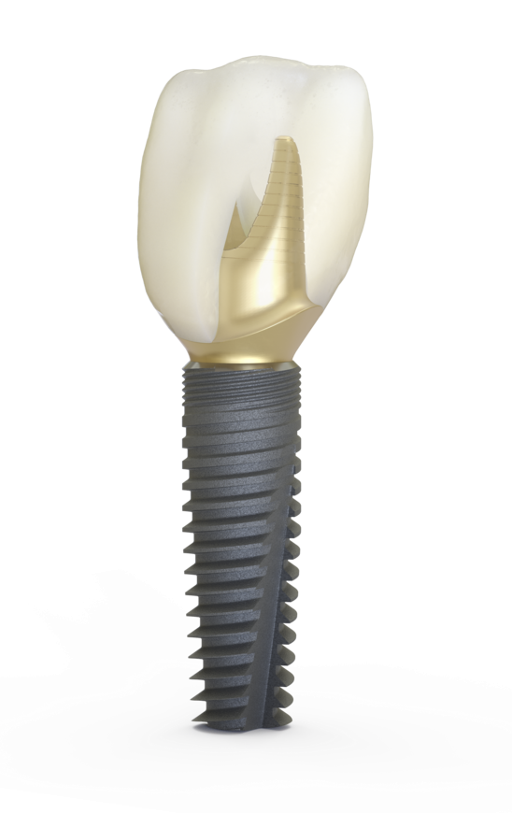
The enclosed materials are the framework for a basic presentation or course featuring DS PrimeTaper from Dentsply Sirona

Slide 3
DS PrimeTaper Table of Contents
Design philosophy Slide 4
Implant design Slide 5
Implant workflow Slide 20
Implant line and instruments Slide 25
Drilling protocols and site preparation Slide 40
Implant installation Slide 47
Guided surgery Slide 53

Slide 4
DS PrimeTaper Philosophy and development
Enable optimized implant treatments for all clinical indications, delivering desired immediate installation stability, which enables immediate restorations
Lasting bone care ensures reliable function and esthetics, with long-term marginal bone maintenance
Give an efficient handling experience and is supported by a seamless, fully integrated digital implant workflow

Slide 5
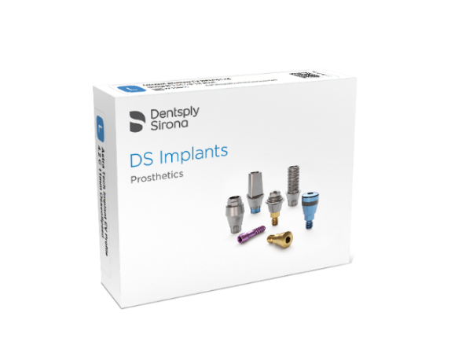
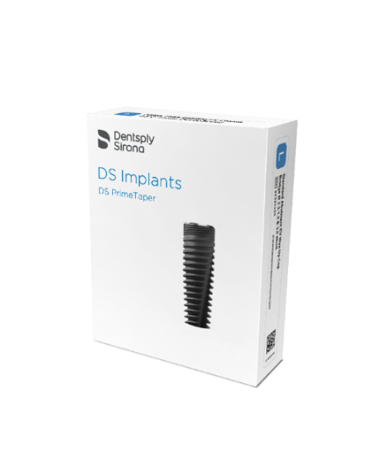
DS PrimeTaper implant portfolio Harmonized, simplified and modernized
5

Slide 6
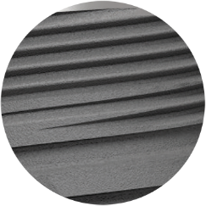
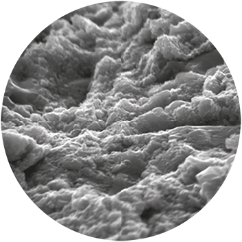
DS PrimeTaper implant portfolio Features and benefits
Taking the best parts of Astra Tech Implant EV
The clinically proven track record for fast, predictable osseointegration and excellent esthetics
And adding to it, with:
Efficient and simplified handling
Predictable, linear torque build up during installation
Lasting bone care
Efficient handling
Enviable esthetics
Seamless workflow integration
Notes:
The features and benefits of DS PrimeTaper is summarized in these four cornerstones:
Lasting bone care
Efficient handling
Enviable esthetics
Seamless workflow integration
To achieve all this, DS PrimeTaper is taking the best parts of Astra Tech Implant EV with added simplicity (to achieve stability, drilling sequence, etc.) and more efficient handling.

Slide 7
DS PrimeTaper Lasting bone care
Lasting bone care
Seamless workflow integration
Efficient handling
Enviable esthetics

Slide 8
Lasting bone care Stability and long-term bone maintenance
Lasting bone care
DS PrimeTaper provides immediate installation stability and long-term bone maintenance
Variable thread and flute design provides excellent cutting efficiency for precise bone management
Delivers immediate installation stability in different bone qualities
Provides long-term bone preservation thanks to proven features derived from Astra Tech Implant System EV
OsseoSpeed
MicroThread
EV Connection
Outstanding surface technology (OsseoSpeed) outperforms other major surfaces in the market*
*Norton, MR, Astrom, M, The Influence of Implant Surface on Maintenance of Marginal Bone Levels for Three Premium Implant Brands: A Systematic Review and Meta-analysis. Int J Oral Maxillofac Implants 2020;35(6):1099-111
Notes:
PrimeTaper EV provides immediate installation stability in different bone qualities and long-term bone maintenance.
This is thanks to the variable thread and flute design which provides excellent cutting efficiency and precise bone management, allowing for immediate installation stability during placement in different bone qualities enabling immediate restorations.
The proven and derived features and benefits from Astra Tech Implant System EV, these are: OsseoSpeed, MicroThread, and the EV Connection.
Here we also want to mention the outstanding surface technology of OsseoSpeed. A recently published study by Dr. Michael Norton, UK, demonstrates that OsseoSpeed outperforms other major surfaces in the market for example TiUnite from Nobel Biocare as well as SLA/SLActive from Straumann.

Slide 9
Lasting bone care Design philosophy
Lasting bone care
MicroThread on the implant neck
Providing biomechanical bone stimulation
and long-term marginal bone maintenance
Progressive design with variable thread shapes
Stabilizing and contributing to initial stability and to cutting efficiency
Linear torque build-up throughout the implant installation for predictable implant placement
Stable and fast implant installation procedures thanks to double thread design
Pronounced flute design with high cutting capacity
Effective installation for all implant cases
Easy, stable and predictable installation
Sufficient stability in different bone qualities for immediate function
CONSERVING MicroThread
CONDENSING Crestal squared thread
Simple and secure, to give immediate confidence
Reduced risk of spinners
Reduced risk of not reaching final position
Secured positioning and direction
CUTTING Apical pointed thread
Notes:
Lasting bone care is part of the design philosophy for this implant.
First
a progressive thread design with variable thread shape, but it also has a tapered shape.
On the left-hand side, you see;
at the marginal portion of the implant, the micro-threaded part,
then the squared thread shape below the micro-thread but in the upper part of the macro thread and
at the bottom the apically more pointed threads.
The cutting capability comes mainly from threads in the apical portion and from the pronounced flute. All combined these give an effective installation for all indications.
A predictable installation with a linear torque build-up and a stable and fast installation thanks to the double thread design. That means that the implant advances double the pitch distance when you turn it one turn. In the case of DS PrimeTaper, which has a pitch of 0.75 mm, the distance you get into the osteotomy by turning the implant one turn is thus 1.5 mm.
The micro-thread also contributes to the stability and to cortical bone stimulation.
All in all, this reduces the risks of spinners and of not reaching final position; without the possible negative effects of the implant changing direction or finding its own way during installation. It neatly follows the osteotomy you prepared.

Slide 10
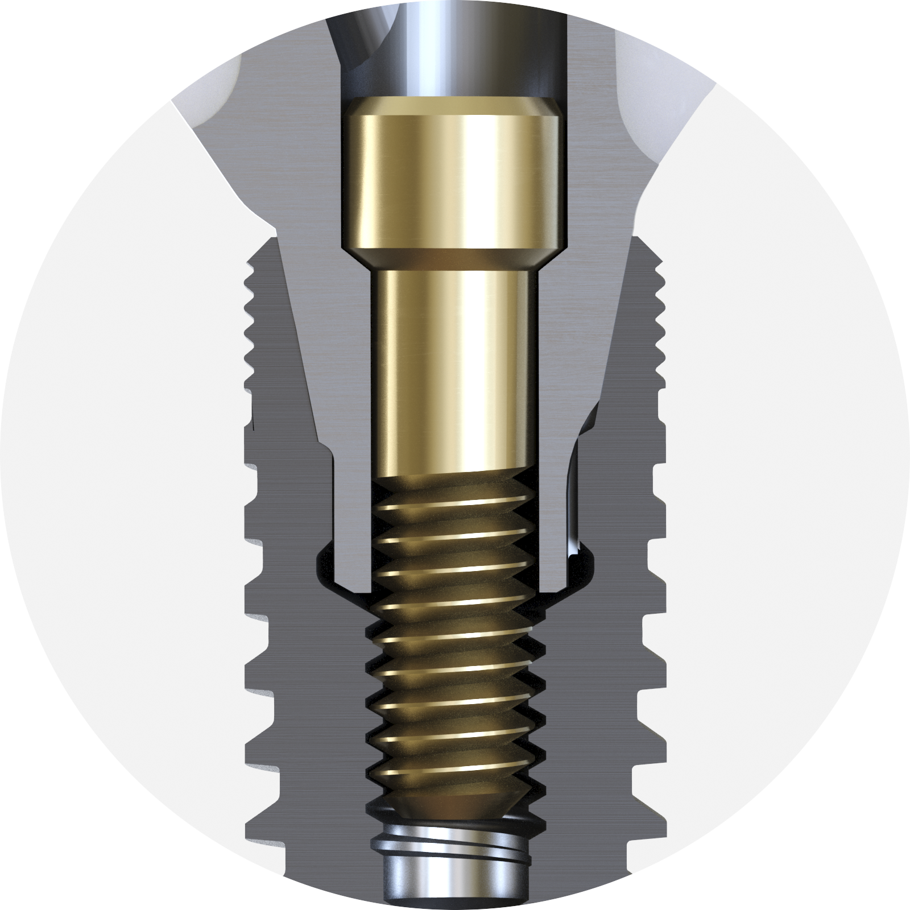
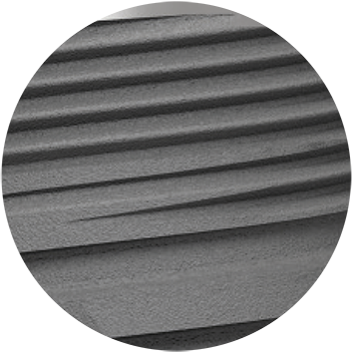
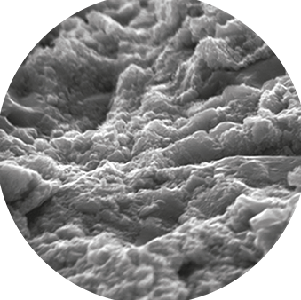
Lasting bone care Features backed by science, proven from Astra Tech Implant System EV
Lasting bone care
MicroThread for long-term marginal bone maintenance
EV Connection
for a stable fit
OsseoSpeed stimulates early bone healing and osseointegration
Progressive taper and thread design
Notes:
As mentioned before, the key features are derived from the Astra Tech Implant System EV - features that are already well-proven and documented.

Slide 11
Lasting bone care MicroThread
Lasting bone care
Minute threads on implant neck delivers biomechanical bone stimulation and maintained marginal bone levels over the long term.
Lee DW, Choi YS, Park KH, Kim CS, Moon IS. Effect of microthread on the maintenance of marginal bone level: a 3-year prospective study. Clin Oral Implants Res 2007;18(4):465-70.
Abrahamsson I, Berglundh T. Tissue characteristics at microthreaded implants: An experimental study in dogs. Clin Implant Dent Relat Res 2006;8(3):107-13.
Hansson S, Werke M. The implant thread as a retention element in cortical bone: the effect of thread size and thread profile: a finite element study. J Biomech 2003;36(9):1247-58.
Hansson S. The implant neck: smooth or provided with retention elements. A biomechanical approach. Clin Oral Implants Res 1999;10(5):394-405
Notes:
MicroThread are the so-called minute threads on implant neck that ensures positive biomechanical bone stimulation at the bone/implant interface where peak stresses typically occur. This is a finding from one of the inventors of Astra Tech Implant System, Stig Hansson, who demonstrated that having a micro threaded area in the coronal part of the implant provides good biomechanical bone stimulation that preserves the bone over the long term.

Slide 12
Lasting bone care OsseoSpeed
Lasting bone care
A chemically modified titanium surface with a unique topography that stimulates early bone healing and speeds up the bone healing process.
Ellingsen JE, Johansson CB, Wennerberg A, Holmén A. Improved retention and bone-to-implant contact with fluoride-modified titanium implants. Int J Oral Maxillofac Implants 2004;19(5):659-66.
Berglundh T, Abrahamsson I, Albouy JP, Lindhe J. Bone healing at implants with a fluoride-modified surface: an experimental study in dogs. Clin Oral Implants Res 2007;18(2):147-52
Geckili O, Bilhan H, Bilgin T. A 24-week prospective study comparing the stability of titanium dioxide grit-blasted dental implants with and without fluoride treatment. Int J Oral Maxillofac Implants 2009;24(4):684-88.
Barewal RM, Stanford C, Weesner TC. A randomized controlled clinical trial comparing the effects of three loading protocols on dental implant stability. Int J Oral Maxillofac Implants. 2012;27(4):945-956.
Notes:
OsseoSpeed has a chemically modified titanium surface with a unique topography that stimulates early bone healing and speeds up the bone healing process.

Slide 13
Lasting bone care EV connection
Lasting bone care
The EV Connection with its stable fit offers an easy and straight forward abutment connection and scanning/ impression procedures.
Notes:
The EV connection offers a stable fit and comes with several abutment placement and indexing options such as the much appreciated one-position-only for impression components and for patient-specific Atlantis abutments which will only seat in one position. It also offers components fitting a six-position indexing, as well as a non-indexed option.
The EV Connection with its stable internal conical connection was first introduced in Astra Tech Implant System, an innovation that is now copied in different versions and implemented on most implants being sold today.

Slide 14
Lasting bone care
Lasting bone care
DS PrimeTaper implants deliver immediate installation stability and can be used in all clinical indications, including extraction sockets.
The progressive tapered design provides sufficient stability allowing for immediate loading and temporization
Long-term stability and bone preservation, ensured through proven features derived from Astra Tech Implant System EV
OsseoSpeed
MicroThread
EV Connection
*Previously called Connective Contour
Notes:
DS PrimeTaper implants deliver immediate installation stability in different bone qualities and can be used in all clinical indications, including extraction sockets.
The design of the implant and its progressive thread allows for immediate loading and temporization.
The secondary stability, which gives the long-term bone maintenance comes from the proven features derived from Astra Tech Implant System EV.

Slide 15
DS PrimeTaper Efficient handling
Efficient handling
Lasting bone care
Seamless workflow integration
Enviable esthetics

Slide 16
Efficient handling experience
Efficient handling
DS PrimeTaper implants support an efficient handling for the whole treatment team.
Fast implant installation due to the double thread design
Intuitive and easy drilling protocol in a logical tray layout
Drilling protocol delivers flexibility in osteotomy preparation, with few drills providing efficiency for the practice
Predictable abutment installation due to one-position-only connection
Easy and efficient handling in digital implant workflows
Predictable and a perfect fit of single- and multiple-unit Atlantis solutions using Primescan intraoral scanner
One-position-only
Notes:
Several aspects contribute to the efficient handling.
First, the faster implant installation due to the double thread design. And since this is a tapered implant you start your implant installation already one third or halfway down into the osteotomy. Then you have the double thread assisting in a fast and smooth implant installation.
The easy drilling protocol and logical tray layout deliver flexibility in osteotomy preparation, with few drills providing efficiency for the practice.
The predictable abutment installation due to one-position-only connection that comes with the EV connection is supported by the easy and efficient handling in digital implant workflows.
The predictable fit of single- and multiple-unit Atlantis solutions and using Primescan intraoral scanner is also part of the efficient handling. There is also a whole range of stock components with EV connection supporting both indexed and non-indexed alternatives.

Slide 17
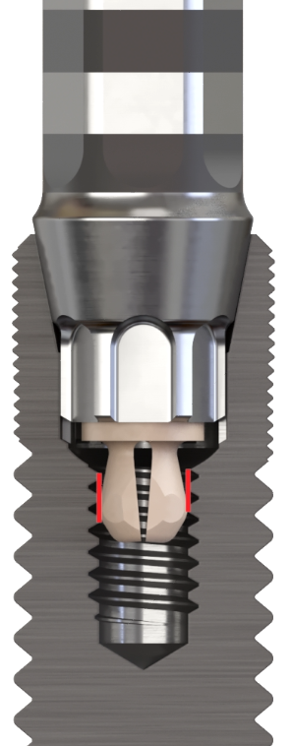
Efficient handling experience With new Implant Driver EV
Efficient handling
Secure and consistent pick-up and installation of the implant
Compatible with implants with the EV Connection
DS PrimeTaper
Astra Tech Implant System EV
Based on new material and design technology
NEW
Notes:
The new implant driver provides a secure and consistent pick-up and installation of the implant.
It is compatible with implants with the EV Connection, which are the DS PrimeTaper and Astra Tech Implant System. The driver is based on a new material with a PEEK tip and a new design technology.

Slide 18
DS PrimeTaper Enviable esthetics
Enviable esthetics
Seamless workflow integration
Lasting bone care
Efficient handling

Slide 19
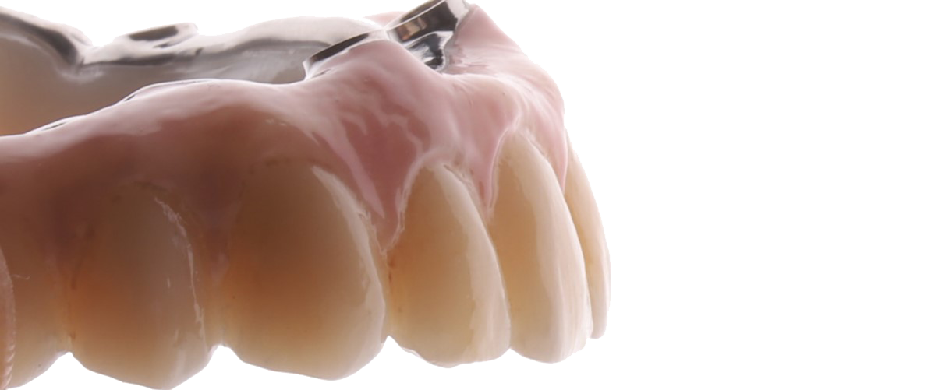
Enviable esthetics
Enviable esthetics
Maintaining the bone long-term is a prerequisite for reliable function and natural esthetic results.
Provides long term bone maintenance and healthy soft tissue thanks to proven features from Astra Tech Implant System EV
The comprehensive robust prosthetic solutions enable healthy soft tissue for long-lasting esthetics
Provides efficient restorative workflows for all indications and treatment protocols
Designed EV connection for all restorative components
Notes:
Maintaining the bone long term is a prerequisite for reliable function and natural esthetic results.
The comprehensive, robust prosthetic solutions that enable healthy soft tissues for long-lasting esthetics provides an efficient restorative workflow for all indications and treatment protocols.
Designed with tight and stable fit for all restorative components, irrespective if it is stock or customized.

Slide 20
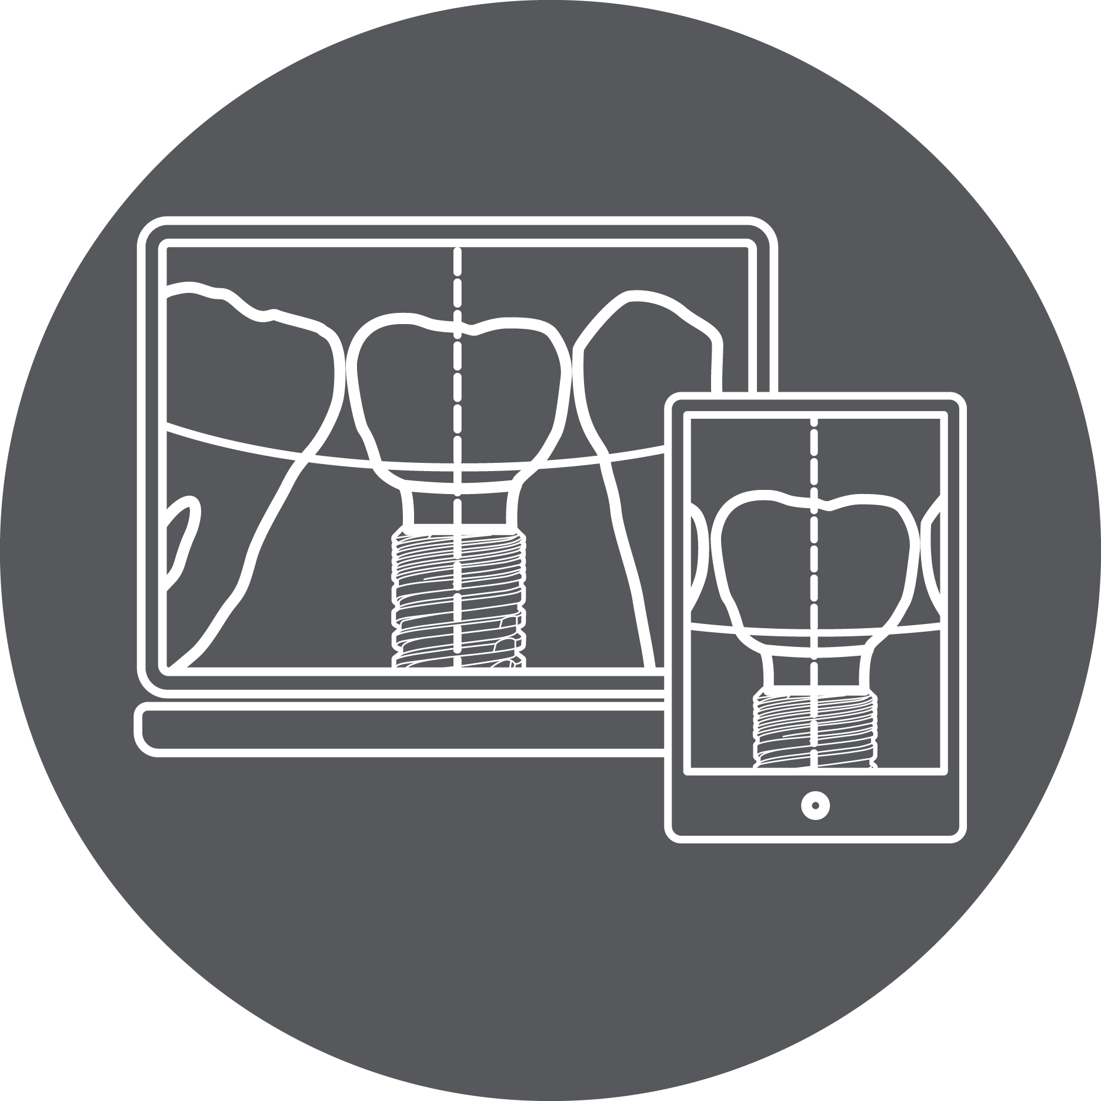
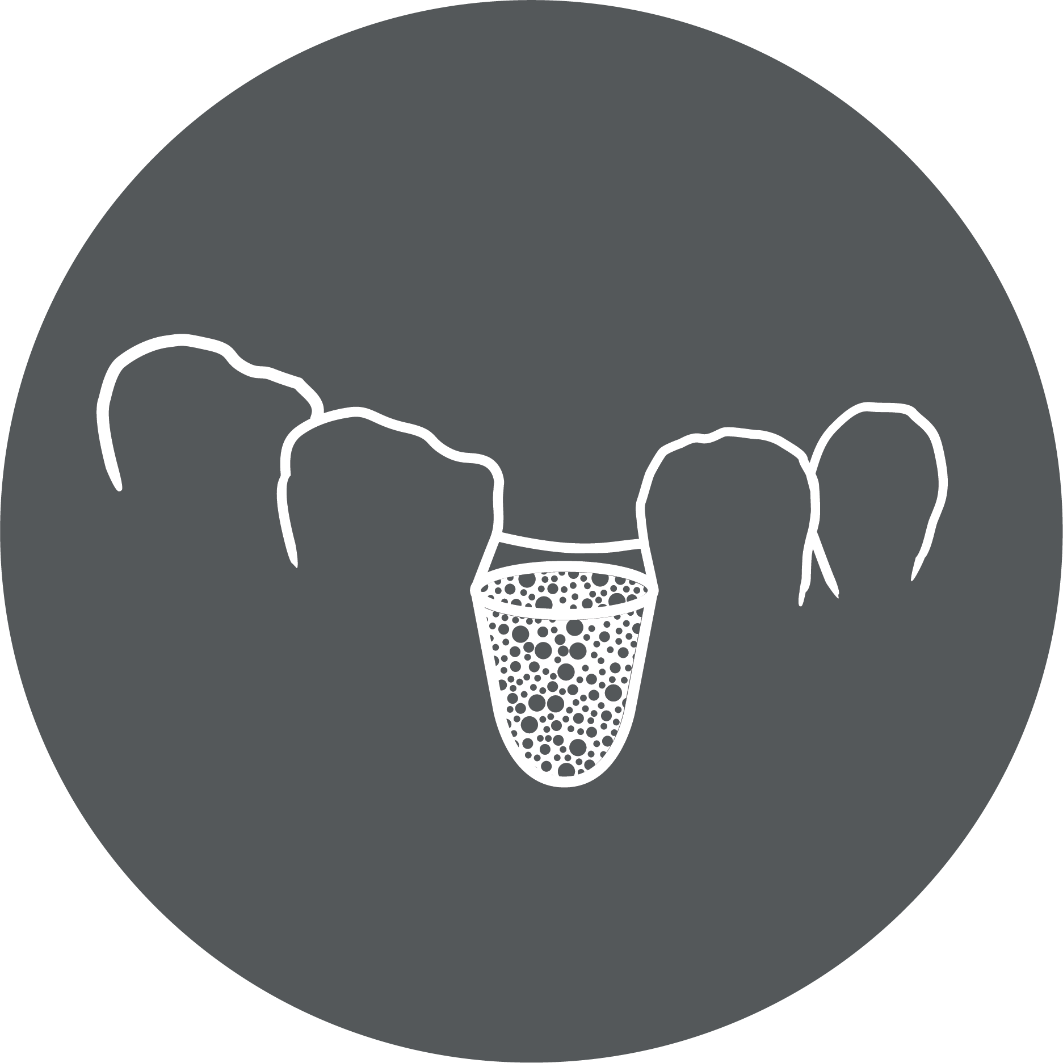
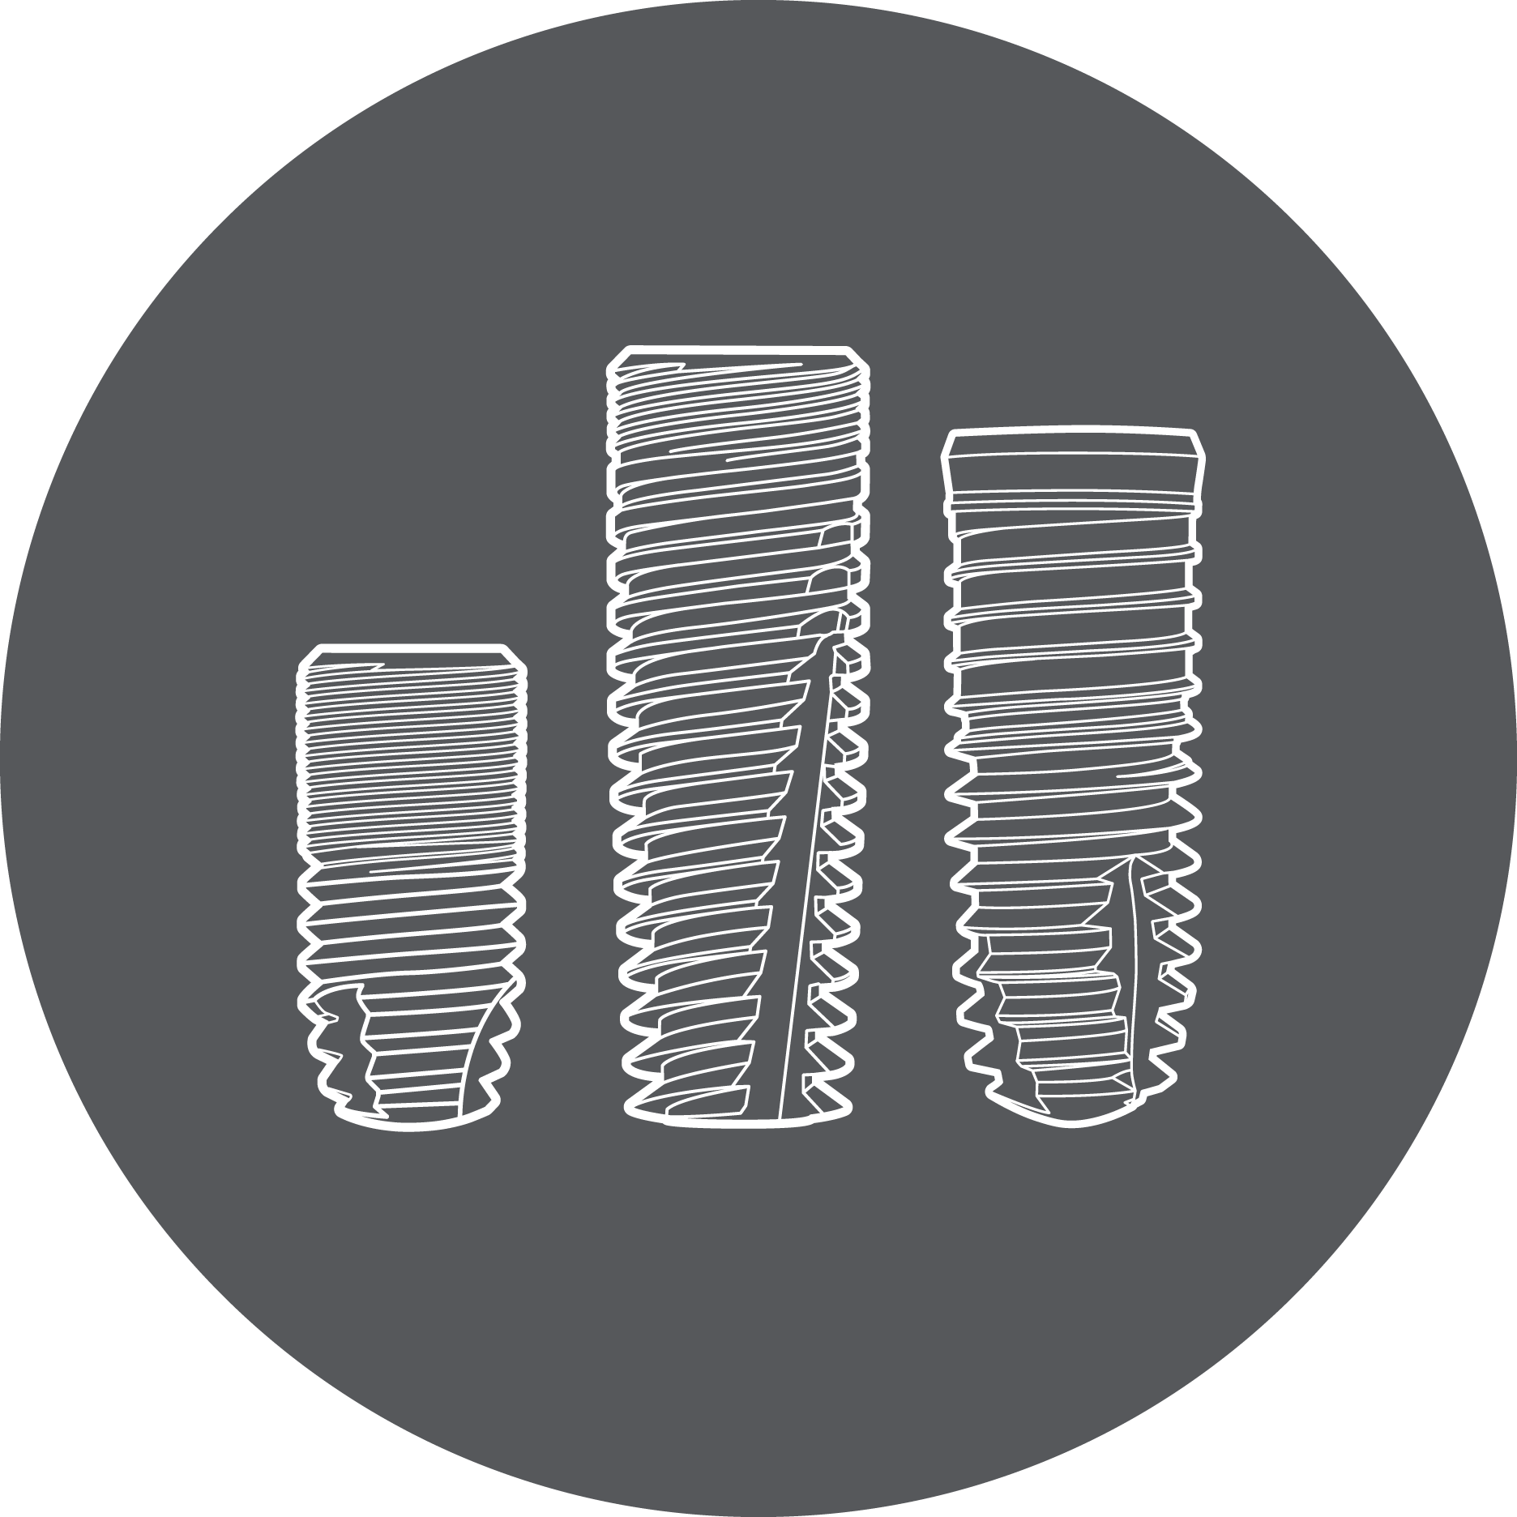
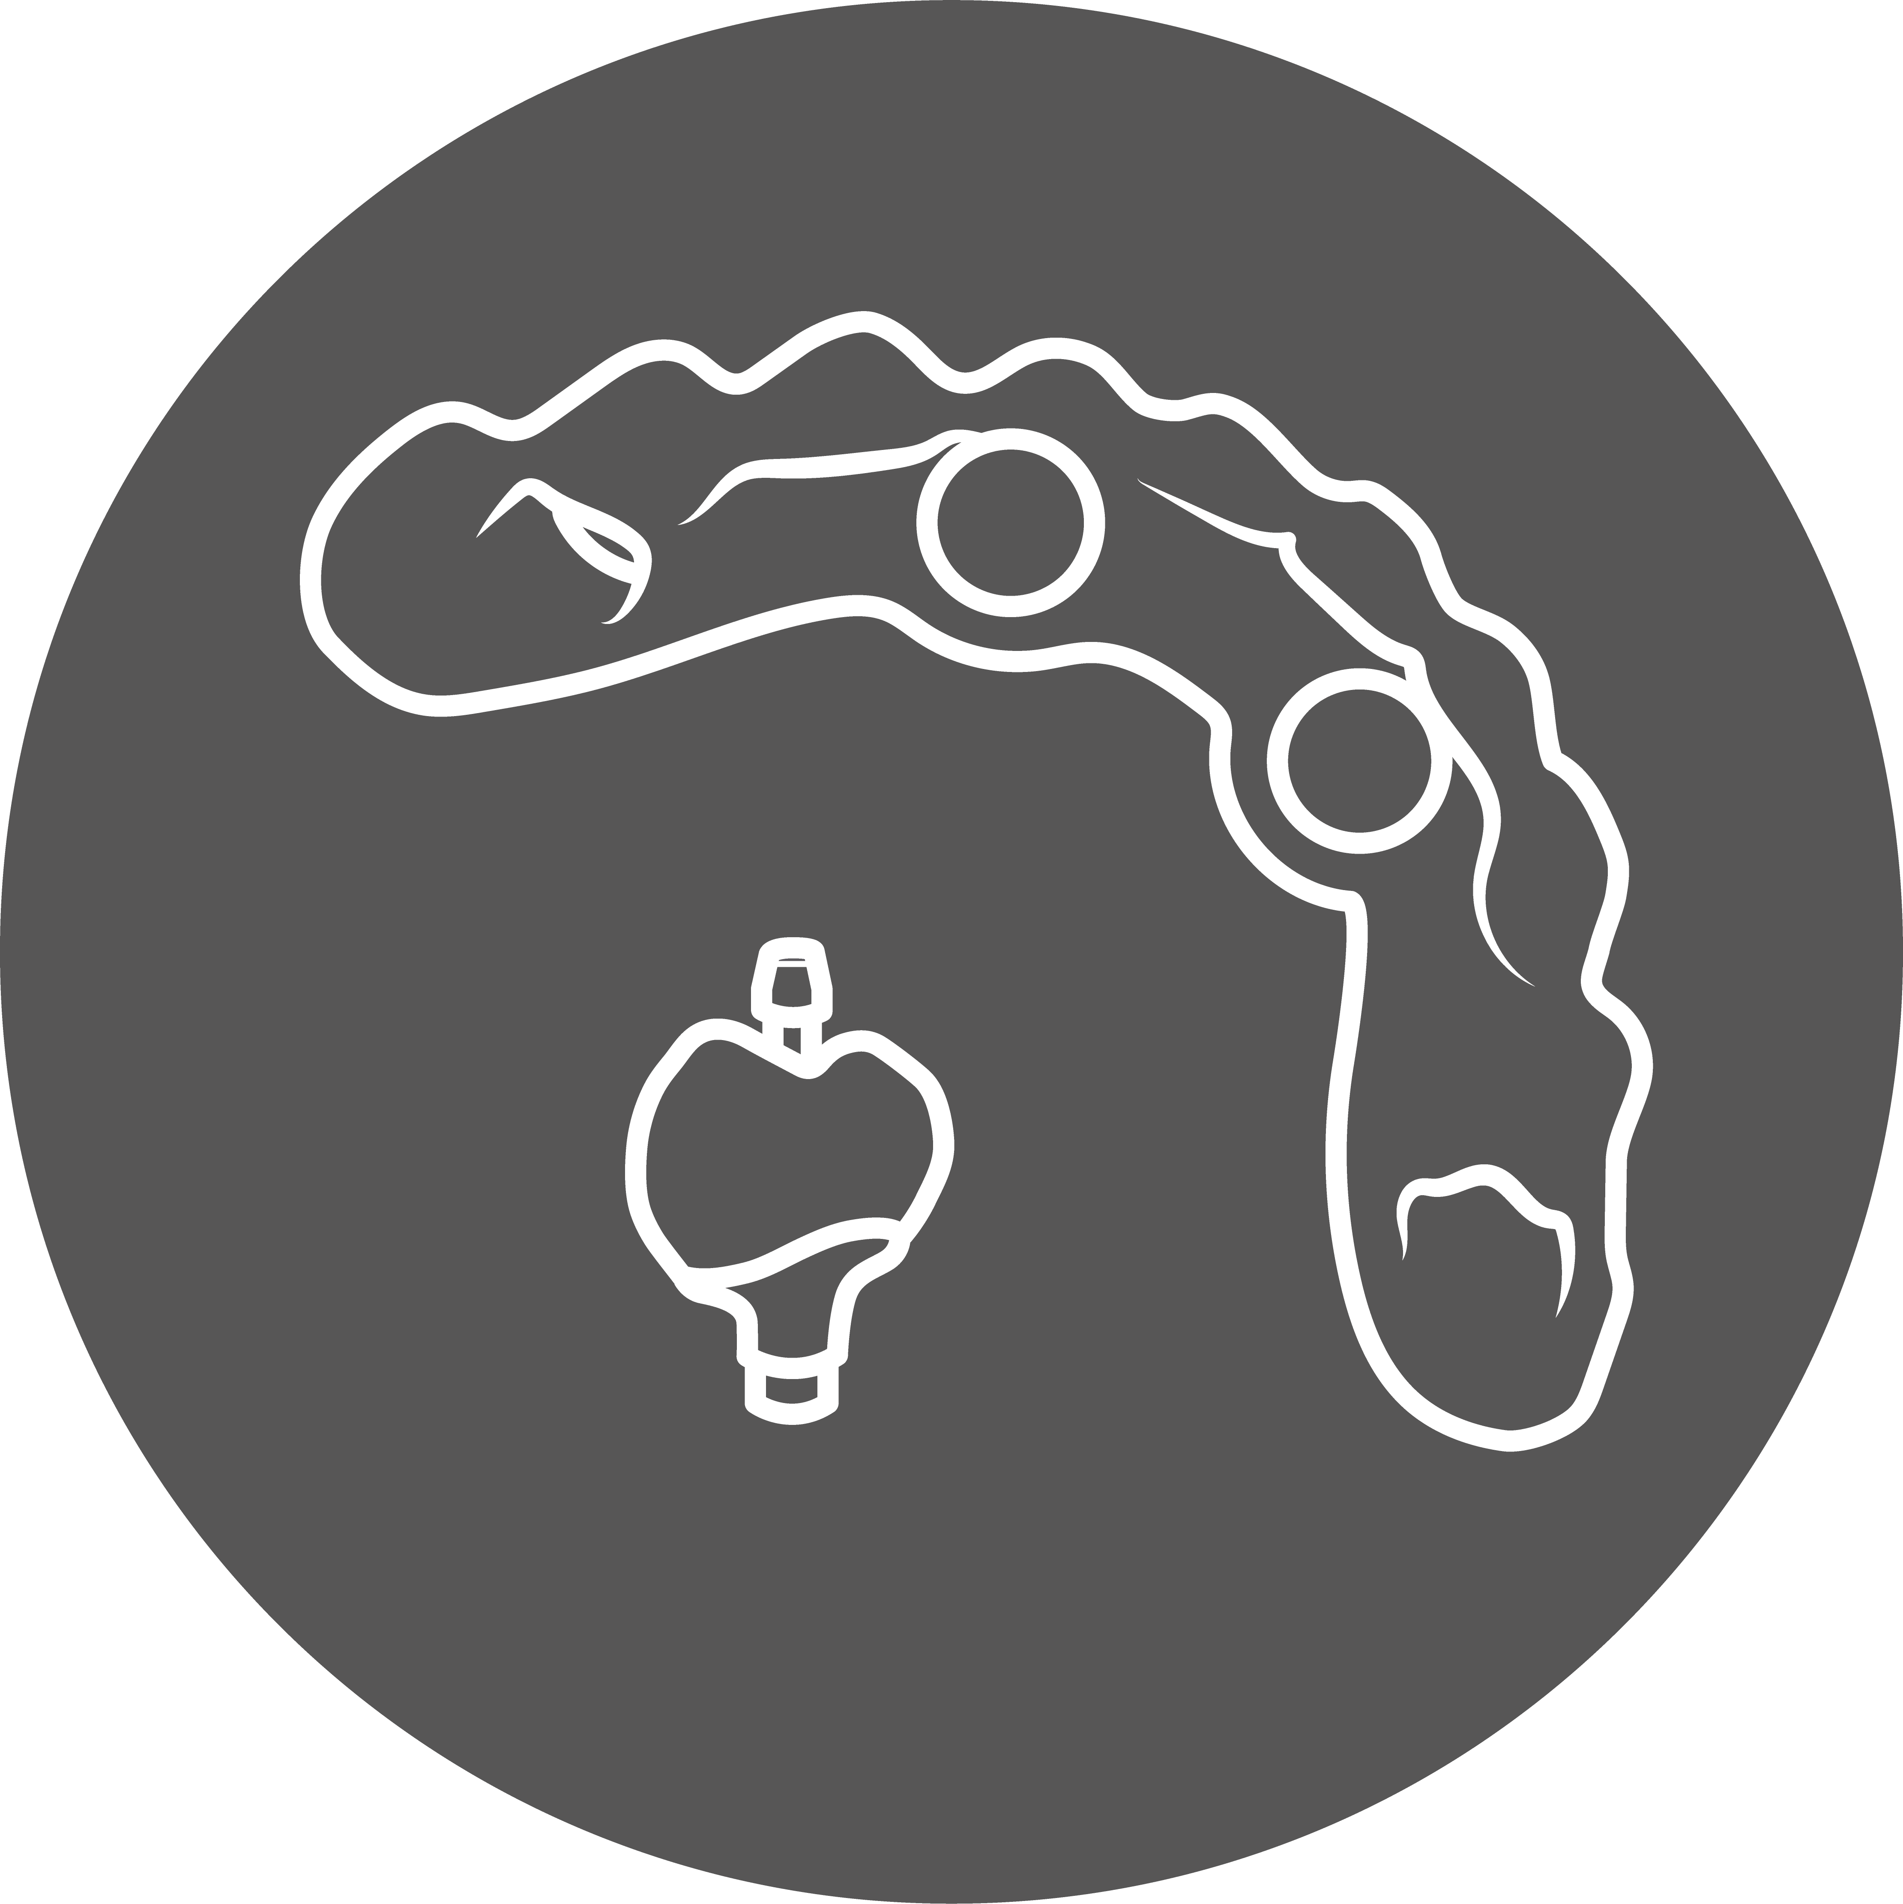
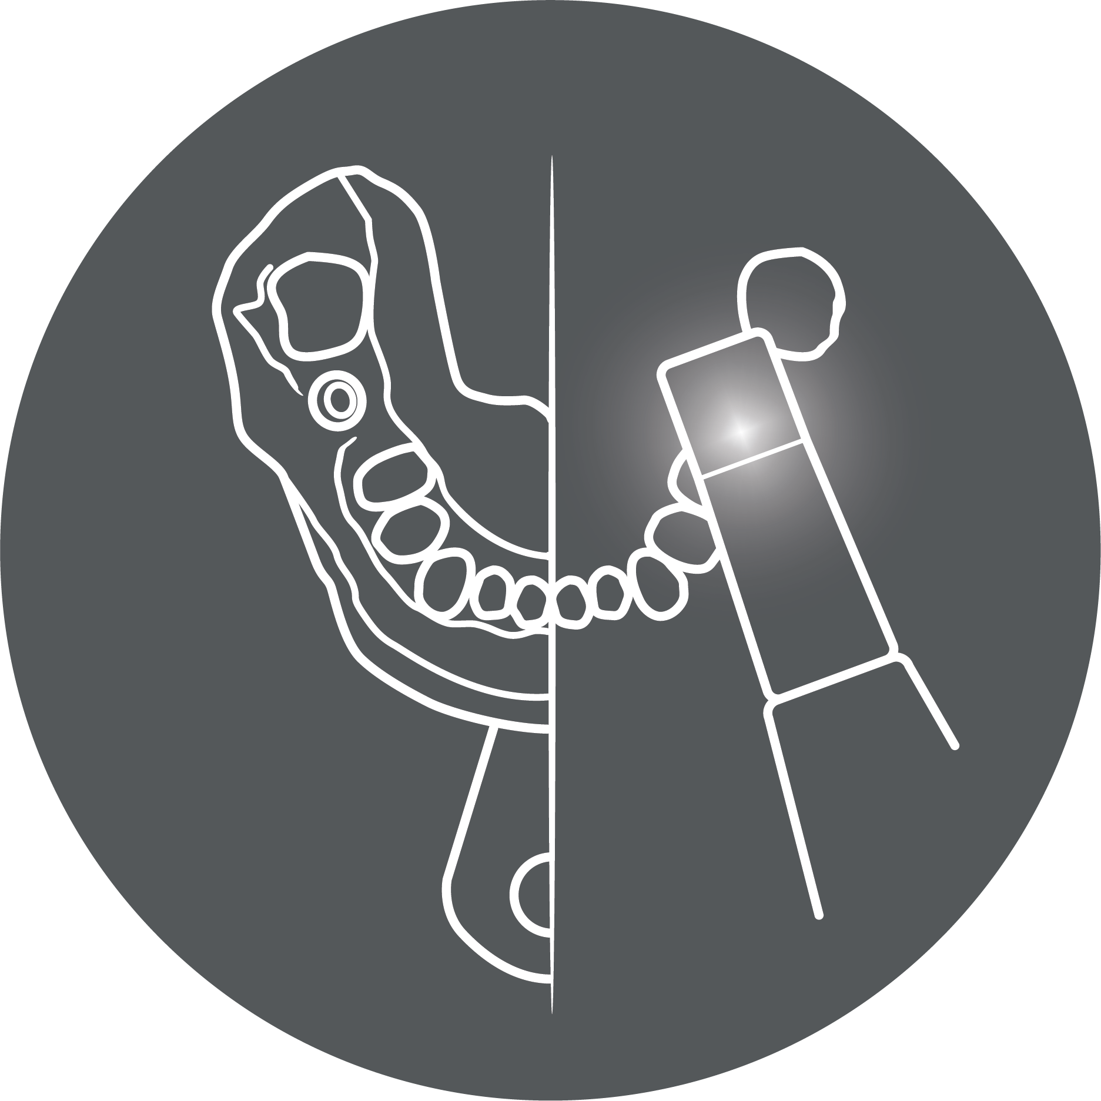
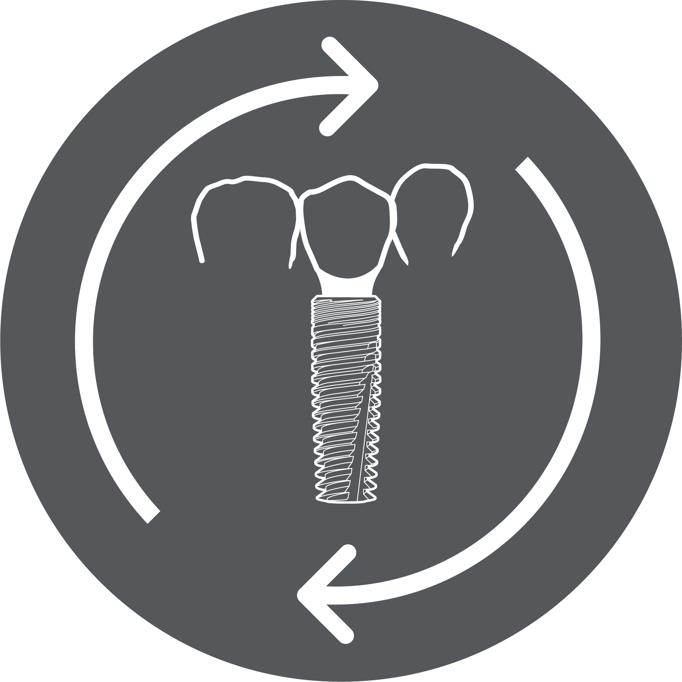
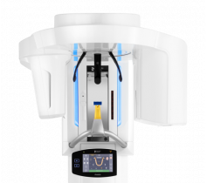
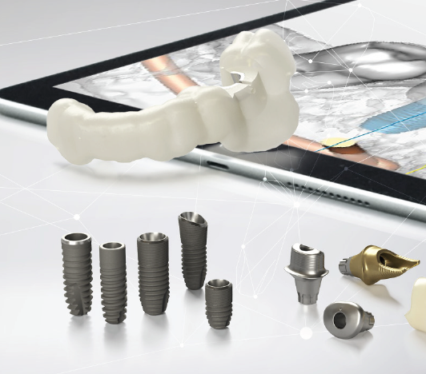
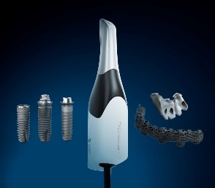
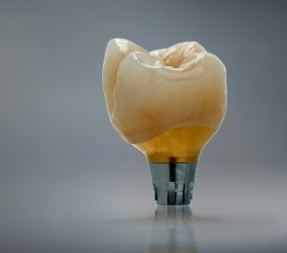
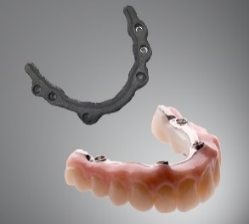
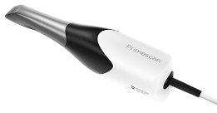
Digital implant workflow Seamless implant workflow with DS PrimeTaper
Dentsply Sirona transforms digital implant dentistry with solutions from scan to crown that outperform expectations in bone health, longevity and esthetics.
DIAGNOSIS & PLANNING
SURGERY & TEMPORIZATION
FINAL RESTORATION
NEW
NEW
NEW
NEW
NEW

Slide 21
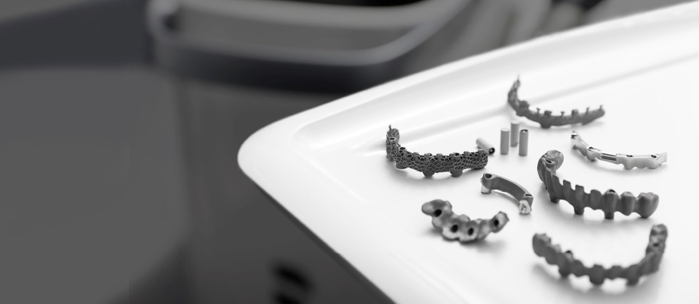
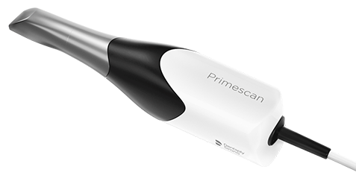
Workflow experience Digital impressions available for fully edentulous restorations
DS PrimeTaper is the most modern product line in implant dentistry, supported by a seamless, fully integrated digital implant workflow for both single- and multiple-unit restorations.
NEWS 2021
Primescan for fully edentulous restorations

Slide 22
Atlantis solutions Maintaining the high standards of Primescan
Digital impression is used for a fully digital implant workflow – bringing predictability, security, quality and comfort
Intraoral scanning is the perfect start to digital dentistry, making impressions more accurate, faster and easier than ever – Atlantis suprastructures are your ideal next step
With Primescan and partnering dental laboratory, you have convenient access to world-class, patient-specific Atlantis suprastructures design and manufacturing
Schimmel et al., Accuracy of intraoral scanning in completely and partially edentulous maxillary and mandibular jaws: an in vitro analysis
Mangano et al., Congruence between Meshes and Library Files of Implant Scanbodies: An In Vitro Study Comparing Five Intraoral Scanners
Knechtle et al., Accuracy of digital complete-arch, multi-implant scans made in the edentulous jaw with gingival movement simulation: An in vitro study

Slide 23
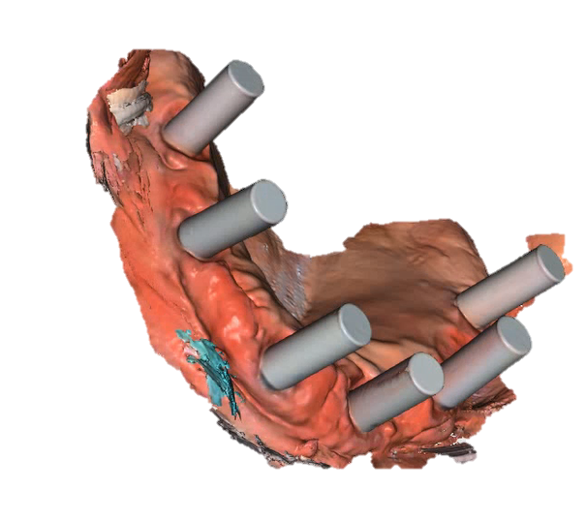
Digital impressions Atlantis suprastructures using Primescan
Improve precision, function and esthetics of single- and multiple-unit restorations using Primescan and Atlantis solutions.
NEW FOR MULTIPLE-UNITS
Use Atlantis IO FLO-S when scanning for Atlantis suprastructures on DS Implants*
*DS PrimeTaper implant system and Astra Tech Implant System EV

Slide 24
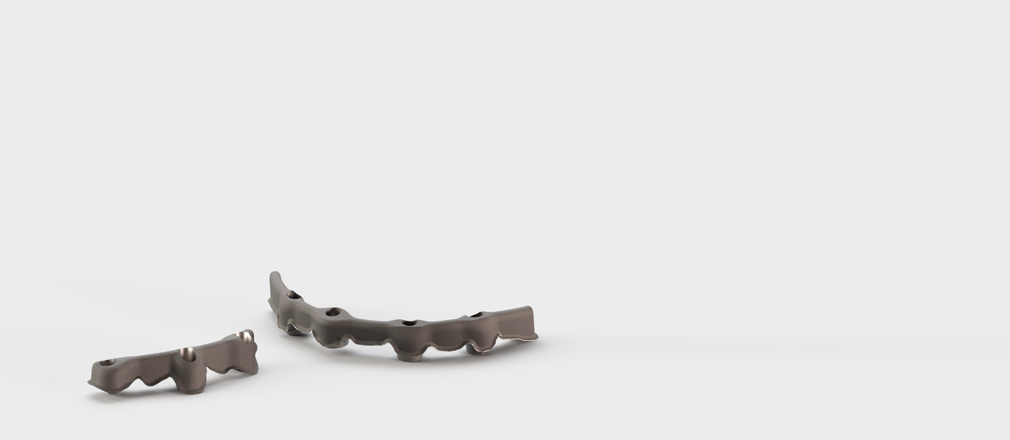
Atlantis CustomBase Solution Multiple-unit restorations using Atlantis BridgeBase
Your bridge to natural esthetic implant restorations
Based on expert design to offer a digital lab workflow
Atlantis BridgeBase offers a strong splinted foundation
Predictable process using the Atlantis Core File
Compatible with zirconia and other CAD/CAM materials for increased esthetic advantage
Customized emergence profile for enhanced tissue management
Patient-specific design of core and height for optimized retention and support
Hidden metal framework for natural translucency
Optimal positioning of the screw access channel for improved esthetics, function and installation procedures

Slide 25
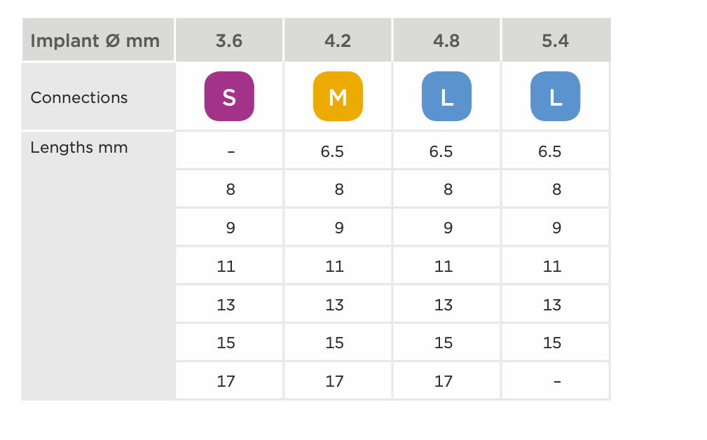
DS PrimeTaper implant line Implants sizes and color coding
The DS PrimeTaper Implant line is available in different diameters and lengths. The color coding makes it easy to identify the correct connection and to select the right prosthetic components
 | 6.5 mm | 8 mm | 9 mm | 11 mm | 13 mm | 15 mm | 17 mm
Ø3.6
Ø4.2
Ø4.8
Ø5.4
Notes:
DS PrimeTaper is available in diameters from 3.6 up to 5.4 mm and in lengths from 6.5 mm to 17 mm. A PrimeTaper 3.0 mm implant will follow within short as a line extension to the now released implants.
The indicator for the EV connection is color-coded and marked S, M, and L.
The two largest sizes (4.8 and 5.4) of DS PrimeTaper share the same EV interface – the blue large (L).

Slide 26
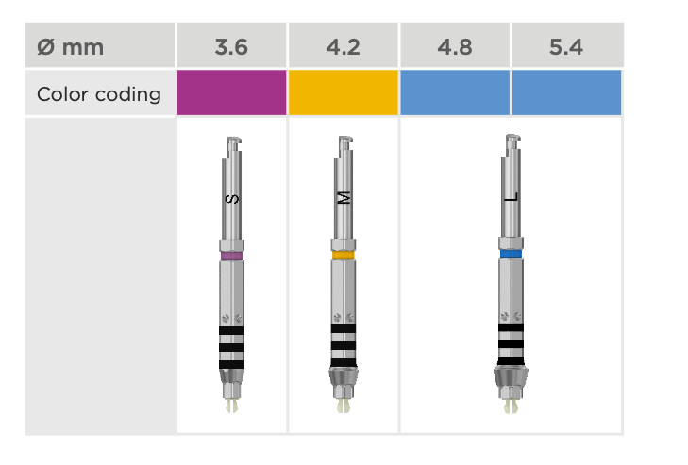
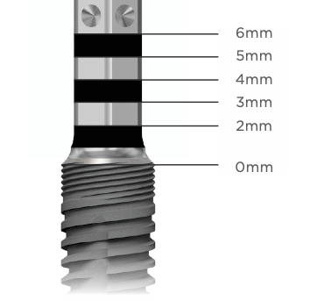
DS PrimeTaper implant line Efficient handling with the new Implant Driver EV
Notes:
The driver comes with color-coding and depth markings as part of the design.

Slide 27
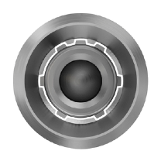
DS PrimeTaper implant line Implant-abutment connection
The implants have a unique interface providing three different options for abutment placement/indexing.
Abutment placement/indexing options
One-position-only
Atlantis patient-specific, abutments will seat in one position only.
Six positions
Indexed abutments will seat in six available positions.
Non-indexed
Non-indexed abutments will be seated in any rotational position.
Restorative solutions
The implants portfolio offers prefabricated and patient-specific abutments. Restorations include prosthetic options on implant and abutment levels. Various types of fixation possibilities e.g. screw-, cement-, friction- and attachment-retained restorations.

Slide 28
DS PrimeTaper implant line Instruments
Drills
The implant site is prepared in accordance with the drilling protocol to ensure simple and safe implant placement in all bone qualities.
Guide Drill
Used to mark a starting point
Precision Drill
Used to mark a starting point
Notes:
The Precision Drill is an extremely sharp drill and should be handled with caution to avoid injury.

Slide 29
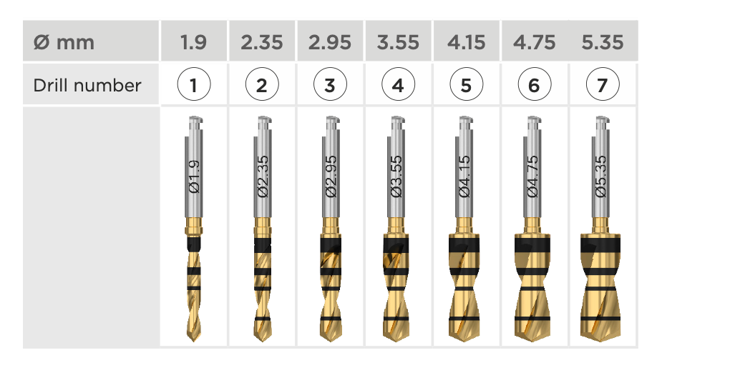
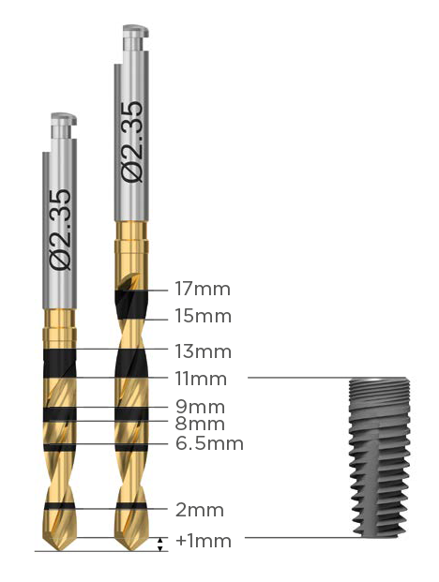
DS PrimeTaper implant line Instruments
PrimeTaper Drills
For implant site preparation up to the planned implant diameter
Depth marked
Multiple use with option for single use
Marked with the respective diameters and numbers (1–7)
Available in two lengths:
Drill long
6.5–17mm
Drill short
6.5–13mm
PrimeTaper EV Ø4.2 x 11mm
Notes:
The effective drilling depth is maximum 1mm more than the implant length, indicated by the depth marking.

Slide 30
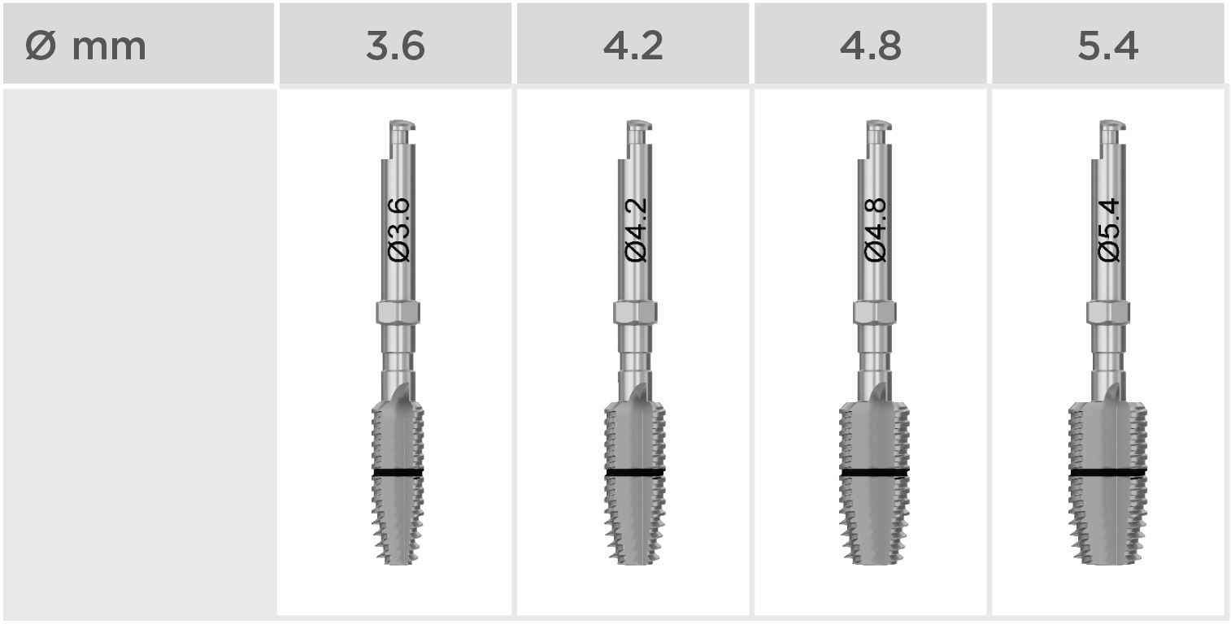
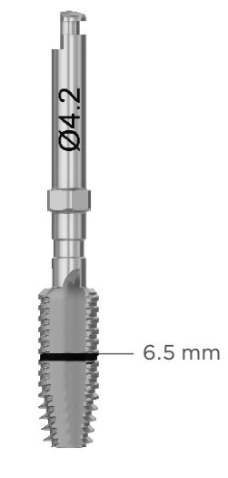
DS PrimeTaper implant line Instruments
PrimeTaper Taps
For very dense bone preparation
Depth marked 6.5mm
Multiple use with option for single use
6.5mm

Slide 31
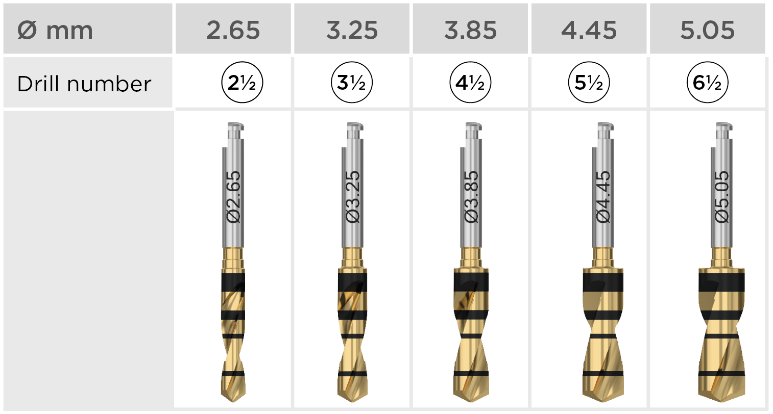
DS PrimeTaper implant line Instruments
Intermediate drills
Intermediate drills for fine-tuning the diameter of the osteotomy
Depth marked
Multiple use with option for single use
Marked with the respective diameters
Available in two lengths
Notes:
All drills except the Precision Drill can be used for maximum ten cases. They should be carefully cleaned and sterilized after each surgery and replaced as soon as a decrease in cutting efficiency is observed.

Slide 32
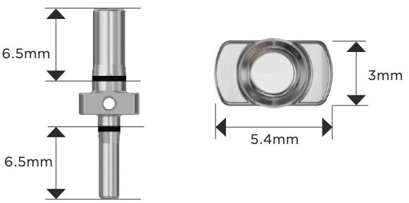
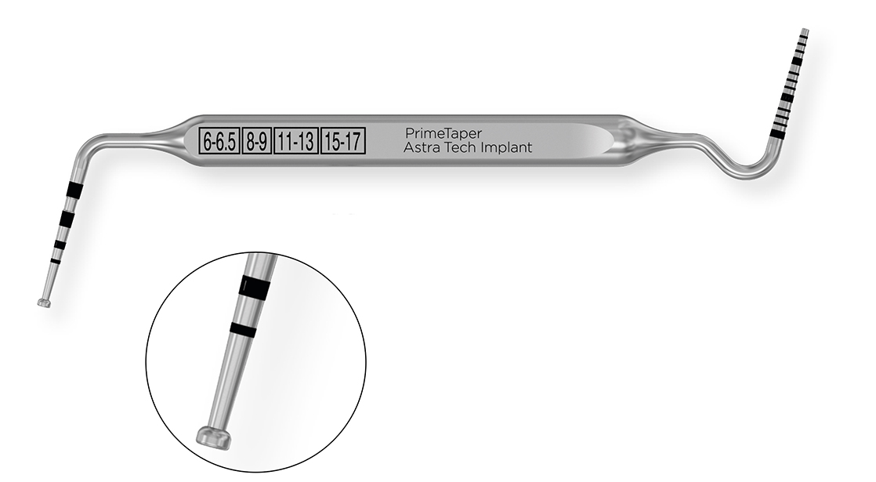
DS PrimeTaper implant line Instruments
PrimeTaper Direction indicator
Used after drill 1 and drill 3
Used for visualizing the position and direction of the prepared osteotomy and for measuring the space between osteotomies.
6.5mm
3mm
5.4mm
6.5mm
Implant Depth Gauge
Used for measuring the depth of the implant site
Markings correspond to the implant lengths
The other end of the gauge can be used as a
measuring probe.
6.5mm
Instrument Extender
Used for extending the length of a drill or implant driver
Ensure sufficient irrigation when using the extender

Slide 33
DS PrimeTaper implant line Instruments
Implant drivers
The implant drivers can be used with a contra angle or with a surgical driver handle and a torque wrench.
Implant Driver EV
For implant installation
Color-coded and depth marked
Available in short and long
6mm
5mm
4mm
3mm
2mm
0mm
The reference point (“0”) of the depth markings is the intended bone level, i.e., the lowest point of the bone level.
To facilitate optimal placement of pre-designed abutments, align one of the dots buccally.
Notes:
Carefully clean and sterilize the driver after each surgery and replace it as soon as any decrease in functionality is observed. The Implant Driver EV can be used for approximately 100 implant installations.

Slide 34
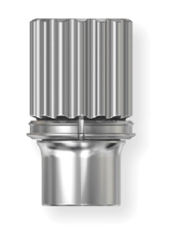
DS PrimeTaper implant line Instruments
Torque wrench
Torque Wrench EV
For implant installation and adjustment of the implant position
Used together with the surgical driver handle
Torque Wrench EV Surgical Driver Handle
Used together with the torque wrench

Slide 35
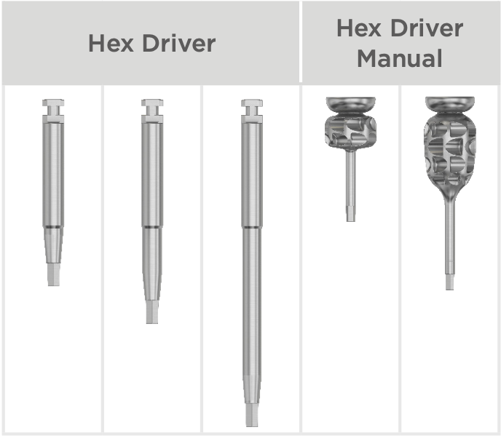
DS PrimeTaper implant line Instruments
Hex drivers
Used for tightening screws, surgical and restorative components

Slide 36
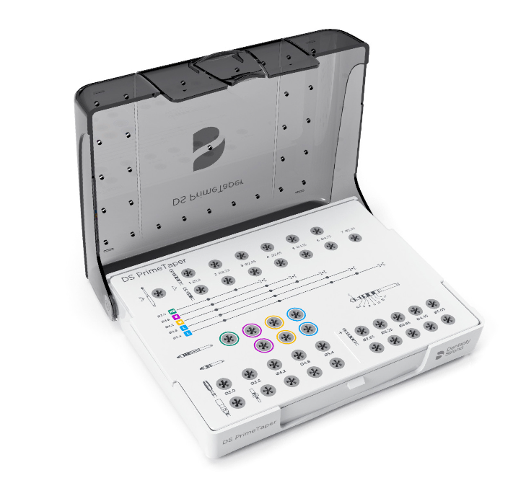
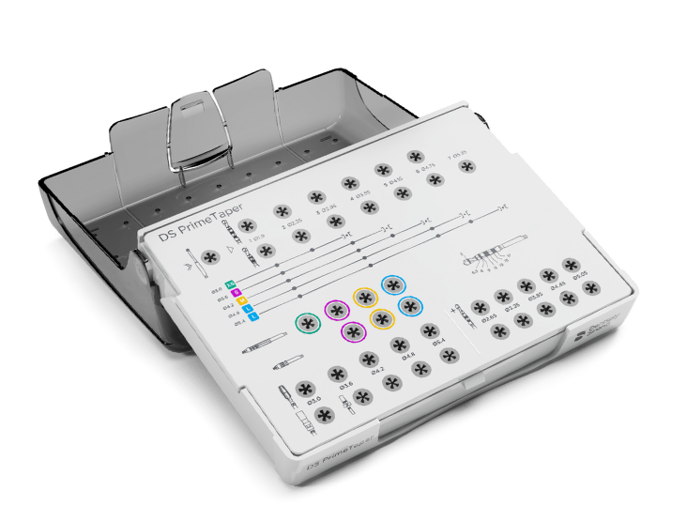
DS PrimeTaper implant line Instruments
Surgical tray
All instruments for surgical use are stored in the PrimeTaper Surgical Tray, which is designed to make all instruments easily accessible.

Slide 37
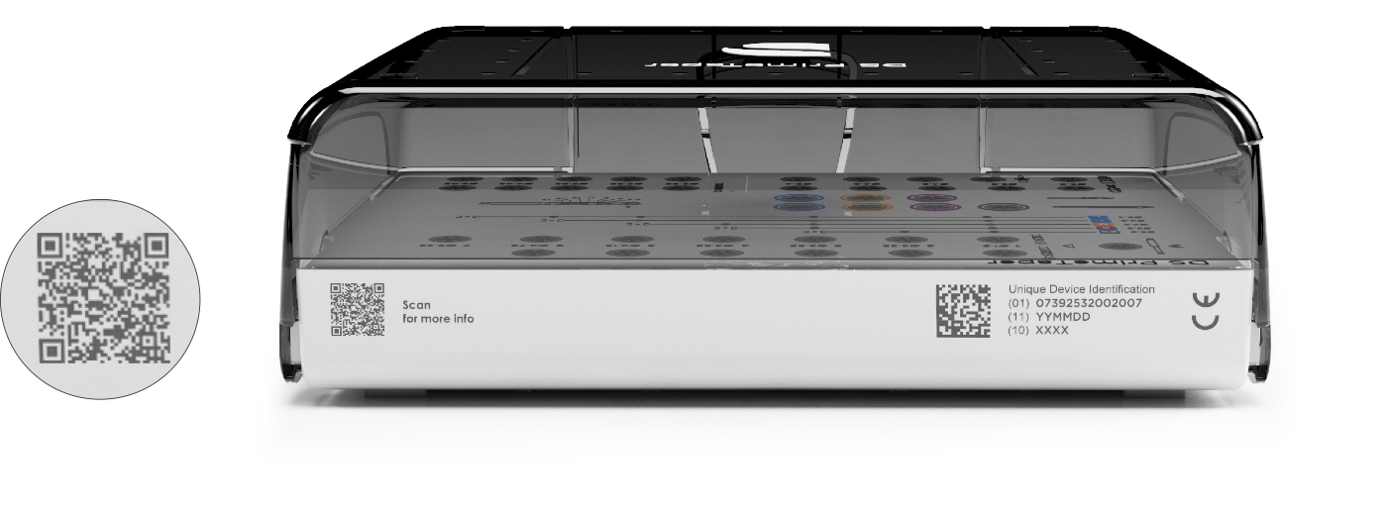
DS PrimeTaper implant line Instruments
QR code for additional information about the surgical tray.

Slide 38
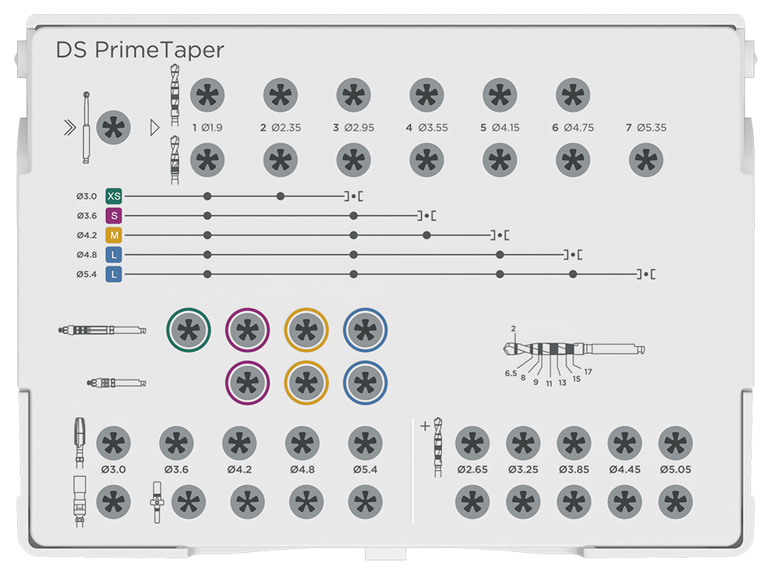
DS PrimeTaper implant line Instruments
PrimeTaper Drill
Guide Drill
Implant Driver EV
PrimeTaper Tap
Intermediate Drill
Instrument Extender
PrimeTaper Direction Indicator

Slide 39
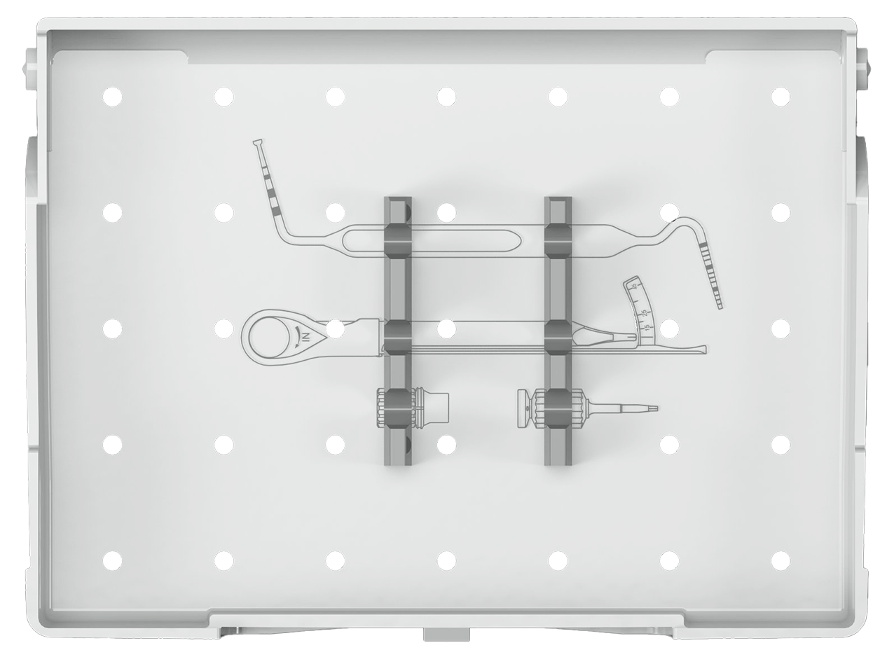
DS PrimeTaper implant line Instruments
PrimeTaper/Astra Tech Implant Depth Gauge
Torque Wrench EV
Hex Driver
Torque Wrench EV Surgical Driver Handle

Slide 40
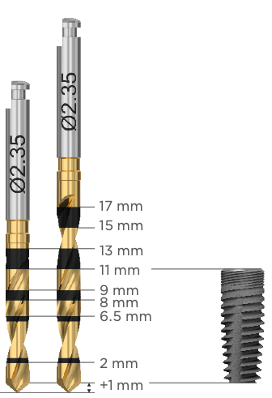
DS PrimeTaper surgical tray Drills
For implant site preparation up to the planned implant diameter
Depth marked drill with high visibility
Multiple use with option for single use
Marked with the respective diameters and numbers (1-7)
Available in two lengths
Drill long
6.5-17 mm
Drill short
6.5-13 mm
PrimeTaper EV Ø4.2 x 11 mm
Notes:
DS PrimeTaper comes with straight drills – this is possible due to the combination of the drills and the cutting capacity of the implant – they work in harmony as a system – providing full flexibility and simplicity at the same time.

Slide 41
DS PrimeTaper drilling protocol Protocol for soft, medium and dense bone qualities
Drilling protocol for soft medium and dense bone qualities
Figures refer to drill numbers (1-7).
“] [” refers to cortical preparation (mandatory).
Adapt the cortical preparation to the individual thickness of the cortex.
Drilling to the 2 mm marking using the drill for cortical preparation “] [” will ensure sufficient space for the MicroThread portion of the implant.
Notes:
The recommended drilling protocol consists of 7 numbered drills, and they increase in diameter based on their number. For example, for the 4.2 mm implant, you start with drill number 1, continue with drill number 3 and 4, all of these to the full depth, meaning up to the planned implant length.
The final preparation of the cortical bone, indicated by the reversed bracket with a small black dot, refers to the mandatory cortical preparation through the cortex. E.g., if the cortex is only 1 mm, then its only 1 mm that is recommended to prepare. Subsequently if a 3 mm cortex is present, you penetrate the cortex through to 3 mm depth. As a guidance, there is a 2 mm marking (not an uncommon thickness of the cortex) for cortical preparation to allow sufficient space for the MicroThread portion for the implant.
This is the recommended drilling protocol for soft, medium, and dense bone qualities that is expected to cover the vast majority of cases except in very soft or very dense bone, where adaptations can be made.

Slide 42
DS PrimeTaper drilling protocol Protocol for very soft or very dense bone
Very Soft Bone
Very Dense Bone
Very soft bone – stop full depth preparation one drill number prior to the recommended final full depth drill
Continue with cortical preparation ] [
May be applicable in extraction sockets
Very dense bone – screw tap available, used after cortical preparation
Notes:
In very soft bone, you stop full depth preparation one drill number early.
So, for a 4.2 implant in a very soft bone instead of full depth preparation with drills number 1, 3 and 4 as in the recommended protocol you use only drills number 1 and 3 and skip drill number 4 in very soft bone.
Then proceed to the final cortical preparation using drill number 5 through the cortex.
This is also a drilling option that can be advocated in extraction sockets where you may want to under-prepare because of lack of bone support surrounding the implant. Here you may not even have cortical bone present, making the cortical preparation obsolete.
On the other hand, if you have a very dense bone you could finalize your osteotomy preparation after the recommended drilling protocol by using the tap through the cortical bone. In the example of the 4.2 implant, you would after drill number 5 cortical preparation continue using the screw tap through the cortex or as needed depending on the density of the bone in the site.

Slide 43
DS PrimeTaper drilling protocol Implant site preparation procedure
The following images show the implant site preparation for PrimeTaper EV Ø4.2 x 11 mm, using the recommended protocol.
Incision
Make an incision.
Mobilize and fold back the mucoperiosteal flap.
Marking
Mark the cortical bone with the Guide Drill or the Precision Drill, to give the next drill a secure starting point.
Note: The Precision Drill is an extremely sharp drill for single use only. Once out of its package it should never be handled manually or placed on the tray.
Blister
Open the package and place the blister onto a sterile area.
Secure the drill by squeezing the blister.

Slide 44
DS PrimeTaper drilling protocol Implant site preparation procedure
Blister
Expose the drill shaft by bending back the top of the blister.
Pick-up
Engage the drill with the contra angle.
Drill 1 Ø1.9
Drill in the planned direction to the appropriate depth.
The drilling will provide valuable information about the cortical and spongious bone.
Insert the smaller end of the PrimeTaper Direction Indicator into the site to visualize/verify the direction.
Notes:
Cutting instruments should generally be replaced after ten cycles of use. Blunt or damaged instruments must be replaced immediately. Gentle, thorough disinfection and cleaning, will ensure an optimal operation of the drills.
Maximum drilling speed is 1500 rpm.

Slide 45
DS PrimeTaper drilling protocol Implant site preparation procedure
PrimeTaper Drill 3 Ø2.95
Drill in the planned direction to the appropriate depth.
Insert the larger end of the direction indicator into the site to visualize/verify the direction.
PrimeTaper Drill 4 Ø3.55
Drill in the planned direction to the appropriate depth.
Check the osteotomy depth by using the Implant Depth Gauge.
Measuring the osteotomy
After drilling, carefully measure the depth of the implant site by using the depth gauge.
Use the same clinical reference point for the depth as for the planned implant position. Note: The depth should allow the implant to be level with or slightly submerged in relation to adjacent marginal bone.

Slide 46
DS PrimeTaper drilling protocol Implant site preparation procedure
Cortical preparation of the bone - PrimeTaper Drill 5 Ø4.15
Optional tapping in very dense bone
Prepare the site with the PrimeTaper Tap Ø4.2 at maximum 25 rpm through the cortical bone. The depth marking indicates 6.5 mm.
Turn the tap counter-clockwise to remove it from the osteotomy.
1 mm thick cortex
Cortical preparation is marked with this symbol ] [ in the drilling protocol.
Drill through the entire thickness of the cortical bone, in this case 1 mm.
3 mm thick cortex
Drill through the entire thickness of the cortical bone, in this case 3 mm.
Notes:
Drilling to the 2 mm marking, using the drill for cortical preparation “] [“, will ensure sufficient space for the MicroThread portion of the implant.

Slide 47
DS PrimeTaper implant installation
Implant container
Open the blister package.
Pour the sterile inner container onto a sterile area.
Remove the cap from the container, using a twisting motion to expose the top of the implant.
Machine Implant pick-up
Attach the appropriate Implant Driver EV to the contra angle, see yellow arrows.
Carefully rotate the driver in the implant to align the indexing tabs.
Make sure that the implant driver is fully seated into the implant, see blue arrows.
Manual implant pick-up
Attach the appropriate Implant Driver EV to the Surgical Driver Handle to pick up the implant.
The driver is correctly seated when the color-coded marking is in contact with the handle, see yellow arrows.
Carefully rotate the driver in the implant to align the indexing tabs.
Make sure that the implant driver is fully seated into the implant, see blue arrows.

Slide 48
DS PrimeTaper implant installation
Machine implant placement
Install the implant with the contra angle at low speed (25 rpm) under profuse irrigation.
Allow the implant to work its way into the osteotomy. Avoid applying unnecessary pressure. Do not exceed 45 Ncm when installing the implant. If not completely seated before reaching 45 Ncm, reverse/ remove the implant and widen the osteotomy appropriately.
Manual implant placement
Install the implant with the implant driver and the surgical driver handle.
Final positioning
Attach the implant driver and the surgical driver handle into the torque wrench until there is an audible click.
Position the implant at the marginal bone level or slightly below.
Position one of the dots on the implant driver buccally to facilitate optimal placement of the pre-designed abutments.
Release the implant driver by lifting it gently from the implant.

Slide 49
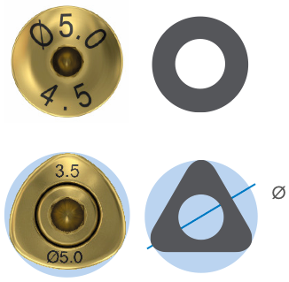
DS PrimeTaper implant installation One-stage surgical protocol
If a one-stage procedure with transgingival healing is planned without preparation of an implant-supported temporary restoration, the implants can be covered with healing abutments. This is an option where an existing denture can be used as a temporary restoration. Healing abutments are also used for soft tissue sculpturing during the healing phase.
Round shapes are indicated for all positions in the mouth.
Triangular shapes for anterior implant sites to mimic the incisors and canines. The Triangular HealDesign EV is a two-piece abutment.

Slide 50
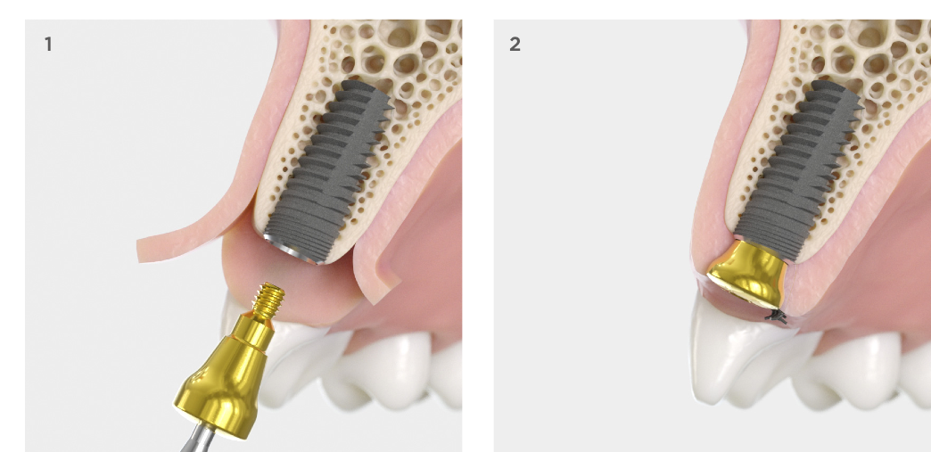
DS PrimeTaper implant installation One-stage surgical protocol
Placing the healing abutment
Place the HealDesign EV using the Hex Driver.
Manually secure the healing abutment using light finger force (5–10 Ncm).
Suturing
Adapt and suture the soft tissue.

Slide 51
DS PrimeTaper implant installation Two-stage surgical protocol
If a two-stage procedure is planned, the implant is sealed with a cover screw during the healing phase to prevent the entry of saliva and bacteria.
Placement of the cover screw
Insert the Cover Screw EV using the Hex Driver.
Tighten with light finger force (5–10 Ncm).
Suturing
Replace and fix the tissue flaps with sutures.
Exposure
After the healing phase expose the implant for fabrication of the prosthetic restoration.
Depending on the planned procedure, place a healing abutment or a temporary restoration.

Slide 52
DS PrimeTaper implant installation Torque guide

Slide 53
DS PrimeTaper guided surgery
Computer-guided 3D planning and implant installation
The implant installation procedure is planned in 3D with the Simplant software. It provides a complete image of the patient‘s anatomy for selection and placement of implants and abutments.
With the Simplant SAFE Guide (manufactured by Dentsply Sirona or 3D printed in the clinic using the Simplant Guide File) as well as with the CEREC Guide 3 (chairside manufacturing) you can work with fully guided procedure. This means that all surgical steps from soft-tissue punch to implant installation can be performed with the guide in place.
Surgical simplicity
Using a Simplant Guide with DS PrimeTaper makes the procedure precise and safe.
The “Sleeve-on-Drill” system simplifies handling and replaces the drill key which saves you an assisting hand.
The guided surgery instrumentation is based on either absolute drill stops or depth markings.
The optional lateral access of the Simplant SAFE Guide facilitates the handling even for cases with limited inter-occlusal space.
When aligning the markings on the implant driver with the patient-specific marking on the Simplant Guide, it ensures that the implant is rotated as planned in the software.
53

Slide 54
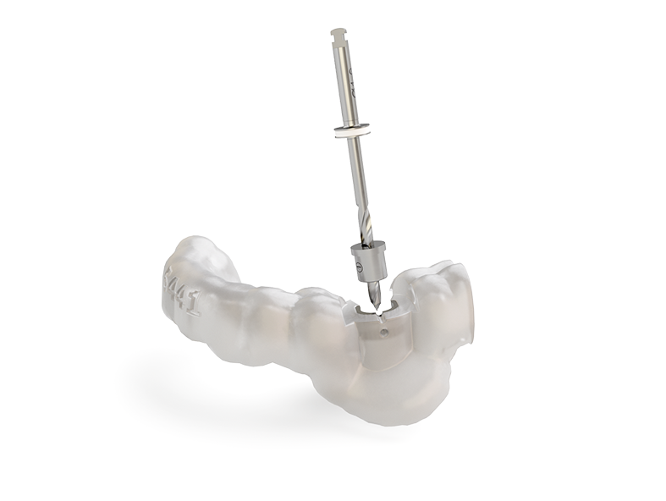
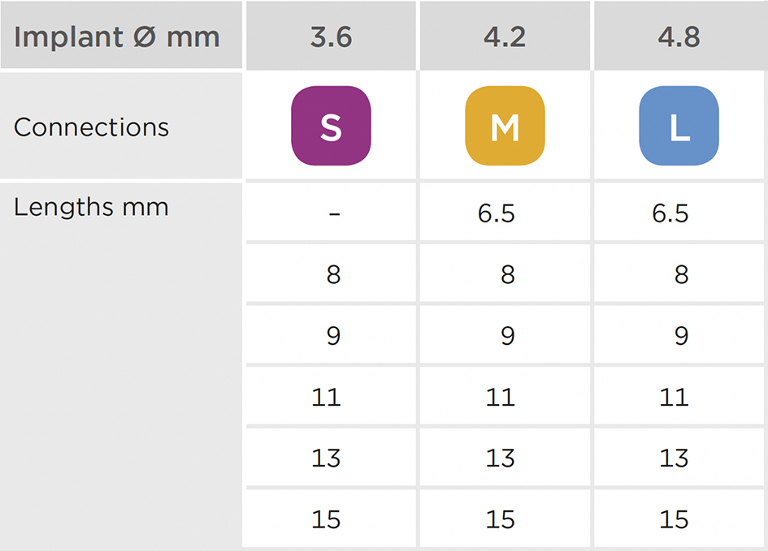
DS PrimeTaper guided surgery
Color coding
The DS PrimeTaper Implant line is available in different diameters and lengths. The color coding makes it easy to identify the correct connection and to select the right prosthetic components.
DS PrimeTaper implants for use with Guided Surgery:

Slide 55
DS PrimeTaper guided surgery Instruments
Specific instruments are available for guided surgery with PrimeTaper EV. They can only be used together with the Simplant SAFE Guide and CEREC Guide 3.
All cutting instruments and drill sleeves are delivered sterile
All instruments are multiple use, except punch and drill sleeve
All drills are intended for use maximum 10 times or less if blunt
Some products are also used for Astra Tech Implant EV. When references are made to 6mm depths or lengths, that corresponds to PrimeTaper Guided Surgery 6.5mm
55

Slide 56
DS PrimeTaper guided surgery Instruments
Mucosal punch
Punch EV-GS
Used to make a circular incision of the implant diameter in the mucosa up to the coronal bone level where the implant shoulder is to be positioned.
Marking corresponds to the implant lengths
Marked with diameter and for single use
6-9-13
8-11-15

Slide 57
DS PrimeTaper guided surgery Instruments
Drills
Initial Drill EV-GS
Used to remove mucosa and to create a centering indentation in the bone for the following drills GS.
Marking corresponds to the implant lengths
Marked with diameter
6-9-13
8-11-15

Slide 58
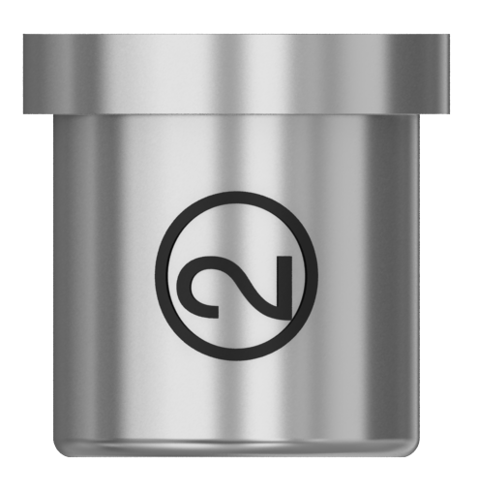
DS PrimeTaper guided surgery Instruments
Sleeve-on-Drill system
Drills with a drill sleeve that can be attached to the instrument.
When using the guide, a simple and precise guiding of the drill is guaranteed.
The drill stop system ensures exact depth control.
Drill stop
6.5-9-13
8-11-15
Fixation groove for drill sleeve
PrimeTaper Drill GS
Used to prepare the implant site successively to the planned implant length and diameter. Used also for the cortical preparation with a drill sleeve attached. The 6.5-8mm lengths of Drill GS 4, 5 and 6 have appropriate depth markings from 1 to 4mm. The cortical drilling depth must be visually controlled not using the depth stop.
Guided with the Sleeve-on-Drill system
Marked with the respective diameter number (1-6), length.
4mm
3mm
2mm
1mm
4mm
3mm
2mm
1mm
Drill sleeve
Depth markings for cortical drilling depending on implant lengths

Slide 59
DS PrimeTaper guided surgery Instruments
PrimeTaper Drill GS (intermediate)
For fine-tuning the diameter of the osteotomy.
Guided with the Sleeve-on-Drill system
Marked with the respective diameter number (2½-5½) and length.
PrimeTaper Tap GS
Used to tap a thread in very dense bone.
Marked with diameter
Markings correspond to preferred tapping depths for implant lengths 6.5-9-13mm and 8-11-15mm respectively
6.5-9-13
8-11-15
11mm
11mm
6.5mm
6.5mm
PrimeTaper Drill Sleeve
For safe guidance of the drills in the surgical guide.
Marked with the respective diameter and number
Marked with ND (Narrow Diameter) when used with drills for implant Ø3.6mm and Ø4.2mm or WD (Wide Diameter) for implant Ø4.8mm
Notes:
The drill sleeves are for single use only and must be removed from the drill immediately after use.

Slide 60
DS PrimeTaper guided surgery Instruments
Implant Driver
Implant Driver GS
Used to install the implant in the prepared implant site.
It has 6 indexing tabs fitting the implant in any of the 6 internal positions
6 notches along the axis correspond to the 6 internal flat surfaces of the implant
Two groves on the shaft indicate the corresponding installation depths 6.5-9-13mm and 8-11-15mm
Color coded
6.5-9-13
8-11-15

Slide 61
DS PrimeTaper guided surgery Instruments
Stabilization abutment
EV-Stabilization Abutment
Used to prevent movement of the surgical guide during preparation of the implant site.
Marked with diameter and implant length 6-9-13mm or 8-11-15mm
Color coded

Slide 62
DS PrimeTaper guided surgery Instruments
Guide fixation
Drill for Guide Fixation Screw
Used to prepare the bone for the fixation screw.
Guide Fixation Screw
For precise implant placement by connecting mucosa-supported guides with the bone through the Guide Fixation Screw.

Slide 63
DS PrimeTaper guided surgery Instruments
Initial Drill EV-GS
PrimeTaper Drill GS
Surgical tray guided surgery
All instruments for surgical use are stored in the PrimeTaper Surgical Tray GS, which is designed to make instruments easily accessible. The instruments are arranged in order of usage.
Punch EV-GS
EV-Stabilization Abutment
Implant Driver GS
PrimeTaper Tap GS
Instrument Extender
Intermediate Drills

Slide 64
DS PrimeTaper guided surgery Instruments
PrimeTaper/Astra Tech
Implant Depth Gauge
Torque Wrench EV
Hex Driver
64
Torque Wrench EV Surgical Driver Handle

Slide 65
DS PrimeTaper guided surgery Simplant SAFE Guide
A custom-made Simplant SAFE Guide is fabricated from the patient’s digital planning data using additive manufacturing with medical grade resin (stereolithography technique). This guarantees the exact and precise transfer of the planning into the patient’s mouth.

Slide 66
DS PrimeTaper guided surgery Simplant SAFE Guide
Types of support
Tooth-supported Simplant Guide
For single tooth and partially edentulous cases when minimally invasive surgery is preferred
Centrally printed by Dentsply Sirona in medical grade resin or delivered as Simplant Guide File with Simplant Guide Sleeves for local manufacturing
A dentition scan (intra oral or lab scan) is required and a desired tooth setup and/or antagonist scan is recommended to provide the prosthetic information
Mucosa-supported Simplant Guide
For fully edentulous cases when minimally invasive surgery is preferred
Centrally printed by Dentsply Sirona in medical grade resin or delivered as Simplant Guide File with Simplant Guide Sleeves for local manufacturing
(CB) CT Scan prosthesis required
Bone-supported Simplant Guide
For larger partially or fully edentulous cases
Positioned on the jawbone after raising a mucoperiosteal flap
Centrally printed by Dentsply Sirona in medical grade resin
To provide the prosthetic information, a (CB) CT Scan prosthesis is recommended

Slide 67
DS PrimeTaper guided surgery Simplant SAFE Guide
Dynamic guide sleeve position
The positions of the guide sleeves in the surgical guide are adjusted to the planned implant length. One drill length can accommodate different osteotomy depths. The guide sleeve position will be added by the planning software according to the planned implant length. Manual adjustments are not possible.
Notes:
Consider during planning in the software that the osteotomy can reach up to 1.3mm deeper than the recommended placement of the implant.
For the 6.5 mm long implant the Drilling/Osteotomy depth is 7 mm.

Slide 68
DS PrimeTaper guided surgery Simplant SAFE Guide
Tooth-supported procedure
A tooth-supported surgical guide can be used either with a flapless technique or by raising a flap.
Tooth-supported Simplant SAFE Guide
Check the coverage of the guide base and correct it if necessary.
Depending on the design of the guide, the criteria for bone- or mucosa-supported guides apply to the edentulous regions.
Place the guide into the patient’s mouth and check for a precise and stable fit.
When there are few remaining teeth or instability of the guide, it is fixed according to the procedure for bone- or mucosa-supported surgical guides.
Notes:
When placing multiple implants in a situation with a low number of remaining teeth or unfavorable structure of existing teeth, tooth-supported guides must also be stabilized with stabilization abutments. In such cases at least the first two implants must be prepared, inserted and provided with a stabilization abutment before drilling is carried out at other sites.

Slide 69
DS PrimeTaper guided surgery Simplant SAFE Guide
Bone-supported procedure
A bone-supported surgical guide is used for edentulous and partially edentulous patients with more than three missing teeth.
Bone-supported Simplant SAFE Guide
Check the fit and the extension of the guide base.
To guarantee a definite and stable fit, the base should only be as large as necessary.
Place the guide into the patient’s mouth and check for a precise and stable fit.
Make sure the guide maintains its position in the jaw.
If necessary use guide fixation screws to fix the guide into the jaw.
Notes:
Excessive force on the surgical guide, e.g. excessive tightening of the fixation screws (osteosynthesis screws), tilting of instruments and excessive pressure should be avoided particularly at the fixing points. This may cause breakage of the guide making them unusable. Only use fixation screws where the guide design includes guide sleeves for fixation.

Slide 70
DS PrimeTaper guided surgery Simplant SAFE Guide
Mucosa-supported procedure
Mucosa-supported surgical guides guarantee a minimally invasive procedure and are generally utilized for edentulous patients.
Mucosa-supported Simplant SAFE Guide
Check the fitting of the guide on the master cast. This must be large enough to guarantee a stable fit.
Place the guide in the patient’s mouth and check for a precise and stable fit.
A bite index made from plastic or registration silicone, fabricated beforehand in the articulator, guarantees that the surgical guide records the same position as the scanning template.
Fix the surgical guide vestibularly in the designated positions.
Carefully close the patient’s mouth and allow biting into the index.
If required, use fixation screws palatally or lingually.
Notes:
When placing multiple implants, mucosa-supported guides must be stabilized with stabilization abutments. At least the first two implants must be prepared, inserted and provided with a stabilization abutment before drilling is carried out at other sites. Hence, the surgical guide cannot be displaced or distorted between the further drilling processes.

Slide 71
DS PrimeTaper guided surgery Implant site preparation
In the following, the implant site for PrimeTaper EV Ø4.2 x 11mm is prepared for guided surgery by using the same steps as for conventional preparation. The transgingival procedure with a guide is described.
8-11-15mm
Mucosal punching
The mucosal punch is only required for flapless surgery.
Insert the Punch EV-GS 4.2 into the guide. Start rotating and cut through the tissue until it lightly comes in contact with the bone.
The correct position has been reached when depth marking of 8-11-15mm is flush with the top margin of the SAFE Guide.
The maximum speed for the punch is 800 rpm.
Initial drilling
Use the Initial Drill EV-GS 4.2 to remove and to prepare the starting point for the first full-length drill.
The correct position has been reached when the depth marking of 8-11-15 is flush with the top margin of the SAFE Guide.
1-Drill EV-GS
Use the 1-Drill EV-GS of the planned implant length.
Lock the drill sleeve in the first groove above the drill tip.
Lower the drill sleeve into the guide sleeve of the surgical guide to the stop. Do not activate the rotation until this point.
Drill without excessive pressure until reaching the depth stop (no intermittent drilling).
The still forward rotating drill is withdrawn until reaching the locking position for the drill sleeve. The drill sleeve shall remain in the guide during this procedure.
Stop rotating and carefully remove the drill with the attached drill sleeve out of the surgical guide.
Notes:
Drilling, except for the Punch, should be performed at a maximum speed of 1500 rpm with profuse irrigation. Use the hole below the guide sleeve in the Simplant SAFE Guide for adequate cooling.

Slide 72
DS PrimeTaper guided surgery Implant site preparation
Expansion drilling Drill 3 and 4
After the pilot drilling, the implant site is successively prepared to the planned implant diameter and length using PrimeTaper Drills 3 and 4 GS.
Notes:
Cutting instruments should be replaced after 10 uses or if they are damaged or blunt. Punches and drill sleeves are single use and must be replaced after surgery.

Slide 73
DS PrimeTaper guided surgery Implant site preparation
Drilling protocol
Recommended drilling protocol for soft, medium and dense bone qualities (for more bone qualities, see slide 25 and 26).
Figures refer to drill numbers 1-6
] [ refers to cortical preparation only (mandatory)
Adapt the cortical preparation to the individual thickness of the cortex
The cortical preparation has to be performed with the PrimeTaper Drill GS for implant lengths 6.5-8mm. The depths of the preparation is indicated by the depth markings.
Drilling to the 2mm marking, using the drill for cortical preparation “] [”, will ensure sufficient space for the MicroThread portion of the implant

Slide 74
DS PrimeTaper guided surgery Implant site preparation
1mm
3mm
6.5-9-13
8-11-15
4mm
3mm
2mm
1mm
4mm
3mm
2mm
1mm
8-11-15mm
Cortical preparation of the bone
1mm thick cortex
Cortical preparation is marked with this symbol ] [ in the drilling protocol.
Use the 6.5-8mm length Drill GS 5
Drill through the entire thickness of the cortical bone, in this case 1mm
The 6.5-8mm drill have markings for 1-4mm depths depending on cortical thickness
Drilling to 2mm marking will ensure sufficient space for the MicroThread portion of the implant
3mm thick cortex
Drill through the entire thickness of the cortical bone, in this case 3mm.
Depth markings for cortical drilling depending on implant lengths

Slide 75
DS PrimeTaper guided surgery Implant site preparation
6.5-9-13
8-11-15
11mm
11mm
6.5mm
6.5mm
6.5mm
Optional tapping in very dense bone
Use the Tap GS after crestal preparation
The maximum rotary speed is 25 rpm.
Tap until reaching preferred depth
The markings start with 6.5mm tapping depth measured when the marking is flush with the guide.
Remove the tap from the osteotomy in a counterclockwise direction.
Notes:
Since the tap does not have a depth stop, the visual control of the maximum preparation depth must be observed. If the tap is screwed in too deeply, there is a risk of damaging anatomical structures and nerves.

Slide 76
DS PrimeTaper guided surgery Implant installation
The following images show the placement of PrimeTaper EV Ø4.2 x 11mm.
8-11-15mm
6.5-9-13mm
Implant installation
Use the PrimeTaper Driver EV GS (M) to place the implant at 25 rpm and maximum 45 Ncm.
The grooves indicate the implant installation depth.
The correct groove in this case 8-11-15mm has to be flush with the surgical guide.
Implant installation to final position
Align one of the six notches of the implant driver with the index marking in the surgical guide. The marking is placed buccally as default.
If the implant rotation has been individualized in the software, align with that moved marking in the guide
The alignment between driver and guide ensures optimal placement of pre-surgically planned and produced Atlantis abutments. It also means that the implant rotation can be planned e.g. according to indexed angled stock abutments
Securing the surgical guide with Stabilization Abutments
This procedure is primarily intended for mucosa-supported surgical guides.
Prior to inserting further implants, the stabilization abutment is inserted and secures the guide to prevent it from moving and rotating between preparations of multiple implant sites.
At least the first two implants must be prepared, placed and provided with a stabilization abutment in succession before further implants are placed.
Notes:
For correct placement of the PrimeTaper EV implant, only use the specific Implant Driver EV GS with Order No. 68017001, 68017002, 68017003.

Slide 77
Thank you

